Slide 1
Welcome to the Life Cycle Assessment (LCA) Learning Module Series
Liv Haselbach Quinn Langfitt
For current modules email lhaselbach@lamar.edu or visit cem.uaf.edu/CESTiCC or https://engineering.lamar.edu/civil/faculty/haselbach/research.html
Acknowledgements:
CESTiCC Washington State and LAmar Universitıes

Slide 2
LCA Module Series Groups
Group A: ISO Compliant LCA Overview Modules
Group α: ISO Compliant LCA Detailed Modules
Group B: Environmental Impact Categories Overview Modules
Group β: Environmental Impact Categories Detailed Modules
Group G: General LCA Tools Overview Modules
Group γ: General LCA Tools Detailed Modules
Group T: Transportation-Related LCA Overview Modules
Group τ: Transportation-Related LCA Detailed Modules

Slide 3
Case Study: Washington State Ferries Oil Filtration
Module τ5

Slide 4
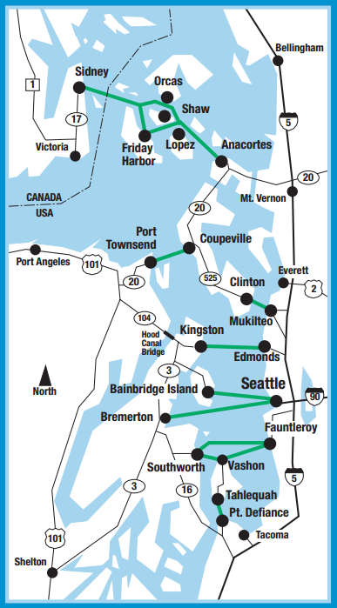
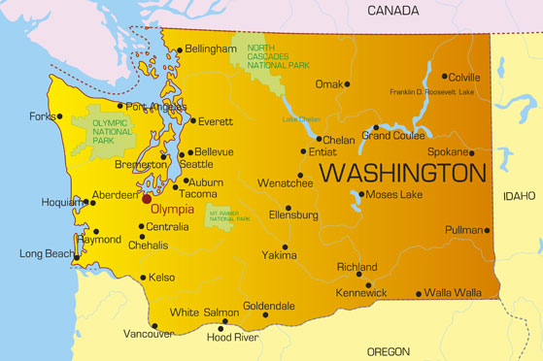
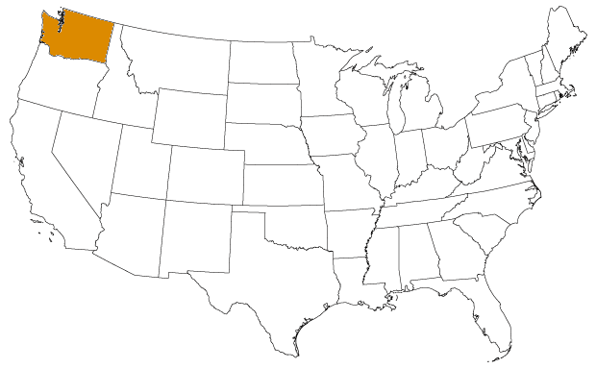
Washington State Ferries (WSF)
Located in Puget Sound in the Seattle-Tacoma metro area
Largest ferry system in the United States
Twenty-two vessels servicing twenty ports of call
Roll-on roll-off style (geared towards carrying vehicles)
23 million trips per year
10 million vehicle trips
13 million passengers

Slide 5
Problem Statement
WSF Oil Filtration
Washington State Ferries is investigating an alternative engine oil filtration system for their vessels.
Goals of the project
Reduce environmental impacts
Reduce costs
Increase operational ease

Slide 6
Comparison of Filtration Systems
“Standard”
Paper cartridge filters
Change filters four times per year
“Self-Cleaning”
Stainless steel filter mesh
Backwashed to clean
Change oil twice per year
No filter changes
Higher filtration efficiency (should increase oil life)

Slide 7
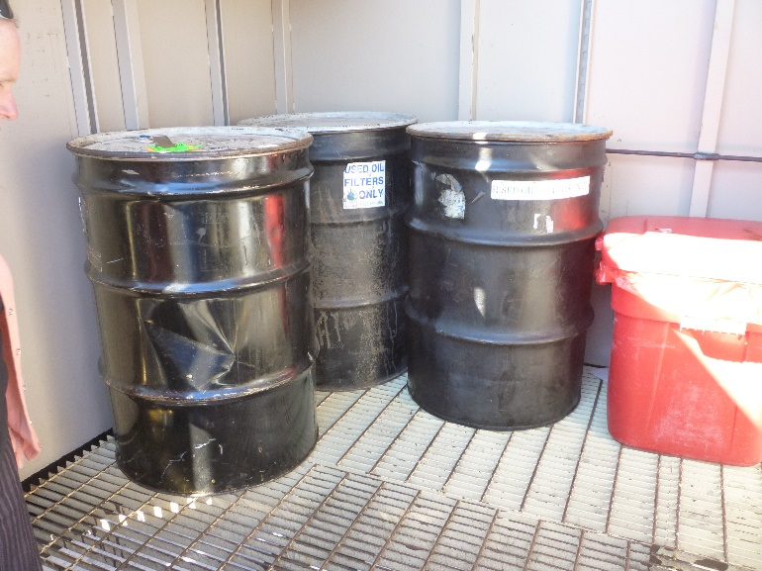
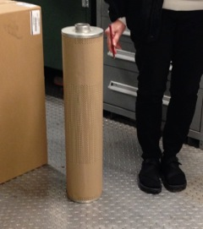
Standard System
Collection barrels
System
housing
Filter cartridge

Slide 8
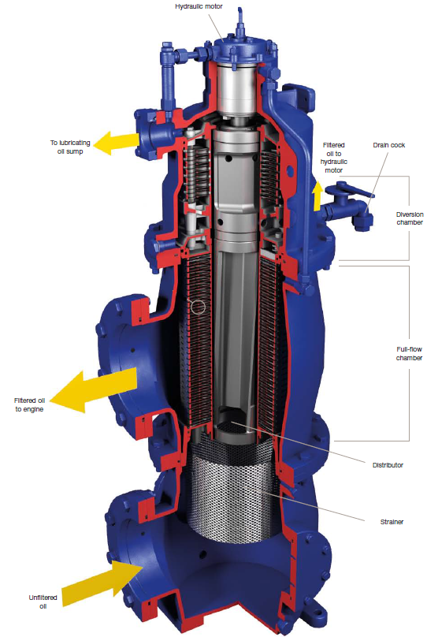
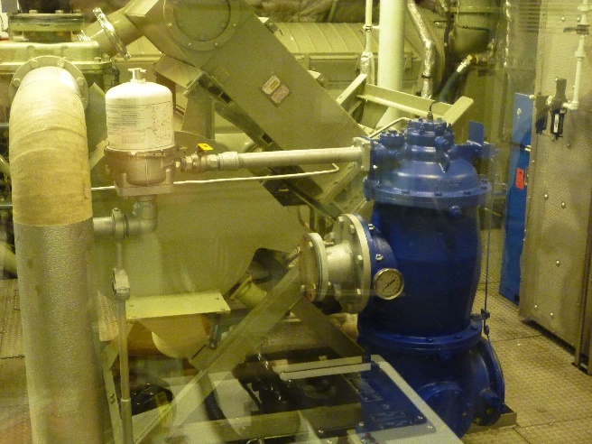
Self-Cleaning System

Slide 9
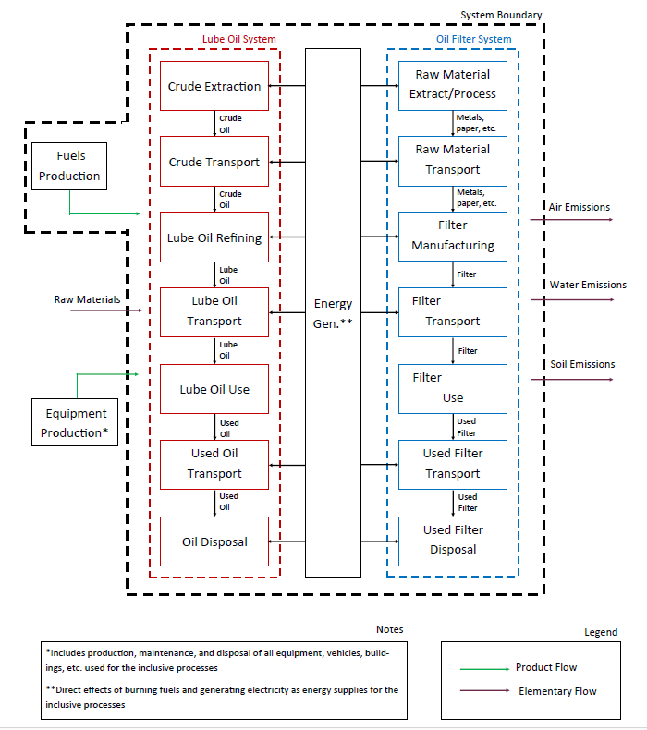
Standard System Diagram
Self-cleaning system difference
Oil filter system is replaced by the self-cleaning housing

Slide 10
Focusing on Oil
Three major systems to quantify
Oil
Filter cartridges (standard system only)
Self-cleaning filtration housing (retrofit, so self-cleaning system only)
LCA data synthesis on oil is the scope of this module
Exploration and extraction of crude oil
Blending additives
New lube oil transport
Disposal company transport to preprocessing
Preprocessing and transport to post-process
Crude oil transport
Refining crude oil into lube oil
Lube oil use in vessel
Used oil transferred to disposal company
Refine into marine diesel fuel

Slide 11
Langfitt and Haselbach 2015 and 2014
The following is a description of an LCA-based data synthesis performed by Langfitt and Haselbach 2014 and generalized in Langfitt and Haselbach 2015
Goal:
The goal of this study is to provide those in the marine sector with a simple assessment of life cycle environmental oil impacts to utilize during decision-making for decisions which may impact oil use. These scenarios could include at least procedural modifications for oil changes, oil filtration system upgrades, and engine system upgrades. Only one product, mineral lubricating oil, is being examined, so no comparative assertions are made. (Langfitt and Haselbach 2015)
Scope
Impact methodology: TRACI 2.0
Included processes as outlined in following slide
Data collected is mostly for general lubricating oil, not specific to vessels, except for combustion in engine
Allocation procedures and cut-off criteria on a per study basis (this is only a data synthesis)
No changes to technology over time
Normalization to the United States annual per capita impacts
Langfitt, Q., and Haselbach, L. (2015). ““Life Cycle Assessment Synthesis for a Volume of Lubricating Oil in Marine Applications.” ASCE Construction Institute: Environmental Sustainability in Transportation Infrastructure.

Slide 12
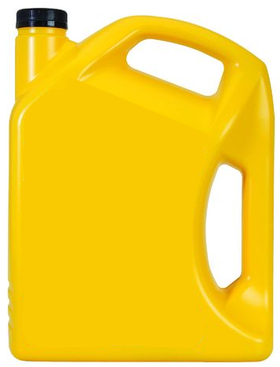
Functional Unit
Final functional unit of a study comparing the two filtration systems would be based on the function(s) of a ferry
For lube oil assessment alone, a declared unit can be used
1 gallon of lubricating oil with a density of 0.88 kg/L used in a ferry vessel and distilled into marine diesel oil at end-of-life
Using this declared unit allows the assessment to be used in other decisions regarding oil use
Passenger
Vehicle
Passenger-vehicle
Passenger-vehicle-freight
Miles
Trips
Hours
Per kWh engine output
One year “typical operation”
Per dollar fare collected
OR
1 Gallon
Marine lubricating oil
Notes:
Make sure to say here that the amount of lubricating oil purchased, the amount recovered for distillation, and the difference (considered combusted in the engine) would all be data inputs as reference units when converting the data to the functional unit basis. However, since what we are presenting in this module is only the LCA-based data collection and results of the oil, a declared unit is used instead, which must later be converted to represent the quantities based on the functional unit.

Slide 13
Impact Categories Included
Acidification Potential (AP) [H⁺ moles-Equiv.]
Ecotoxicity Potential (ETP) [CTUeco]
Eutrophication Potential (EP) [kg N-Equiv.]
Global Warming Potential (GWP) [kg CO₂-Equiv.]
Human Health Cancer Potential (HHCP) [cases]
Human Health Non-Cancer Potential (HHNCP) [cases]
Human Health Criteria Air Potential (HHCAP) [kg PM₁₀-Equiv.]
Smog Creation Potential (SCP) [kg O₃-Equiv.]
Stratospheric Ozone Depletion Potential (ODP) [kg CFC 11-Equiv.]

Slide 14
Environmental Data Collection
Raimondi et al. 2012
GaBi database truck + assumed distance
GaBi database truck + actual distance
Geyer et al. 2013
Exploration and extraction of crude oil
Blending additives
New lube oil transport
Disposal company transport to and between facilities
Preprocessing
Crude oil transport
Refining crude oil into lube oil
Lube oil use in vessel
Used oil transferred to disposal company
Distill into marine diesel fuel
GaBi Database
Geyer et al. 2013
Riamondi et al. 2012
Primary combustion modeling*
No expected impacts (risk of spill not included in LCA)
Boughton and
Horvath 2004
*Based on Audibert 2006

Slide 15
Conversion to Common Declared Unit
Most data sources used unit of 1 kg oil
Converted to gallons using density of oil in functional unit
$$\frac{Impact category indicator}{1 kg oil}∗0.88\frac{kg}{L}∗\frac{3.79 L}{gallon}=\frac{Impact category indicator}{1 gallon}$$

Slide 16
Oil Acquisition Results (Langfitt and Haselbach 2014)
“Assessment of Lube Oil Management and Self-Cleaning Oil Filters Feasibility in WSF Vessels Phases II and III: Part 1 Report.” (2014). Q. Langfitt and L. Haselbach. Report to PacTrans.

Slide 17
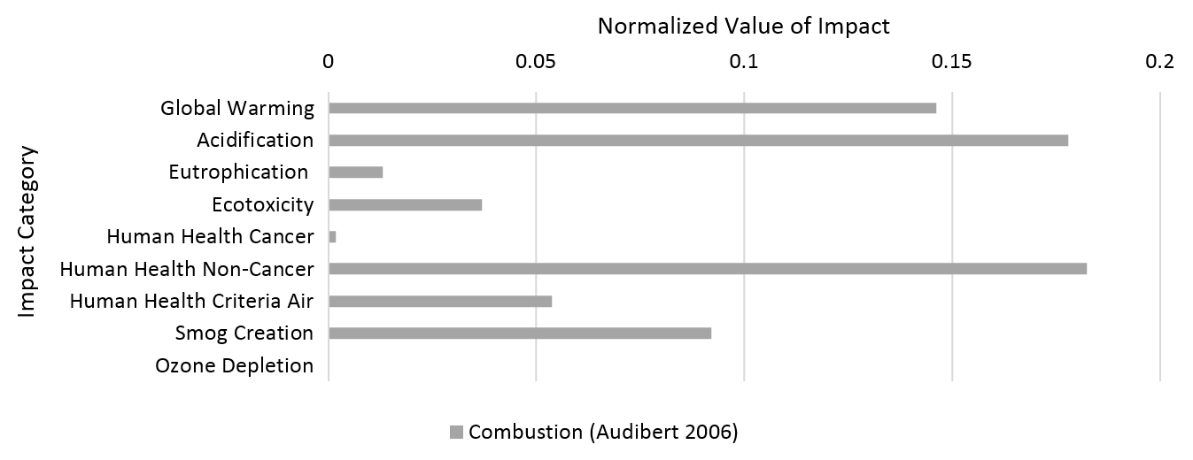
Oil Combustion During Use Phase Results (Data from Langfitt and Haselbach 2014)
“Assessment of Lube Oil Management and Self-Cleaning Oil Filters Feasibility in WSF Vessels Phases II and III: Part 1 Report.” (2014). Q. Langfitt and L. Haselbach. Report to PacTrans.

Slide 18
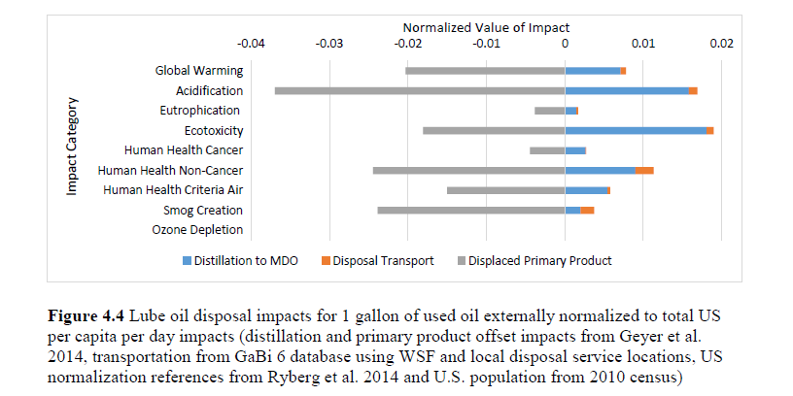
Oil Disposal Results (Langfitt and Haselbach 2014)
“Assessment of Lube Oil Management and Self-Cleaning Oil Filters Feasibility in WSF Vessels Phases II and III: Part 1 Report.” (2014). Q. Langfitt and L. Haselbach. Report to PacTrans.

Slide 19
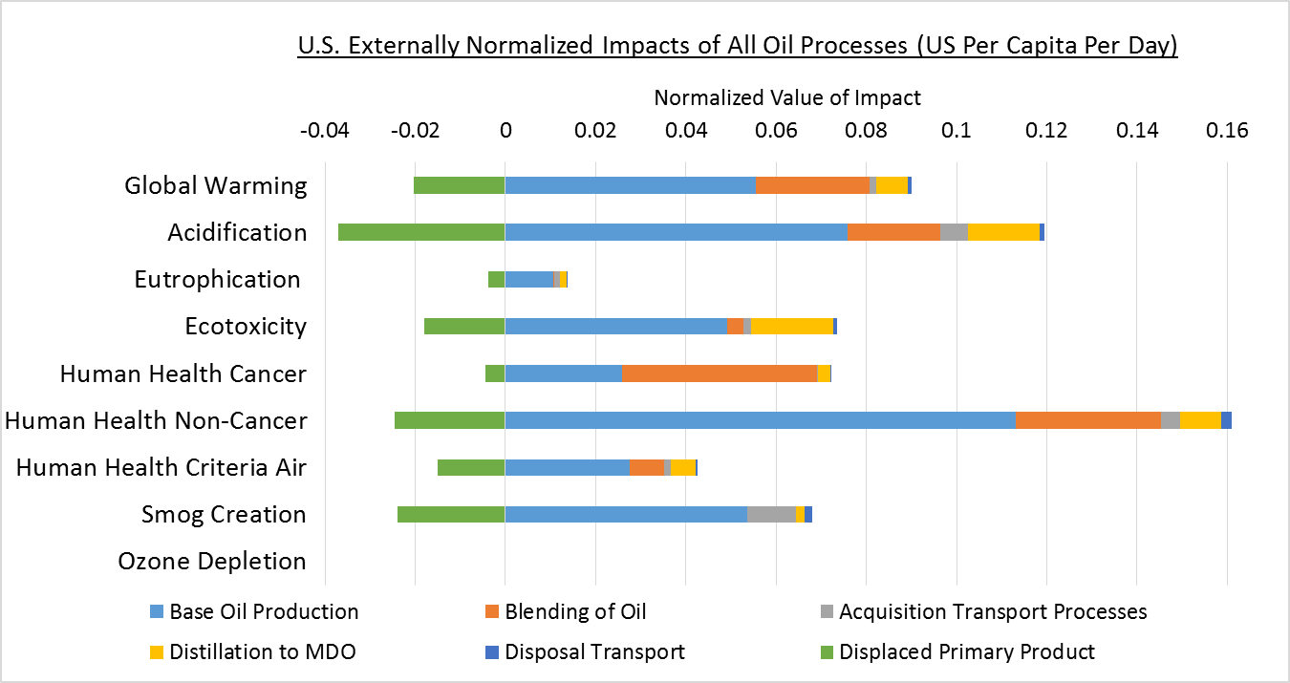
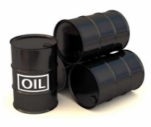
Putting the Results in Context
1200 gal of oil use distilled to MDO
(no combustion)
84 person-days
GWP
100 person-days
AP
12 person-days
EP
66 person-days
ETP
82 person-days
HHCP
164 person-days
HHNCP
34 person-days
HHCAP
54 person-days
SCP

Slide 20
Thank you for completing Module τ5!
Group A: ISO Compliant LCA Overview Modules
Group α: ISO Compliant LCA Detailed Modules
Group B: Environmental Impact Categories Overview Modules
Group β: Environmental Impact Categories Detailed Modules
Group G: General LCA Tools Overview Modules
Group γ: General LCA Tools Detailed Modules
Group T: Transportation-Related LCA Overview Modules
Group τ: Transportation-Related LCA Detailed Modules

Slide 21
References not on Slides
Audibert, F. (2006). Waste Engine Oils: Rerefining and Energy Recovery. Elsevier, Oxford, UK.
GaBi 6. (2015). “Extension database: XVII Full US.”
Geyer, R., Kuczenski, B., Henderson, A., and Zink, T. (2013). “Life Cycle Assessment of Used Oil Management in California.” DRRR-2013-1465, California Department of Resources Recycling and Recovery.
Raimondi, A., Girotti, G., Blengini, G. A., and Fino, D. (2012). “LCA of petroleum-based lubricants: state of art and inclusion of additives.” The International Journal of Life Cycle Assessment, 17(8), 987–996.
Boughton, B., and Horvath, A. (2004). “Environmental assessment of used oil management methods.” Environmental science & technology, 38(2), 353–358.
Langfitt, Q., and Haselbach, L. (2014). “Assessment of Lube Oil Management and Self-Cleaning Oil Filter Feasibility in WSF Vessels.” 2013-S-WSU-0044, Washington State Department of Transportation.
Ryberg, M., Vieira, M. D. M., Zgola, M., Bare, J., and Rosenbaum, R. K. (2014). “Updated US and Canadian normalization factors for TRACI 2.1.” Clean Technologies and Environmental Policy, 16(2), 329–339.
US Census Bureau. (2010). “Population Distribution and Change: 2000-2010.” 2010 Census Briefs.

Slide 22
Suggestions for Assignments
Read the listed references in slide #21.
Try to find alternative functional units or declared units for this study. You can go back and check modules alpha 1 and alpha 2 for further information on functional units or declared units.
In terms of findings, which stages have the biggest potential environmental impact and why?

