Slide 1

Welcome to the Life Cycle Assessment (LCA) Learning Module Series
Liv Haselbach Quinn Langfitt
For current modules email haselbach@wsu.edu or visit cem.uaf.edu/CESTiCC
Acknowledgements:
CESTiCC Washington State University Fulbright

Slide 2
LCA Module Series Groups
Group A: ISO Compliant LCA Overview Modules
Group α: ISO Compliant LCA Detailed Modules
Group B: Environmental Impact Categories Overview Modules
Group β: Environmental Impact Categories Detailed Modules
Group G: General LCA Tools Overview Modules
Group γ: General LCA Tools Detailed Modules
Group T: Transportation-Related LCA Overview Modules
Group τ: Transportation-Related LCA Detailed Modules

Slide 3
GREET Tutorial
Module τ3

Slide 4

Introduction to GREET
Greenhouse gas, Regulated Emissions, and Energy use in Transportation
Developed by Argonne National Lab in 1996, supported by DOE
Over 100 fuel production pathways and 50 vehicle types
Life cycle model in that it takes into account the full system life cycle
Not an LCA tool by ISO 14040 because it does not characterize environmental impacts (no LCIA)
Useful as a standalone tool
Frequently used as a data source for transportation LCAs
Available at: https://greet.es.anl.gov/
This module is only an overview. For advanced features refer to the “User Manual” under the “About” menu in the program.

Slide 5
What will GREET Tell You? (Emissions)
Greenhouse gas emissions
Carbon dioxide
Biogenic carbon dioxide
Methane
Nitrous oxide
Regulated emissions (basically the criteria air pollutants as defined by EPA)
Volatile organic compounds (excluding carbon monoxide)
Carbon monoxide
Nitrogen oxides
Sulfur oxides
Particulate matter (PM_{2.5} and PM₁₀ separately)
Gaseous hydrogen

Slide 6
What will GREET Tell You? (Resource Use)
Natural gas (renewable, non-renewable)
Coal (average)
Crude oil
Nuclear energy
Hydroelectric power
Bituminous oil
Wind power
Forest residue
Geothermal power
Solar power
Animal waste
Uranium ore
Switchgrass
Farmed trees
Fertilizer

Slide 7
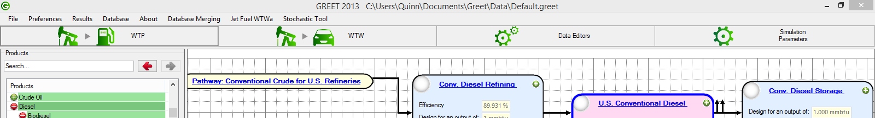
GREET Selection Pane
Well-to-pump
Impacts to produce fuels and other materials
Well-to-wheel
Impacts from production and use of fuels
Data editors
Vehicle mileage, emissions factors for different vehicles, electricity grid mixes, etc.
Simulation parameters
Modelling year, process input and output editing, crop yields for biofuels feedstocks, heating value, etc.

Slide 8
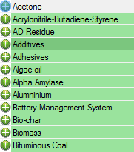
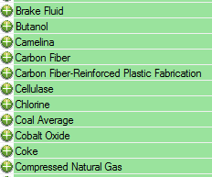
Well-to-Pump Pane
Well-to-pump: Impacts from extraction of fuel (i.e. well) to input to vehicle (i.e. pump)
And so on…

Slide 9
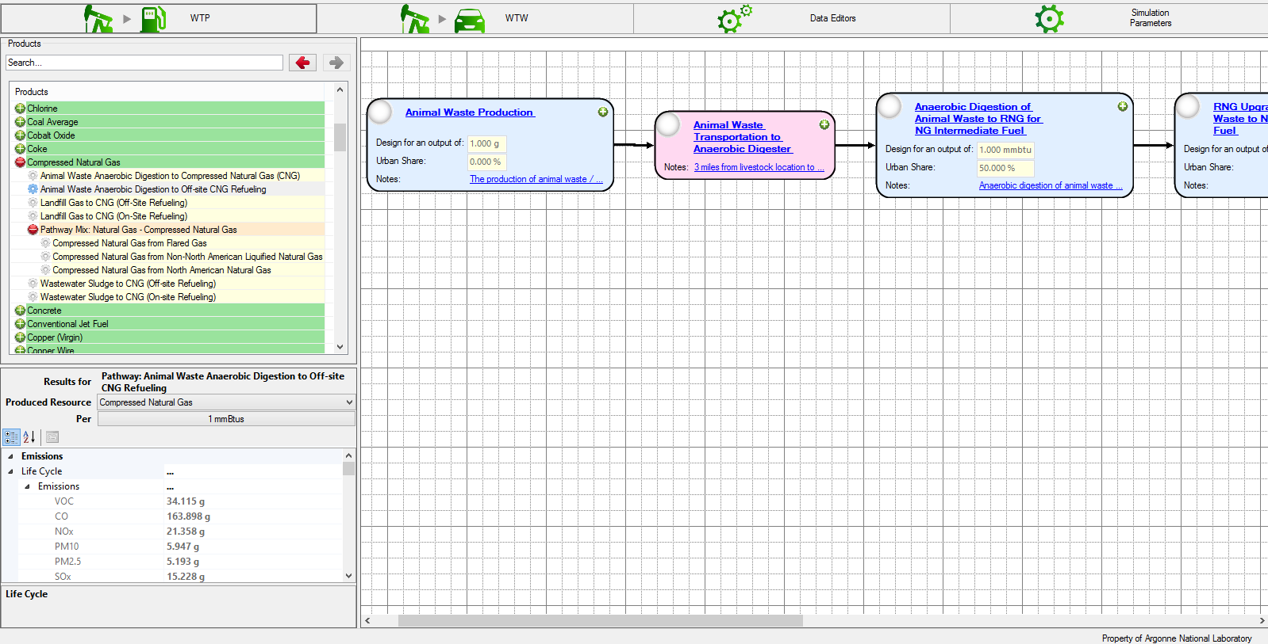
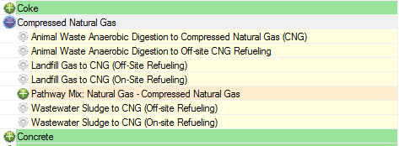
Well-to-pump example: Compressed Natural Gas

Slide 10
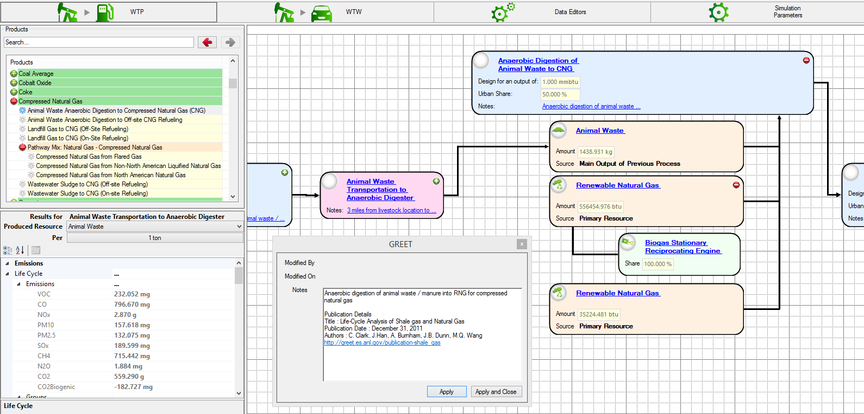
Expanding Processes to See Details

Slide 11
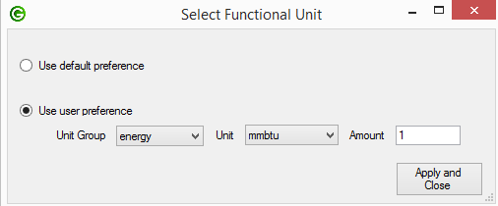




Well-to-pump example: Functional Unit Choice

Slide 12
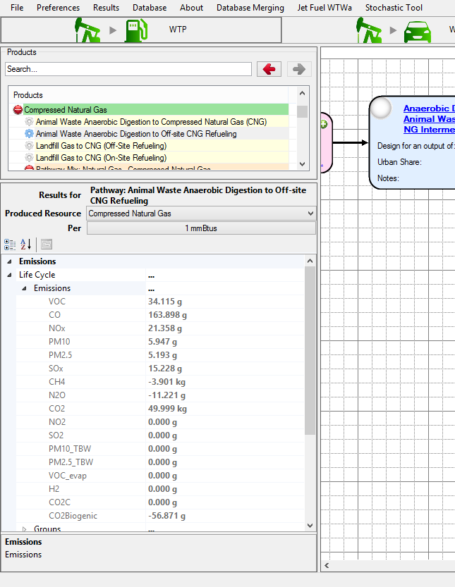
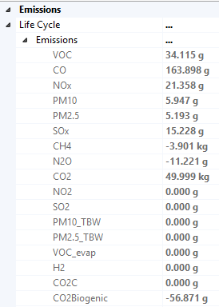
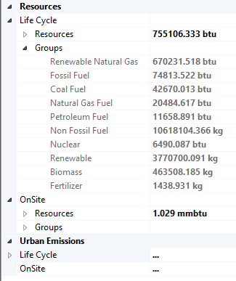
Well-to-pump example: Results

Slide 13
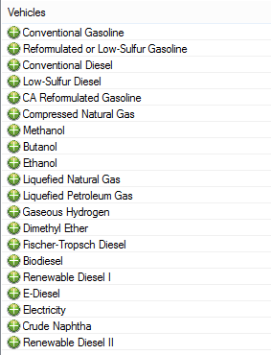
Well-to-Wheel Pane
Well-to-wheel: Impacts from extraction of fuel (i.e. well) to power to wheels (i.e. wheel)

Slide 14
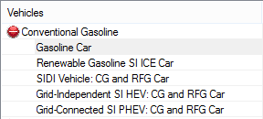
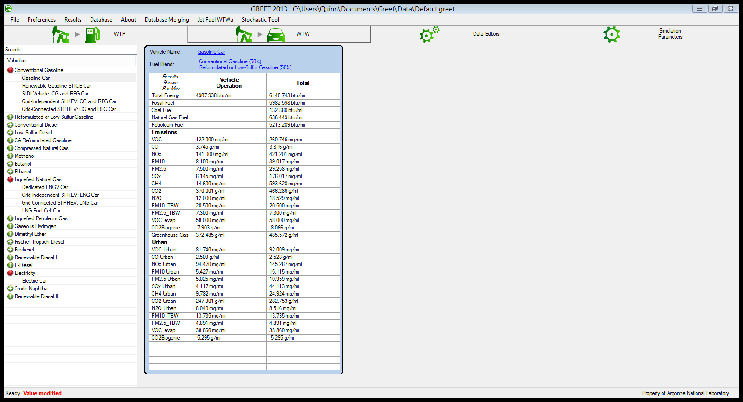
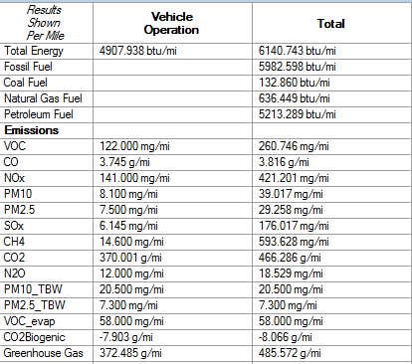
Well-to-Wheel Example: Gasoline Car

Slide 15
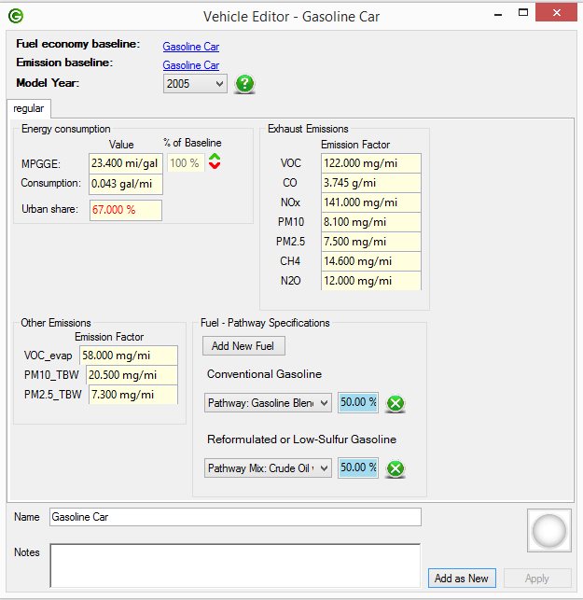
Well-to-Wheel Example: Gasoline Car

Slide 16
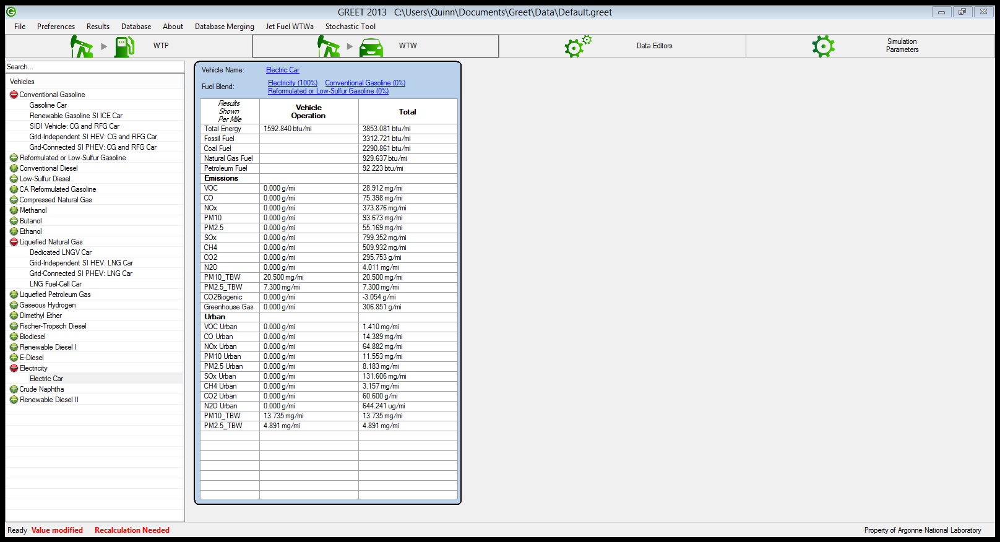
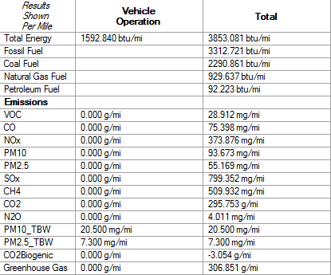
Well-to-Wheel Example: Electric Car

Slide 17
Thank you for completing Module τ3!
Group A: ISO Compliant LCA Overview Modules
Group α: ISO Compliant LCA Detailed Modules
Group B: Environmental Impact Categories Overview Modules
Group β: Environmental Impact Categories Detailed Modules
Group G: General LCA Tools Overview Modules
Group γ: General LCA Tools Detailed Modules
Group T: Transportation-Related LCA Overview Modules
Group τ: Transportation-Related LCA Detailed Modules

