Slide 1
Welcome to the Life Cycle Assessment (LCA) Learning Module Series
Liv Haselbach Quinn Langfitt
For current modules email haselbach@wsu.edu or visit cem.uaf.edu/CESTiCC
Acknowledgements:
CESTiCC Washington State University Fulbright

Slide 2
LCA Module Series Groups
Group A: ISO Compliant LCA Overview Modules
Group α: ISO Compliant LCA Detailed Modules
Group B: Environmental Impact Categories Overview Modules
Group β: Environmental Impact Categories Detailed Modules
Group G: General LCA Tools Overview Modules
Group γ: General LCA Tools Detailed Modules
Group T: Transportation-Related LCA Overview Modules
Group τ: Transportation-Related LCA Detailed Modules

Slide 3
Building LCA Software Tutorial (BIRDS, BEES)
Module γ2

Slide 4
Building Industry Reporting and Design for Sustainability (BIRDS v1)
For environmental and economic analysis of new commercial buildings
Operating energy
Environmental performance of materials, construction, and use
Life-cycle cost
Online-based tool
Produced by NIST in the US
Simple input in three steps (output options in fourth step)
Select building
Select comparisons
Select environmental preferences
Available at: birdscom.nist.gov
Logo: birdscom.nist.gov

Slide 5
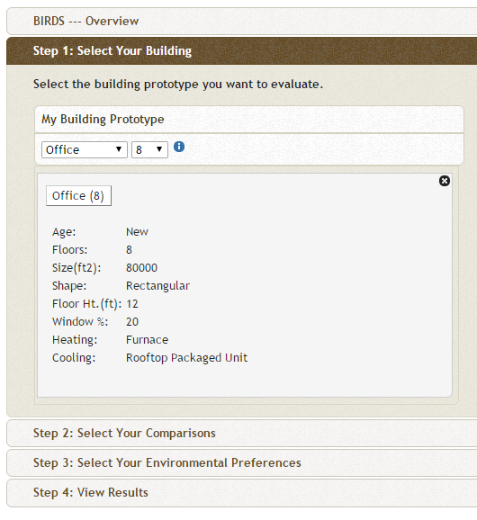
BIRDS (Step 1)
Building types include
Apartment
Dormitory
Hotel
Office
Restaurant
Retail Store
High School
For each various number of floors available
Click to open detailed information as shown

Slide 6
Baselines
In Steps 2 and 3 baselines must be selected including
Building location
Building energy standard
Study period
Impact category weighting scheme
In Step 4, will choose which to make comparisons along
Only one can be used as the basis of comparison at a time
All others will take value of base case

Slide 7
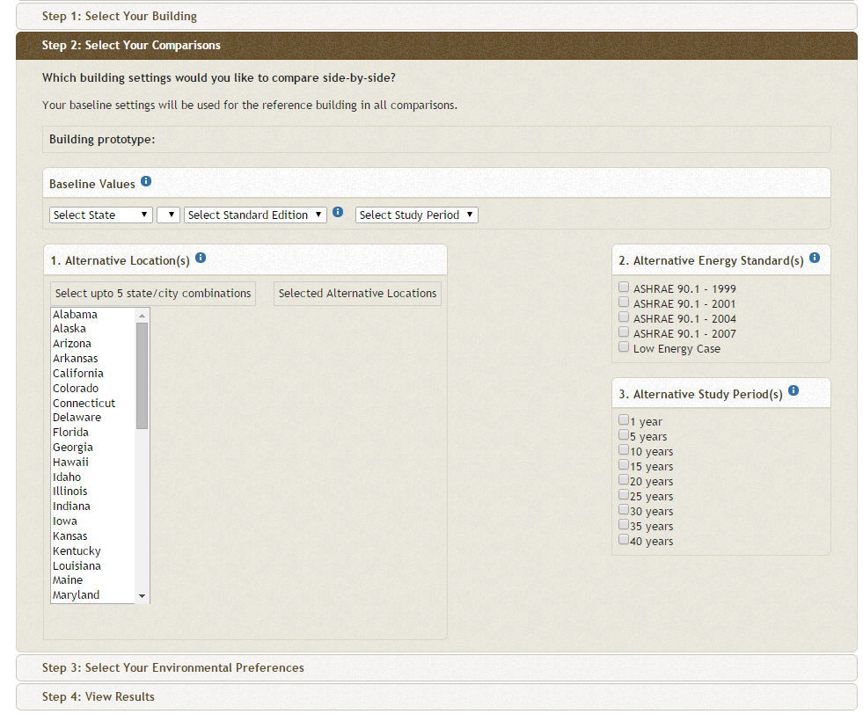
BIRDS (Step 2)
Choose baseline value
State
City
ASHRAE Edition
Time period (1-40 years)
Can choose alternatives to compare to
Same selections as baseline
ASHRAE 90.1
Energy Standard for Buildings Except Low-Rise Residential Buildings
Prescriptive or performance based
Often used as municipal/state standard or part of standards
ASHRAE 189.1-2009

Slide 8
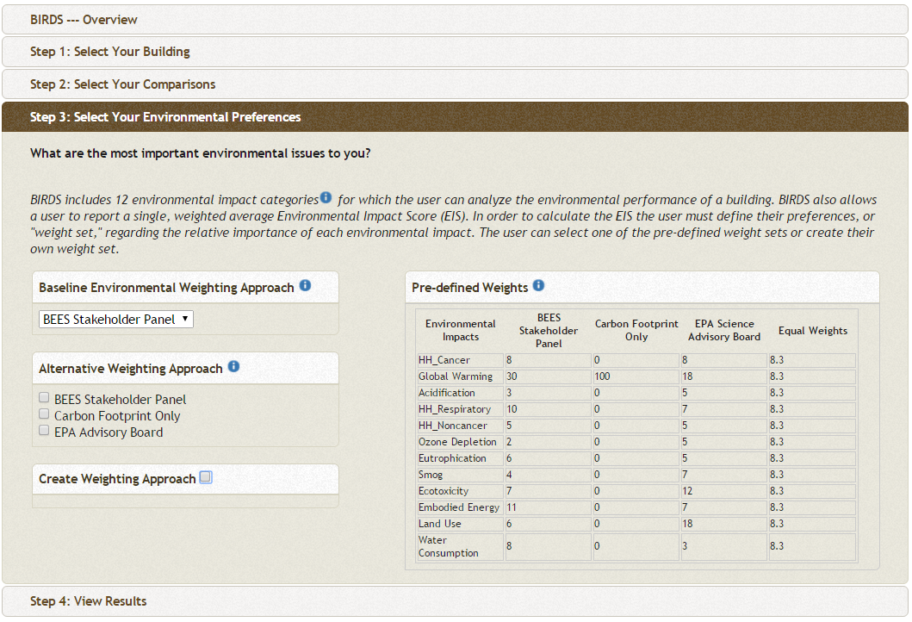
BIRDS (Step 3)
12 impact categories
Choose weighting scheme
BEES Stakeholder Panel
EPA Advisory Board
Carbon Footprint Only
Equal Weights
Custom Weights
This baseline and alternatives is not referring to baseline/ alternatives chosen in Step 2
Just alternative weighting schemes to apply to all cases
Click by Pre-defined Weights to see how schemes are developed

Slide 9
BIRDS (Step 3)

Slide 10
BIRDS (Step 4)
Choose type of results
Life-cycle cost
Operating energy
Environmental impact
Choose one dimension as comparison basis
Building location
Building energy standard
Study period
Impact category weighting scheme
Indictor unit
kg eq substance
kg eq substance/ft²
change in each

Slide 11
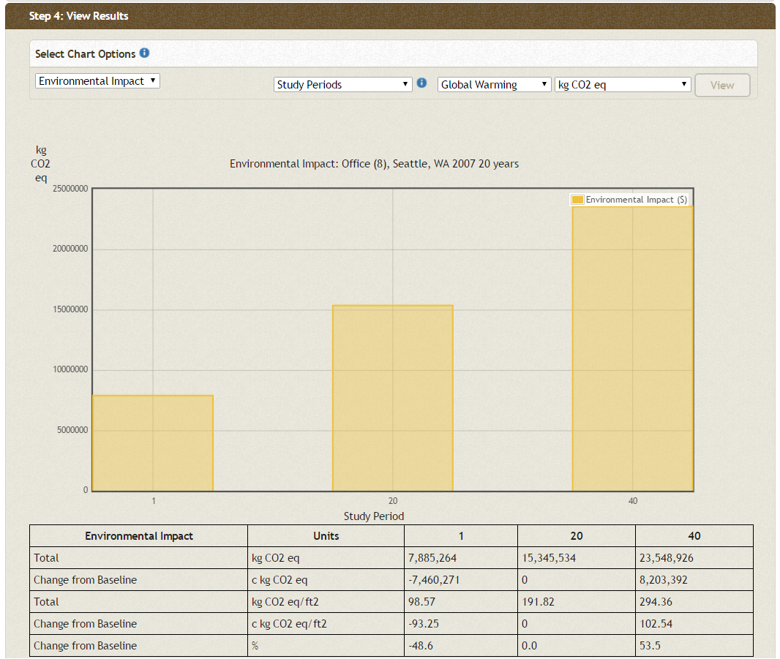
BIRDS Results Study Period Global Warming kg CO2-eq
Shows total impact (not yearly)
Divide by study period for yearly impact
Shows only selected unit on chart
All units in table below

Slide 12
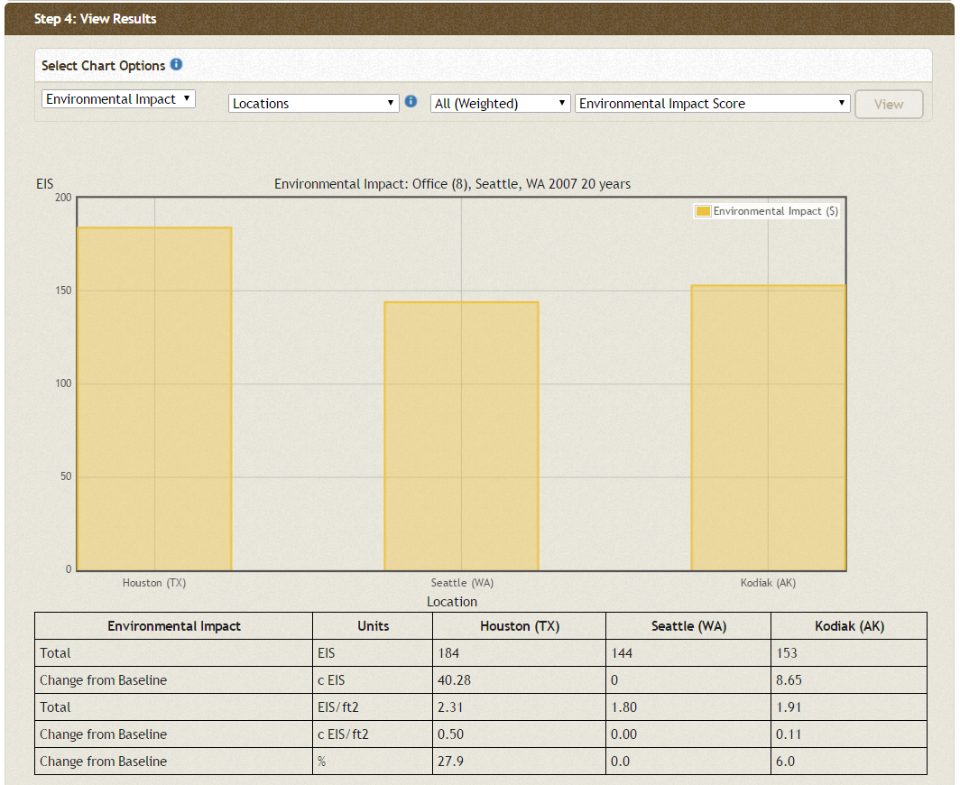
BIRDS Results Locations All (Weighted) Env. Impact Score

Slide 13
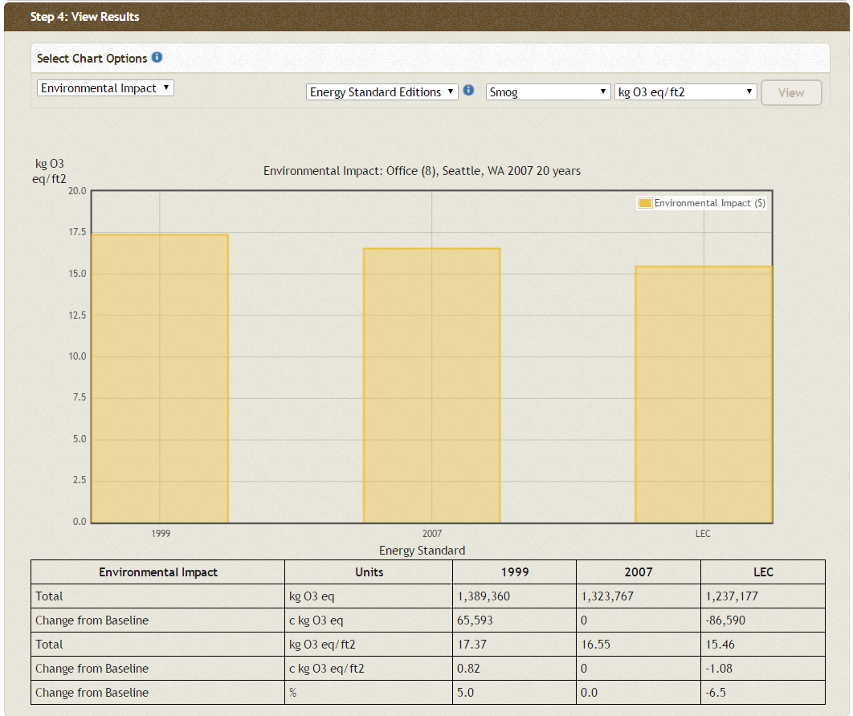
BIRDS Results Energy Edition Smog kg O₃-eq/ft²

Slide 14
Building for Environmental and Economic Sustainability (BEES)
Predecessor to BIRDS
For environmental and economic analysis of building products
Online-based tool
Produced by NIST in the US
Analyze individual building products (rather than whole building)
Nearly 200 products included
Concrete, roofing, insulation, water distribution piping, cleaning materials, paving, more
Simple to use
Most data and processes set, just choose weighting scheme, product(s) of interest, and transport distance
Link to BEES online

Slide 15
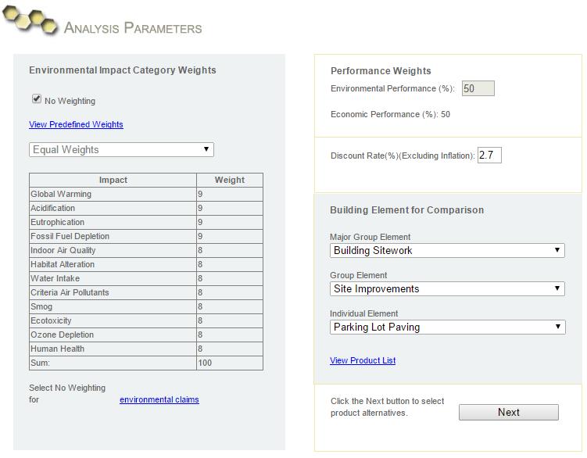
BEES Analysis Parameters

Slide 16
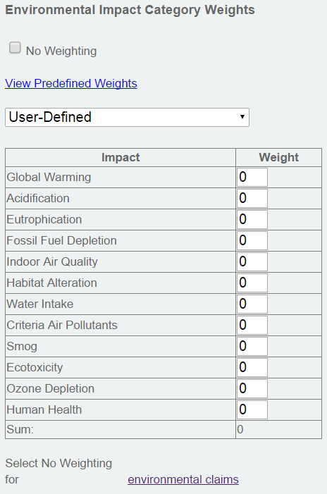
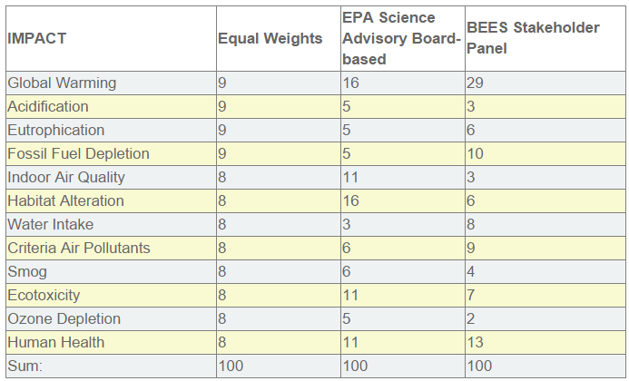
Environmental Weighting Scheme

Slide 17
Performance weights
BEES can output a “score” in addition to impact category indicators
This weights importance of environment and economics in scores
For environmental analysis alone, enter 100
Discount rate deals with time value of money (does not affect environmental)
1 dollar invested today might be worth 2 dollars in 10 years

Slide 18
Element Selection
Major group elements include
Building Maintenance
Building Repair & Remodeling
Building Sitework
Domestic Water Distribution
Equipment & Furnishings
Interiors
Sanitary Waste
Services
Shell
Substructure
All products in one list

Slide 19
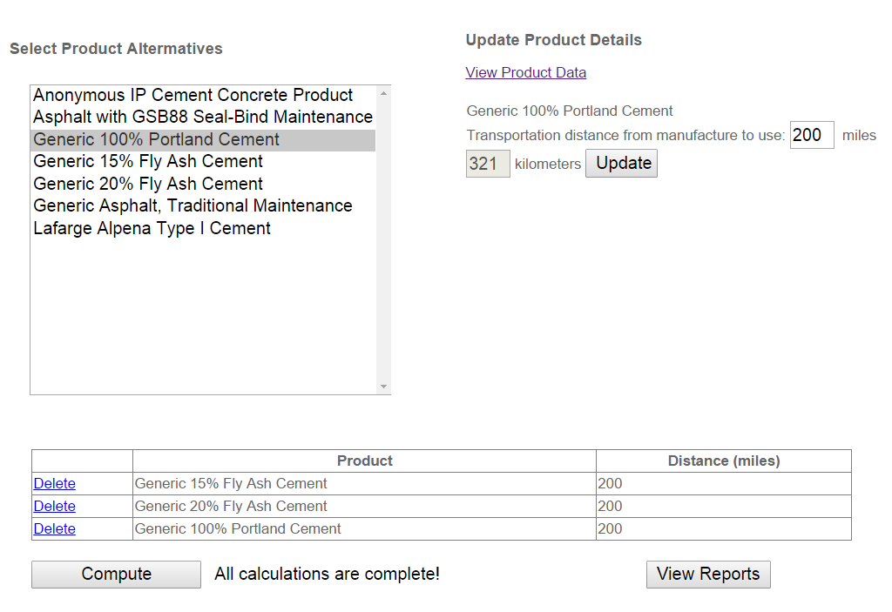
Product Selection
Inventory results by life cycle stage
Only appears after clicking compute

Slide 20
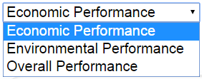
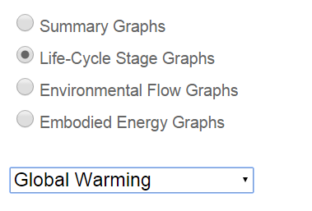
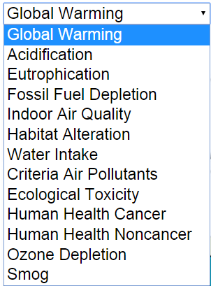
Output Type Selection

Slide 21
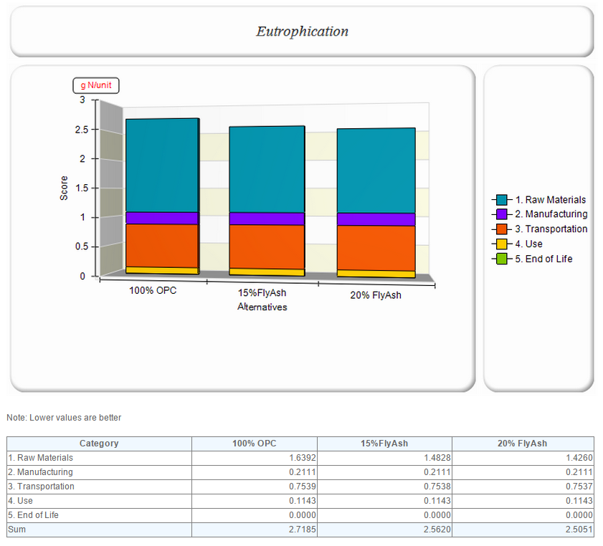
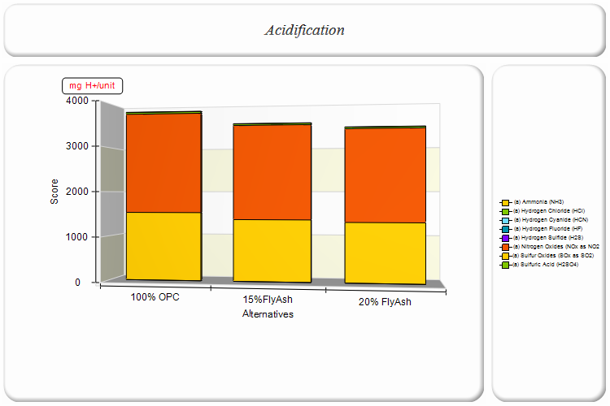
BEES Output
By life cycle stage
By environmental flow

Slide 22
Thank you for completing Module γ2!
Group A: ISO Compliant LCA Overview Modules
Group α: ISO Compliant LCA Detailed Modules
Group B: Environmental Impact Categories Overview Modules
Group β: Environmental Impact Categories Detailed Modules
Group G: General LCA Tools Overview Modules
Group γ: General LCA Tools Detailed Modules
Group T: Transportation-Related LCA Overview Modules
Group τ: Transportation-Related LCA Detailed Modules

