Slide 1
Welcome to the Life Cycle Assessment (LCA) Learning Module Series
Liv Haselbach Quinn Langfitt
For current modules email haselbach@wsu.edu or visit cem.uaf.edu/CESTiCC
Acknowledgements:
CESTiCC Washington State University Fulbright

Slide 2
LCA Module Series Groups
Group A: ISO Compliant LCA Overview Modules
Group α: ISO Compliant LCA Detailed Modules
Group B: Environmental Impact Categories Overview Modules
Group β: Environmental Impact Categories Detailed Modules
Group G: General LCA Tools Overview Modules
Group γ: General LCA Tools Detailed Modules
Group T: Transportation-Related LCA Overview Modules
Group τ: Transportation-Related LCA Detailed Modules

Slide 3
EIO-LCA Tutorial and Links to GaBi Tutorials
Module γ1

Slide 4
Links to GaBi Tutorials
GaBi is a full process-based LCA tool for a wide variety of sectors
Thinkstep has already produced detailed video tutorials on use of the tool
Part 1: LCA and introduction to GaBi
Part 2: Scenario Modelling
Part 3: Helpful GaBi features
Free trial available to follow along
Educational users can get a special education version for use in class

Slide 5
Economic Input-Output Life Cycle Assessment (EIO-LCA)
Free web-based tool
Produced by Carnegie Mellon University
Calculates results based on economic ties between sectors
Assessment based on economic activity input by the user in a sector
Producer
Purchaser
Many datasets to choose from including:
US National
Two US States (PA and WV)
Other countries
Includes product types in a wide variety of industries
428 in total for US 2002 data
Producer Models for these Countries
*Flag maps not to scale Flag maps other than Canada source: commons.wikimedia.org Canada: mapsof.net

Slide 6
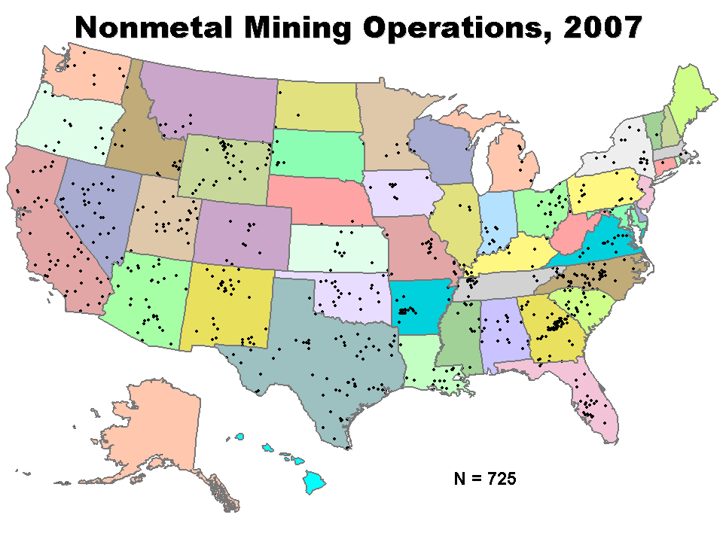
How it Works
Example → Making concrete
Need aggregate, cement, water, electricity, trucks, etc.
$$\frac{GWP_{s}}{EA_{s}}∗EA_{p}=GWP_{p}$$
$$GWP_{s}=$$
$$Total GWP of sector$$
$$\frac{AP_{s}}{EA_{s}}∗EA_{p}=AP_{p}$$
$$EA_{s}=$$
$$Economic activity$$
$$of sector$$
$$\frac{EP_{s}}{EA_{s}}∗EA_{p}=EP_{p}$$
$$EA_{p}=$$
$$Economic activity$$
$$of product in sector$$
$$⋮$$
$$GWP_{p}=$$
$$GWP of product \\ from sector$$
Figure: cdc.gov

Slide 7
How it Works
Example → Making concrete
Need aggregate, cement, water, electricity, trucks, etc.
$$\frac{GWP_{s}}{EA_{s}}∗EA_{p}=GWP_{p}$$
$$GWP_{s}=$$
$$Total GWP of sector$$
$$\frac{AP_{s}}{EA_{s}}∗EA_{p}=AP_{p}$$
$$EA_{s}=$$
$$Economic activity$$
$$of sector$$
$$\frac{EP_{s}}{EA_{s}}∗EA_{p}=EP_{p}$$
$$EA_{p}=$$
$$Economic activity$$
$$of product in sector$$
$$⋮$$
$$GWP_{p}=$$
$$GWP of product \\ from sector$$
Figure: cdc.gov

Slide 8
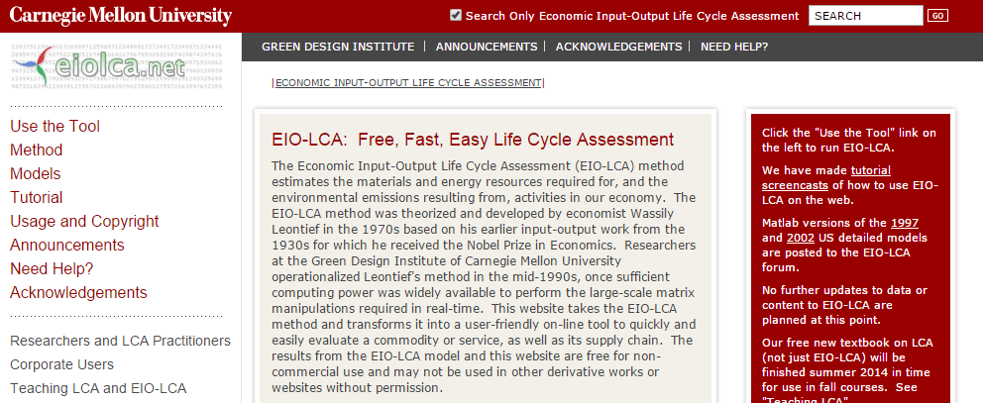
Getting to the tool
Visit eiolca.net

Slide 9
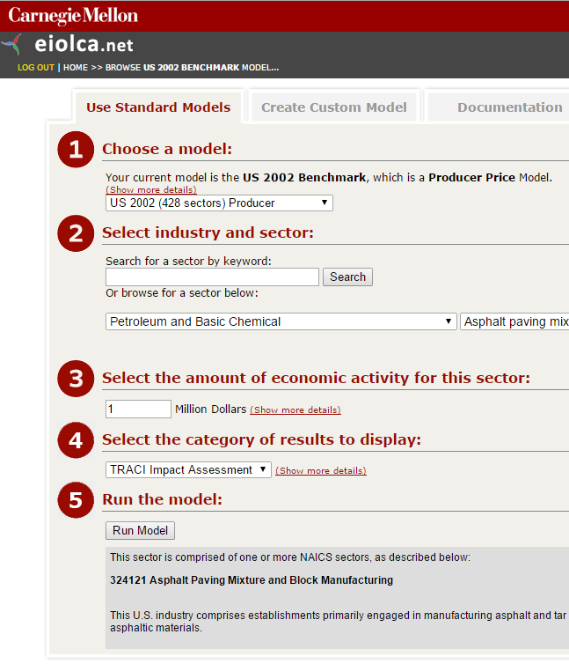
EIO-LCA Input (Step 1)
US National Producer Price Models
US 1992 (485)
US 1992 (97)
US 1997 (491)
US 2002 (428)
US National Purchaser Price Models
US 1997 (483)
US 1992 (428)
US State Purchaser Price Models
PA 1997 (491)
WV 1997 (491)
PA+WV 1997 (491)
International Purchaser Price Models
Germany (58)
Spain 2000 (73)
Canada 2002 (105)
China 2002 (122)

Slide 10
EIO-LCA Input (Step 2)
Semiconductors, Electronic Equipment, and Media Reproduction
Computers, Audio-Video, and Communications Equipment
Resin, Rubber, Artificial Fibers, Agric. Chems, and Pharm
Other Metal hardware and Ordinance Manufacturing
Cutlery, Hand tools, Structural and Metal Containers
Trade, Transportation, and Communications Media
Finance, Insurance, Real Estate, Rental and Leasing
Management, Administrative, and Waste Services
Plastic Rubber, and Nonmetallic mineral products
Paint, Adhesives, Cleaning and Other Chemicals
Arts, Entertainment, Hotels and Food Services
Vehicles and Other Transportation Equipment
Agriculture, Livestock, Forestry, and Fisheries
Other Services, Except Public Administration
Furniture, Medical Equipment, and Supplies
Lighting, Electrical Components, Batteries
Other Miscellaneous Manufacturing
Education and Health Care Services
Professional and Technical Services
Government and Special Services
Petroleum and Basic Chemical
Textiles, Apparel, and Leather
Food, Beverage, and Tobacco
Wood, Paper, and Printing
Machinery and Engines
Mining and Utilities
Construction

Slide 11
EIO-LCA Input (Step 3)
Amount of economic activity in the sector of interest
Based on which type of model was used
Purchaser (Value of goods of interest)
Producer (Cost to produce goods of interest)
In millions of dollars
Based on linear model, so can scale linearly
If interested in small value, input higher value in tool to get enough significant figures and then divide manually to value of interest

Slide 12
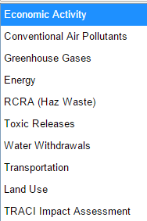
EIO-LCA Inputs (Step 4)
Can output results in a number of ways
Results can be downloaded as Excel file
TRACI version 1
Carnegie Mellon logo source: cmu.edu

Slide 13
EIO-LCA Inputs (Step 5)
Click Run Model!
Below in the gray box a short description of what is included in the industry of choice is shown
NAISC = National American Industry Classification System
Carnegie Mellon logo source: cmu.edu

Slide 14
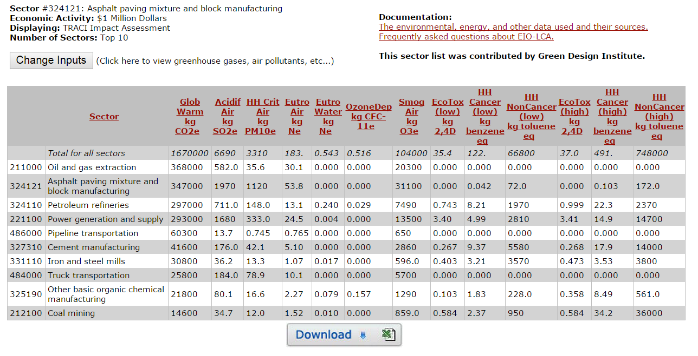
EIO-LCA Output
Carnegie Mellon University Green Design Institute. (2015) Economic Input-Output Life Cycle Assessment (EIO-LCA) US 2002 (428 sectors) Producer model[Internet], Available from: <http://www.eiolca.net/>

Slide 15
EIO-LCA Output
Carnegie Mellon University Green Design Institute. (2015) Economic Input-Output Life Cycle Assessment (EIO-LCA) US 2002 (428 sectors) Producer model[Internet], Available from: <http://www.eiolca.net/>

Slide 16
Custom Models
For products that are not fully captured by one sector in the model, can create custom model
Each sector that contributes to that product is selected and the dollar value of economic activity is entered
If product system is similar to one available, but different in some inputs, can create hybrid model
Allows user to change the magnitude of any individual economic tie
These are only for advanced users and requires understanding of economic ties
Detailed video tutorial for custom modelling is available here: http://www.eiolca.net/tutorial/ScreencastTutorial/video3.swf

Slide 17
Use of Results
Academic users can use the results for free
Citing should be done in the following format (substitute appropriate dataset):
Carnegie Mellon University Green Design Institute. (2008) Economic Input-Output Life Cycle Assessment (EIO-LCA), US 1997 Industry Benchmark model [Internet], Available from:<http://www.eiolca.net> Accessed 1 January, 2008.
Information on corporate use is available here: http://www.eiolca.net/CorporateUsers/index.html

Slide 18
Thank you for completing Module γ1!
Group A: ISO Compliant LCA Overview Modules
Group α: ISO Compliant LCA Detailed Modules
Group B: Environmental Impact Categories Overview Modules
Group β: Environmental Impact Categories Detailed Modules
Group G: General LCA Tools Overview Modules
Group γ: General LCA Tools Detailed Modules
Group T: Transportation-Related LCA Overview Modules
Group τ: Transportation-Related LCA Detailed Modules

