Slide 1
Welcome to the Life Cycle Assessment (LCA) Learning Module Series
Liv Haselbach Quinn Langfitt
For current modules email haselbach@wsu.edu or visit cem.uaf.edu/CESTiCC
Acknowledgements:
CESTiCC Washington State University Fulbright

Slide 2
LCA Module Series Groups
Group A: ISO Compliant LCA Overview Modules
Group α: ISO Compliant LCA Detailed Modules
Group B: Environmental Impact Categories Overview Modules
Group β: Environmental Impact Categories Detailed Modules
Group G: General LCA Tools Overview Modules
Group γ: General LCA Tools Detailed Modules
Group T: Transportation-Related LCA Overview Modules
Group τ: Transportation-Related LCA Detailed Modules

Slide 3
Transportation LCA Software Tools
Module G3

Slide 4
Transportation LCA Common Topics
Transport LCA Topics of Interest
Pavement
Roadway Maint.
Vehicles
Fuels
Modal Choice
Infra-structure
*Not an exhaustive list of topics
Notes:
Fuel, particularly biofuels or other alternative fuels
Vehicles, particularly alternative tech like electric, hybrid, etc.
Modal assessment like switch car to trains or buses to trains

Slide 5
Transportation LCA
Many transportation “life cycle assessments” are not truly LCAs by the ISO standard
Many studies only inventory regulated emissions, greenhouse gases, and energy
Sometimes reported as the quantities of emissions, sometimes as impact category indicators
Why are these limited inventories common?
Many database tools are focused on these types of emissions since they are generally what is mandated in regulations
Therefore, easy data accessibility for these data points compared to a more exhaustive LCI
This is not to say that there aren’t transportation LCAs with full inventories and impact category characterization
CO₂
(carbon dioxide)
SO₂
(sulfur dioxide)
VOCs
(volatile organics)
Common Greenhouse Gases
N₂O
(nitrous oxide)
NO_{x}
(nitrogen oxides)
PM
(particulate matter)
Regulated Emissions
CH₄
(methane)
CO
(carbon monoxide)
Pb (lead)
(less common)

Slide 6
Some Transportation “LCA” Software Tools
The Greenhouse Gas, Regulated Emissions, and Energy Use in Transportation Model (GREET)
Fuel and Emissions Calculator (FEC)
The Pavement Life-Cycle Assessment Tool for Environmental and Economic Effects (PaLATE)
Athena Impact Estimator for Highways

Slide 7
GREET
Greenhouse gas, Regulated Emissions, and Energy use in Transportation
Developed by Argonne National Lab in 1996, supported by DOE
Life cycle model in that it takes into account the full system life cycle of vehicles and fuels (Well-to-wheel and well-to-pump options)
Over 100 fuel production pathways and 50 vehicle types
Not a true LCA tool by ISO 14040 because it does not characterize emissions as environmental impacts
Useful as a standalone tool
Frequently used as a data source for transportation LCAs
Available at: https://greet.es.anl.gov/
Logo source: greet.es.anl.gov

Slide 8
GREET Use: Assessment Type Selection

Slide 9
GREET Use: Well-to-Pump Conventional Diesel

Slide 10
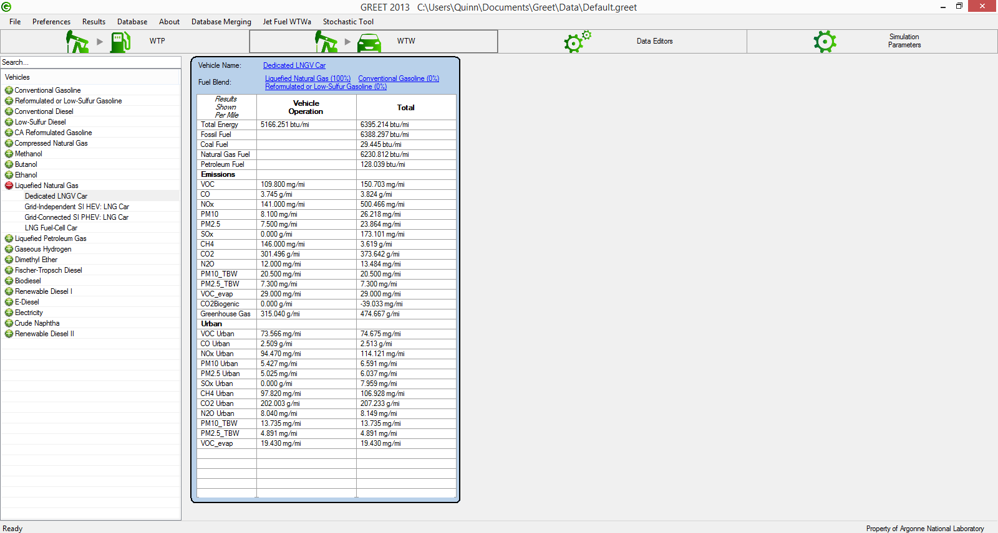
GREET Use: Well-to-Wheel LNG in Car

Slide 11
FEC
Fuel and Emissions Calculator
Spreadsheet-based tool produced by Georgia Tech
Similar to type of data from GREET except
Focused on bus and rail
Specific to location
Specific to duty cycle
Can compare vehicles/fuels based on their actual operating characteristics and environment
Especially useful to transit agencies for vehicle type, fuel, and route selection decisions
Still in “beta” phase, so not all of the data/operations have been checked for error and bugs
Working towards making it a web-based tool with expanded capabilities
Program website: http://fec.ce.gatech.edu/
Logo source: mocvdtechnology.com

Slide 12
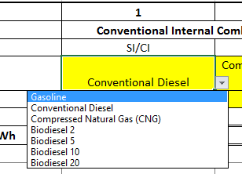
FEC - Input
Notes:
Yellow boxes are for intputs.

Slide 13
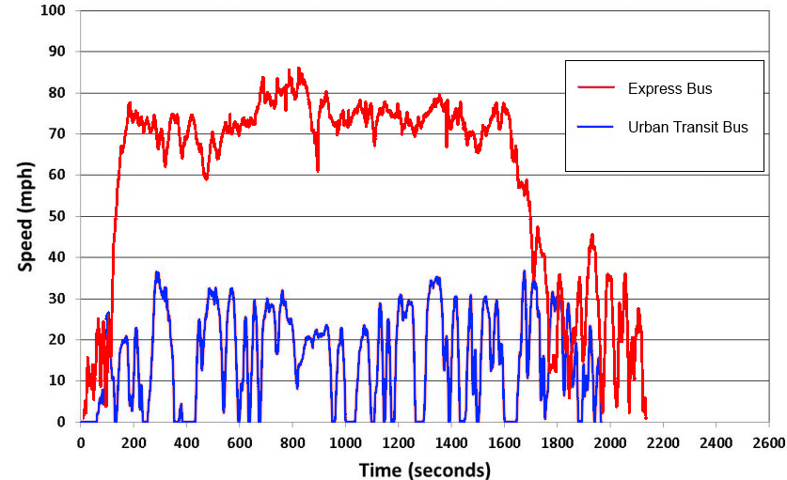
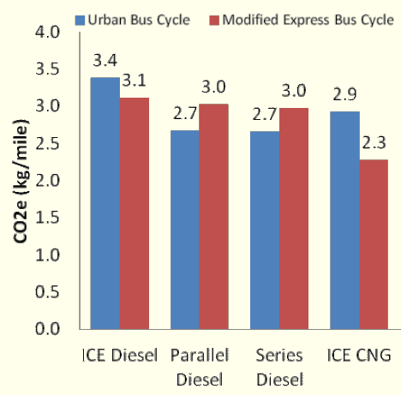
FEC Duty Cycle Comparison
Xu, Y., D. Lee, F. Gbologah, G. Cernjul, V. Elango, M. Rodgers, R. Guensler (2013). “Load-Based Life-Cycle Greenhouse Gas Emissions Calculator for Transit Buses; An Atlanta, GA Case Study.” 2nd T&DI Green Streets, Highways and Development Conference, Austin, TX, USA. November 3-6, 2013.
Graph: Xu, Y. (2014). “Fuel and Emissions Calculator for Transit Bus and Rail Technologies.” National Center for Sustainable Transportation Webinar Series.

Slide 14
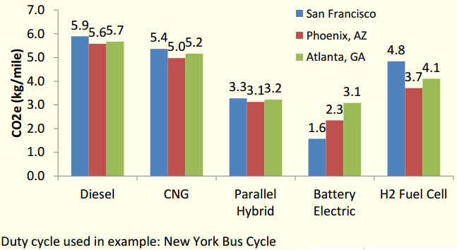
FEC - Output
Also broken down by upstream fuel emissions, on-road emissions, and per route
Xu, Y. (2014). “Fuel and Emissions Calculator for Transit Bus and Rail Technologies.” National Center for Sustainable Transportation Webinar Series.
Notes:
Graph from report made by GHG results, not directly the output of the tool.

Slide 15
PaLATE
The Pavement Life-Cycle Assessment Tool for Environmental and Economic Effects
Excel-based tool for LCA of environmental and economic effects of pavements and roads
Pavement LCA tool developed specifically for the US
By UC Berkeley: Free and currently being updated
For use by: pavement designers, transportation agency decision-makers, civil engineers, and researchers
Outputs mostly LCI results, rather than LCIA results
Many environmental impacts are not addressed
All except leachates are mostly related to energy use
More information and how to get it at: www.ce.berkeley.edu/~horvath/palate.html
Logo source: ce.berkeley.edu/~horvath/palate.html

Slide 16
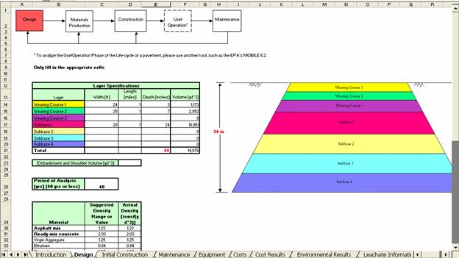
PaLATE - Input
Inputs include:
Roadway design parameters
Construction materials
Transport distances and modes
Maintenance materials
Transport distances and modes
Construction equipment
Onsite and offsite
Source: www.ce.berkeley.edu/~horvath/palate.html

Slide 17
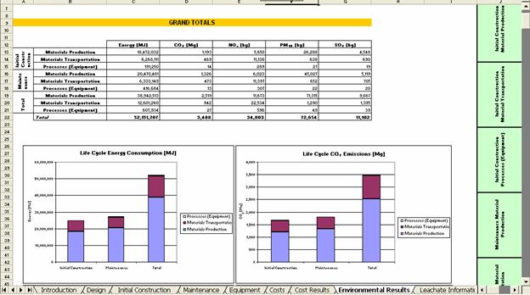
PaLATE - Output
Palate outputs the following:
Inventory data
Energy use
CO₂
NO_{x}
PM₁₀
SO₂
CO
Hg
Pb
Impact category indicators
Global warming potential
Human toxicity potential (focused on from leachate inventory)
Life cycle costs

Slide 18
IE for Highways
Athena Impact Estimator for Highways
Free, download-based tool
Analyzing initial paving materials, highway use, maintenance, end-of-life using LCA
Currently only for Canadian Provinces
Designed to make LCA of pavement more accessible to transportation engineers and pavement designers
Based on fairly simple inputs on roadway parameters, materials, distance of transport, energy use, etc.
Can alter more detailed inputs for more control or leave with the default recommended values
Mostly based on national averages, with some regional data for distances and electrical grid
Download from Website
http://www.athenasmi.org/our-software-data/impact-estimator-for-highways/
Logo source: athenasmi.org

Slide 19
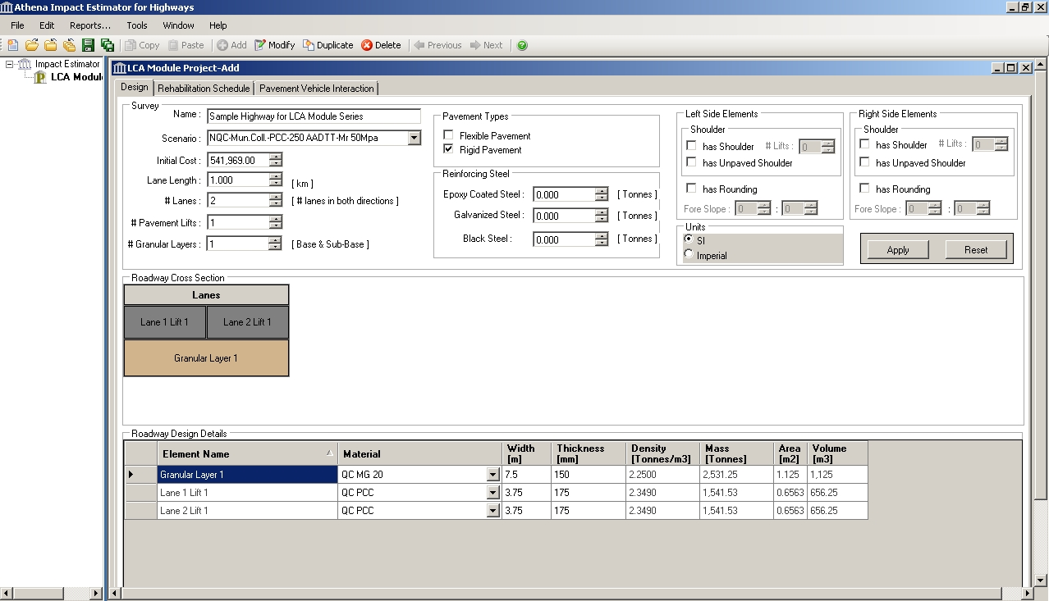
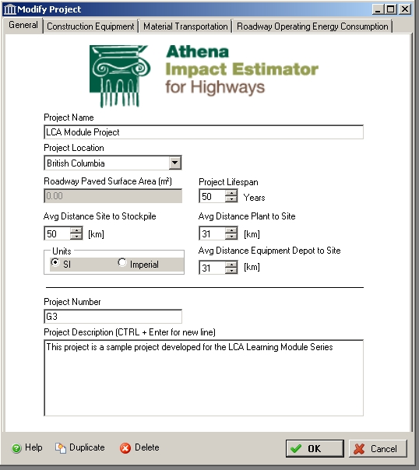
IE for Highways - Input

Slide 20
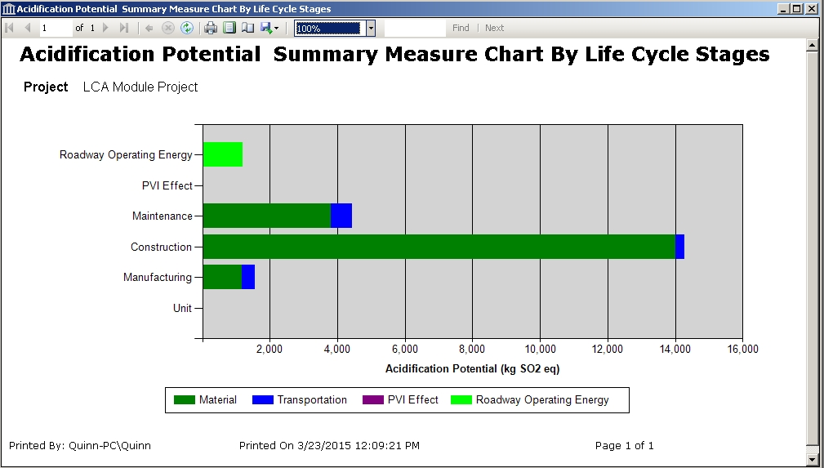
IE for Highways - Output

Slide 21
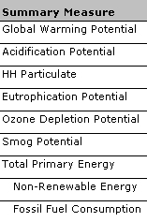
IE for Highways – Output Table

Slide 22
Thank you for completing Module G3!
Group A: ISO Compliant LCA Overview Modules
Group α: ISO Compliant LCA Detailed Modules
Group B: Environmental Impact Categories Overview Modules
Group β: Environmental Impact Categories Detailed Modules
Group G: General LCA Tools Overview Modules
Group γ: General LCA Tools Detailed Modules
Group T: Transportation-Related LCA Overview Modules
Group τ: Transportation-Related LCA Detailed Modules

Slide 23
Self-Assessment Quiz
MODULE G3: Transportation LCA Software Tools

Slide 24
What type of assessment results are often termed “LCA” in the transportation sector, but do not complete the ISO requirements on LCA?
Life cycle costs
Life cycle greenhouse gas and regulated emissions, and energy use
Ridership forecasting

Slide 25
Correct!
Inventories of greenhouse gases, regulated emissions, and energy use are often called LCA in transportation (and other sector) studies, but fail to quantify a large range of impacts with impact category indicators, so do not complete the requirements of the ISO standard. The other options listed are common assessments, but would not be called “LCA”.

Slide 26
Which of these tools is focused on assessments of bus and rail systems?
GREET
FEC
PaLATE
Athena IE for Highways

Slide 27
Correct!
The FEC (Fuel and Emissions Calculator) is designed to assess bus and rail decisions based on factors like engine type, fuel used, duty cycle, and operating location.

Slide 28
Which of these tools for pavement/highway LCA was developed specifically for the United States?
PaLATE (Pavement Life Cycle Assessment Tool for Environmental and Economic Effects)
Athena Impact Estimator for Highways
All of the above
None of the above

Slide 29
Correct!
PaLATE was designed by the University of California-Berekely and was developed for the United States. Athenia IE for Highways was developed for Canada.

Slide 30
What types of vehicles is GREET capable of doing life cycle assessments on?
Buses under various engine technologies, fuels, duty cycles, and locations
Internal combustion engine passenger vehicles only
Passenger vehicles with a wide range of engine types, fuel types, and fuel pathways
Alterative technology passenger vehicles only (such as fuel cell and natural gas vehicles)

Slide 31
Correct!
GREET can analyze over 50 types of passenger vehicles and over 100 fuel production pathways (including both standard and alternative technologies for each). The FEC is a different tool and that is the one which can analyze buses.

Slide 32
Which type of output is Athena Impact Estimator for Highways capable of producing?
Bill of materials
Impact category indicator results (“summary measures”)
Inventories of environmental uses and releases
All of the above

Slide 33
Correct!
Athena Impact Estimator for Highways can output results in a number of formats including impact category indicators, environmental release and use inventories, and a bill of materials.

Slide 34
Sorry that’s Incorrect
Please try again!

