Slide 1

Welcome to the Life Cycle Assessment (LCA) Learning Module Series
Liv Haselbach Quinn Langfitt
For current modules email haselbach@wsu.edu or visit cem.uaf.edu/CESTiCC
Acknowledgements:
CESTiCC Washington State University Fulbright

Slide 2
LCA Module Series Groups
Group A: ISO Compliant LCA Overview Modules
Group α: ISO Compliant LCA Detailed Modules
Group B: Environmental Impact Categories Overview Modules
Group β: Environmental Impact Categories Detailed Modules
Group G: General LCA Tools Overview Modules
Group γ: General LCA Tools Detailed Modules
Group T: Transportation-Related LCA Overview Modules
Group τ: Transportation-Related LCA Detailed Modules

Slide 3
General Paid LCA Software Tools
It is suggested to review Modules A1 and A2 prior to this module
Module G1

Slide 4
Why Use Software to Handle LCA?
With even moderately large systems, data handling and calculation can be complex and software will help:
Reduce time needed for assessments
Prevent errors
Assisted conversion of data to functional unit basis
Increase capabilities (e.g. monte carlo simulations, sensitivity analyses)
Organize systems and data
Automate creation of graphs and tables
Provide process and flow information through databases only available in the software package
However, some software/database packages can:
Be fairly expensive
Require a learning curve to use effectively

Slide 5
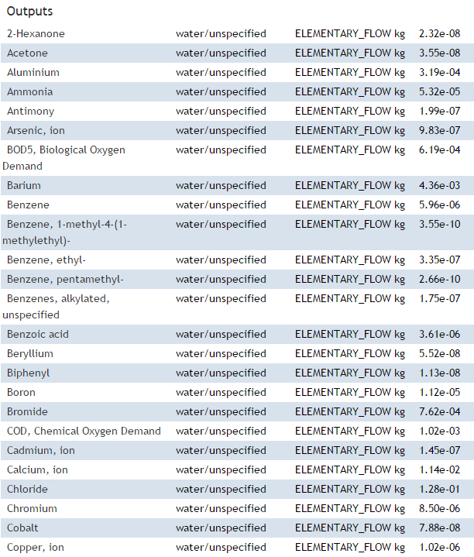
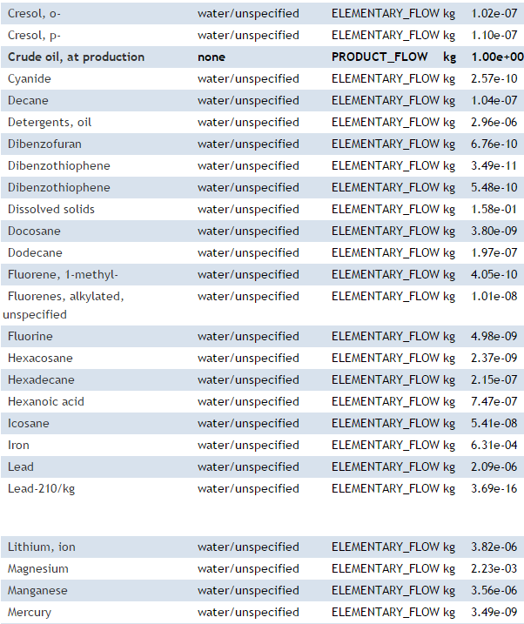
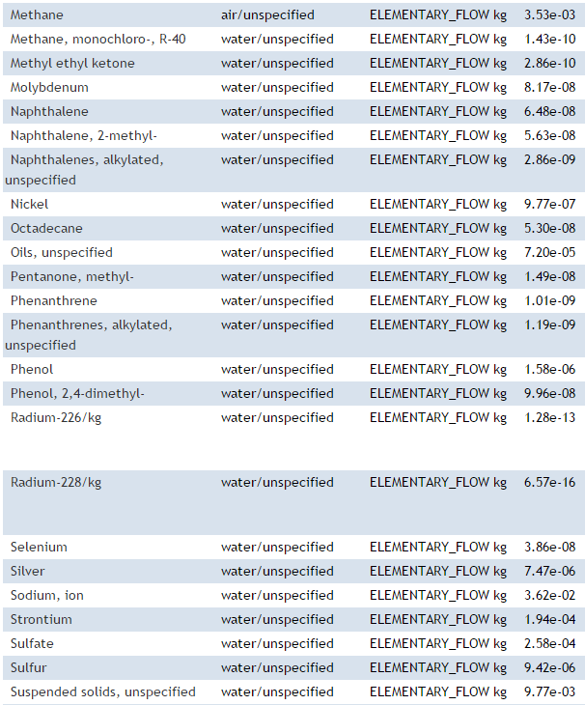
Example of Data Complexity (Output Inventory for Crude Oil from NREL LCI)

Slide 6
Common General LCA Software Tools
General LCA Software Tools
GaBi
SimaPro
Quantis Suite
Umberto
Generally fully featured with:
Uncertainty analysis
Parameterized models
Graphical model and results capabilities
More
Most widely used

Slide 7

GaBi
Ganzheitliche Bilanz, German for “holistic balance”
Paid software produced by PE International, free educational version available for students and teachers
GaBi has extensive database options including their own database and integration with external databases, such as ecoinvent, US LCI, etc.
Most data includes background information, reviews, etc.
Can pay their data team to collect data if needed
Users draw the life cycle “plan” as a flowchart, then calculate impacts
Software calculates results using sequential modeling
Includes i-report feature to produce reports with results
Single computer licenses only (“Buy one, Install one”*)
* http://www.gabi-software.com/america/support/gabi-faq/

Slide 8
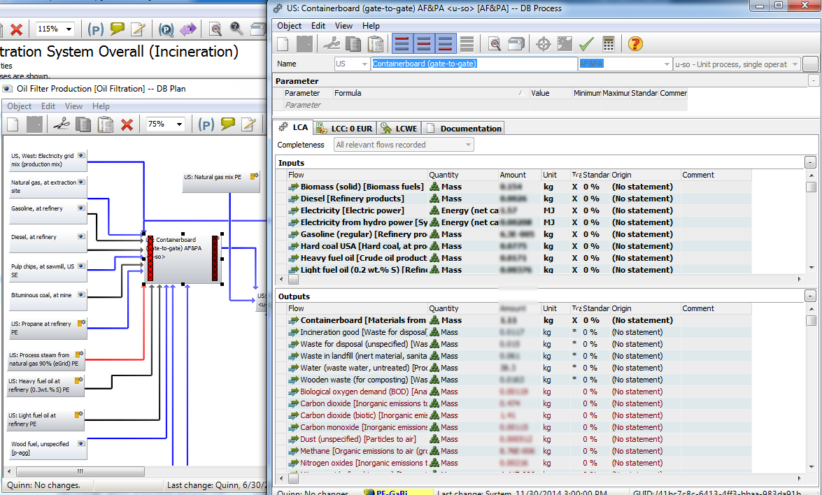
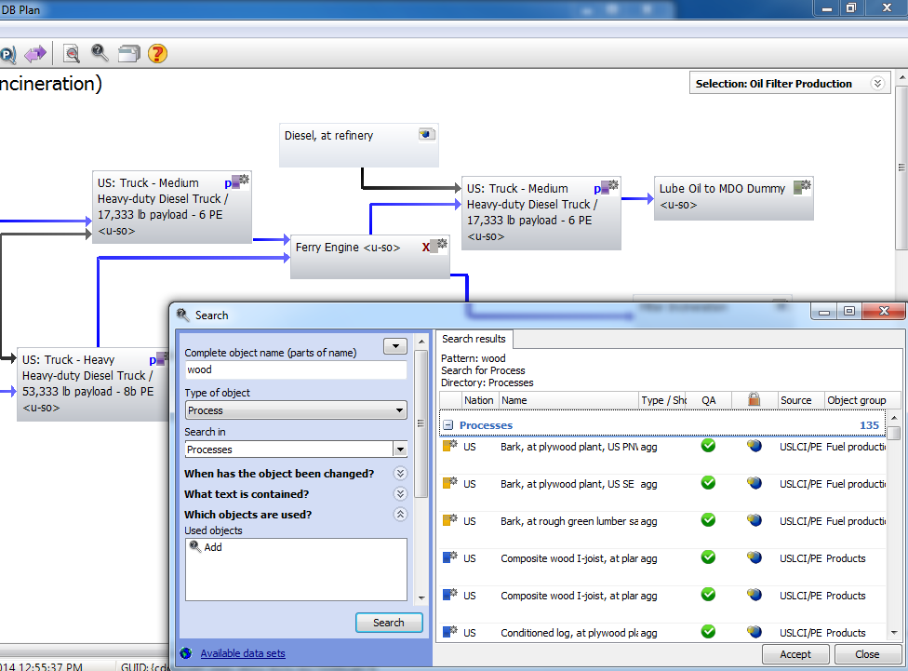
GaBi Input

Slide 9
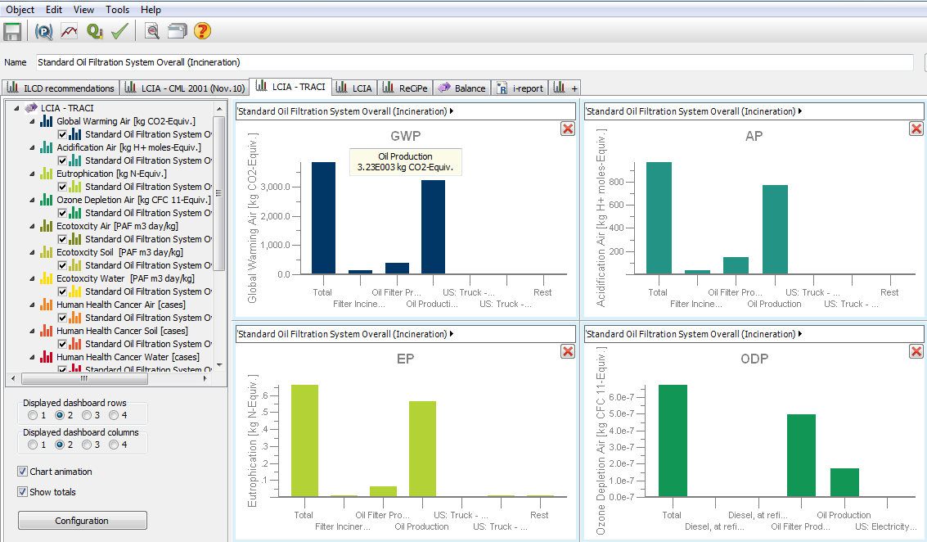
GaBi Output

Slide 10

SimaPro
Produced by PRé Consultants
Integrates with US LCI, ELCD, ecoinvent, and LCA food databases
Uses a more text/menu approach to modelling, rather than graphical approach
Though graphical flowcharts can be viewed following data input
Calculates results using matrix inversion
For use by professionals at two levels (Analyst or Developer)
Server based, convenient for multiple users and for remote connection
Appears to be more commonly used, and hence easier to share with others and find tutorial type information

Slide 11
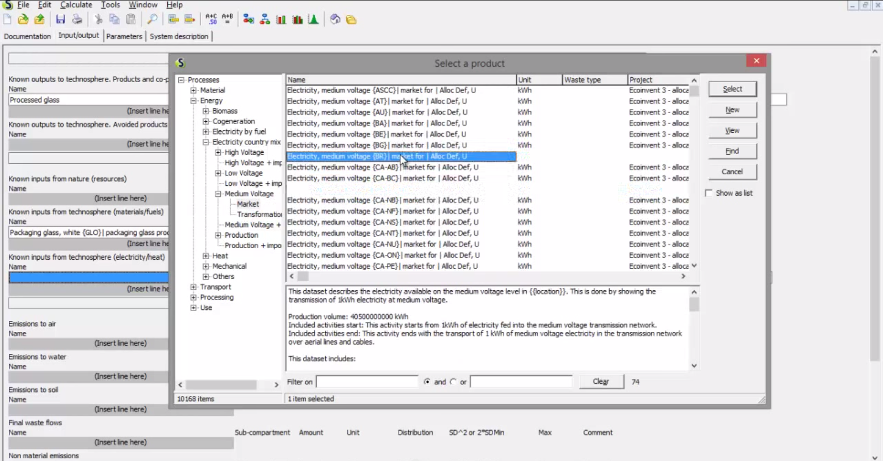
SimaPro Input
Davies, P. (2014). “LCA with SimpaPro8: Tutorial 2” YouTube, https://www.youtube.com/watch?v=czqbCs6hwuI

Slide 12
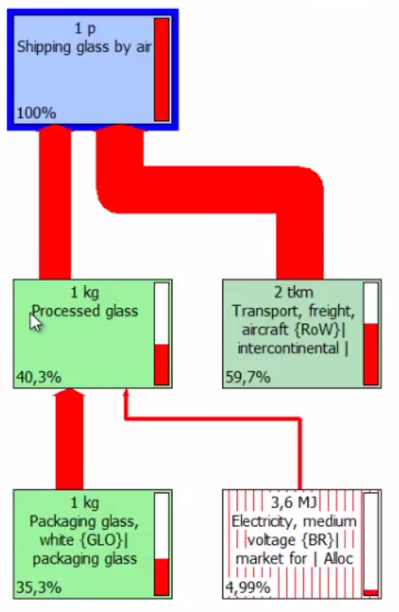
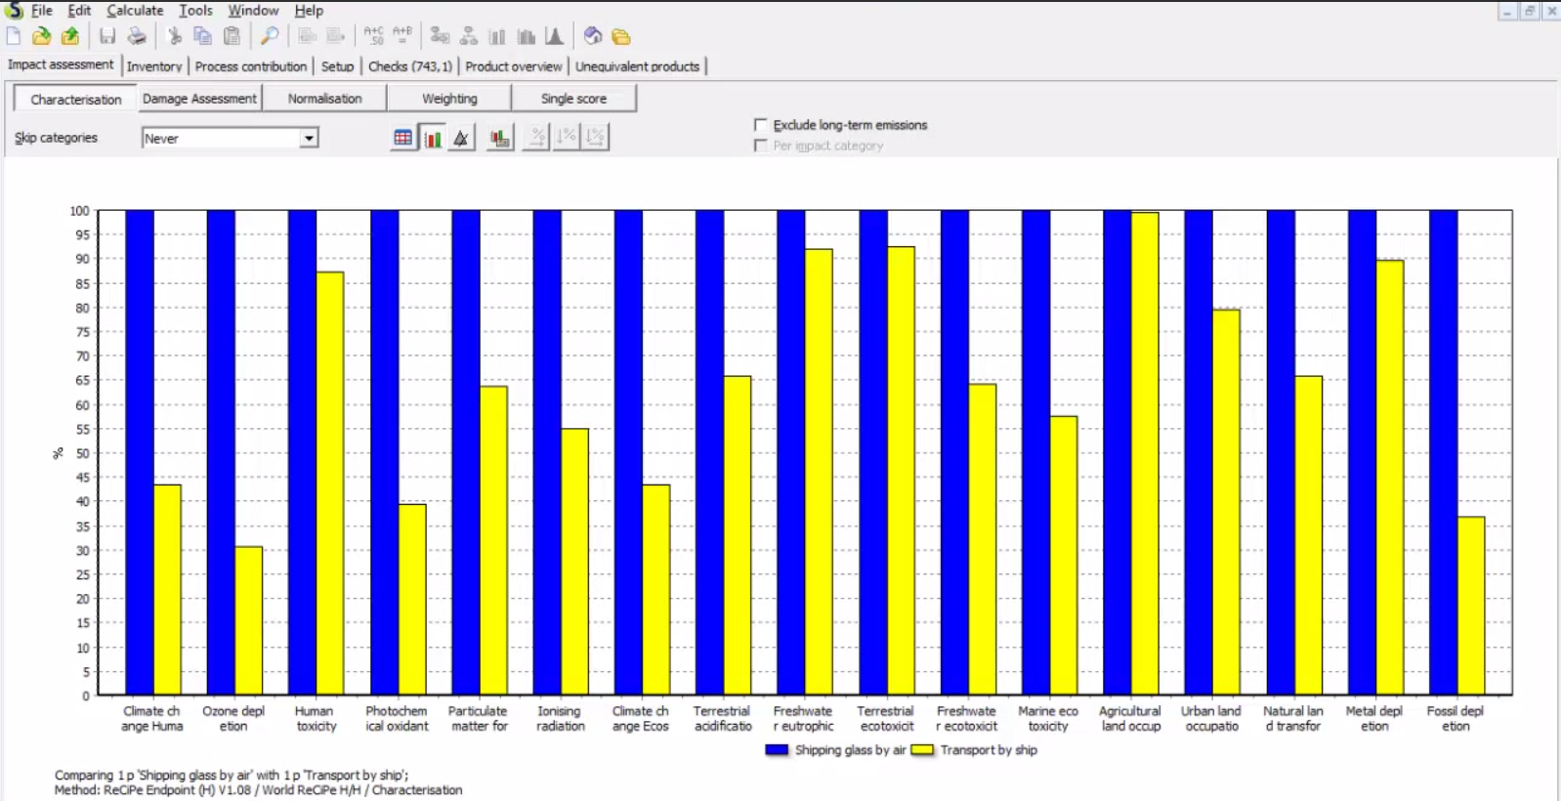
SimaPro Output
Davies, P. (2014). “LCA with SimpaPro8: Tutorial 3” YouTube, https://www.youtube.com/watch?v=yFFXumd4M6Y

Slide 13
Smaller Packages within GaBi and SimaPro
SimaPro
GaBi
EarthSmart is for evaluating the environmental impacts of a Product or Service life cycle
e-Dea is software that allows everyone to design with environmental awareness
PackageSmart is an LCA tool focused on packaging
LENS™ is a combined technology, software and expert services solution that allows organisations to manage their utility and environmental compliance costs
Superpac is a Pack design and Pallet loading software.
3Pillars is a Sustainability ROI (Return on Investment) evaluating your triple bottom line
GaBi Envision is the dedicated tool to design sustainable products and processes
GaBi Server supports LCA collaboration and is ideal for organisations with two or more LCA practitioners.
GaBi DfX is the professional software for compliance and sustainable product development with a view to the end of life phase

Slide 14
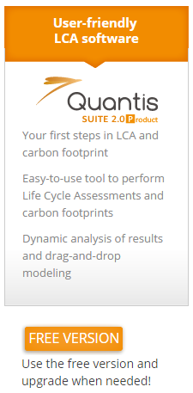
Quantis Suite
Web-based application
Integrates with ecoinvent 2.2 database
Model by phases, drag and drop inputs and processes to the stages. Manually choose quantities.
Free trial version available, must purchase full version
Includes ~400 of the total 4000 processes in ecoinvent
Includes IMPACT 2002+ impact methodology for five impact categories
Has partnered with SimaPro on some tools to expand distribution reach and resources
A few versions of the software available
Quantis Suite Product – LCAs according to ISO 14040 and carbon footprint
Quantis Suite Corporate – Carbon footprint focused, other environmental aspect tools
Quantis Impulsio – Ecodesign software

Slide 15
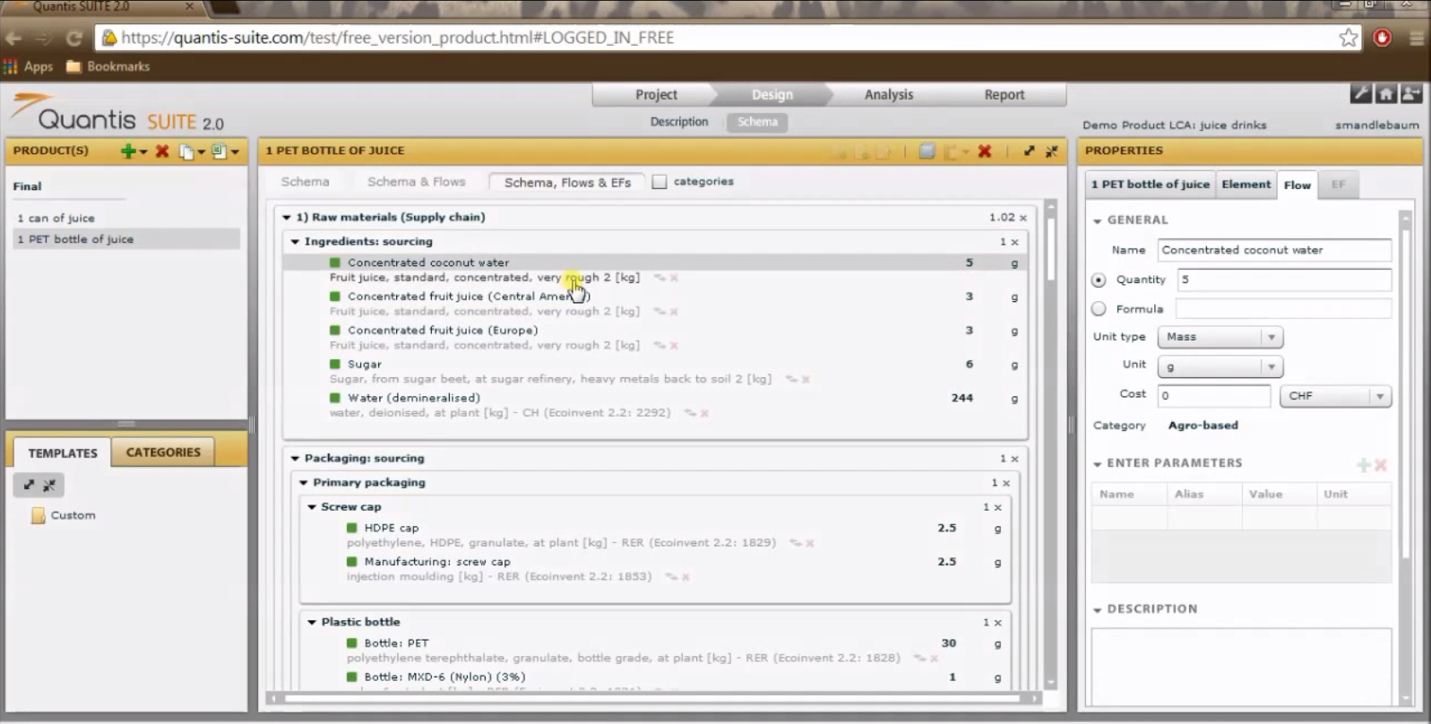
Quantis Suite Input
Quantis (2013). “QS Product Free 1 intro tour” YouTube, https://www.youtube.com/watch?v=QRHaD91rxwA

Slide 16
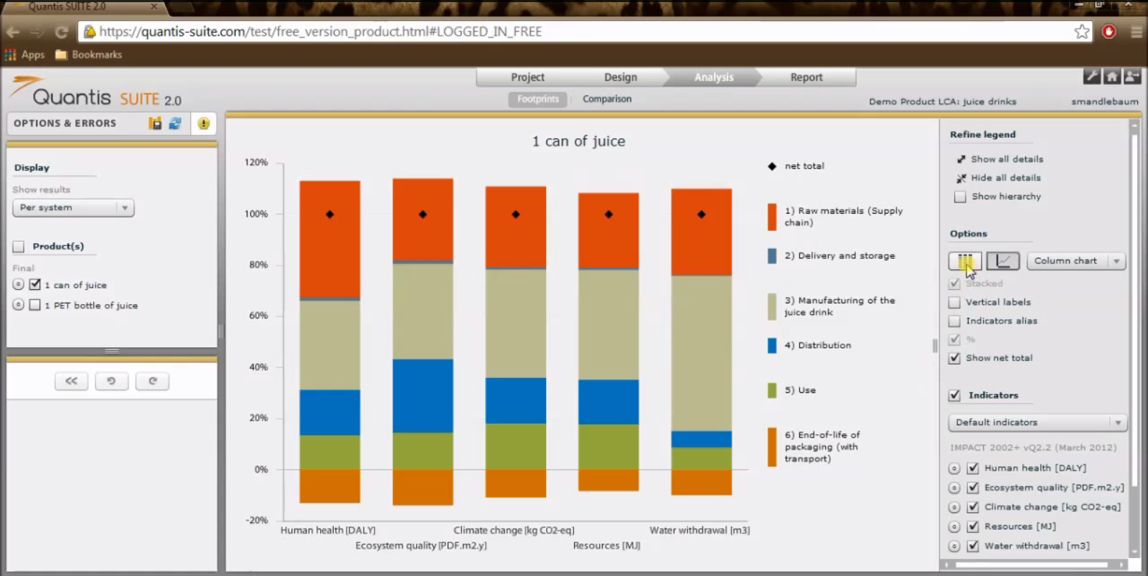
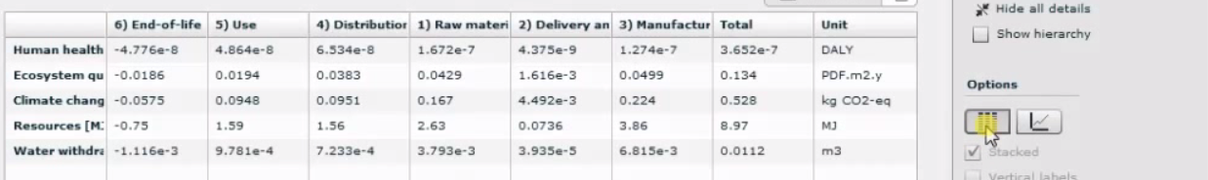
Quantis Suite Output
Quantis (2013). “QS Product Free 1 intro tour” YouTube, https://www.youtube.com/watch?v=QRHaD91rxwA

Slide 17


Umberto
Produced by ifu Hamburg
Integrate with ecoinvent 3 (included with software) and GaBi (separate purchase) databases
Frequent online web demos
Graphically oriented modelling approach featuring Sankey diagrams
Interfaces with Microsoft Excel and other Office programs
Multiple versions depending on needs
NXT Efficiency: Costs, materials, and energy
NXT LCA: Life cycle assessment
NXT CO₂: Carbon footprint only
NXT Universal: Combines environmental with cost and efficiency

Slide 18
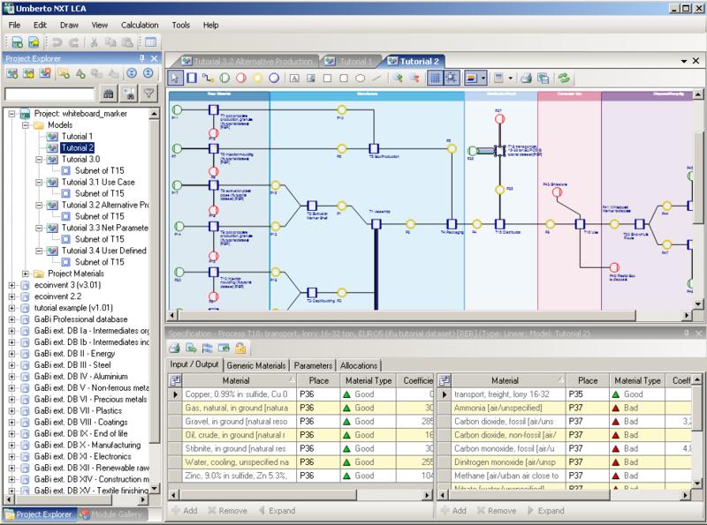
Umberto Input

Slide 19
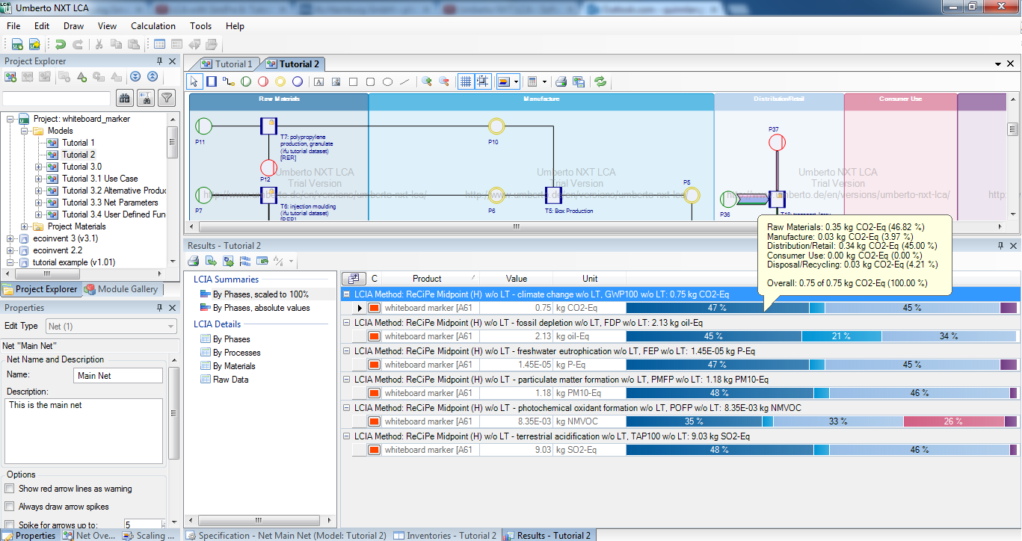
Umberto Output

Slide 20
Conclusion
Free Trial Links GaBi SimaPro Quantis Umberto
Most of these software options have similar features
Most have the ability to use data from multiple databases including ecoinvent and GaBi databases
Main differences seem to be in the user interfaces
Free trial versions are available for each to get a feel for their input and output style
There are a few differences in specific extra features such as ability to generate reports within the software, be used remotely, export to other programs, and have add-ons for specific goals
Cost of each software may vary and most require requesting a quote to see pricing structure
Bottom Line:
Each one accomplishes the main functionality of simplifying the process of a life cycle assessment, but may differ slightly in specialized capabilities and style of use

Slide 21
Thank you for completing Module G1!
Group A: ISO Compliant LCA Overview Modules
Group α: ISO Compliant LCA Detailed Modules
Group B: Environmental Impact Categories Overview Modules
Group β: Environmental Impact Categories Detailed Modules
Group G: General LCA Tools Overview Modules
Group γ: General LCA Tools Detailed Modules
Group T: Transportation-Related LCA Overview Modules
Group τ: Transportation-Related LCA Detailed Modules

Slide 22
Self-Assessment Quiz
MODULE G1: General Paid LCA Tools

Slide 23
Which of these can be an advantage of using software to handle an LCA over doing one by hand?
Prevent computational errors
Increase capabilities
Reduce time needed to carry out the assessment
All of the above

Slide 24
Correct!
There are many advantages of using software to help compute LCA results, though those covered here must be purchased and may require a learning curve.

Slide 25
Which software tool produces and features their own database for their tool?
GaBi
SimaPro
Quantis Suite
Umberto

Slide 26
Correct!
PE international produces its own databases for GaBi while the other tools tend to rely more on third-party data sources. All of the softwares can use data from other sources like ecoinvent and the US LCI.

Slide 27
Which software tool operates exclusively as an online platform?
GaBi
SimaPro
Quantis Suite
Umberto

Slide 28
Correct!
Quantis Suite is the only tool covered that operates as a web-based tool. The other software options have various ways to connect over the internet, but are based on a computer or server.

Slide 29
Is there only one version of each software or multiple options to choose from?
Only one version of each
Multiple options

Slide 30
Correct!
Each tool has either different versions or add-on packages for specific tasks and goals, depending on the needs of the assessment (e.g. CO₂ only, costs in addition to LCA, etc.)

Slide 31
Which software tool offers a free trial version?
GaBi
SimaPro
Quantis Suite
Umberto
All of the above

Slide 32
Correct!
All of these offer free trial versions so you can explore the interface and features of each tool for yourself. Links to the free trial pages are on the conclusion slide (slide 20).

Slide 33
Sorry that’s Incorrect
Please try again!

