Slide 1

Welcome to the Life Cycle Assessment (LCA) Learning Module Series
Liv Haselbach Quinn Langfitt
For current modules email haselbach@wsu.edu or visit cem.uaf.edu/CESTiCC
Acknowledgements:
CESTiCC Washington State University Fulbright

Slide 2
LCA Module Series Groups
Group A: ISO Compliant LCA Overview Modules
Group α: ISO Compliant LCA Detailed Modules
Group B: Environmental Impact Categories Overview Modules
Group β: Environmental Impact Categories Detailed Modules
Group G: General LCA Tools Overview Modules
Group γ: General LCA Tools Detailed Modules
Group T: Transportation-Related LCA Overview Modules
Group τ: Transportation-Related LCA Detailed Modules

Slide 3
Impact Assessment Methodologies
Module β9

Slide 4
Impact Assessment Methodology is Part of LCIA
Set of characterization factors for converting inventory flows into environmental impacts
May include normalization and weighting schemes
Some midpoint, some endpoint, some both,
some distance-to-
target
Various geographic
and temporal coverage
Different science to
inform factors
Characterization
Classification
LCIA
Mandatory Elements
Impact category selection (Comprehensive set)
Category indicator selection
Characterization model selection (impact methodology)

Slide 5
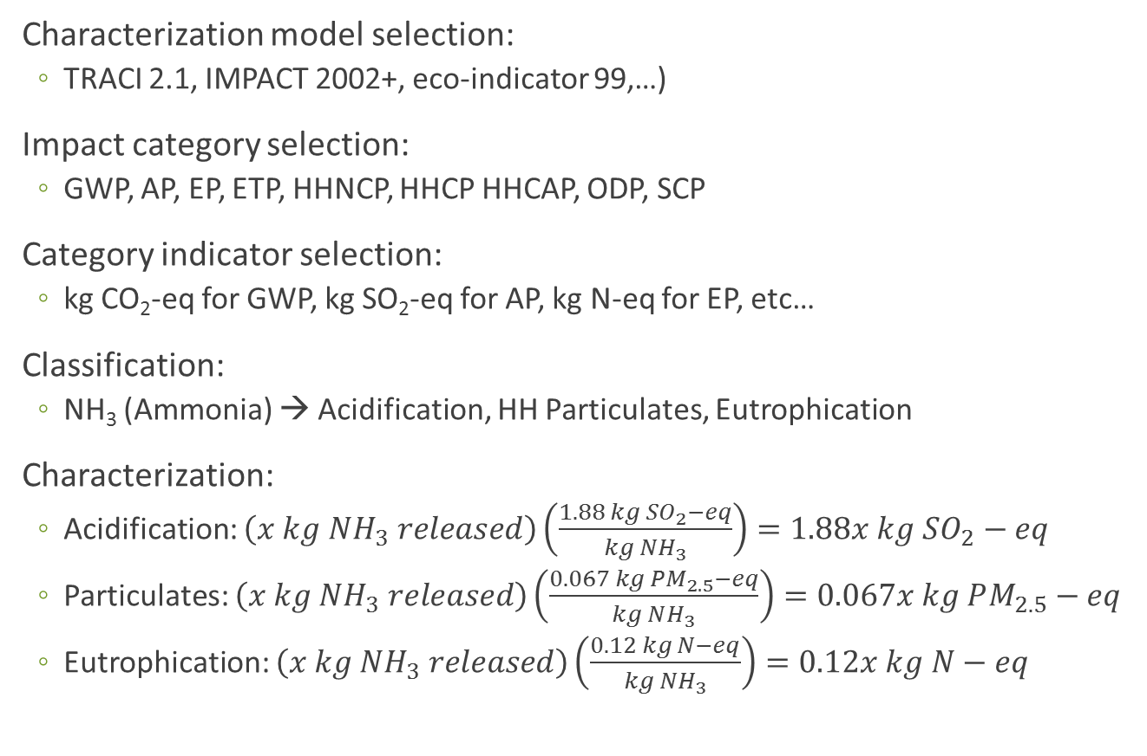
LCIA Sample Procedure
Impact Methodology Affects These!
Characterization model selection:
  TRACI 2.1, IMPACT 2002+, eco-indicator 99,…)
Impact category selection:
  GWP, AP, EP, ETP, HHNCP, HHCP HHCAP, ODP, SCP
Category indicator selection:
  kg CO₂-eq for GWP, kg SO₂-eq for AP, kg N-eq for EP, etc…
Classification:
  NH₃ (Ammonia) → Acidification, HH Particulates, Eutrophication
Characterization:
  Acidification: $\left(x kg NH_{3} released\right)\left(\frac{1.88 kg SO_{2}−eq}{kg NH_{3}}\right)=1.88x kg SO_{2}−eq$
  Particulates: $\left(x kg NH_{3} released\right)\left(\frac{0.067 kg PM_{2.5}−eq}{kg NH_{3}}\right)=0.067x kg PM_{2.5}−eq$
  Eutrophication: $\left(x kg NH_{3} released\right)\left(\frac{0.12 kg N−eq}{kg NH_{3}}\right)=0.12x kg N−eq$
Repeat for each flow, sum results in each impact category
Characterization factor

Slide 6
Impact Assessment Methodologies
Three main schools of thought for assessing impacts
  Distance-to-Target
  Midpoint
  Damage
Average update frequency around 5-10 years for most methodologies that have received updates
Methodologies more than 10 years old are “no longer likely to reflect the state of the art“ (Margni and Curran 2012).
Some newer methodologies build off of older ones, combining features and indicators with updates
  e.g. ReCiPe, IMPACT 2002+, and IMPACT world+
One criticism of LCIA (and LCA by extension) is that the wide variety of impact methodologies leads to variability in results which use different methods
  Variability might make results less trustworthy for use in decisions
Margni, M., and Curran, M. (2012). “Life cycle Impact Assessment.” In Life Cycle Assessment Handbook : A Guide for Environmentally Sustainable Products, John Wiley and Sons, Hoboken, NJ.

Slide 7

Listing of Impact Assessment Methodologies
Covered in this module
Eco-indicator 99
Impact 2002+
LUCAS
LIME 2
TRACI
IMPACT World⁺
CML-IA
Some others*
Volumes Critiques
EPS 2000
EDIP 2003
Ecological Scarcity 2006
MEEuP
ReCiPe
ILCD Handbook
Schools of Thought Key
Mid
&
End
Midpoint
Endpoint
Distance-to-Target
*Still more may exist that were not included in either list

Slide 8

CML-IA
Produced by the Institute of Environmental Science (CML)
at University of Leiden, Netherlands
Last update 2015 (first released 1992)
Global average cover, except acidification and smog (Europe)
Midpoint indicators only
Method includes own characterization factors as well as integrating factors from other methodologies/studies for sensitivity analysis
All characterization factors downloadable from: www.cml.leiden.edu/software/data-cmlia.html
Normalization data provided for all impact categories (inventories and category indicators) for:
  Netherlands: 1997-1998
  West Europe: 1995
  World: 1990, 1995, 2000
  European Union: 25+3 2000
Logo: en.wikipedia.org

Slide 9
CML-IA Impact Categories Covered
Abiotic resource depletion (fossil fuels and elements, separately)
Land Competition
Global Warming (20, 100, 500 yr)
Ozone Layer Depletion (some time dependent factors as well as time independent)
Human Toxicity
Aquatic Ecotoxicity (freshwater and marine, separately)
Aquatic Sedimental Ecotoxicity (freshwater and marine, separately)
Terrestrial Ecotoxicity
Photochemical oxidation (high and low NOx regimes, separately)
Acidification
Eutrophication
Radiation
Odor

Slide 10
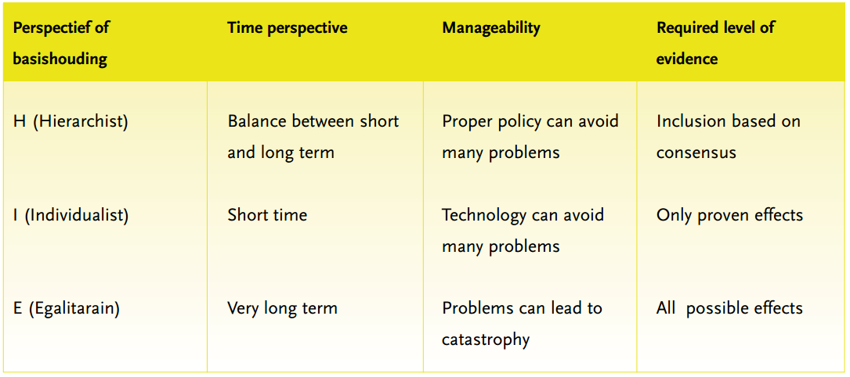
Eco-Indicator 99
Developed by Pré
Endpoint methodology
  “Damage oriented method for Life Cycle Impact Assessment”*
Global coverage for climate change, ozone depletion, and resources. European for all others.
Last updated 2001 (it seems)
Three sets of factors for different perspectives
  Individualist (short time scale)
  Hierarchist (moderate time scale, default)
  Egalitarian (very long time scale)
Method requires weighting and includes factors
  From 365 person Swiss LCA interest group panel
*www.pre-sustainability.com/download/EI99_Manual.pdf

Slide 11
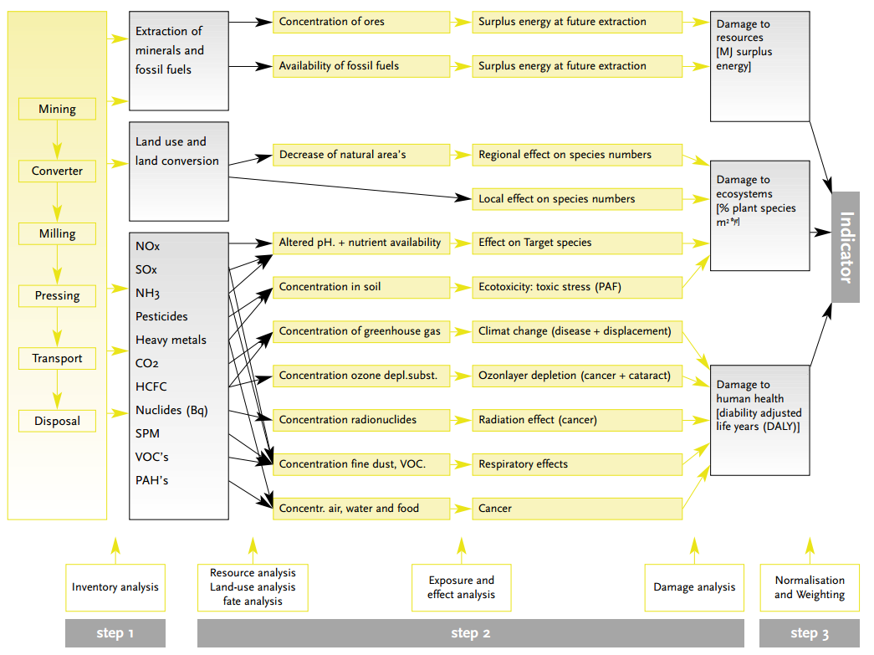
Eco-Indicator
99
Three step calculation
  Inventory
  Damages
  Weighting
Available results are damage
to resources, ecosystems, and human health (separately) from each impact category, and the “indicator”
Indicator is based on weighted results and unit is “points”
1 point≈1/1000 annual per capita European environmental loading
*www.pre-sustainability.com/download/EI99_Manual.pdf

Slide 12

TRACI
Developed by the US Environmental Protection Agency
Tool for the Reduction and Assessment of Chemical and other environmental Impacts
Most recent version is TRACI 2.1 released in 2012
Midpoint method
Geographic coverage is the United States
  As a whole
  On a state-by-state or regional basis for some impact categories (acidification, smog creation, eutrophication)
External normalization data provided for US by Bare et al. 2006, more recently Ryberg et al. 2014 provides normalization references using TRACI 2.1
Website: www.epa.gov/nrmrl/std/traci/traci.html
Can get spreadsheet with factors for TRACI 2.1 externally from here.
Logo source: epa.gov

Slide 13
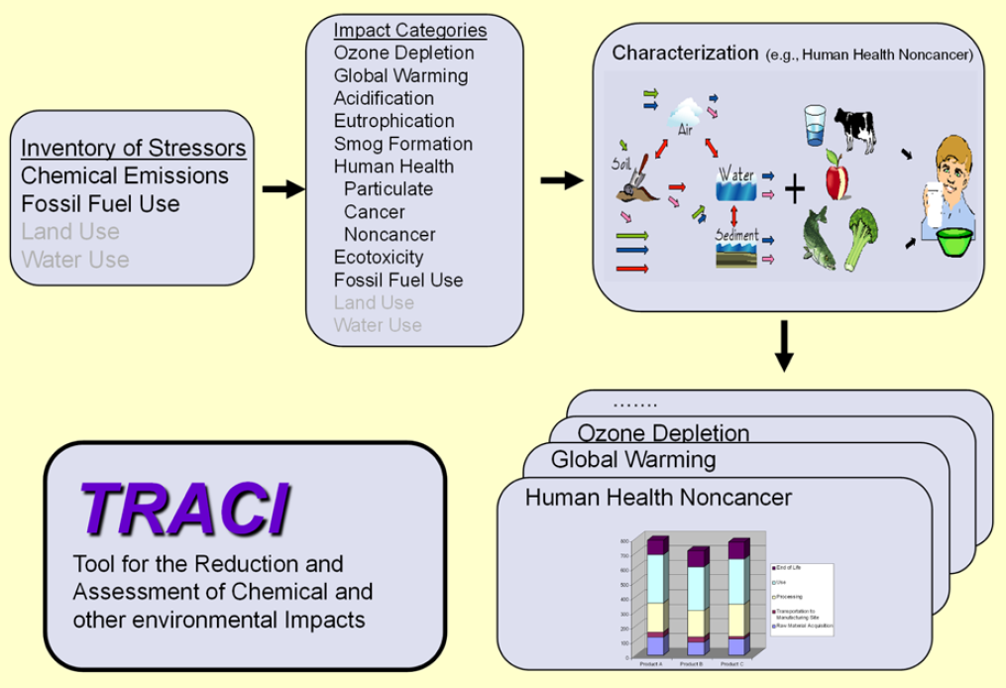
TRACI Impact Categories
Acidification
Ecotoxicity
Eutrophication
Fossil fuel depletion
Global warming
Human health cancer
Human health non-cancer
Human health criteria air pollutants
Ozone depletion
Smog formation
Source: https://www.pre-sustainability.com/download/TRACI_2_1_User_Manual.pdf

Slide 14

IMPACT 2002+
Developed by the Swiss Federal Institute of Technology – Lausanne (EPFL)
Released in 2003
IMPact Assessment of Chemical Toxins
Both midpoint and endpoint characterization
European geographic coverage
Normalization factors (annual per capita) included for Europe for 2000
Original characterization factors for ecotoxicity and human toxicity, others borrowed from other impact methodologies including:
  Eco-indicator 99
  CML 2001
Project page here.
Image source: plus.google.com

Slide 15
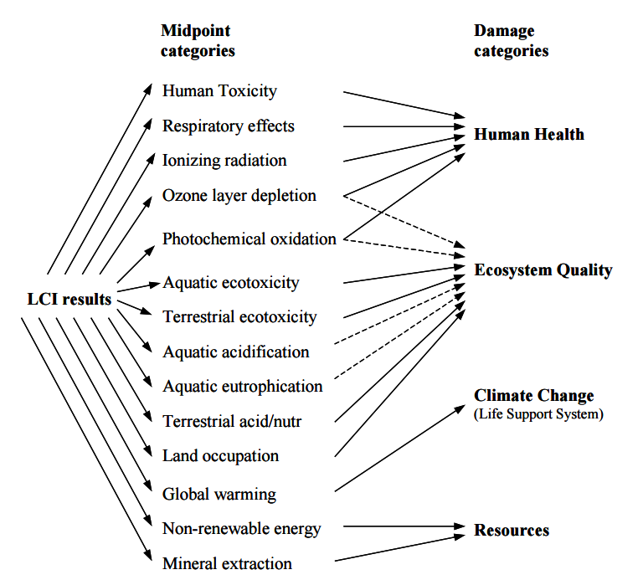
IMPACT 2002+
Categories
eplca.jrc.ec.europa.eu/uploads/ILCD-Handbook-LCIA-Background-analysis-online-12March2010.pdf

Slide 16
LIME
Developed by the National Institute of Advanced Industrial Science and Technology (AIST) in Japan
Life-cycle Impact assessment Method based on Endpoint modelling
Originally published in 2005, updated to LIME2 in 2012
Geographic coverage: Japan
Midpoint and endpoint modelling
Endpoint based on damages, then at final stage by economic valuation
Includes many midpoint impact categories not commonly found in other impact methodologies, such as indoor air quality and noise
  At endpoint level, includes social assets in addition to human and ecosystem health
More information about LIME2 here

Slide 17
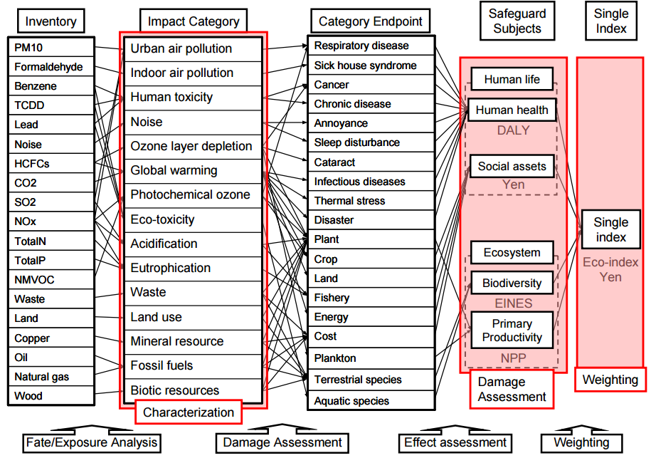
LIME2
Scheme
eplca.jrc.ec.europa.eu/uploads/ILCD-Handbook-LCIA-Background-analysis-online-12March2010.pdf

Slide 18
LUCAS
Developed by CIRAIG (http://www.ciraig.org/en/)
LCIA method Used for a CAnadian-Specific context
Published in 2007
Midpoint results only at this time, endpoint (“damage categories”) expected to be added in future
Geographic coverage: Canada
Based on previously existing methodologies with parameterized updates to make characterization factors Canadian-specific, including
  TRACI
  IMPACT 2002+
  EDIP 2003
Normalization factors to Canadian per capita impacts included in methodology
More information about LUCAS in: Toffoletto et al. (2007). “LUCAS – A New LCIA Method Used for a CAnadian-Specific Context.” Int. J. of LCA, 12(2), 93-102.

Slide 19
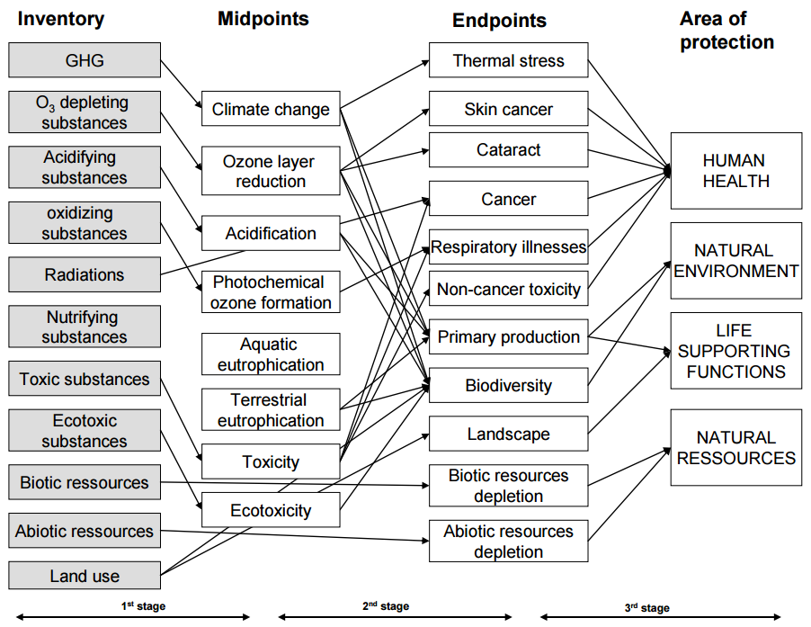
LUCAS Impact
Categories
It appears that only
midpoints have been
characterized as of the
time of this module’s
publication

Slide 20
IMPACT World⁺
Developed in 2012 by a consortium of groups including
  CIRAIG, Polytechnique Montréal
  Technical University of Denmark (DTU)
  University of Michigan, Ann Arbor
  Quantis International
  École Polytechnique de Lausanne (EPFL)
Meant to be customizable to the following geographic resolutions for these impact categories
  Global
  Continental (nine global regions)
  Country
  Fine resolution (e.g. sub-watershed or ecoregion)
Midpoint and endpoint indicators
Website: http://www.impactworldplus.org/en/index.php
Respiratory Effects
Human Toxicity
Eco-toxicity
Ionizing Radiation
Water Use
Acidification
Land Use
Eutrophication

Slide 21
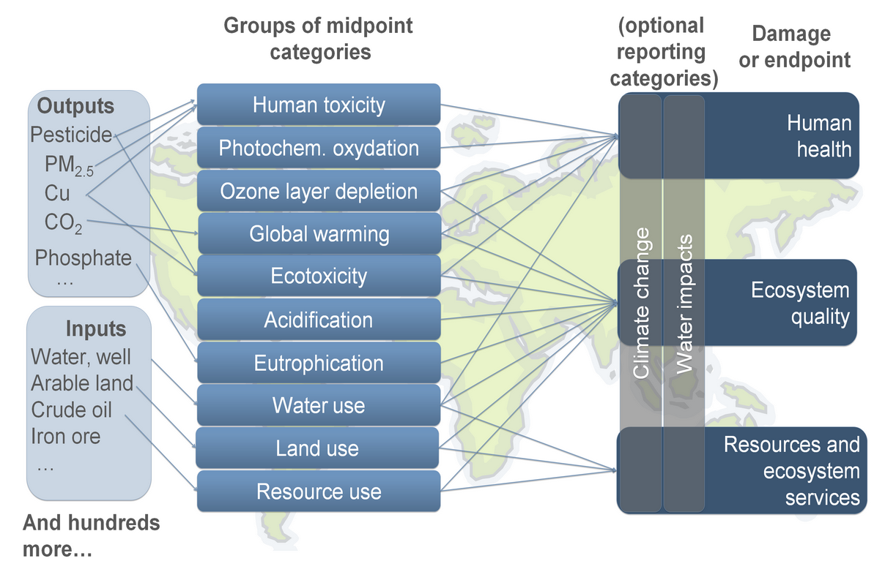
IMPACT
World⁺
^{Categories}
Short term and long term for some impact categories at endpoint (e.g. global warming)
Source: http://www.impactworldplus.org/en/

Slide 22
Thank you for completing Module β9
Group A: ISO Compliant LCA Overview Modules
Group α: ISO Compliant LCA Detailed Modules
Group B: Environmental Impact Categories Overview Modules
Group β: Environmental Impact Categories Detailed Modules
Group G: General LCA Tools Overview Modules
Group γ: General LCA Tools Detailed Modules
Group T: Transportation-Related LCA Overview Modules
Group τ: Transportation-Related LCA Detailed Modules

