Slide 1

Welcome to the Life Cycle Assessment (LCA) Learning Module Series
Liv Haselbach Quinn Langfitt
For current modules email haselbach@wsu.edu or visit cem.uaf.edu/CESTiCC
Acknowledgements:
CESTiCC Washington State University Fulbright

Slide 2
LCA Module Series Groups
Group A: ISO Compliant LCA Overview Modules
Group α: ISO Compliant LCA Detailed Modules
Group B: Environmental Impact Categories Overview Modules
Group β: Environmental Impact Categories Detailed Modules
Group G: General LCA Tools Overview Modules
Group γ: General LCA Tools Detailed Modules
Group T: Transportation-Related LCA Overview Modules
Group τ: Transportation-Related LCA Detailed Modules

Slide 3
Human Health Particulate Matter
It is suggested to review Modules B1 and B3 prior to this module
Module β7

Slide 4
Summary of Module B1 and Other Points
All impacts are “potential”
Only anthropogenic sources are included
Different substances have different relative amounts of forcing
Usually results are related to the equivalent release of a particular substance
Different impact categories have different scales of impacts
Global, regional, local
Watch Module B1 for background
Module B3 includes a brief overview of human health particulates potential

Slide 5

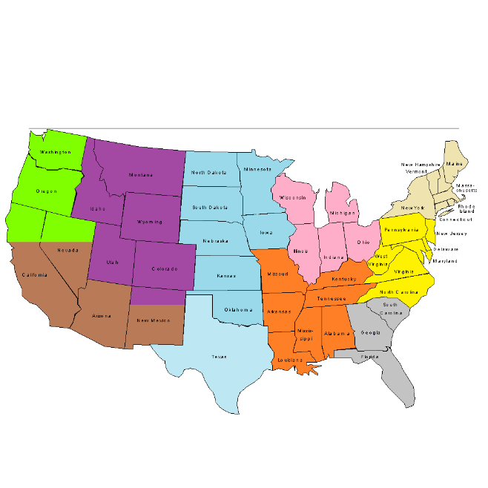

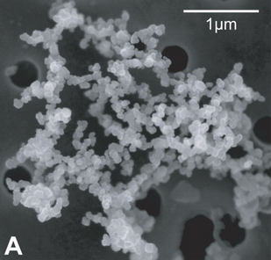
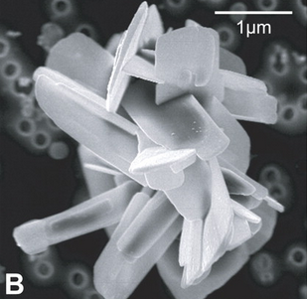
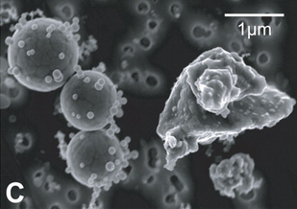
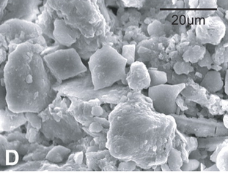
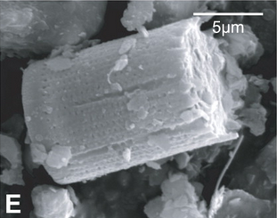
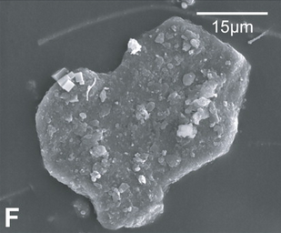
Human Health – Particulates
Scale of impacts:
Health issues related to increased respiration of very small particles
Small particles released directly and formed through secondary reactions
Both solids and liquid droplets
When breathed into lungs may cause respiratory disease and cancer
Category also called “criteria air pollutants”, but really only deals with subset
This category doesn’t deal with toxicity related to the specific substances
Only based on the size of the particles, not their composition
Therefore, less uncertainty about impacts since studying particulate matter inhalation is more straightforward than human health impacts from chemicals
Local
Regional
Global
Images source: http://elements.geoscienceworld.org/content/6/4/215/F5.large.jpg

Slide 6
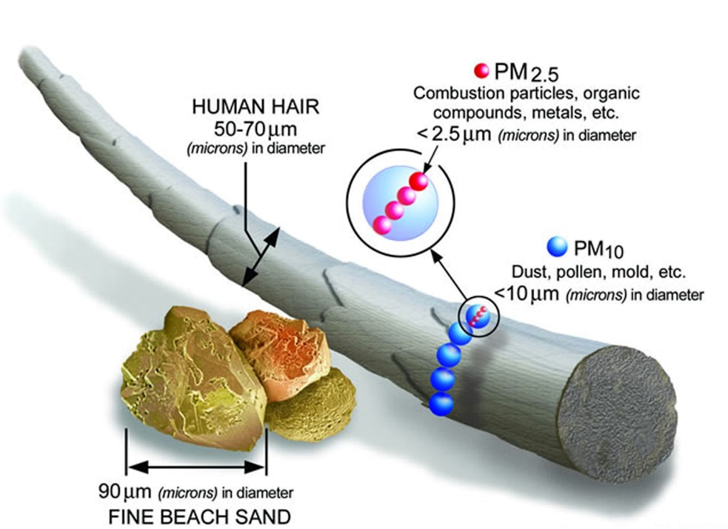
Size classifications
Particulates classified based on diameter
Since not perfect spheres, actually based on “hydraulic diameter”
μm is micrometer (or micron) and equals 10⁻⁶ m
Coarse PM: 10 μm to 40 μm
Too large to significantly penetrate respiratory system
PM₁₀: 2.5 μm to 10 μm
May get into upper respiratory system
PM_{2.5}: 0.1 μm to 2.5 μm
May get deep into lungs
Ultrafine PM: <0.1 μm
May penetrate cell walls
Increasing Human Health Effect
Image source: epa.gov

Slide 7
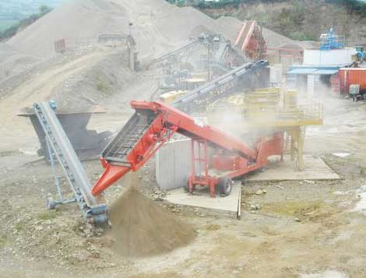
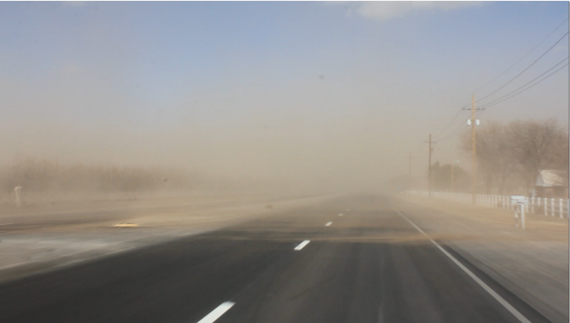
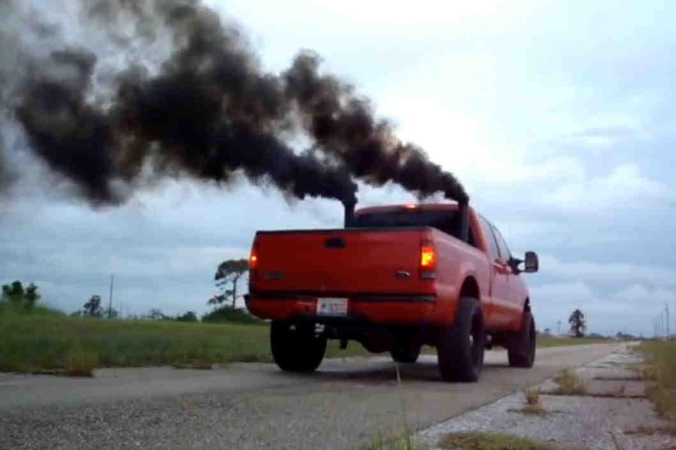
Formation of Particulate Matter (PM)
Materials handling
Crushing
Loading bulk materials
Grinding
Wind-blown dust and dirt
Combustion
Ash (incombustible material)
Soot (incompletely combusted material)
Formation from gases
SO₂
NO₂
NH₄
VOCs
Primary particulate matter
Directly released as PM
Secondary particulate matter
PM formed from non-PM precursors
Top: oregrinder.com Middle: senmwx.com

Slide 8
Secondary Formation
Secondary formation from gases is a major contributor to PM_{2.5}
Depends on atmospheric conditions
Seasonal variation in ability to form secondary PM through various pathways
NO_{x} and SO_{x} require oxidants and water vapor, so more active in the summer
NH₃ can form ammonium nitrate and ammonium sulfate mostly in the winter
Therefore, emission source profiles and climate/temperature influence secondary PM formation
Sample pathway for NO_{x}:
Mostly mobile sources
Mostly agricultural sources
NO_{x}
Nitric Acid
Reactions with other chemicals
Secondary PM

Slide 9
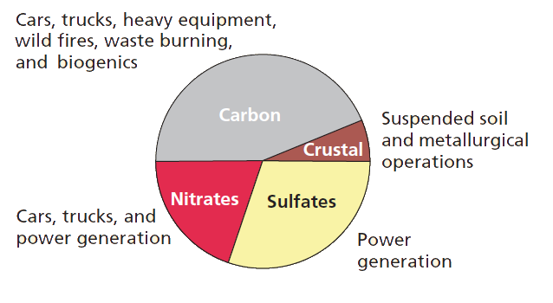
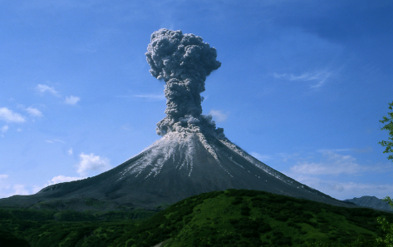
Sources
Natural Sources
(not counted in LCA)
Volcanoes
Forest fires
Windstorms
Pollen
Ocean spray
egu.eu
Figure source: EPA. “Understanding Particle Pollution.” www.epa.gov/airtrends/aqtrnd04/pmreport03/pmunderstand_2405.pdf

Slide 10
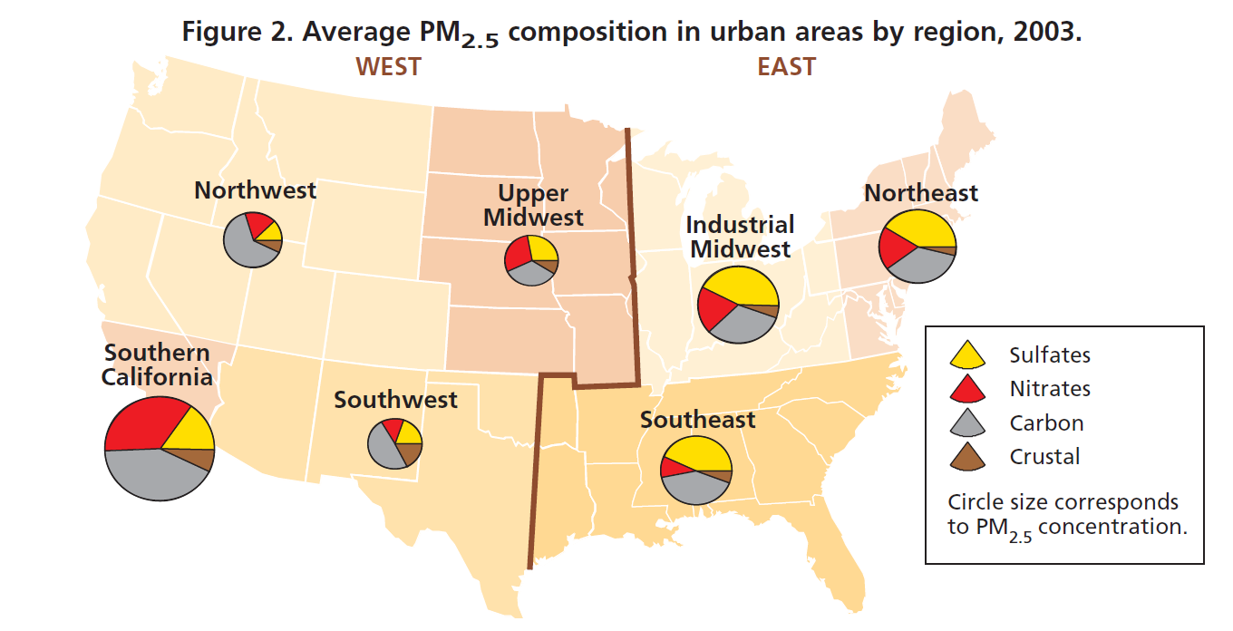
Composition of Particulate Matter By US Region
Figure source: EPA. “Understanding Particle Pollution.” www.epa.gov/airtrends/aqtrnd04/pmreport03/pmunderstand_2405.pdf

Slide 11
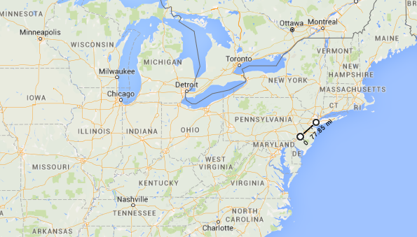
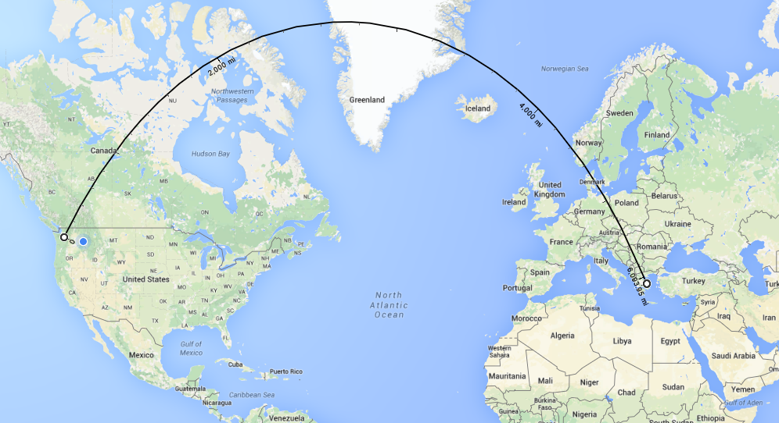
Transport
Larger particles settle out relatively quickly
Minutes to days in the atmosphere
<100 km travel range
Smaller particles can stay airborne longer and travel a long way in the wind
Days to weeks in the atmosphere
About 100-10,000 km range
This is one reason why there are multiple scales of impacts
~100 km
~10,000 km

Slide 12
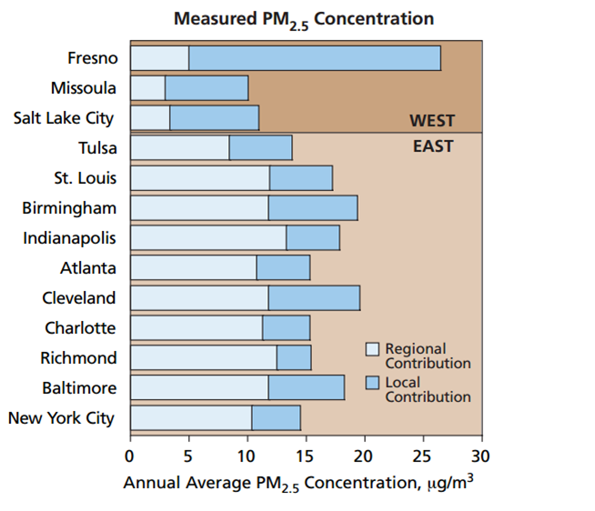
Local and Regional Source Contributions
The US EPA compared contributions from local and regional sources
Substantial portions of average concentrations from each source scale
More regional sources in the Eastern US
Power plants
Consistently high population density
High proportion local source in Western
Figure source: EPA. “Understanding Particle Pollution.” www.epa.gov/airtrends/aqtrnd04/pmreport03/pmunderstand_2405.pdf

Slide 13
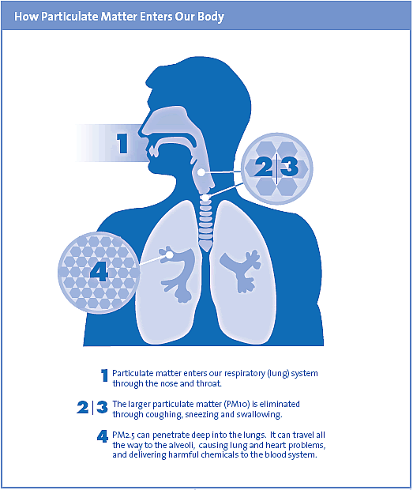
Human Health Effects
Both short term and long term effects
Short-term
Decreased lung function
increased respiratory symptoms
Cardiac arrhythmias
Heart attacks
Premature death
Long-term
Decreased lung function
Chronic bronchitis
Lung cancer
Premature death
Some populations more susceptible than others
People with heart/lung disease, elderly, and children
Image source: bcairquality.ca

Slide 14
Quantified Mortality Risk from Particulate Matter Exposure (Pope III et al. 2002)
Pope III et al. (2002) studied long-term exposure
Sample size of 500,000 adults over 30 years old from all 50 US states
Corrected for age, sex, race, weight, height, smoking history, alcohol use, occupational exposures, diet, education, and marital status
Assessed mortality from three causes: all-cause, cardiopulmonary, and lung cancer compared with PM exposure
Findings
PM_{2.5}
All-cause
Cardiopulmonary
Lung Cancer
10 μg/L
4%
6%
8%
10 μg/L
Pope III, C. A., Burnett, R. T.,…& Thurston, G. D. (2002). Lung cancer, cardiopulmonary mortality, and long-term exposure to fine particulate air pollution. Jama, 287(9), 1132-1141.

Slide 15
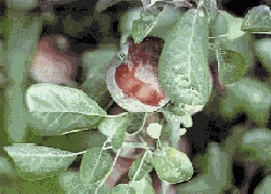
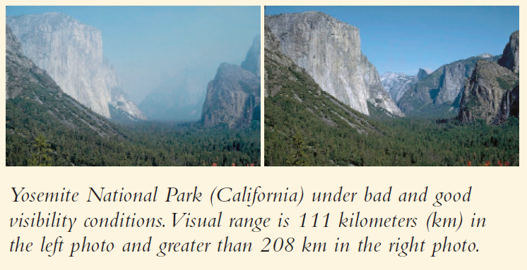
Other Effects of Particulates
Ecosystem and built environment effects are not included in this category for LCA
Only impacts on human health
Particle pollution also may affect
Reduced visibility (such as at national parks)
Affects vegetation and ecosystems, by settling on soil and water
Damage to man-made structures
Cement kiln dust on apple leaves
Leaves: omafra.gov.on.ca Visibility: EPA. “Understanding Particle Pollution.” www.epa.gov/airtrends/aqtrnd04/pmreport03/pmunderstand_2405.pdf

Slide 16
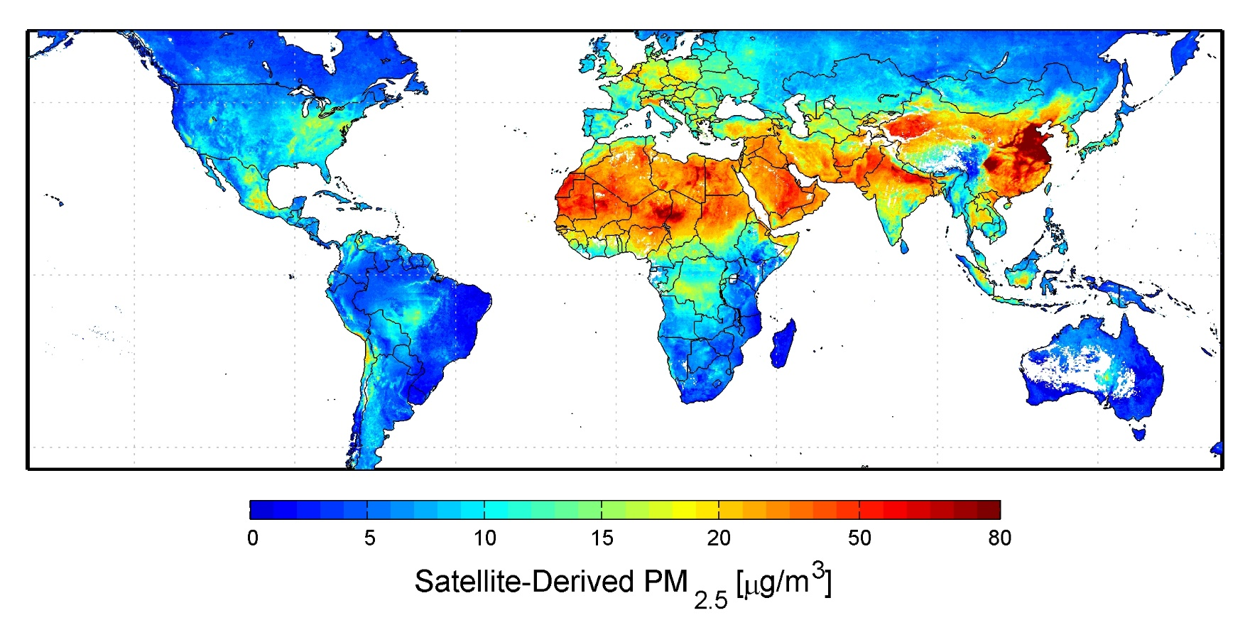
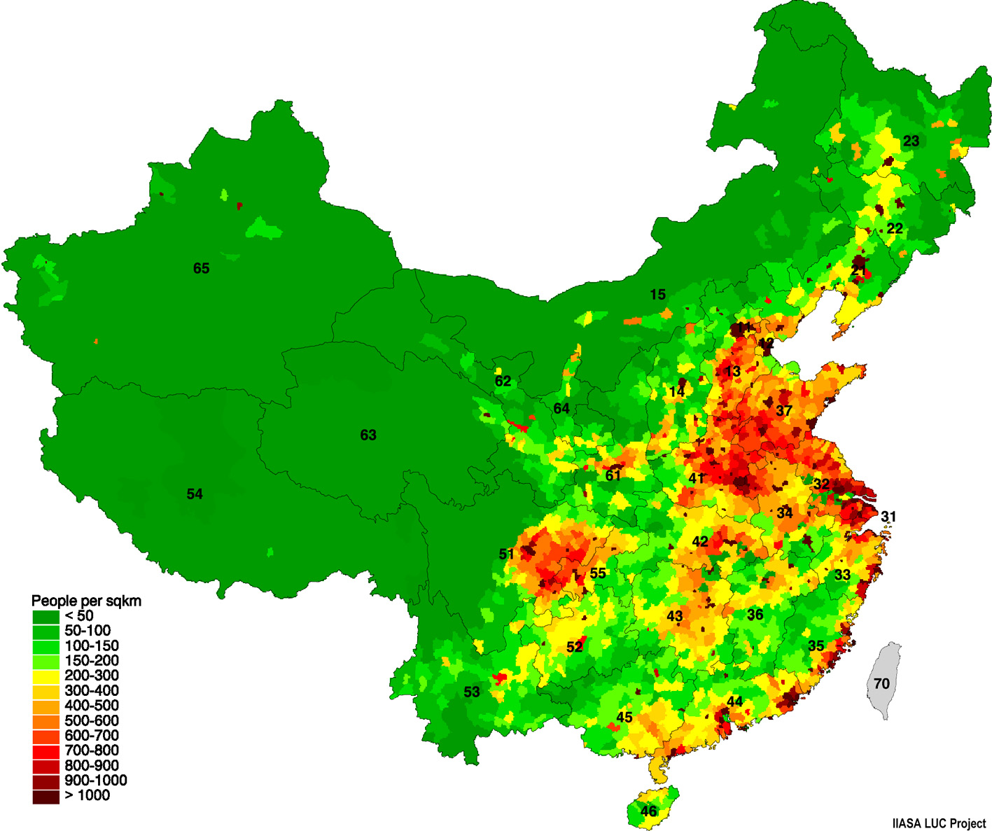
Where are there issues with PM in the world?
Population Density Map of China
(averaged over 2001-2006)
PM_{2.5} map: nasa.gov China pop density: china-food-security.org

Slide 17
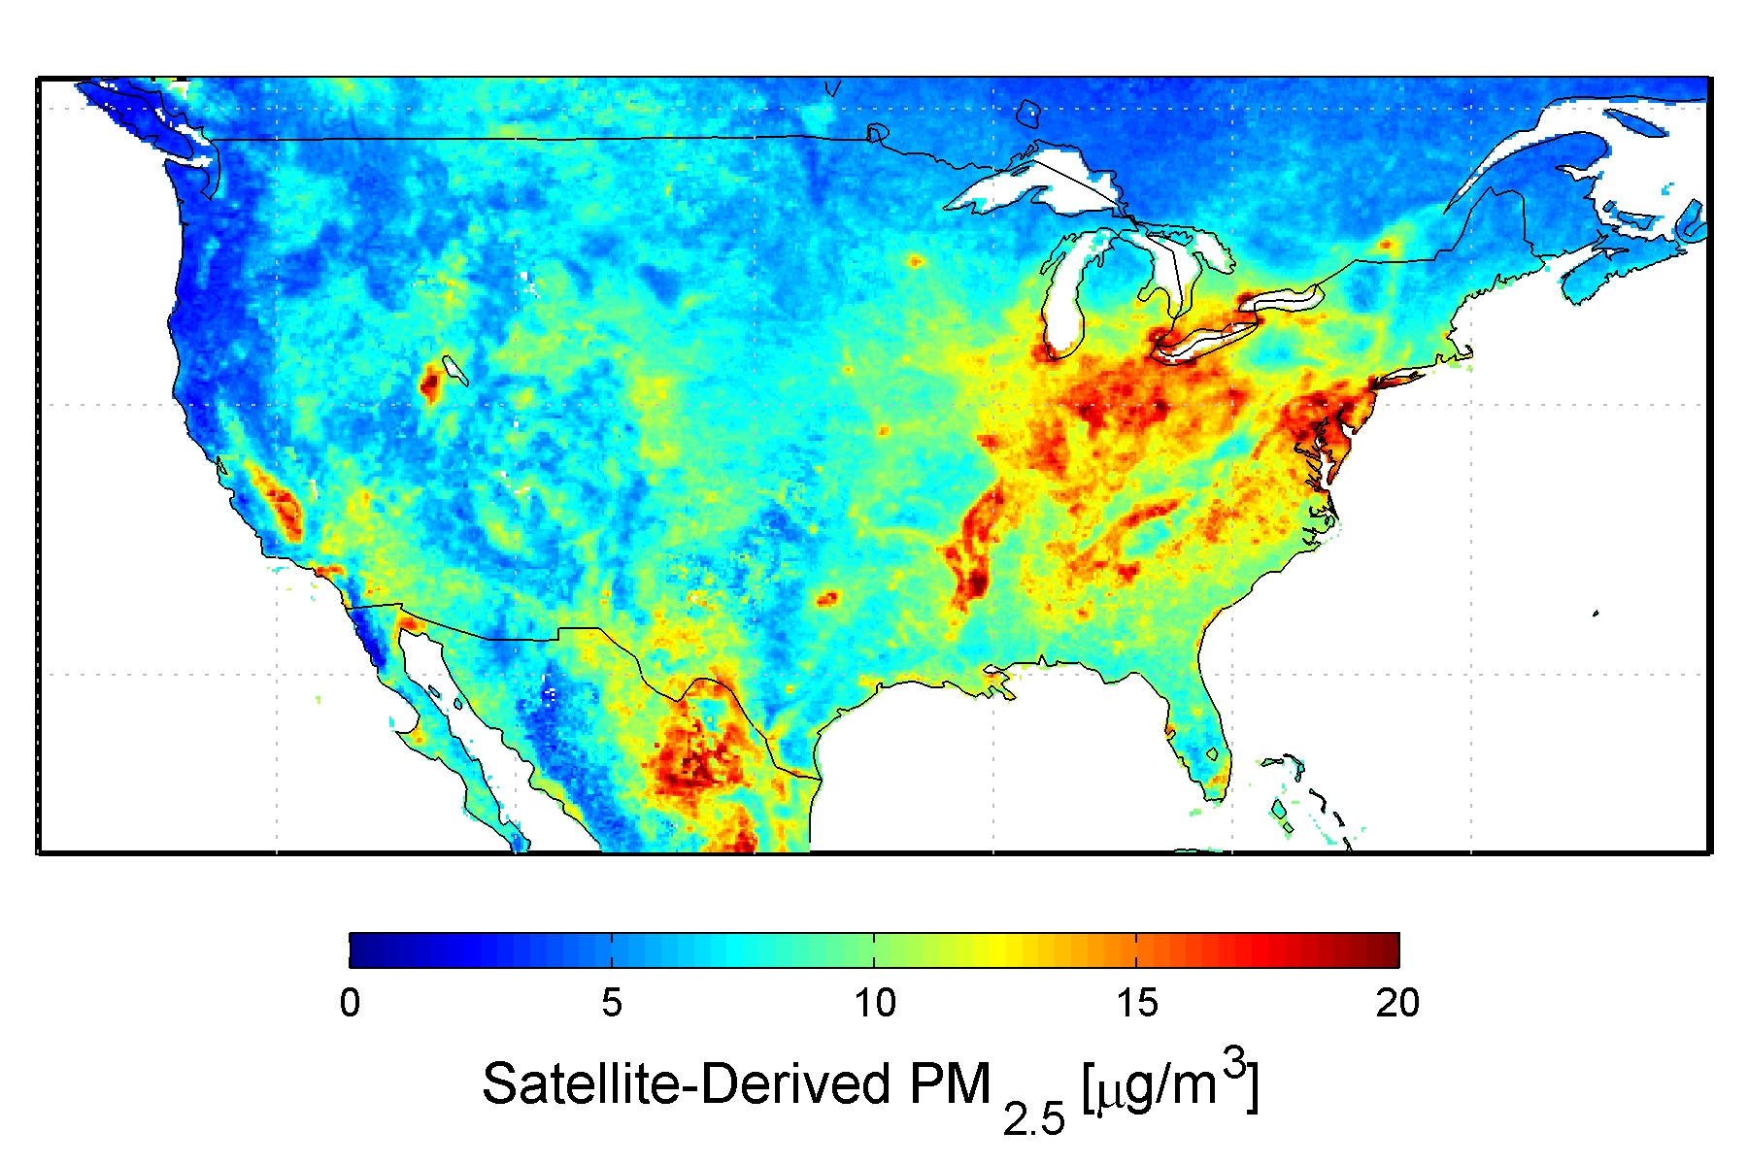
Where are there issues with PM in the US?
Top of scale was 80 in last slide
(averaged over 2001-2006)
Source: nasa.gov

Slide 18
Characterization of Particulates Potential
HHCAP Characterization Factors (TRACI 2.1)
HHCAP= Σ_{i} (m_{i} x HHCAP_{i})
where
HHCAP=Human health criteria air pollutants (designation for particulates in TRACI)
m_{i} = mass (in kg) of inventory flow i,
HHCAP_{i} = kg of PM_{2.5} that have the equivalent health impact of one kg of inventory flow ‘i‘
1 kg of substance | HHCAP_{i} (kg PM_{2.5}-eq)
PM_{2.5} | 1
PM₁₀ | 0.228
Sulfur dioxide | 0.061
Nitrogen oxides | 0.007
Carbon monoxide | 3.6×10⁻⁴
Ammonia | 0.067
PM_{2.5} about 4-5 times as severe as PM₁₀ based on these factors

Slide 19
Human Health – Particulates
Major sources
Fuel combustion
Wood burning
Dust from roads
Dust from fields
Main substances*
44%
43%
8%
5%
PM₁₀
PM_{2.5}
SO_{x}
NO_{x} and Others
Midpoint
Increased human exposure to particulate matter
Possible Endpoints
Heart health effects
Aggravated asthma
Decreased lung function
Cancer
*Ryberg et al. 2014

Slide 20
Thank you for completing Module β7!
Group A: ISO Compliant LCA Overview Modules
Group α: ISO Compliant LCA Detailed Modules
Group B: Environmental Impact Categories Overview Modules
Group β: Environmental Impact Categories Detailed Modules
Group G: General LCA Tools Overview Modules
Group γ: General LCA Tools Detailed Modules
Group T: Transportation-Related LCA Overview Modules
Group τ: Transportation-Related LCA Detailed Modules

Slide 21
Homework
Which would be expected to have a larger impact on human health based on the characterization factors in TRACI 2.1: (a) 1 kg release of PM_{2.5} or (b) 10 kg release of PM₁₀?
While it would probably not be captured in LCA, how might those releases from question 1 have different impacts on a population of interest located 200 km away from the point of release?
Look at the regional composition of particulate matter in Slide 10 and the sources of those types in Slide 9. Hypothesize why the composition is as shown in the region you live in, if you live in the United States, or choose a region if you live elsewhere.

