Slide 1

Welcome to the Life Cycle Assessment (LCA) Learning Module Series
Liv Haselbach Quinn Langfitt
For current modules email haselbach@wsu.edu or visit cem.uaf.edu/CESTiCC
Acknowledgements:
CESTiCC Washington State University Fulbright

Slide 2
LCA Module Series Groups
Group A: ISO Compliant LCA Overview Modules
Group α: ISO Compliant LCA Detailed Modules
Group B: Environmental Impact Categories Overview Modules
Group β: Environmental Impact Categories Detailed Modules
Group G: General LCA Tools Overview Modules
Group γ: General LCA Tools Detailed Modules
Group T: Transportation-Related LCA Overview Modules
Group τ: Transportation-Related LCA Detailed Modules

Slide 3
Human Toxicity and Ecotoxicity Potentials
It is suggested to review Modules B1 and B3 prior to this module
Module β6

Slide 4
Summary of Module B1 and Other Points
All impacts are “potential”
Only anthropogenic sources are included
Different substances have different relative amounts of forcing
  Usually results are related to the equivalent release of a particular substance
Different impact categories have different scales of impacts
  Global, regional, local
Watch Module B1 for background
Module B3 includes a brief overview of human and ecotoxicity

Slide 5

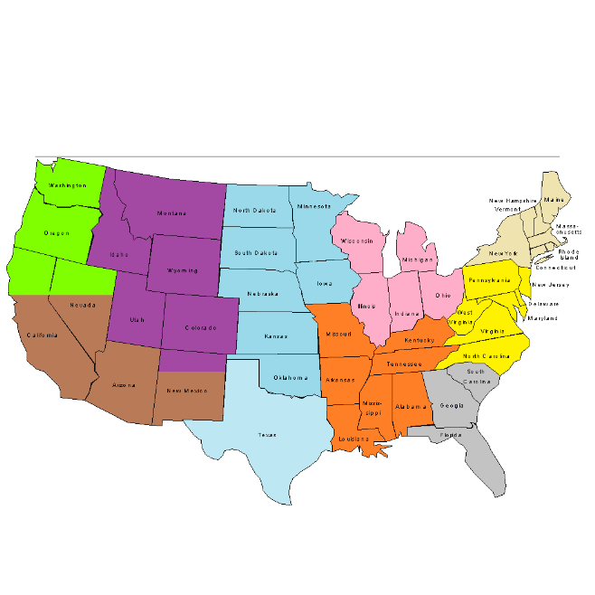

Human Toxicity Potential (HTP)
Effects to individual human health that can lead to disease or death
  Usually split between carcinogenic and non-carcinogenic
  Can either cause or aggravate existing health conditions
  Only considers direct impacts, indirect ones in other impact categories
  Large scale impacts, not facility specific (occupational) ones
Also called human health cancer potential (HHCP) and human health non-cancer potential (HHNCP)
Different from human health effects from breathing particulate matter
Scale of impacts:
Local
Regional
Global

Slide 6

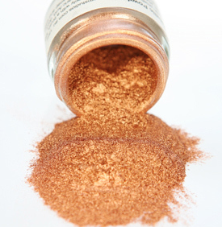
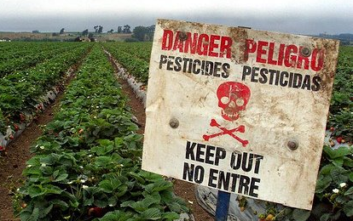
Ecotoxicity Potential
Scale of impacts:
Impacts on whole ecosystems that can decrease production
and/or decrease biodiversity
More focused on whole system impacts than individual impacts
Sometimes split between aquatic (water) and terrestrial (soil)
Mostly forced by emissions of metals and organic chemicals
Local
Pond: scienceinthebox.com (P&G website) Pesticides: lhsslaw.com copper: sakshidyesandchemicals.com

Slide 7

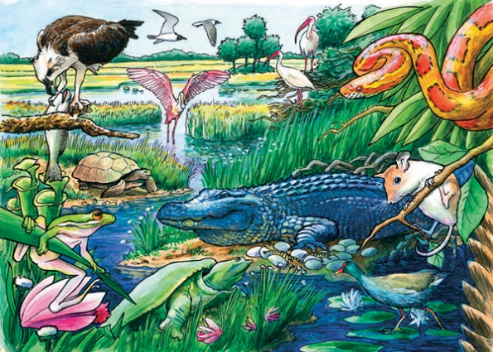
Human toxicity vs. ecotoxicity
Human Toxicity | Ecotoxicity
Usually split between cancer and non-cancer causing | Only one impact category for general toxicity (other splits like water, soil possible)
Focused on health impacts of each individual | Focused on general health of overall ecosystem
Local, regional, and global impacts scale | Local impact scale
Can be characterized using USEtox and the comparative toxic unit
Fate factor in characterization factor is the same
Humans: clipartpanda.com Animals: rainbowresource.com

Slide 8
USEtox
Midpoint characterization factors for human toxicity and freshwater ecotoxicity
  Marine ecotoxicity (seawater) is not included because of limited scientific data
Developed by the Society for Environmental Toxicology and Chemistry (Hauschild et al 2008)
Is a consensus model to address the differences in old models used for characterization including
  Identifying underlying reasons for differences in old models
  Develop consensus about proper modelling practice
  Harmonize old models to remove differences
  Create a model that is parsimonious, transparent, well-documented, falls within the range of other models, and is endorsed by creators of old models
Old models drawn upon include
CalTOX
IMPACT 2002
USES-LCA
BETR
EDIP
WATSON
EcoSense

Slide 9
Comparative toxic unit (CTU)
Midpoint indicator for both human toxicity and ecotoxicity
Meant to “stress the comparative nature of the characterization factors”*
Some impact methodologies use other midpoint indicators including
  Ecotoxicity as kg 2,4-dichlorophenoxy-acetic acid (2,4-D) – eq
  Human toxicity cancer as kg benzene-eq, human toxicity non-cancer as kg toluene-eq
PAF*m³*day
Potentially affected fraction integrated over volume and time
CTU
Comparative Toxic Unit
Cases
Morbidity disease cases
CTU_{e}
CTU_{h}
per kg substance released
per kg substance released
Note: PAF is the % of the species exposed to concentrations above their “no observable effects concentration”
*USEtox manual

Slide 10
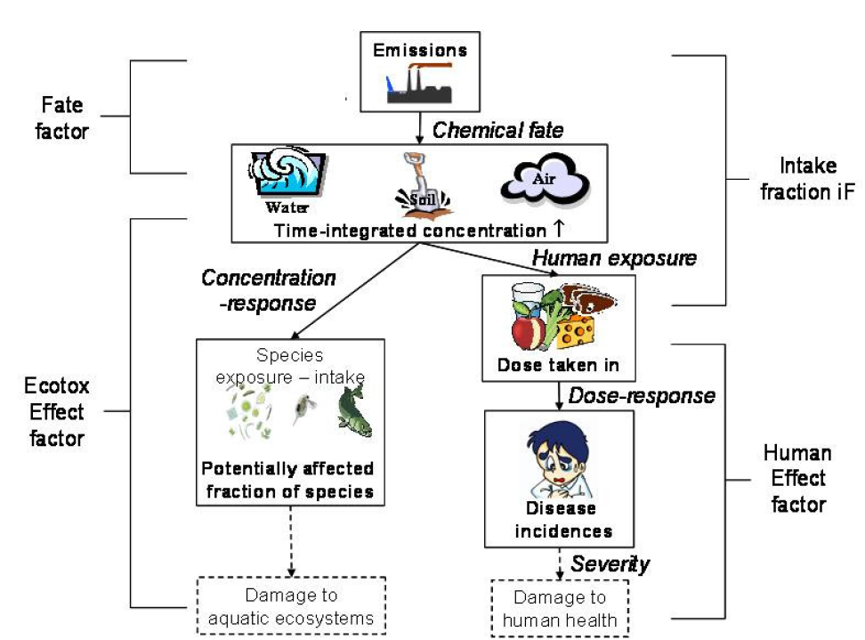
Characterization factor development
Exposure
Fate
Effect
Characterization factor
CF=FF*XF*EF
Three factors go into characterization factors
Figure source: USEtox user manual

Slide 11
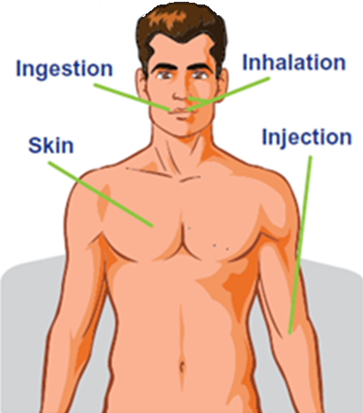
Routes of Exposure for Humans
Hazardous chemicals can enter the body in a number of ways
  Ingestion
  Inhalation
  Skin (dermal)
Varying degrees of impacts depending on exposure route
  Generally severity in the following order
Some toxic substances have more variation in toxicity based on exposure route than others
  This is one reason why some characterization factors are labelled “interim” in USEtox
Skin
Ingestion
Inhalation
Increasing severity for equal intake
Image source: rssb.co.uk

Slide 12
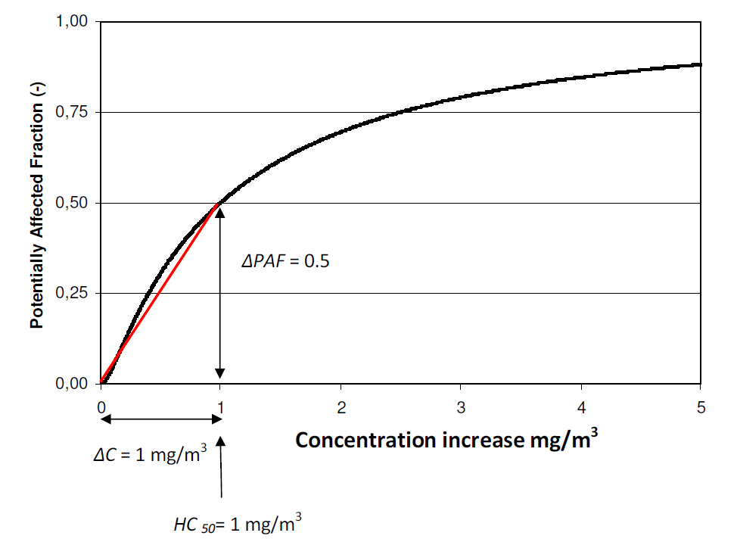
Dose-Effects (Conc.-Effects) Relationship
For most toxic substances dose and health effects have a non-linear relationship
Linearization is required to generate standard LCA characterization factors
To linearize, USEtox uses slope of effects from 0 to 50% partially affected fraction.
  Fairly good indicator for low to moderate concentration increases
  Poor indicator for high concentration increases (overestimates based on graph)
Figure source: USEtox user manual

Slide 13
Uncertainty
Generally considered the most uncertain traditional impact categories in LCA
No true midpoint, so endpoints essentially need to be quantified in a pseudo-midpoint design
Too little resolution of space and time in inventory
Relies on linear dose-response curves
No consideration for combinations of toxic substances
Toxicity determined under laboratory conditions
Different exposure mechanisms have different effects
For human toxicity, may be based on tab testing of toxicity in animals and scaled up by body weight
For ecotoxicity, little consideration of the variation of effects on different species
  Factors usually developed based on only a few species, but wider ecosystem impacts hard to deduce

Slide 14
Interim vs. Recommended Characterization Factors
Interim
Recommended
Substances with “relatively high uncertainty in addressing fate, exposure, and/or effects of a chemical.”
“Substances where the USEtox model is considered fully appropriate and the underlying substance data is of sufficient quality.”
Generally the following are classified as interim:
  Metals
  Inorganic chemicals
  Organometallic chemicals
  Detergents
For aquatic ecotoxicity, interim is used if characterization based on less than 3 trophic levels
For human health, interim if based on sub-acute data or if fraction absorbed by inhalation is much higher than ingestion
(positions of organisms on food chain)
(Between acute and chronic)
Note: Some characterization models ignore interim factors, however USEtox states: “Excluding interim characterization factors is in principle only meaningful for sensitivity analysis in a life cycle assessment study”
http://www.usetox.org/faq#t22n76

Slide 15
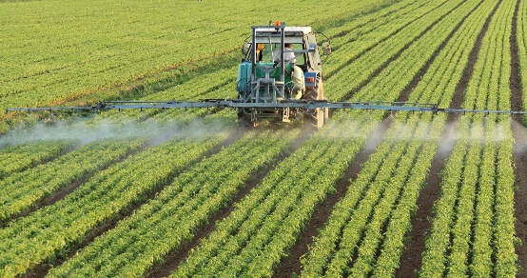
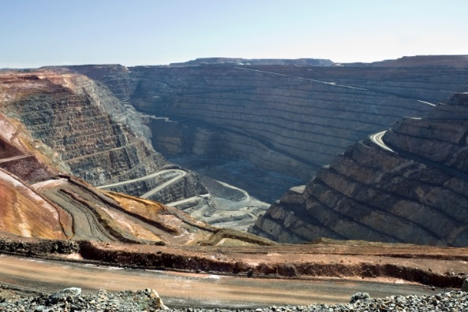
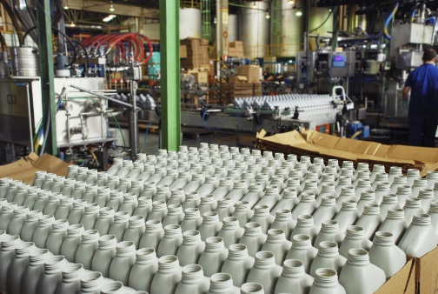
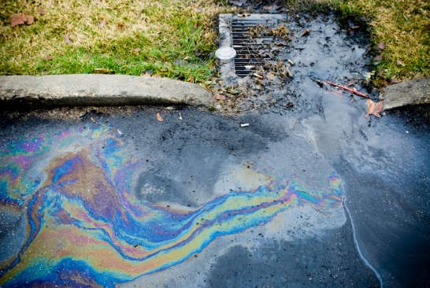
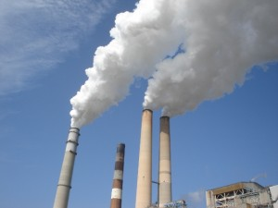

Sources of Toxic Chemicals
Agriculture (pesticide application and production)
Mining
Manufacturing facilities (such as for plastics)
Stormwater runoff from streets (from oils and greases)
Fuel combustion
Waste combustion (including backyard barrel burning)
Pesticides: ccceh.org mining: envirogen.com manufacturing: fauske.com stormwater: klorotechpavers.com fossil fuel: forbes.com barrel: epa.illinois.gov

Slide 16
Characterization of Ecotoxicity Potential
ETP (freshwater) Characterization Factors (TRACI 2.1)
ETP= Σ_{i} (m_{i} x ETP_{i})
where
ETP = ecotoxicity potential in CTU_{e} (comparative toxic unit=PAF*m³*d)
m_{i} = mass (in kg) of inventory flow i,
ETP_{i} = CTU_{e} (comparative toxic unit=PAF*m³*d) per one kg of inventory flow ‘i‘
1 kg of substance | ETP_{i} (CTU)
Copper (II) emission to freshwater | 55,200
Copper (II) emission to air | 23,300
Sulfuric acid to freshwater | 300
Sulfuric acid to air | 78
Dichlorobenzene to freshwater | 502
Dichlorobenzene to air | 2.34
p-p’-DDT to freshwater | 278,318
p-p’-DDT to air | 4897

Slide 17
Characterization of Human Health Cancer Potential
HHCP Characterization Factors (TRACI 2.1)
1 kg of substance | HHCP_{i} (CTU)
Toluene to air | 3.18×10⁻¹²
Toluene to fresh water | 3.29×10⁻⁹
Toluene to natural soil | 4.28×10⁻¹¹
Benzene to air | 2.97×10⁻⁷
Copper to air | 0
Copper to water | 0
Mercury to air | 7.06×10⁻³
Mercury to water | 1.20×10⁻⁴
Carbon tetrachloride to air | 4.67×10⁻⁵
Carbon tetrachloride to water | 4.16×10⁻⁵
HHCP= Σ_{i} (m_{i} x HHCP_{i})
where
HHCP = human health cancer potential in CTU_{h}
m_{i} = mass (in kg) of inventory flow i,
HHCP_{i} = comparative toxic unit (cases of morbidity) per one kg of inventory flow ‘i‘, where morbidity is any health condition reducing the quality of life, not necessarily resulting in death
Note: for emissions to air. the value reported is the average of that for rural and urban emissions

Slide 18
Characterization of Human Health Non-Cancer Potential
HHNCP Characterization Factors (TRACI 2.1)
1 kg of substance | HHNCP_{i} (CTU)
Toluene to air | 5.30×10⁻⁸
Toluene to fresh water | 1.78×10⁻⁸
Toluene to natural soil | 7.96×10⁻⁹
Benzene to air | 7.52×10⁻⁸
Copper to air | 1.34×10⁻⁵
Copper to water | 8.63×10⁻⁷
Mercury to air | 8.35×10⁻¹
Mercury to water | 1.42×10⁻²
Carbon tetrachloride to air | 1.55×10⁻⁴
Carbon tetrachloride to water | 1.42×10⁻⁴
HHNCP= Σ_{i} (m_{i} x HHNCP_{i})
where
HHCCP = human health non-cancer potential in CTU_{h}
m_{i} = mass (in kg) of inventory flow i,
HHNCP_{i} = comparative toxic unit (cases of morbidity) per one kg of inventory flow ‘i‘, any health condition reducing the quality of life, not necessarily resulting in death
Note: for emissions to air. the value reported is the average of that for rural and urban emissions

Slide 19
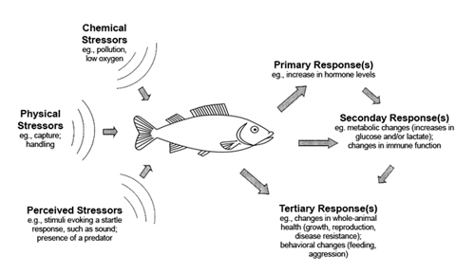
Ecotoxicity Potential
Major sources
Mining
Agriculture
Manufacturing
Energy production
Transportation systems
Main substances
Zinc
Copper
Organic Chemicals
Midpoint
General degradation of ecosystems (no true midpoint)
Possible Endpoints
Decreased populations
Decreased biodiversity
Image source: dosits.org

Slide 20
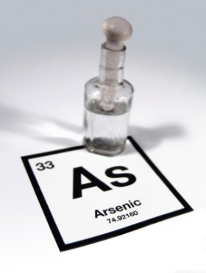
Human Toxicity Potential
Major sources
Mining
Agriculture
Manufacturing
Energy production
Some major substances
6%
Formaldehyde
Dioxins
Chromium
Arsenic
Zinc
Benzo(a)pyrene
Midpoint
General health effects on humans (no true midpoint)
Possible Endpoints (either causing or aggravating)
Asthma
Cancer
Heart disease
Low birth rate
Image source: globalhealingcenter.com

Slide 21
Thank you for completing Module β6!
Group A: ISO Compliant LCA Overview Modules
Group α: ISO Compliant LCA Detailed Modules
Group B: Environmental Impact Categories Overview Modules
Group β: Environmental Impact Categories Detailed Modules
Group G: General LCA Tools Overview Modules
Group γ: General LCA Tools Detailed Modules
Group T: Transportation-Related LCA Overview Modules
Group τ: Transportation-Related LCA Detailed Modules

Slide 22
Homework
Download the USEtox characterization factors from their website. Give some examples of recommended and interim characterization factors for human toxicity cancer, human toxicity non-cancer, and ecotoxicity separately.
Which sources of toxic chemicals might be a concern where you live?
How might substances that are toxic to humans have impacts on the global scale? That is how might a toxic chemical released/applied/used travel around the world?
What do you think is meant in Slide 7 when stated that a difference between human toxicity and ecotoxicity is that the former is characterized with respect to individual health and the latter with respect to general ecosystem health (what else could be involved when looking at a whole ecosystem)? Is this difference represented in the impact category indicator unit for each?

