Slide 1

Welcome to the Life Cycle Assessment (LCA) Learning Module Series
Liv Haselbach Quinn Langfitt
For current modules email haselbach@wsu.edu or visit cem.uaf.edu/CESTiCC
Acknowledgements:
CESTiCC Washington State University Fulbright

Slide 2
LCA Module Series Groups
Group A: ISO Compliant LCA Overview Modules
Group α: ISO Compliant LCA Detailed Modules
Group B: Environmental Impact Categories Overview Modules
Group β: Environmental Impact Categories Detailed Modules
Group G: General LCA Tools Overview Modules
Group γ: General LCA Tools Detailed Modules
Group T: Transportation-Related LCA Overview Modules
Group τ: Transportation-Related LCA Detailed Modules

Slide 3
Eutrophication Potential
It is suggested to review Modules B1 and B3 prior to this module
Module β5

Slide 4
Summary of Module B1 and Other Points
All impacts are “potential”
Only anthropogenic sources are included
Different substances have different relative amounts of forcing
Usually results are related to the equivalent release of a particular substance
Different impact categories have different scales of impacts
Global, regional, local
Watch Module B1 for background
Module B3 includes a brief overview of eutrophication potential

Slide 5
Common Impact Categories
Acidification Potential (AP)
Global Warming/Climate Change Potential (GWP)
Stratospheric Ozone Depletion Potential (ODP)
Smog/Ozone/Photochemical Oxidants/Creation Potential (SCP)
Human Health Particulates/Criteria Air Potential (HHCAP)
Human Health/Toxicity Cancer/Non-Cancer Potential (HTP)
Ecotoxicity Potential (ETP)
Eutrophication Potential (EP)
Air
Air
Water
Soil
Bolded impact categories are those covered in this module
These are only some of the possible impact categories in LCA

Slide 6

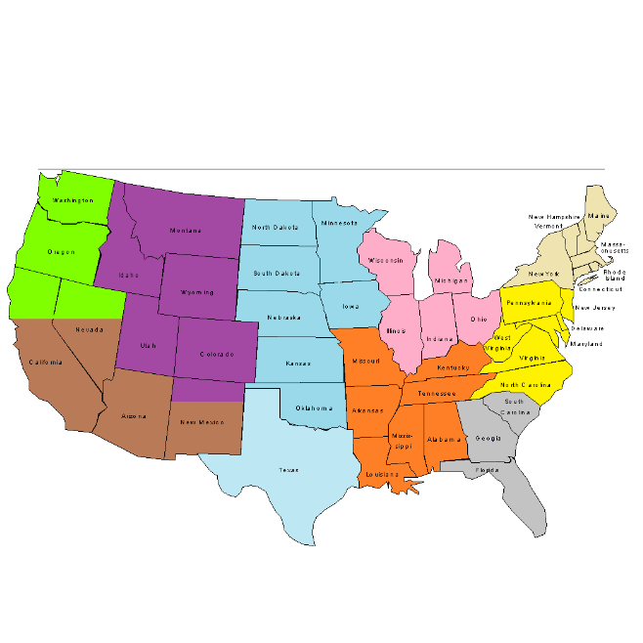
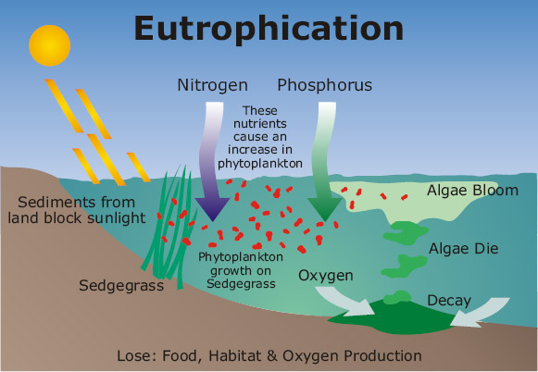
Eutrophication Potential
Scale of impacts:
Excessive biological activity of organisms due to over-nutrification
Also called nutrification
Especially in aquatic systems, often apparent through algal blooms
Can lead to oxygen deficiency in water killing aquatic life
Mostly forced by nitrogen and phosphorus
Organisms need nutrients to grow, but too much can have undesirable consequences
Local variations can be very important
In addition to water, also soil impacts
Local
Regional
Source: ecodetail.net.au

Slide 7
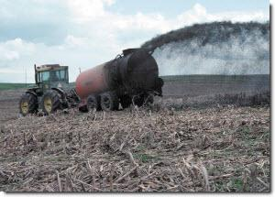

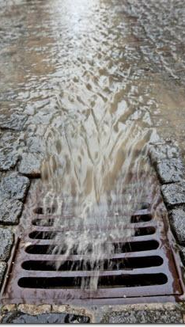
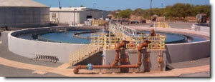

Main Substances and Sources
Eutrophying substances are nutrients, and when in excess, may be pollutants
Nitrogen and phosphorus are the main nutrients of interest
Various forms and pathways of release for each
Sources of these nutrients include:
Agriculture: Animal manure and excess fertilizer
Storm water: Collects nutrients and pollutants from roads, roofs, etc.
Wastewater: Sometimes nitrogen or phosphorus removal can be low these can be discharged in the effluent
Fossil fuels: For electricity, transport, industry, etc. (emits nitrogenous compounds to the air)
Home activities: Fertilizers, pet waste, detergents, and soaps
Cars in traffic: apr.org All other images: EPA. “Sources and Solutions.” Nutrient Pollution. epa.gov

Slide 8
Characterization of Eutrophication Potential
EP Characterization Factors (TRACI 2.1)
1 kg of substance | EP_{i} (kg N-eq)
Ammonia (to water) | 0.78
Ammonia (to air) | 0.12
Nitrogen Oxides (as NO₂ to air) | 0.04
Nitrate (to water) | 0.237
BOD | 0.05
COD | 0.05
Phosphorus to air | 1.12
Phosphorus to water | 7.29
EP= Σ_{i} (m_{i} x EP_{i})
where
EP=eutrophication potential in kg N-eq (alternate units also used such as kg P-eq)
m_{i} = mass (in kg) of inventory flow i,
EP_{i} = kg of nitrogen with the same eutrophication potential as one kg of inventory flow ‘i‘

Slide 9
BOD and COD as Eutrophying “Substances”
BOD
COD
Biochemical Oxygen Demand
“Amount of oxygen consumed by microorganisms in decomposing organic matter in water”*
Chemical Oxygen Demand
“A measure of the oxygen equivalent of the organic matter content of a sample that is susceptible to oxidation by a strong chemical oxidant.”**
Better metric for these processes
Easier to measure
Oxygen demand is not a particular substance or a nutrient
It’s a surrogate for measuring organic matter present in the water
Oxygen demand (BOD or COD) is sometimes considered as having a eutrophication potential since it directly contributes to the endpoint effects of depleting oxygen from a lake
Same effects that algae has when it is broken down after it dies
Only one or the other should be characterized
If characterizing both, double counting is occuring
*http://water.epa.gov/type/rsl/monitoring/vms52.cfm **Standard Methods for the Examination of Water and Wastewater, 19th Edition.

Slide 10
Limiting Nutrient Concept
Nutrients such as nitrogen and phosphorus are used for biological growth in fairly uniform ratios
Sometimes one nutrient will be shorter supply than the other(s) and once exhausted, new cells will not be able to grow. Adding more of the other nutrient(s) will have little or no effect, while adding the limiting nutrient can have a large effect.
If we
nitrogen
then
biomass
Nitrogen Limited
If we
phosphorus
then
biomass
If we
nitrogen
then
biomass
Phosphorus Limited
If we
phosphorus
then
biomass

Slide 11
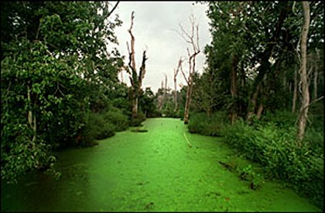
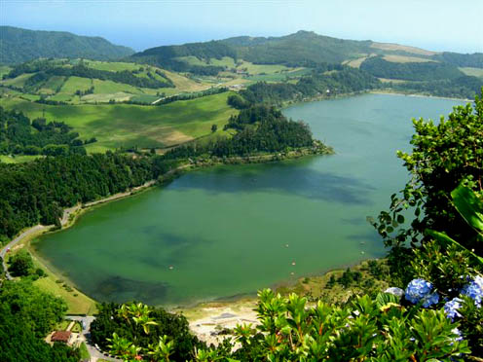
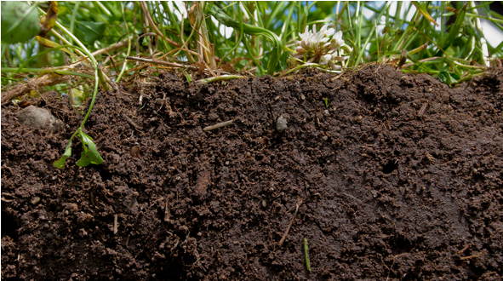
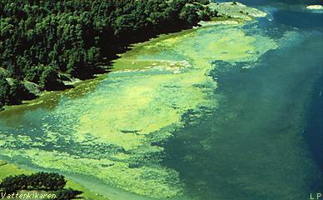
Typical Limiting Nutrients By Setting
Fresh Water
Typically Phosphorus Limited
Midpoints
kg PO₄³⁻ -equivalent (phosphate)
kg P-equivalent (phosphorus)
Soil and Salt Water
Typically Nitrogen Limited
Nitrogen Limited
Midpoints
kg NO₃—equivalent (nitrate)
kg N-equivalent (nitrogen)
River algal bloom: eutro.org
Algal bloom lake: azores-adventures.com
Soil: betterground.org
Ocean: funmozar.com
Ocean eutrophication: earthuntouched.com/

Slide 12
Deposition and Transport
Can be deposited by:
Directly running off into water or soil
Being emitted to air and subsequently deposited to water or soil
Just because a substance is emitted, doesn’t mean it gets to the water or soil
For example, may be absorbed by plants along the way
Or for fertilizers, most of the applied fertilizer is absorbed by crops as intended. Only some becomes runoff depending on slope, precipitation, volatilization, and biological availability
Alternatively, nutrients can travel a long way
Phosphorus emitted in a region where it is not the limiting nutrient could be transported to a region where it is
Why eutrophication can have regional scale of impacts
Characterization factors may have transport and fate built into them, particularly if regionalized

Slide 13
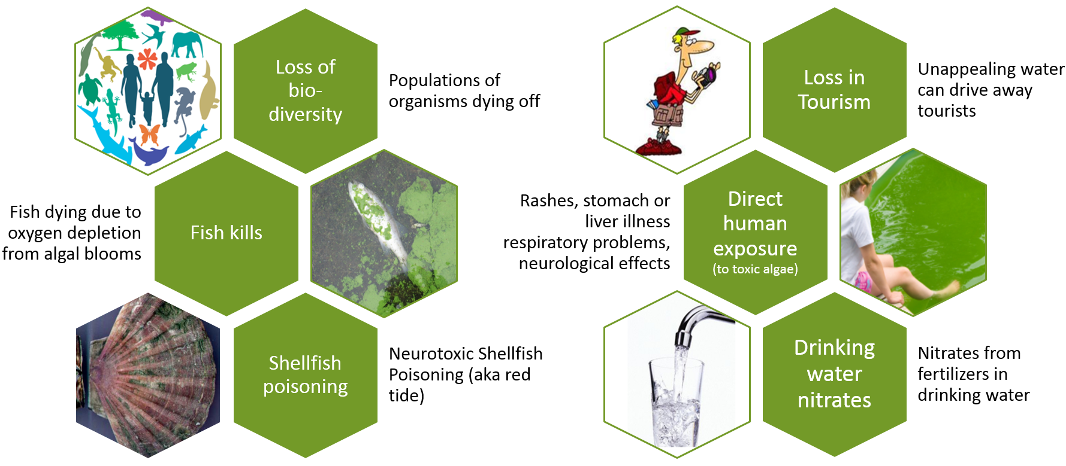
Effects of Eutrophication
Biodiversity: cbd.int fish kill: toxics.usgs.gov shellfish: nem.org.uk tourist: bphw.wikispaces.com swimming: doheny.com tap water: bu.edu
*www2.epa.gov/nutrientpollution/effects

Slide 14
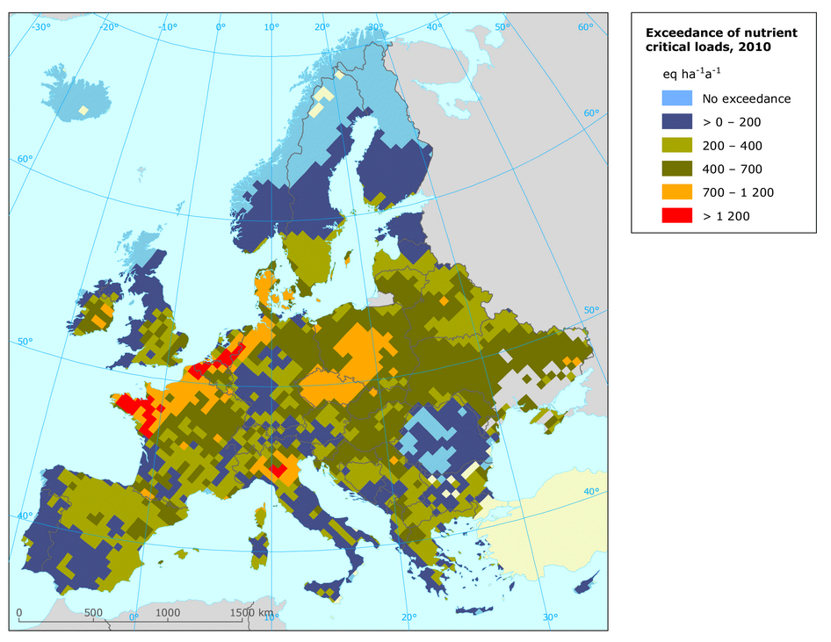
Regional Variation
In mol N-eq/hectare-yr
More of an issue if near or above the “critical load”
If well below the critical load, adding some nutrients is less likely to cause overgrowth of organisms
As can be seen, regions of high population are more likely to exceed the critical load
Some impact methodologies have separate regional characterization factors
One example is TRACI
Regions consisting of 9 groups of states
Sometimes regulated through total maximum daily loads (TMDL)
Figure source: European Environment Agency. (2013). “Exposure of ecosystems to acidification, eutrophication, and ozone.”

Slide 15
Eutrophication Potential
Major sources
Agricultural runoff
Storm and wastewater
Septic field seepage
Fossil fuel Combustion
Main substances*
Others: 8%
42%
33%
10%
7%
Nitrogen
Phosphorus
NO_{x}
NH₃
esp. marine
Water
esp. freshwater
Air
Midpoint
Excessive biological growth, especially of algae
Possible Endpoints (mostly due to aquatic oxygen depletion)
Death of aquatic life
Loss of biodiversity
Foul odor
Toxicity to humans
*Ryberg et al. 2014

Slide 16
Thank you for completing Module β5!
Group A: ISO Compliant LCA Overview Modules
Group α: ISO Compliant LCA Detailed Modules
Group B: Environmental Impact Categories Overview Modules
Group β: Environmental Impact Categories Detailed Modules
Group G: General LCA Tools Overview Modules
Group γ: General LCA Tools Detailed Modules
Group T: Transportation-Related LCA Overview Modules
Group τ: Transportation-Related LCA Detailed Modules

Slide 17
Homework
What is the nearest body of water to your house or university? Using assumptions presented in this module on typical limiting nutrients, would a large release of phosphorus be expected to result in an increase in biomass concentration in that water body?
Look up the discharge characteristics of a local wastewater treatment plant. If you cannot find one in your area follow the link at the bottom of the slide for the Pullman, WA treatment plant. Using the average values of daily discharge and the characterization factors on slide 8, calculate the annual eutrophication potential of the discharge (only for those substances with factors on slide 8, although that is simply a sampling of characterized substances).
https://fortress.wa.gov/ecy/wqreports/public/WQPERMITS.document_pkg.download_document?p_document_id=119464

