Slide 1

Welcome to the Life Cycle Assessment (LCA) Learning Module Series
Liv Haselbach Quinn Langfitt
For current modules email haselbach@wsu.edu or visit cem.uaf.edu/CESTiCC
Acknowledgements:
CESTiCC Washington State University Fulbright

Slide 2
LCA Module Series Groups
Group A: ISO Compliant LCA Overview Modules
Group α: ISO Compliant LCA Detailed Modules
Group B: Environmental Impact Categories Overview Modules
Group β: Environmental Impact Categories Detailed Modules
Group G: General LCA Tools Overview Modules
Group γ: General LCA Tools Detailed Modules
Group T: Transportation-Related LCA Overview Modules
Group τ: Transportation-Related LCA Detailed Modules

Slide 3
Smog Creation Potential
It is suggested to review Modules B1 and B2 prior to this module
Module β4

Slide 4
Summary of Module B1 and Other Points
All impacts are “potential”
Only anthropogenic sources are included
Different substances have different relative amounts of forcing
Usually results are related to the equivalent release of a particular substance
Different impact categories have different scales of impacts
Global, regional, local
Watch Module B1 for background
Module B2 includes a brief overview of smog creation potential

Slide 5
Common Impact Categories
Global Warming/Climate Change Potential (GWP)
Acidification Potential (AP)
Stratospheric Ozone Depletion Potential (ODP)
Smog/Ozone/Photochemical Oxidants/Creation Potential (SCP)
Human Health Particulates/Criteria Air Potential (HHCAP)
Human Health/Toxicity Cancer/Non-Cancer Potential (HTP)
Ecotoxicity Potential (ETP)
Eutrophication Potential (EP)
Mostly
Air
Air
Water
Soil
Bolded impact categories are those covered in this module
These are only some of the possible impact categories in LCA

Slide 6
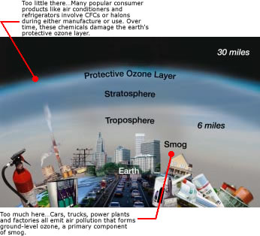
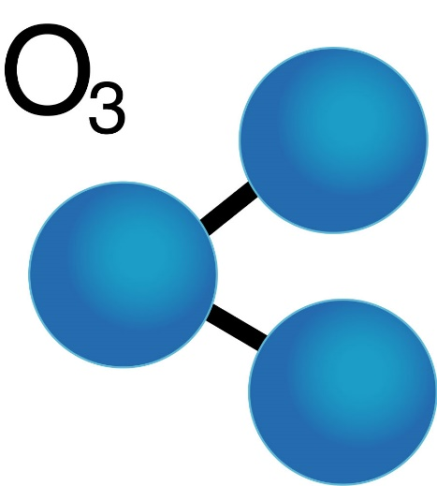
Ozone
Molecule composed of three oxygen atoms
Colorless, odorless gas
The focus of two very different impact categories
Ozone depletion potential – “Good” ozone
Smog creation potential – “Bad” ozone
Ozone molecule: naturallythebest.com Good/bad ozone: epa.gov

Slide 7
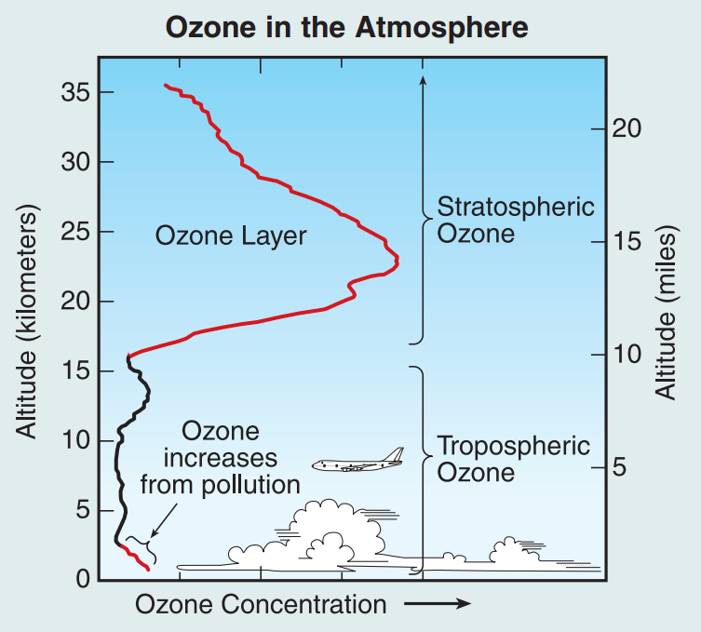
Ozone Profile
“Good” Ozone
“Bad” Ozone
Image source: NOAA. (2006). “The Science of Ozone Depletion” <www.esrl.noaa.gov/csd/assessments/ozone/2006/twentyquestionsposter.pdf>

Slide 8

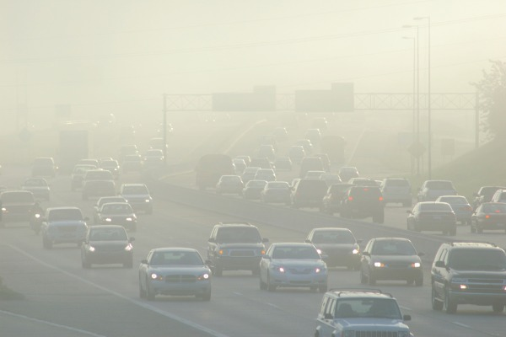
Smog Creation Potential (SCP)
Scale of impacts:
Increased formation of ground-level ozone
Also called photoxidant formation, ozone creation, etc.
Formed from reactions of NO_{x}, VOCs, other pollutants, and sunlight
Can have effects on human health and vegetation
Effects vary, but LCA does not usually capture, based on:
Current air composition (i.e. NO_{x} or VOC limited)
Time of day and year (sunlight)
Physical characteristics of area and weather patterns
Exposed populations
Commonly expressed as:
kg O₃-equivalent
kg C₂H₄-equivalent
kg NO_{x}-equivalent
Local
O₃: ozone C₂H₄: ethane NO_{x}: nitrogen oxides VOCs: volatile organic compounds
Image source: edmunds.com

Slide 9
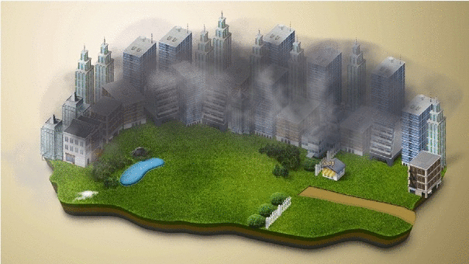
What is Smog?
Term coined from combining the words smoke and fog
Originally used to refer to pollution in London in the 19th century from coal emissions
Modern smog (being addressed in this impact category) is different
Sometimes called photochemical smog
Main compound is ground-level ozone
Other constituents include:
Peroxyacetyl nitrates
Aldehydes,
Remaining NO_{x} and VOCs (not converted to ozone)
Image source: culturacolectiva.com

Slide 10
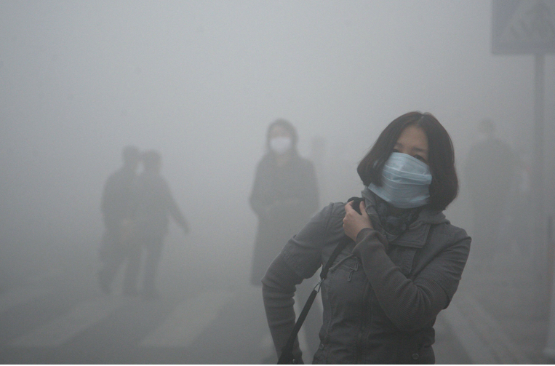
Effects of Smog
Human health
Eye irritation
Respiratory tract irritation
Lung irritation
Reduced lung function
Aggravation of asthma
Vegetation
Crops
Forests
Quality of Life
Decreased visibility (such as for seeing landmarks)
Mostly short term effects
Some worry chronic short term
effects could lead to long term ones
Some populations at higher risk
Children
Elderly
Those with pre-existing respiratory conditions
Those who work outside

Slide 11

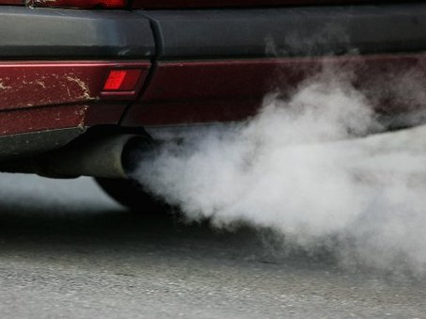
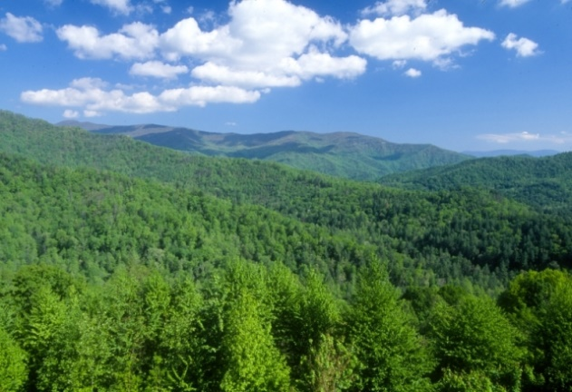
Requirements for Smog Formation
VOCs
Organic chemicals with a low boiling point (<250°C at 1 atm pressure).
Hundreds of chemicals fall under this distinction.
Requirements for forming ground level ozone:
Solar radiation
Reactive nitrogen oxides (NO_{x})
Reactive volatile organic compounds (VOCs) and/or carbon monoxide (CO)
Major anthropogenic source is vehicle emissions
Major natural source is forests
Car exhaust: rjdaviesmotor.com Forest: fs.usda.gov Sun: radnorlibrary.org

Slide 12
Smog Creation Chemistry – NO_{x} Cycle
Sun
1)
+
NO₂ + hν
NO
O
2)
+
O
O₂
O₃
3)
+
+
NO
O₂
O₃
NO₂

Slide 13
Smog Creation Chemistry – NO_{x} and HO_{X}
NO_{x} Cycle
HO_{x} Cycle (example with CO)
Sun
1)
+
+
1)
+
CO
HO
CO₂
H
NO₂ + hν
NO
O
2)
+
2)
+
H
O₂
HO₂
O
O₂
3)
+
+
O₃
NO
HO₂
HO
3)
+
NO₂
+
NO
O₂
Creates NO₂ from NO without destroying ozone
O₃
NO₂

Slide 14
Characterization of Smog Creation Potential
SCP Characterization Factors (TRACI 2.1)
SCP= Σ_{i} (m_{i} x SCP_{i})
where
SCP=smog creation potential of full inventory in kg O₃-eq
m_{i} = mass (in kg) of inventory flow i,
SCP_{i} = kg of O₃ that would be released (though O₃ is rarely emitted directly) for the same smog creation as one kg of inventory flow ‘i'
1 kg of substance | SCP_{i} (kg O₃-eq)
Nitric oxide | 24.8
Nitrogen dioxide | 16.8
VOCs (in general) | 3.6
Butene (1-Butene) | 9.7
Formaldehyde | 9.5
Carbon monoxide | 0.056
Acetaldehyde | 6.5
Methane | 0.014
Methane should not be aggregated with other VOCs for
SCP characterization, it has a much lower SCP_{i} than most

Slide 15
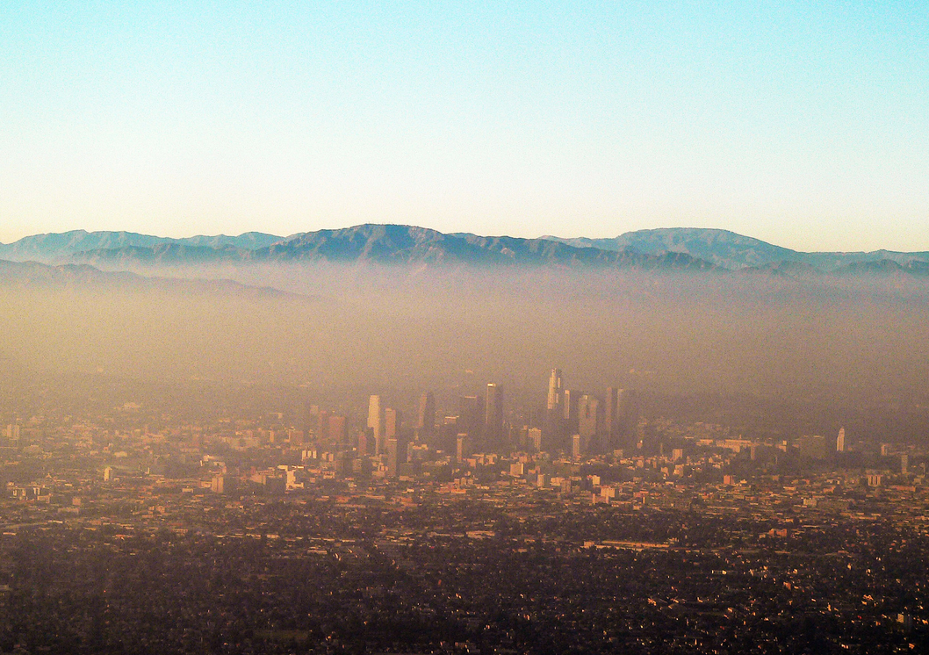
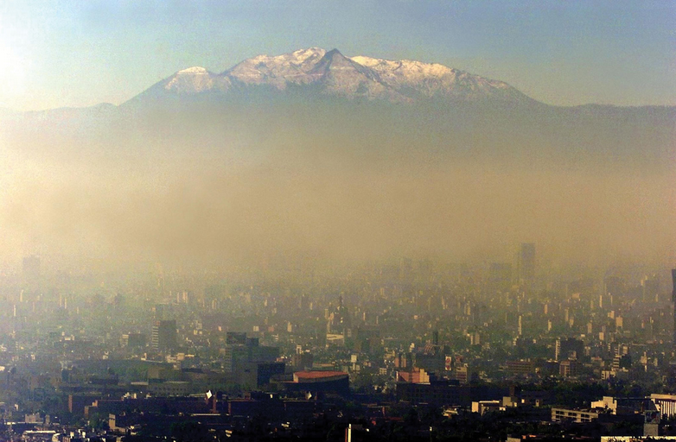
Importance of Regional Variation – Topography and Climate
Landscape features like canyons can trap pollutants
Limits air circulation
Can cause air inversions
Similar phenomenon can happen in a “street canyon” between buildings in urban environment
Solar insolation drives reactions so they are more likely to occur where there is significant sun (temporal resolution important here too)
A few examples of these conditions:
Los Angeles, CA, USA
Denver, CO, USA
Mexico City, Mexico
Santiago, Chile
Los Angeles
Mexico City
Los Angeles: pulsoverde.nrdc.org Mexico City: cdn.zmescience.com

Slide 16
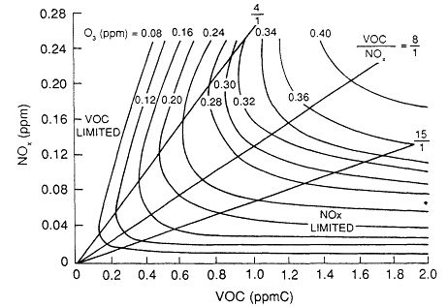
Importance of Regional Variation – Preexisting Air Composition
Preexisting NO_{x} and VOC concentrations are important
In VOC limited area, NO_{x} emission will have little impact (and vice versa)
Most VOCs concentration from forests in many regions
About 90% is typical in rural USA
About 10-40% is typical in urban USA
Cannot control these, so often NO_{x} control is the main focus
Image source: oceanworld.tamu.edu

Slide 17
Some Efforts to Account for Regional Variation
TRACI incorporates:
Relative influence of NO­­_{x} vs VOC
Impact by state (location specific)
“Methods for aggregation of effects among receiving states by area” (Bare et al. 2002)
RAINS (Developed by UNECE)
Regional Air Pollution Information and Simulation
Impact by country in Europe
Relates emissions of precursors to O₃ concentration at receptor site
Shah and Ries (2009)
Spatial and temporal resolution for 48 US states and Washington DC
Based on combination of MM5-SMOKE-CAMx for meteorology, emissions, and chemistry and transport, respectively
Shah, V.P, and Ries R.J. (2009). “A characterization model with spatial and temporal resolution…United States.” Int. J Life Cycle Assess, 14, 313-327.

Slide 18
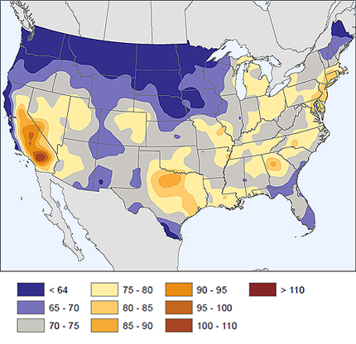
Smog Creation Potential (SCP)
Major sources
Cars and other vehicles
Industrial processes
Energy production
Main substances*
Others: 2%
87%
11%
NO_{x}
VOCs
Midpoint
Increase in ground-level
ozone concentration
2005-2009 4th highest annual value of maximum daily 8-hr. ozone in ppb
Possible Endpoints
Reduced lung function/aggravation
Aggravate Asthma
Vegetation damage
Eye irritation
NO_{x}: nitrogen oxides VOCs: volatile organic compounds
*Ryberg et al. 2014 Image source: science.nature.nps.gov

Slide 19
Thank you for completing Module β4!
Group A: ISO Compliant LCA Overview Modules
Group α: ISO Compliant LCA Detailed Modules
Group B: Environmental Impact Categories Overview Modules
Group β: Environmental Impact Categories Detailed Modules
Group G: General LCA Tools Overview Modules
Group γ: General LCA Tools Detailed Modules
Group T: Transportation-Related LCA Overview Modules
Group τ: Transportation-Related LCA Detailed Modules

Slide 20
Homework
Estimate how much of an issue you would expect smog to be in your current city versus one other city of your choosing, based on sources, topography, sunlight, etc.
Look up the actual average ozone concentration (or whatever you can find. e.g. 4th highest annual maximum) of the two cities. If it differs from your expectation, think of what other factors might be at play and discuss them.
Which of the effects of smog from Slide 10 would likely be an issue in your current city, assuming that smog were present.

