Slide 1

Welcome to the Life Cycle Assessment (LCA) Learning Module Series
Liv Haselbach Quinn Langfitt
For current modules email haselbach@wsu.edu or visit cem.uaf.edu/CESTiCC
Acknowledgements:
CESTiCC Washington State University Fulbright

Slide 2
LCA Module Series Groups
Group A: ISO Compliant LCA Overview Modules
Group α: ISO Compliant LCA Detailed Modules
Group B: Environmental Impact Categories Overview Modules
Group β: Environmental Impact Categories Detailed Modules
Group G: General LCA Tools Overview Modules
Group γ: General LCA Tools Detailed Modules
Group T: Transportation-Related LCA Overview Modules
Group τ: Transportation-Related LCA Detailed Modules

Slide 3
Ozone Depletion Potential
It is suggested to review Modules B1 and B2 prior to this module
Module β3

Slide 4
Summary of Module B1 and Other Points
All impacts are “potential”
Only anthropogenic sources are included
Different substances have different relative amounts of forcing
Usually results are related to the equivalent release of a particular substance
Different impact categories have different scales of impacts
Global, regional, local
Watch Module B1 for background
Module B2 includes a brief overview of ozone depletion potential

Slide 5
Common Impact Categories
Acidification Potential (AP)
Global Warming/Climate Change Potential (GWP)
Stratospheric Ozone Depletion Potential (ODP)
Smog/Ozone/Photochemical Oxidants/Creation Potential (SCP)
Human Health Particulates/Criteria Air Potential (HHCAP)
Human Health/Toxicity Cancer/Non-Cancer Potential (HTP)
Ecotoxicity Potential (ETP)
Eutrophication Potential (EP)
Air
Air
Water
Soil
Bolded impact categories are those covered in this module
These are only some of the possible impact categories in LCA

Slide 6
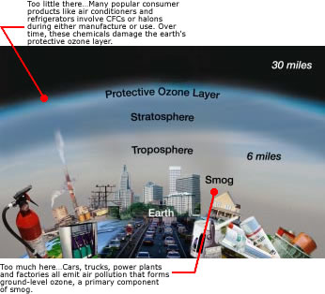
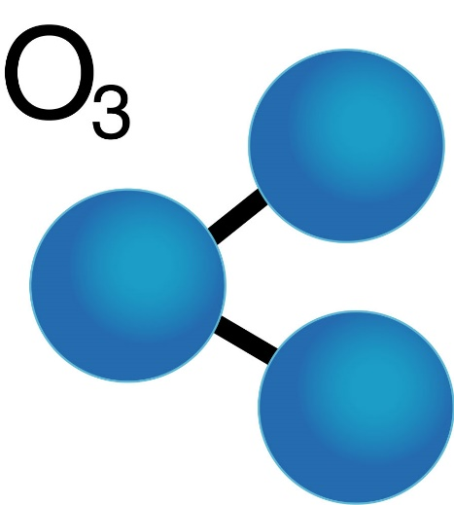
Ozone
Molecule composed of three oxygen atoms
Colorless, odorless gas
The focus of two very different impact categories
Ozone depletion potential – “Good” ozone
Smog creation potential – “Bad” ozone
Ozone molecule: naturallythebest.com Good/bad ozone: epa.gov

Slide 7
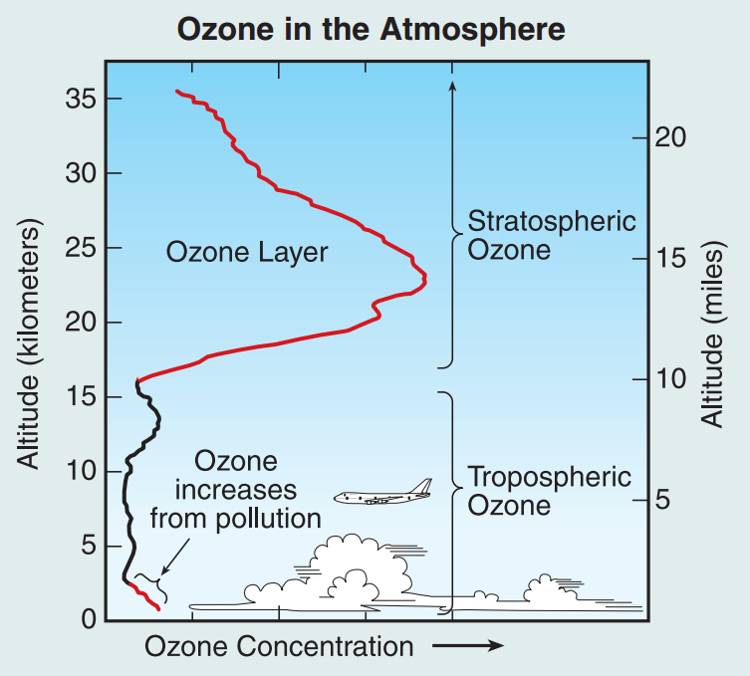
Ozone Profile
“Good” Ozone
“Bad” Ozone
Image source: NOAA. (2006). “The Science of Ozone Depletion” <www.esrl.noaa.gov/csd/assessments/ozone/2006/twentyquestionsposter.pdf>

Slide 8

Ozone Depletion Potential (ODP)
Reduction of ozone concentration in the stratosphere
This is “good” ozone which filters out UV-B radiation
Additional UV can cause negative effects on humans, crops, and the built environment
Occurs when ozone depleting substances catalyze ozone destroying reactions
First noticed by scientists in 1970s
Two phenomena covered by this impact category
Decreased overall ozone concentration in the stratosphere
More severe depletion in localized holes (e.g. the ozone hole)
Not a major cause of global warming/climate change
Some time dependence, but usually not accounted for in LCA
Scale of impacts:
Global

Slide 9
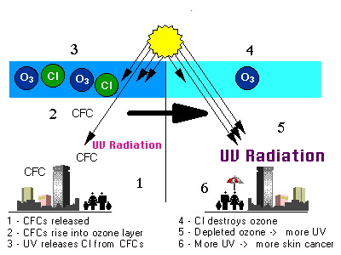
Process and Effects of Ozone Depletion
Midpoint
Endpoint
Emissions of ozone depleting substances
Substances are transported to stratosphere where Cl⁻ and Br⁻ detach
Ozone depleted based on substance’s reactivity/lifetime
Reduced ozone allows increased UVB penetration
Effects of increased UV:
Skin cancer
Cataracts
Damage to:
Crops
Materials
Marine life
Flow diagram adapted from: Bare, J., Norris, G., Pennington, D., and McKone, T. (2002). “Traci.” Journal of Industrial Ecology, 6(3‐4), 49-78.
Image source: epa.gov

Slide 10
Substances
Classes of Ozone Depleting Substances (Selection)
Abbrev. | Name | Severity | Main use(s) | Some Examples*
Halons | Haloalkanes | Very high | Fire suppression | Halon 1301, Halon 1211
CFCs | Chlorofluorocarbons (Freons) | High | Refrigeration, A/C, aerosols, solvents | CFC-11, CFC-12
HCFCs | Hydrochlorofluorocarbons | Moderate | Refrigeration, A/C, aerosols, solvents | HCFC-140, HCFC-22
*Common naming (e.g. CFC-11) is based on numbering scheme for # of C atoms, # of H atoms, # of F atoms, and # of Br atoms
Due to decreases in emissions of these, N₂O (laughing gas) is becoming important
Will likely be largest contributor to ODP in 21st century according to Ravishankara et al. (2009)
Causes ozone loss through different mechanism
Main anthropogenic emissions from agriculture and fuel combustion
Not even classified as ODP in most impact methodologies (including TRACI 2.1 and CML 2007)

Slide 11
Stratospheric Ozone Chemistry
Formation
Happens at equal rates in natural equilibrium
Destruction
Sun
Sun
Step 1
Step 1
+
O₂ + hν
2O
O
O₂
O₃ + hν
Step 2
+
Step 2
+
2O
O
2O₂
O₃
2O₂
2O₃

Slide 12
Chlorine/Bromine Catalyzed Reaction
Chlorine and bromine travel to the stratosphere attached to CFCs, HCFCs, Halons, etc.
After some time, the chlorine or bromine atoms break off in reaction with sunlight in the stratosphere
They can then catalyze ozone destruction through the following sequence
Step 1
+
+
Cl
O₃
ClO
O₂
Step 2
+
+
ClO
O
Cl
O₂

Slide 13
Characterization of Ozone Depletion Potential
ODP Characterization Factors (TRACI 2.1)
ODP= Σ_{i} (m_{i} x ODP_{i})
where
ODP=ozone depletion potential of full inventory in kg CFC-11-eq
m_{i} = mass (in kg) of inventory flow i,
ODP_{i} = kg of CFC-11 with the same ozone depletion potential as one kg of inventory flow ‘i‘
Based on each substance’s reactivity and lifetime
1 kg of substance | ODP_{i} (kg CFC-11-eq)
Carbon Tetrachloride (CCl₄) | 0.73
CFC-12 (CCl₂F₂) | 1.00
Halon 1301 (CF₃Br) | 16.0
HCFC-22 (CHF₂Cl) | 0.05
Methyl Bromide (CH₃Br) | 0.51
Trichloroethane (1,1,1-CH₃CCl₃) | 0.12
Nitrous Oxide (N₂O)* | 0.017
*Not characterized in TRACI 2.1, value from Ravishankara et al. (2009)

Slide 14
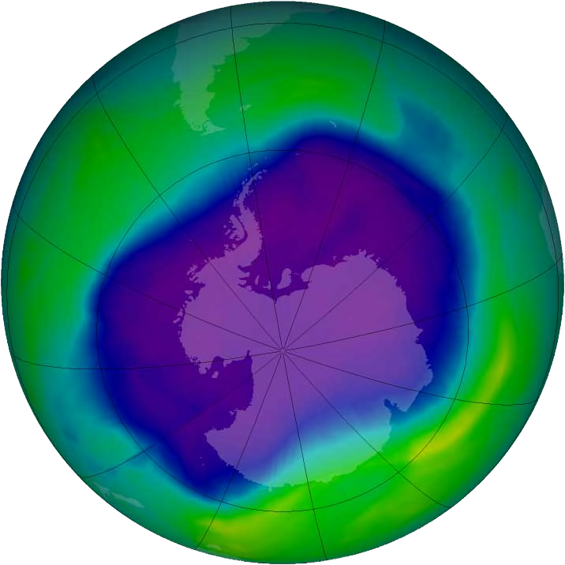
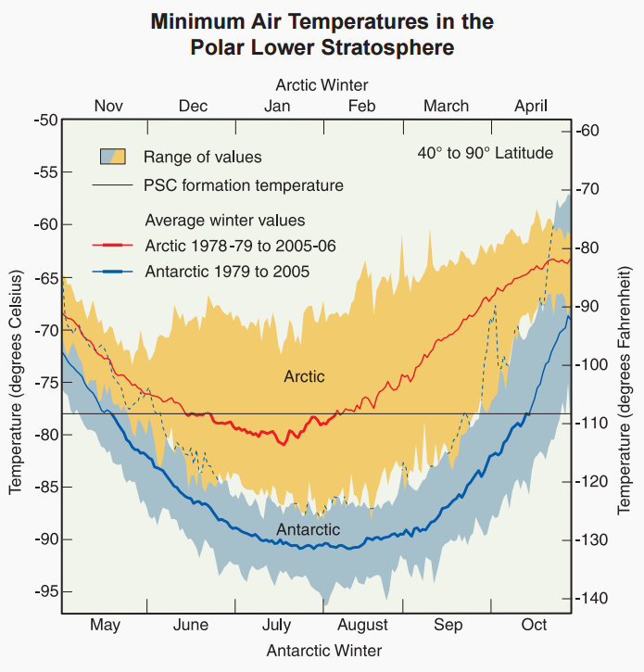

Ozone Hole
Extensive localized losses
Mostly at arctic and Antarctic
Antarctic hole most severe
Largest in springtime
Polar holes due to presence of polar stratospheric clouds (PSCs - ice clouds) and due to relative isolation of air transport there in the winter
Convert HCl and ClONO₂ into ClO (more reactive)
Enhanced destruction of ozone
Minimum temperature and sustained low temperature for PSC formation more common in Antarctic
Polar Stratospheric Clouds
Hole: Wikipedia.org PSC and Formation Conditions: NOAA. (2006). “Twenty Questions: 2006 Update.”

Slide 15
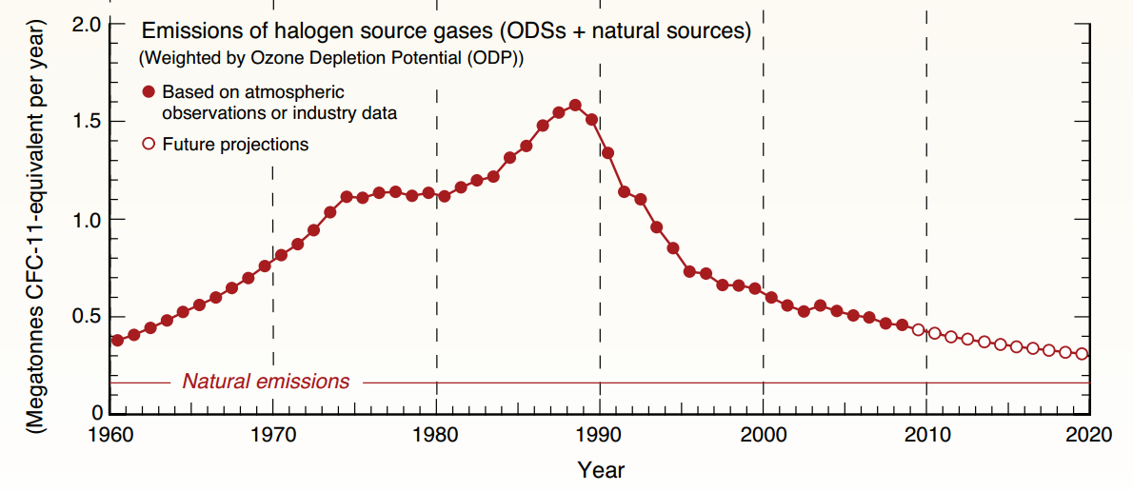
Montreal Protocol
International treaty to limit the production and use of ozone depleting substances
Agreed upon in 1987, and enforced starting in 1989
Universally ratified by the United Nations members
Phase out of harmful substances, phase in of less harmful replacements
First phase out CFCs (high ODP)
Then phase out HCFCs (moderate ODP)
Various others: halons, carbon tet, etc.
Replace mostly by HFCs (no ODP)
Significant reduction in ODP emissions
Recovery of ozone hole expected within about 50 years (EPA 2010)
EPA. (2010). “Ozone Science: The Facts Behind the Phaseout” <http://www.epa.gov/ozone/science/sc_fact.html>).
Fig: Fahey and Hegglin. (2010). “20 Q’s and A’s About the Ozone Layer.”

Slide 16
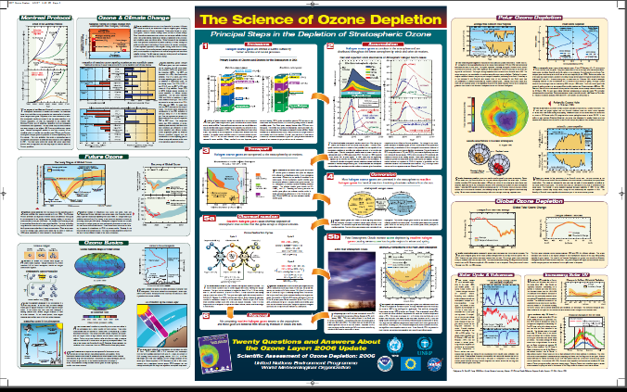
Ozone Depletion Potential (ODP)
Major sources
Manufacturing (polymers, aerosols)
Fire extinguishers
Refrigerant systems
www.esrl.noaa.gov/csd/assessments/ozone/2006/twentyquestionsposter.pdf
Main substances*
Others: 26%
29%
22%
14%
Halon 1301
CFC-11
CFC-12
9%
HCFC-22
Midpoint
Decrease in stratospheric ozone concentration
Possible Endpoints (Due to increased UV-B radiation)
Skin cancer
Crop damage
Materials damage
Marine life damage
CFC: chlorofluorocarbon HCFC: hydrochlorofluorocarbon
*Ryberg et al. 2014

Slide 17
Thank you for completing Module β3!
Group A: ISO Compliant LCA Overview Modules
Group α: ISO Compliant LCA Detailed Modules
Group B: Environmental Impact Categories Overview Modules
Group β: Environmental Impact Categories Detailed Modules
Group G: General LCA Tools Overview Modules
Group γ: General LCA Tools Detailed Modules
Group T: Transportation-Related LCA Overview Modules
Group τ: Transportation-Related LCA Detailed Modules

Slide 18
Homework
Look around your home, school, or office building and identify potential sources of gases that might contribute to ozone depletion.
Follow the link on Slide 16 to the full size poster. From those topics covered on the poster, choose one not covered in this module that interests you and explain what the poster says about it in your own words.
Research what your country or state has done to reduce ozone depletion. Briefly summarize (a few sentences) one piece of legislation or one program that has been enacted to reduce ozone depletion.

