Slide 1
Welcome to the Life Cycle Assessment (LCA) Learning Module Series
Liv Haselbach Quinn Langfitt
For current modules email haselbach@wsu.edu or visit cem.uaf.edu/CESTiCC
Acknowledgements:
CESTiCC Washington State University Fulbright

Slide 2
LCA Module Series Groups
Group A: ISO Compliant LCA Overview Modules
Group α: ISO Compliant LCA Detailed Modules
Group B: Environmental Impact Categories Overview Modules
Group β: Environmental Impact Categories Detailed Modules
Group G: General LCA Tools Overview Modules
Group γ: General LCA Tools Detailed Modules
Group T: Transportation-Related LCA Overview Modules
Group τ: Transportation-Related LCA Detailed Modules

Slide 3
Acidification Potential
It is suggested to review Modules B1 and B2 prior to this module
Module β2

Slide 4
Summary of Module B1 and Other Points
All impacts are “potential”
Only anthropogenic sources are included
Different substances have different relative amounts of forcing
Usually results are related to the equivalent release of a particular substance
Different impact categories have different scales of impacts
Global, regional, local
Watch Module B1 for background
Module B2 includes a brief overview of acidification potential

Slide 5
Common Impact Categories
Global Warming/Climate Change Potential (GWP)
Acidification Potential (AP)
Stratospheric Ozone Depletion Potential (ODP)
Smog/Ozone/Photochemical Oxidants/Creation Potential (SCP)
Human Health Particulates/Criteria Air Potential (HHCAP)
Human Health/Toxicity Cancer/Non-Cancer Potential (HTP)
Ecotoxicity Potential (ETP)
Eutrophication Potential (EP)
Mainly
Air
Air
Water
Soil
Bolded impact categories are those covered in this module
These are only some of the possible impact categories in LCA

Slide 6
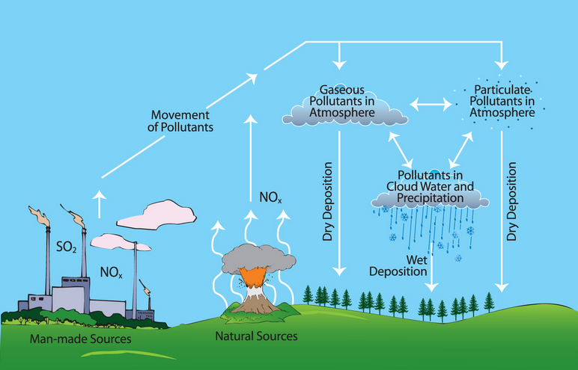
Acidification Potential (AP)
Scale of impacts:
Emissions which increase acidity (lower pH) of water and soils
Major substances:
Sulfur oxides (SO_{x})
Nitrogen oxides (NO_{x})
Ammonia (NH₃)
These can travel some distance before being deposited
Deposition routes include
Wet (Acid rain) (most common form)
Dry
Cloud
Local
Regional
Image source: blog.epa.gov

Slide 7
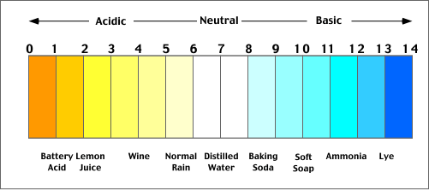
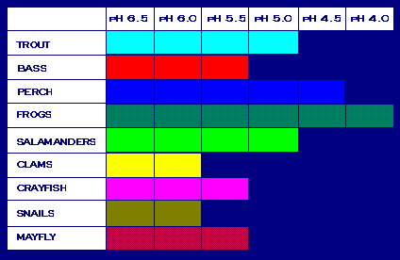
Acidification Potential
Changes in hydrogen ion concentration (i.e. pH)
Some organisms are sensitive (only thrive in limited pH range)
Even those not sensitive can be harmed through food chain
Usually midpoint characterized as:
mol H⁺-eq
kg SO₂-eq (1 kg SO₂₋eq ≈ 50.8 mol H⁺-eq)
Endpoint effects include:
Death of animals (like fish)
Death of plants (especially forests)
Damage to manmade materials (such as buildings)
pH scale: edu.pe.ca Species sensitivity: epa.gov

Slide 8
Characterization of Acidification Potential
AP Characterization Factors (TRACI 2.1)
AP= Σ_{i} (m_{i} x AP_{i})
where
AP=acidification potential of full inventory in kg SO₂-eq
m_{i} = mass (in kg) of inventory flow i,
AP_{i} = kg of sulfur dioxide with the same acidification potential as one kg of inventory flow ‘i'
Note: characterization factors for AP are usually based on stoichiometry of moles H⁺ released
1 kg of substance | AP_{i} (kg SO₂-e)
Ammonia (NH₃) | 1.88
Hydrogen Chloride (HCl) | 0.88
Hydrogen Fluoride (HF) | 1.60
Hydrogen Sulfide (H₂S) | 1.88
Nitrogen Oxides (NO_{x} as NO₂) | 0.70
Sulfur Oxides (SO_{x} as SO₂) | 1
Sulfuric Acid (H₂SO₄) | 0.65

Slide 9
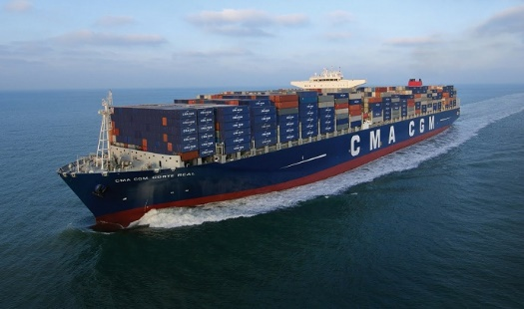
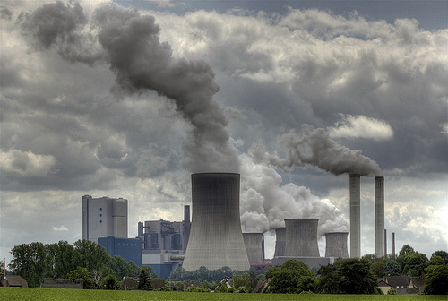
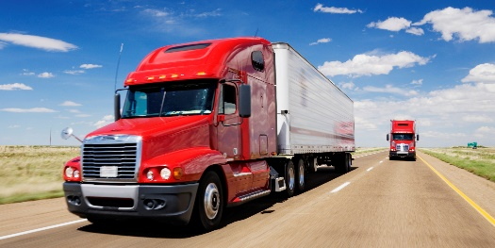
What is SO_{x}?
Major anthropogenic sources:
Combustion of fossil fuels in:
Power plants
Industrial facilities
High sulfur fuels in mobile sources
Industrial processes (e.g. extracting metal from ores)
SO_{x} = Sulfur Oxides
Includes:
Lower sulfur oxides (S_{n}O, S₇O₂ and S₆O₂)
Sulfur monoxide (SO)
Sulfur dioxide (SO₂)
Sulfur trioxide (SO₃)
Higher sulfur oxides (SO_{3+x} where 0<x≤1)
Particulate sulfates (SO₄s)
Sulfur dioxide (SO₂) is predominant form found in the lower atmosphere and forms sulfurous acid (H₂SO₃) when dissolved in atmospheric water
Container ship: maritime-connector.com Power plant: energywisepa.org Truck: huffingtonpost.com

Slide 10
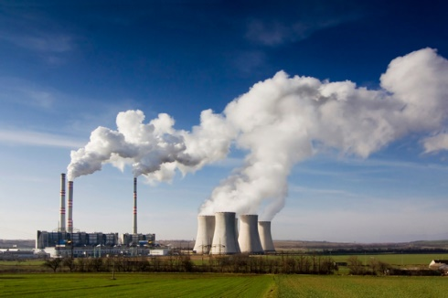
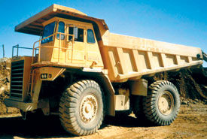
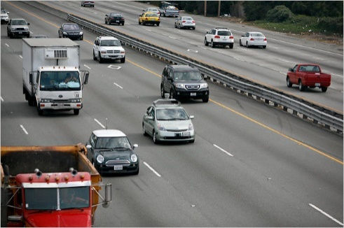
What is NO_{x}?
Major source is combustion of fuels
Air is mostly nitrogen
Most passes through combustion unchanged (i.e. N₂ in, N₂ out)
Some combines with oxygen at high temperature to form NO_{x}
Combustion from:
Stationary power generation
Cars, trucks, and buses
Off-road vehicles/equipment
NO_{x} = Nitrogen Oxides
Includes:
Nitrogen monoxide (NO)
Nitrogen dioxide (NO₂)
Nitrous oxide (N₂O) – Sometimes omitted
NO₂ emitted directly
NO also converts to NO₂ in the atmosphere
When NO₂ dissolves in atmospheric water it is converted to nitric acid (HNO₃)
Power plant: earthmagazine.org Road: nytimes.com Off road: media.noria.com

Slide 11
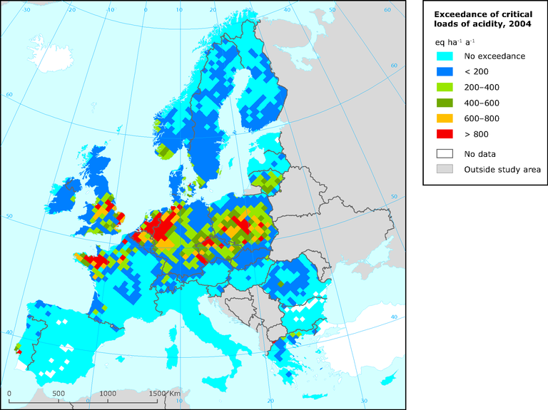
Regional variation
Regional variations can be quite important
Different local plant and animal species
Different levels of current pH balance (proximity to critical loads)
Different buffering capacities
Different pollutant transport properties
Some effort has gone into quantifying these differences
Regional characterization factors and non-linear assessment methods
State-by-state characterization factors available in TRACI
State factors vary from 20% to 160% of overall US average
Figure source: eea.europa.eu

Slide 12
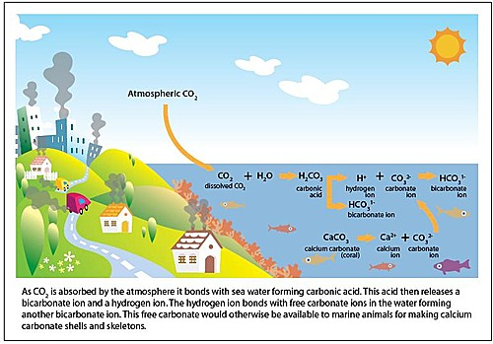
Acidification of Oceans
Acidification of oceans hard to quantify
Ocean have high buffering capacity
Note: this impact category does not include acidification by CO₂ dissolution into oceans
Figure Source: usa.oceana.org

Slide 13
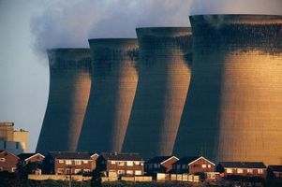
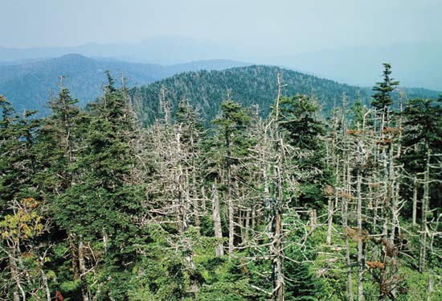
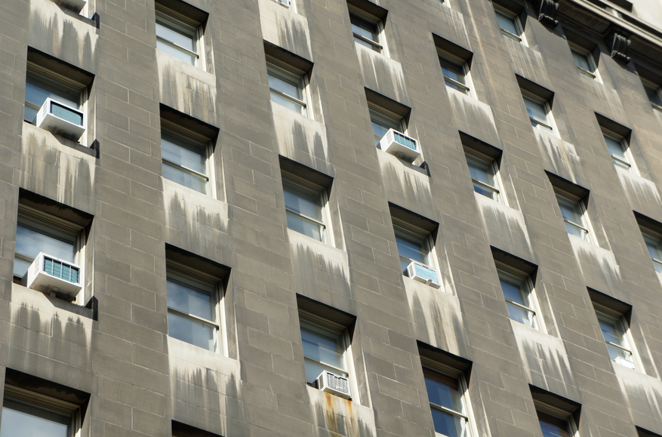
Acidification Potential (AP)
Major sources
Fuel combustion
Electricity
Agriculture
Transportation
Main substances*
Others: 1%
38%
35%
26%
NO_{x}
SO_{x}
NH₃
Midpoint
Increased soil and water acidity
Possible Endpoints
Organisms
Plants (esp. forests)
Buildings
NO_{x}: nitrogen oxides SO_{x}: sulfur oxides NH₃: ammonia
*Ryberg et al. 2014 Building damage: h2owash.biz Forest: Britannica.com Power plant: ehow.com

Slide 14
Thank you for completing Module β2!
Group A: ISO Compliant LCA Overview Modules
Group α: ISO Compliant LCA Detailed Modules
Group B: Environmental Impact Categories Overview Modules
Group β: Environmental Impact Categories Detailed Modules
Group G: General LCA Tools Overview Modules
Group γ: General LCA Tools Detailed Modules
Group T: Transportation-Related LCA Overview Modules
Group τ: Transportation-Related LCA Detailed Modules

Slide 15
Homework
Identify three aquatic species that live in your area and briefly research their sensitivity to acidity increase. What might happen if those species were to die as a result of acid rain?
Think about the industries, sources of electricity, density of vehicle use, etc. in your home region and estimate which sources of acidification (NO_{x}, SO_{x}, NH₃) might be most prevalent. Why do you think that?

