Slide 1

Welcome to the Life Cycle Assessment (LCA) Learning Module Series
Liv Haselbach Quinn Langfitt
For current modules email haselbach@wsu.edu or visit cem.uaf.edu/CESTiCC
Acknowledgements:
CESTiCC Washington State University Fulbright

Slide 2
LCA Module Series Groups
Group A: ISO Compliant LCA Overview Modules
Group α: ISO Compliant LCA Detailed Modules
Group B: Environmental Impact Categories Overview Modules
Group β: Environmental Impact Categories Detailed Modules
Group G: General LCA Tools Overview Modules
Group γ: General LCA Tools Detailed Modules
Group T: Transportation-Related LCA Overview Modules
Group τ: Transportation-Related LCA Detailed Modules

Slide 3
Global Warming Potential (GWP)
It is suggested to review Modules B1 and B2 prior to this module
Module β1

Slide 4
Summary of Module B1 and Other Points
All impacts are “potential”
Only anthropogenic sources are included
Different substances have different relative amounts of forcing
Usually results are related to the equivalent release of a particular substance
Different impact categories have different scales of impacts
Global, regional, local
Watch Module B1 for background
Module B2 includes an overview of global warming potential
Ryberg, M., Vieira, M.D.M., Zgola, M., Bare, J., and Rosenbaum, R.K. (2014). “Updated US and Canadian normalization factors for TRACI 2.1.” Clean Technology and Environmental Policy, 16(2), 329-339.

Slide 5
Common Emissions Impact Categories
Global Warming/Climate Change Potential (GWP)
Acidification Potential (AP)
Stratospheric Ozone Depletion Potential (ODP)
Smog/Ozone/Photochemical Oxidants/Creation Potential (SCP)
Human Health Particulates/Criteria Air Potential (HHCAP)
Human Health/Toxicity Cancer/Non-Cancer Potential (HTP)
Ecotoxicity Potential (ETP)
Eutrophication Potential (EP)
Air
Air
Water
Soil
Bolded impact categories are those covered in this module
These are only some of the possible impact categories in LCA

Slide 6

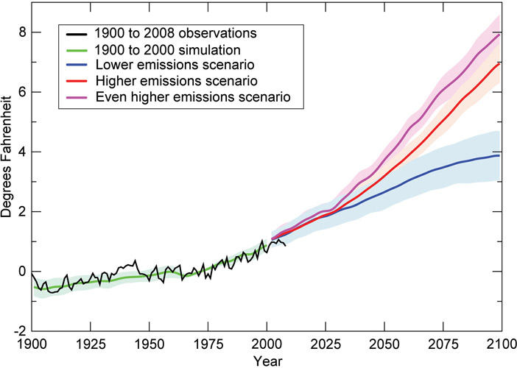
Global Warming Potential (GWP)
Scale of impacts:
Increase in greenhouse gas concentrations, resulting in potential increases in global average surface temperature
Often called climate change to reflect scope of possible effects
Climate=long term Weather=short term
Occurs due to potential increased greenhouse effect from increased concentrations of greenhouse gases in the atmosphere
Some common greenhouse gases (GHGs) include:
Carbon dioxide (CO₂)
Methane (CH₄)
Nitrous oxide (N₂O)
Ozone (O₃)
Water vapor (H₂O) – Usually not considered anthropogenic
Global
Based on one projection under various emissions scenarios
Change in Average Global Surface Temperature
CO₂: carbon dioxide
Figure source: USGCRP (2009). “Global Climate Change Impacts in the United States.”

Slide 7
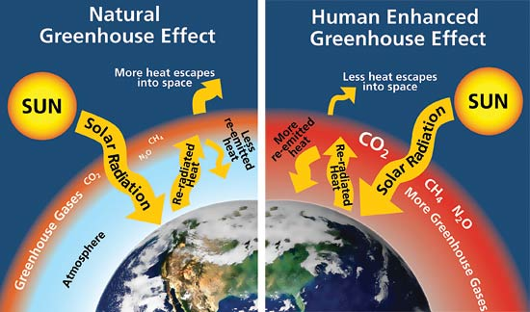
Greenhouse Effect
Trapping of heat in by the troposphere by greenhouse gases due to differences in interaction with long wave and short wave radiation (acts like a blanket)
Incoming radiation from the sun (long wave) is mostly allowed to pass through
Outgoing re-radiated heat from the surface (short wave) is partially blocked
Balance called radiative forcing
Some greenhouse effect needed to sustain natural temperatures
Additional effect from human activity is the concern
Figure source: livescience.com

Slide 8
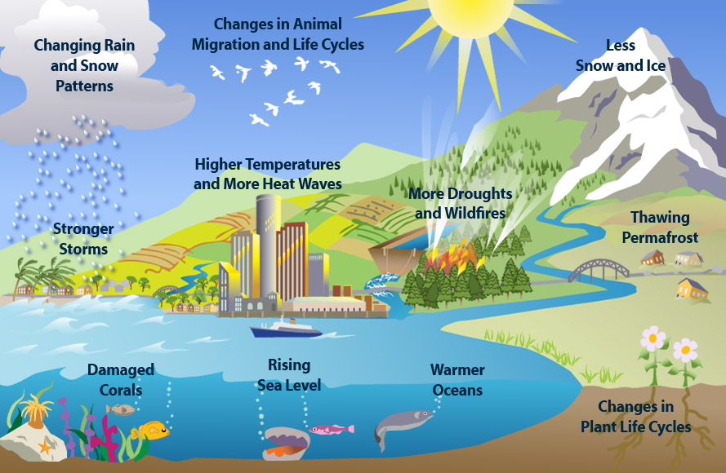
Possible Global Climate Change Effects??
Magnitudes of effects (endpoints) are more difficult to predict. These are just possible scenarios.
Figure source: epa.gov

Slide 9
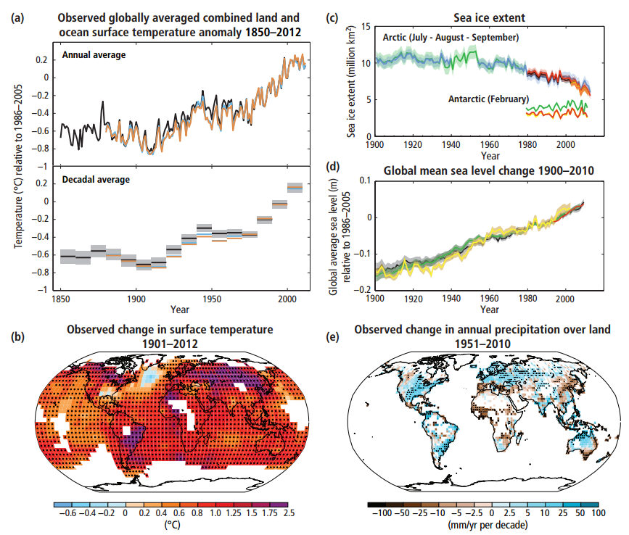
Some Observed Effects That Might Relate to GWP
Source: IPCC, 2014: Climate Change 2014: Synthesis Report. Geneva, Switzerland. <http://www.ipcc.ch/pdf/assessment-report/ar5/syr/SYR_AR5_FINAL_full.pdf>

Slide 10
Characterization of Global Warming Potential
GWP₁₀₀ (100-year basis) Characterization
Factors (from TRACI 2.1)
GWP= Σ_{i} (m_{i} x GWP_{i})
where
GWP=global warming potential in kg CO₂-eq of full inventory of GHGs
m_{i} = mass (in kg) of inventory flow ‘i’,
GWP_{i} = kg of carbon dioxide with the same heat trapping potential as one kg of inventory flow ‘i'
Note: Different groups and scientists have different lists of GWP_{i}
1 kg of substance | GWP_{i} (kg CO₂-e)
Carbon dioxide (CO₂) | 1
Methane (CH₄) | 25
Nitrous oxide (N₂O) | 298
Sulfur hexafluoride (SF₆) | 22,800
Nitrogen trifluoride (NF₃) | 17,200
Methyl bromide (CH₃Br) | 5
Carbon tetrafluoride (CF₄) | 7390
HCFC-134a (C₂H₂F₄) | 1430

Slide 11
Expanded GWP values
1 kg of substance | GWP_{i} (100 year kg CO₂-e) | MMT emitted in US in 2013 | MMT 100 yr CO₂-eq in US in 2013 | Major Sources
Carbon dioxide (CO₂) | 1 | 5,505 | 5,505 | Fossil fuel combustion
Methane (CH₄) | 25 | 25 | 636.3 | Fermentation, natural gas, landfills, etc.
Nitrous oxide (N₂O) | 298 | 1.2 | 355.2 | Agricultural soil management
Sulfur hexafluoride (SF₆) | 22,800 | <0.0005 | 6.9 | Electrical distribution
Nitrogen trifluoride (NF₃) | 17,200 | <0.0005 | 0.6 | Semiconductor manufacture
HFCs | 12-14,800 | Not available | 163 | ODP substance substitutes
PFCs | 7,390-12,200 | Not available | 5.8 | Aluminum production and semiconductor manufacture
Note: MMT is million metric tons (10⁹ kg), ODP is ozone depletion potential, HFC and PFC ranges from http://www.epa.gov/climatechange/ghgemissions/gases/fgases.html
Values from Inventory of U.S. Greenhouse Gas Emissions and Sinks

Slide 12
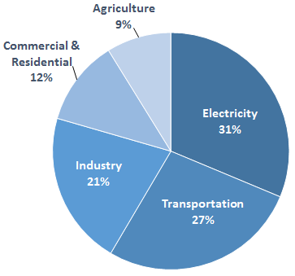
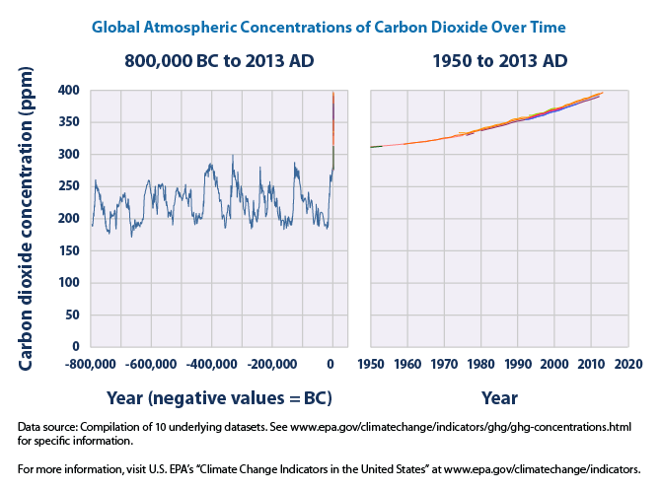
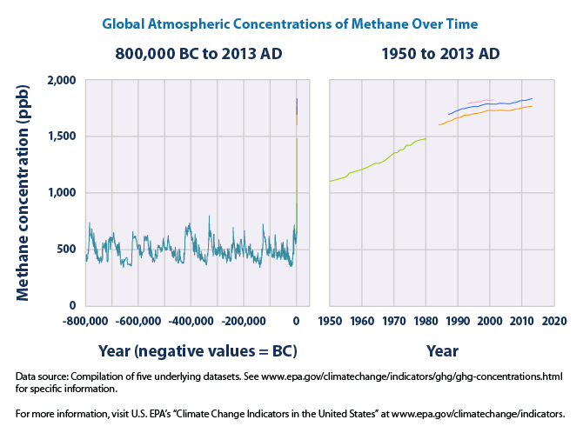
Major Sources and Sinks of Common GHGs
Sources:
Fossil fuel combustion (CO₂, CH₄, N₂O)
Manufacture of cement (CO₂)
Land use change (CO₂)
Decomposition in landfills (CH₄)
Ruminant animal raising (CH₄)
Fertilizers (N₂O)
Sinks:
Oceans
Photosynthesis (CO₂)
Dissolution (CO₂)
Sediment (CO₂)
Atmospheric
Oxidation (CH₄)
Photolysis (N₂O)
Land
Limestone (CO₂)
Plant photosynthesis (CO₂)
When sources increase and/or sinks decrease, concentrations may go up.
Figure sources: epa.gov

Slide 13
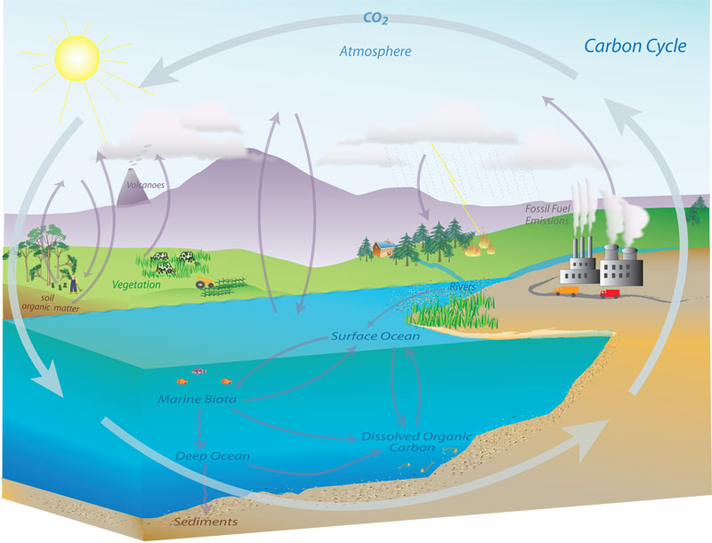
Carbon Cycle
Carbon is exchanged between sources and sinks
Rates not known with absolute certainty
Factors can affect sink rates, such as ocean currents for dissolution
Higher CO₂ concentrations could have effects on rates, such as uptake by plants
Image: www.esrl.noaa.gov/gmd/outreach/carbon_toolkit/images/carbon_cycle.jpg

Slide 14
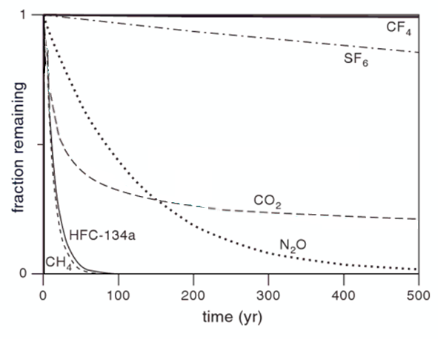
Timescale for Global Warming
Different gases have different residence times in the atmosphere
Only exert radiative forcing while present
Losses due to sinks previously described
GWP is quantified based on increased radiative forcing over a period of time
Usually 100 years is used
Sometimes 20, 50, or 500 years may be used
Also, 1 ton of carbon dioxide released today and re-absorbed today is sometimes referred to as ‘carbon neutral’
Much debate about what carbon neutrality means
Image Source: theoilconundrum.blogspot.com

Slide 15
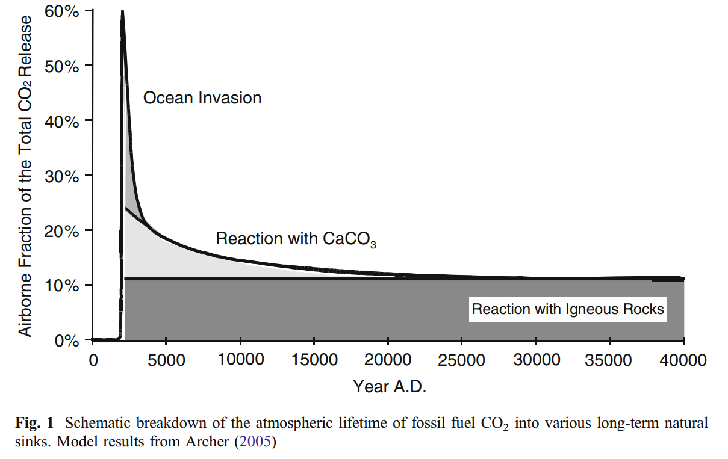
Residence Time of CO₂
“For a given amount of carbon dioxide emitted, some fraction of the atmospheric increase in concentration is quickly absorbed by the oceans and terrestrial vegetation, some fraction of the atmospheric increase will only slowly decrease over a number of years, and a small portion of the increase will remain for many centuries or more.” (EPA 2015)
Source | Life (yr.)
Jacobson (2005) | 30-95
Heweitt and Jackson (2009) | 50-100
Stumm and Morgan (1996) | 7
Archer and Brovkin (2008) | Hundreds of thousands
Figure source: Archer, D. and Brovkin, V. (2008). “The millennial atmospheric lifetime of anthropogenic CO₂.” Climate Change, 90:283-297.
Hewitt, C. N., and Andrea V. Jackson. Atmospheric Science for Environmental Scientists. Chichester, U.K.: Wiley-Blackwell, 2009. Print.
Archer, D. and Brovkin, V. (2008). “The millennial atmospheric lifetime of anthropogenic CO₂.” Climate Change, 90:283-297.
Jacobson, MZ (2005). "Correction to "Control of fossil-fuel particulate black carbon and organic matter, possibly the most effective method of slowing global warming."". J. Geophys. Res. 110. pp. D14105.

Slide 16
Characterization of GWP at Different Timescales
1 kg of substance | Life (yr.) | GWP₂₀ | GWP₁₀₀ | GWP₅₀₀
Carbon dioxide | Variable | 1 | 1 | 1
Methane | 12 | 72 | 25 | 8
HCFC-134a (C₂H₂F₄) | 14 | 3,830 | 1,430 | 435
Nitrous oxide | 120 | 289 | 298 | 153
Nitrogen trifluoride | 740 | 12,300 | 17,200 | 20,700
Sulfur hexafluoride | 3200 | 16,300 | 22,800 | 32,600
Carbon tetrafluoride | 50,000 | 5,210 | 7,390 | 11,200
Note: Lifetimes from Klopffer and Grahl (2014). GWP values from CML 2007
Different GWPs cannot be compared to one another

Slide 17
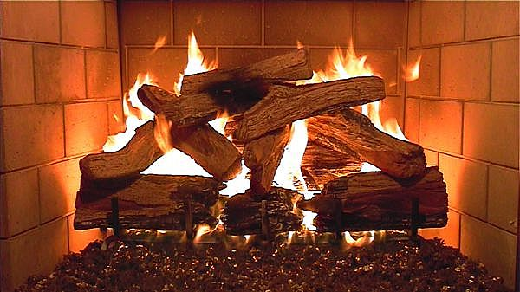
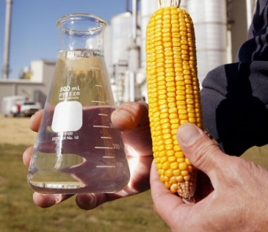
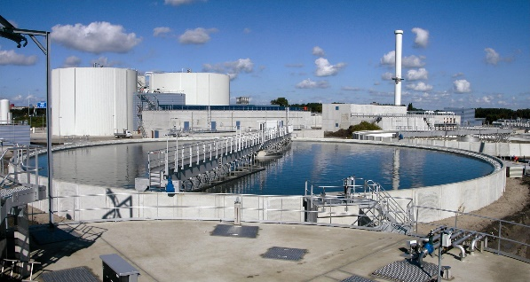
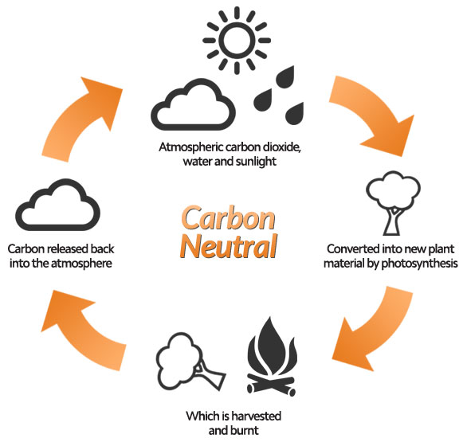
Biogenic CO₂
Biogenic CO₂ is that released from recently living materials, such as:
Often assumed to have net zero release of CO₂
Assumption that CO₂ released is recaptured during re-growth
Many factors may make this a poor assumption in some cases
Time lag between emissions and regrowth
Changes in soil organic matter
Changes in land use
Many more
Therefore, there is much discussion on best practices to attempt to quantify these effects, rather than simply assuming carbon neutrality which may not be applicable in all cases.
Wood
Ethanol
Wastewater Treatment
?
Wood: mtlfd.org Ethanol: eworld.com Wastewater: mottmac.com Carbon neutral: wheildons.co.uk

Slide 18
Global Warming Potential Example Calculation
Example Problem:
Average conventional diesel fuel production, including extraction of crude oil, transportation, and refining produces the following greenhouse gas emissions per gallon of fuel produced:
14.9 g of CH₄
31.0 mg of N₂O
2.35 kg of CO₂
Using only these emissions data, calculate the global warming potential of conventional diesel production expressed in kg CO₂-equivalent using a 100-year time frame.
Data sourced from GREET for U.S. National Average Refineries

Slide 19
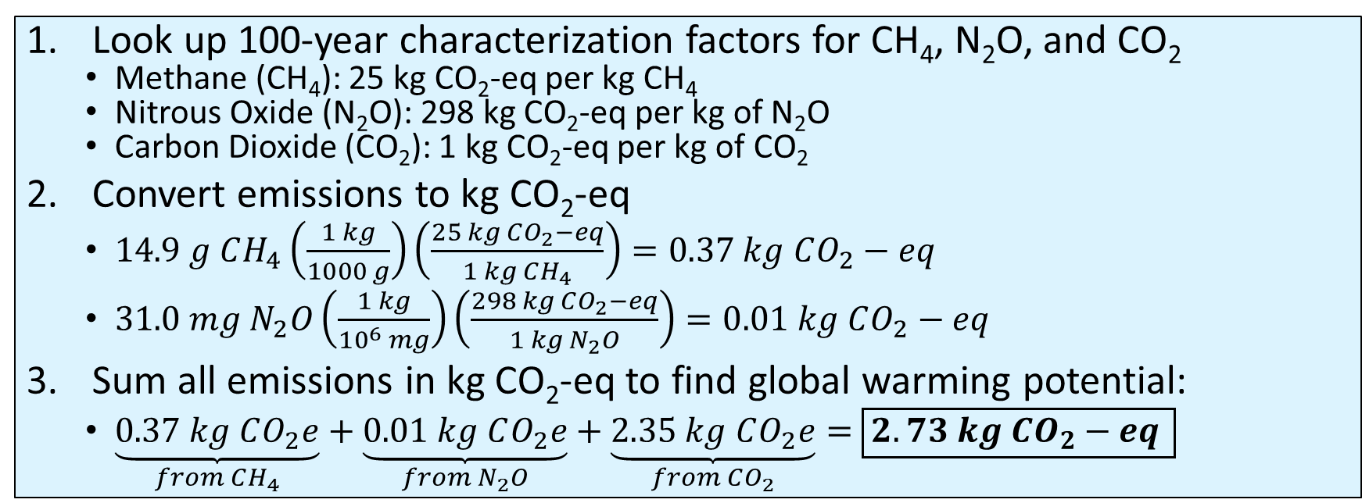
Global Warming Potential Example Calculation
GHG emissions inventory=14.9 g of CH_{4,} 31.0 mg of N₂O, 2.35 kg of CO₂
Calculate the global warming potential in kg CO₂-equivalent (kg CO₂e).
Look up 100-year characterization factors for CH₄, N₂O, and CO₂
Methane (CH₄): 25 kg CO₂-eq per kg CH₄
Nitrous Oxide (N₂O): 298 kg CO₂-eq per kg of N₂O
Carbon Dioxide (CO₂): 1 kg CO₂-eq per kg of CO₂
Convert emissions to kg CO₂-eq
$14.9 g CH_{4}\left(\frac{1 kg}{1000 g}\right)\left(\frac{25 kg CO_{2}−eq}{1 kg CH_{4}}\right)=0.37 kg CO_{2}−eq$
$31.0 mg N_{2}O\left(\frac{1 kg}{{10}^{6} mg}\right)\left(\frac{298 kg CO_{2}−eq}{1 kg N_{2}O}\right)=0.01 kg CO_{2}−eq$
Sum all emissions in kg CO₂-eq to find global warming potential:
$\underset{from CH_{4}}{\underbrace{0.37 kg CO_{2}e}}+\underset{{from N}_{2}O}{\underbrace{0.01 kg CO_{2}e}}+\underset{from CO_{2}}{\underbrace{2.35 kg CO_{2}e}}=\boxed{2.73 kg CO_{2}−eq }$

Slide 20
Global Warming Potential Example Calculation
Example Problem:
All processes involved in the production of corn (to be used for ethanol) result in the following greenhouse gas emissions per US bushel of corn produced:
8.3 g of CH₄
15.0 g of N₂O
3.94 kg of CO₂
Using only these emissions data, calculate the global warming potential of corn production expressed in kg CO₂-equivalent using a 20-year time frame.
Data sourced from GREET

Slide 21
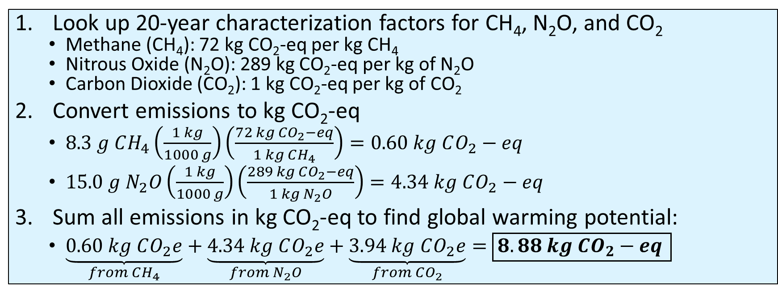
Global Warming Potential Example Calculation
GHG emissions inventory=8.3 g of CH_{4,} 15.0 g of N₂O, 3.94 kg of CO₂
Calculate the global warming potential in kg CO₂-equivalent (kg CO₂e).
Look up 20-year characterization factors for CH₄, N₂O, and CO₂
Methane (CH₄): 72 kg CO₂-eq per kg CH₄
Nitrous Oxide (N₂O): 289 kg CO₂-eq per kg of N₂O
Carbon Dioxide (CO₂): 1 kg CO₂-eq per kg of CO₂
Convert emissions to kg CO₂-eq
$8.3 g CH_{4}\left(\frac{1 kg}{1000 g}\right)\left(\frac{72 kg CO_{2}−eq}{1 kg CH_{4}}\right)=0.60 kg CO_{2}−eq$
$15.0 g N_{2}O\left(\frac{1 kg}{1000 g}\right)\left(\frac{289 kg CO_{2}−eq}{1 kg N_{2}O}\right)=4.34 kg CO_{2}−eq$
Sum all emissions in kg CO₂-eq to find global warming potential:
$\underset{from CH_{4}}{\underbrace{0.60 kg CO_{2}e}}+\underset{{from N}_{2}O}{\underbrace{4.34 kg CO_{2}e}}+\underset{from CO_{2}}{\underbrace{3.94 kg CO_{2}e}}=\boxed{8.88 kg CO_{2}−eq }$

Slide 22
GWP₂₀, GWP₁₀₀, and GWP₅₀₀ Comparison
Production of 1 gallon of diesel fuel
Contribution From | GWP₂₀ | GWP₁₀₀ | GWP₅₀₀
CO₂ (kg CO₂-eq) | 2.35 | 2.35 | 2.35
CH₄ (kg CO₂-eq) | 1.07 | 0.37 | 0.11
N₂O (kg CO₂-eq) | 0.01 | 0.01 | 0.005
Total (kg CO₂-eq) | 3.43 | 2.73 | 2.47
Production of 1 US bushel of corn
Contribution From | GWP₂₀ | GWP₁₀₀ | GWP₅₀₀
CO₂ (kg CO₂-eq) | 3.94 | 3.94 | 3.94
CH₄ (kg CO₂-eq) | 0.60 | 0.21 | 0.06
N₂O (kg CO₂-eq) | 4.34 | 4.47 | 2.30
Total (kg CO₂-eq) | 8.88 | 8.62 | 6.30
GWPs between different time frames cannot be directly related to one another

Slide 23

What time frame should we use?
Likely depends on the goal and intended use of the LCA
For example:
a) If goal is reduce global warming by 2035, maybe 20 year GWP might be most appropriate
b) If the goal is to decrease GWP by 2115, maybe 100 year GWP might most appropriate (but may be hotter in 2035 than in scenario a)
This question is difficult to answer, but at least should be considered anytime an LCA is carried out or interpreted
?
Clock: clker.com

Slide 24
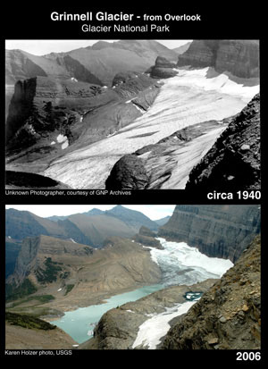
Global Warming Potential (GWP) Summary
Major sources
Fuel combustion
Electricity
Agriculture
Industrial processes
Transportation
Main substances*
80%
9%
11%
CO₂
CH₄
N₂O, O₃, H₂O(g), CFCs, Others
Midpoint
Increased radiative forcing (trapping heat)
Wind and ocean current changes
Soil moisture loss
Some Possible Endpoints
Percentages of impact contributed by each substance is based on total US inventory from Ryberg et al. 2014 and represents the percentage of impacts, not mass
Sea level increase
Increase in severe weather frequency
Increase in heat-related illnesses
CO₂: carbon dioxide CH₄: methane N₂O: nitrous oxide O₃: ozone H₂O(g): water vapor CFC: chlorofluorocarbons
*Ryberg et al. 2014 Glacier: nrmsc.usgs.gov

Slide 25
Thank you for completing Module β1!
Group A: ISO Compliant LCA Overview Modules
Group α: ISO Compliant LCA Detailed Modules
Group B: Environmental Impact Categories Overview Modules
Group β: Environmental Impact Categories Detailed Modules
Group G: General LCA Tools Overview Modules
Group γ: General LCA Tools Detailed Modules
Group T: Transportation-Related LCA Overview Modules
Group τ: Transportation-Related LCA Detailed Modules

Slide 26
Homework
Find 2 carbon footprint studies and explain what timescales they use and why
Convert those results to 20 and 500 year timescales

