Slide 1

Welcome to the Life Cycle Assessment (LCA) Learning Module Series
Liv Haselbach Quinn Langfitt
For current modules email haselbach@wsu.edu or visit cem.uaf.edu/CESTiCC
Acknowledgements:
CESTiCC Washington State University Fulbright

Slide 2
LCA Module Series Groups
Group A: ISO Compliant LCA Overview Modules
Group α: ISO Compliant LCA Detailed Modules
Group B: Environmental Impact Categories Overview Modules
Group β: Environmental Impact Categories Detailed Modules
Group G: General LCA Tools Overview Modules
Group γ: General LCA Tools Detailed Modules
Group T: Transportation-Related LCA Overview Modules
Group τ: Transportation-Related LCA Detailed Modules

Slide 3
Other Common Emissions Impact Categories
Module B3

Slide 4
Summary of Module B1 and Other Points
All impacts are “potential”
Only anthropogenic sources are included
Different substances have different relative amounts of forcing
Usually results are related to the equivalent release of a particular substance
Different impact categories have different scales of impacts
Global, regional, local
Watch Module B1 for background
β modules for more details
Percentages of impact contributed by various substances is based on total US inventory from Ryberg et al. 2014 and represents the percentage of impacts, not the mass percentage
More impact categories are available than can be covered in this module series
Ryberg, M., Vieira, M.D.M., Zgola, M., Bare, J., and Rosenbaum, R.K. (2014). “Updated US and Canadian normalization factors for TRACI 2.1.” Clean Technology and Environmental Policy, 16(2), 329-339.

Slide 5
Common Impact Categories
Acidification Potential (AP)
Global Warming/Climate Change Potential (GWP)
Smog/Ozone/Photochemical Oxidants/Creation Potential (SCP)
Stratospheric Ozone Depletion Potential (ODP)
Human Health Particulates/Criteria Air Potential (HHCAP)
Human Health/Toxicity Cancer/Non-Cancer Potential (HTP)
Ecotoxicity Potential (ETP)
Eutrophication Potential (EP)
Air
Air
Water
Soil
Bolded impact categories are those covered in this module
These are only some of the possible impact categories in LCA

Slide 6
Some Other Impact Categories
Radiation
Abiotic resource depletion
Fossil fuel depletion
Biotic resource depletion
Energy demand
Water use
Land use
Nuisance-related (noise, odor, etc.)
Indoor air quality

Slide 7

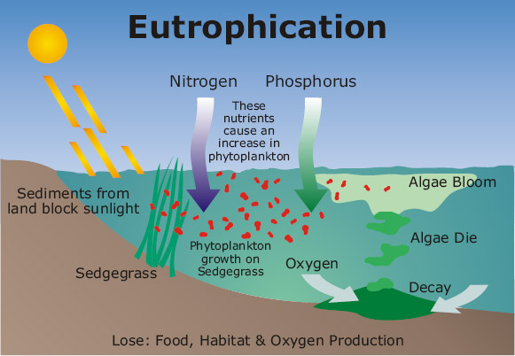
Eutrophication Potential
Scale of impacts:
Excessive biological activity of organisms due to over-nutrification
Especially in aquatic systems, often apparent through algal blooms
Can lead to oxygen deficiency in water killing aquatic life
Mostly forced by nitrogen and phosphorus
Also called nutrification
Organisms need nutrients to grow, but too much can have undesirable consequences
Local variations can be very important
Commonly reported as:
kg PO₄³⁻ -equivalent (phosphate)
kg P-equivalent (phosphorus)
kg NO₃—equivalent (nitrate)
kg N-equivalent (nitrogen)
Local
esp. in
fresh water
esp. in salt
water and soil
Source: ecodetail.net.au

Slide 8

Eutrophication Potential
Major sources
Agricultural runoff
Storm and wastewater
Septic field seepage
Fossil fuel Combustion
Main substances
Others: 8%
42%
33%
10%
7%
Nitrogen
Phosphorus
NO_{x}
NH₃
esp. marine
Water
esp. freshwater
Air
Midpoint
Excessive biological growth, especially of algae
Possible Endpoints (mostly due to aquatic oxygen depletion)
Death of aquatic life
Loss of biodiversity
Foul odor
Algal bloom: apporpedia.org

Slide 9
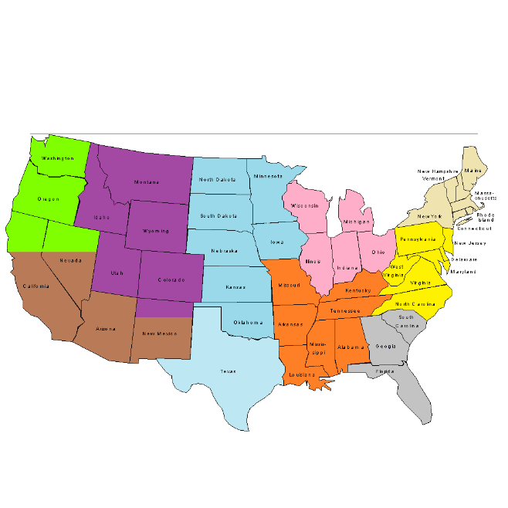

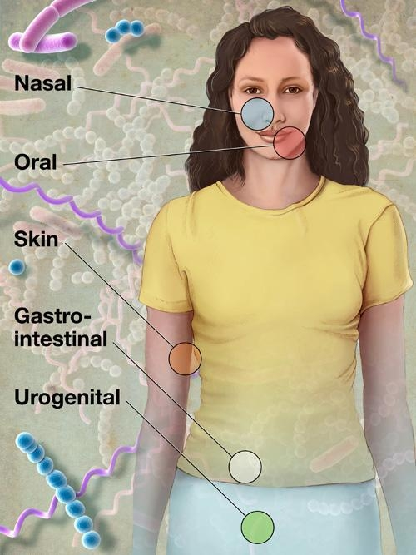
Human Toxicity Potential
Scale of impacts:
Effects to individual human health that can lead to disease or death
Usually split between carcinogenic and non-carcinogenic
Can either cause or aggravate existing health conditions
Only considers direct impacts, indirect ones in other impact categories
Large scale impacts, not facility specific (occupational) ones
Organic chemicals and metals are some of the largest contributors
Much uncertainty in characterization factors
No true midpoint to consider
Based on linear models, but toxicity effects are usually non-linear
Characterization commonly done through USEtox factors
Considers fate, exposure, and effect factors
Commonly expressed as:
kg benzene-eq (cancer) or kg toluene-eq (non-cancer)
Cases (also called Comparative Toxicity Unit – CTU)
Local
Regional
Global
Source: NIH Medical Arts and Printing

Slide 10
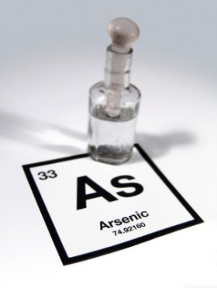
Human Toxicity Potential
Major sources
Mining
Agriculture
Manufacturing
Energy production
Some major substances
6%
Formaldehyde
Dioxins
Chromium
Arsenic
Zinc
Benzo(a)pyrene
Midpoint
General health effects on humans (no true midpoint)
Possible Endpoints (either causing or aggravating)
Asthma
Cancer
Heart disease
Low birth rate
Image source: globalhealingcenter.com

Slide 11

Ecotoxicity Potential
Scale of impacts:
Impacts on whole ecosystems that can decrease production and/or decrease biodiversity
More focused on whole system impacts than individual impacts
Sometimes split between aquatic (water) and terrestrial (soil)
Mostly forced by emissions of metals and organic chemicals
Characterization commonly done through USEtox factors
Considers fate, exposure, and effect factors
Much uncertainty in characterization factors
No true midpoint
Factors based on only a few species, but wider ecosystem effects more difficult to deduce
Commonly expressed as:
kg 2,4-dichlorophenoxy-acetic acid (2,4-D) - equivalent
Potentially affected fraction (PAF) (also called Comparative Toxicity Unit – CTU)
Local
Image source: scienceinthebox.com (P&G website)

Slide 12
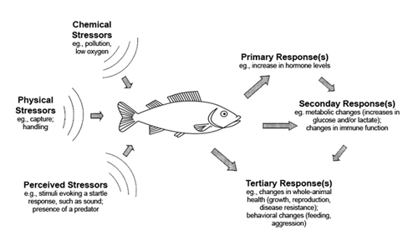
Ecotoxicity Potential
Major sources
Mining
Agriculture
Manufacturing
Energy production
Main substances
Zinc
Copper
Organic Chemicals
Midpoint
General degradation of ecosystems (no true midpoint)
Possible Endpoints
Decreased populations
Decreased biodiversity
Image source: dosits.org

Slide 13
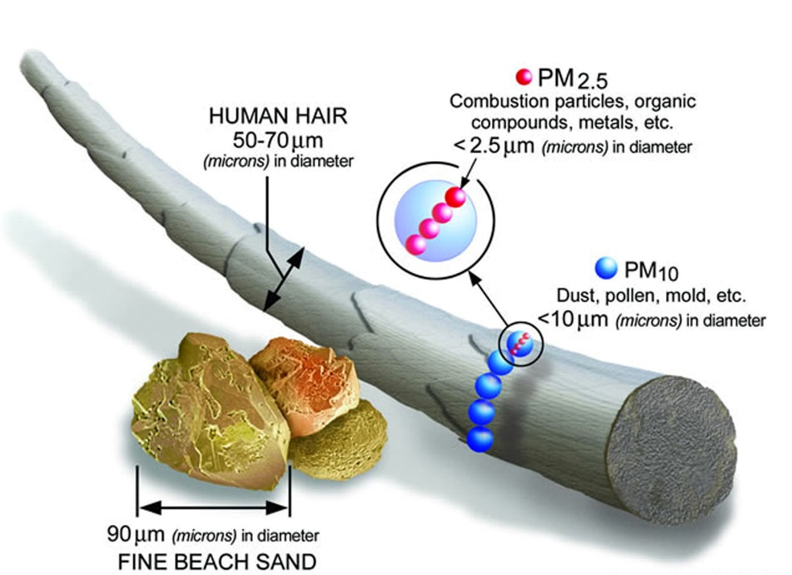
Human Health – Particulates
Scale of impacts:
Health issues related to increased respiration of very small particles
Small particles released directly and formed through secondary reactions
When breathed into lungs may cause respiratory disease and cancer
Category also called “criteria air pollutants”, but really only deals with subset
Health issues more severe for higher risk individuals
Children, elderly, those with asthma
Usually midpoint quantified as:
kg PM_{2.5}-eq
kg PM₁₀-eq
Sometimes reported more as endpoint:
Disability adjusted life years (DALYs)
Local
Regional
Global
Image source: epa.gov

Slide 14
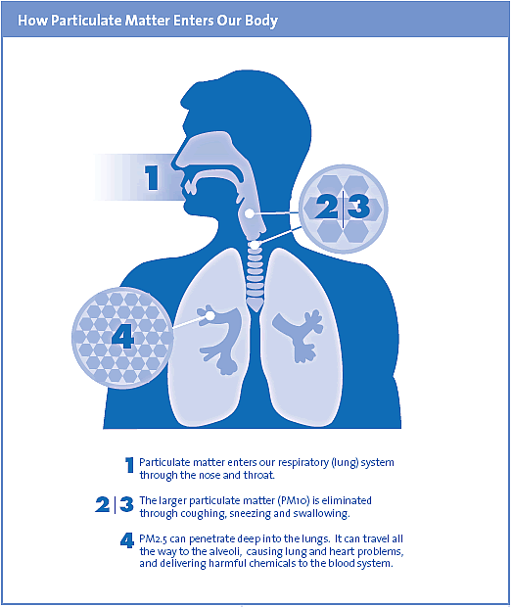
Human Health – Particulates
Major sources
Fossil fuel combustion
Wood burning
Dust from roads
Dust from fields
Main substances
44%
43%
8%
5%
PM₁₀
PM_{2.5}
SO_{x}
NO_{x} and Others
Midpoint
Increased human exposure to particulate matter
Possible Endpoints
Heart health effects
Aggravated asthma
Decreased lung function
Cancer
Image source: bcairquality.ca

Slide 15
A Couple More
Radiation: Regular releases of radioactive material which can have carcinogenetic and hereditary effects
Abiotic resource depletion: Uses of minerals, ores, etc. based on relative scarcity and overall consumption
Fossil fuel depletion: Similar to abiotic resources except based on energy content, not mass
Biotic resource depletion: Uses of recently living materials based on use rate, formation rate, and reserves
Energy demand: Energy required of all stages of life cycle (not energy content)
Embodied energy is a subset of energy demand for only life cycle stages involved in producing the product
Water use: Typically just an inventory of fresh water use, sometimes differentiated by quality
Land use: Alteration to habitats, particularly for threatened and endangered species
Nuisance-related (noise, odor, etc.): Reduced quality of life for humans due to nuisance (rarely included in LCA)
Indoor air quality: Human health impacts of indoor air pollutants, especially VOCs (rarely included in LCA)

Slide 16
Thank you for completing Module B3!
Group A: ISO Compliant LCA Overview Modules
Group α: ISO Compliant LCA Detailed Modules
Group B: Environmental Impact Categories Overview Modules
Group β: Environmental Impact Categories Detailed Modules
Group G: General LCA Tools Overview Modules
Group γ: General LCA Tools Detailed Modules
Group T: Transportation-Related LCA Overview Modules
Group τ: Transportation-Related LCA Detailed Modules

Slide 17
Self-Assessment Quiz
MODULE B3: other common emission impact categories

Slide 18
By what mechanism does eutrophication usually cause the most damage to aquatic life?
Algae blooms block sunlight causing temperatures to drop in the water
Algae blooms deplete the water of oxygen leaving little for other organisms
Toxic levels of nutrients kill aquatic life when they uptake too much

Slide 19
Correct!
The main way in which eutrophication impacts manifest themselves is through excessive growth of algae depleting the water of oxygen and leaving too little for many other organisms to survive.

Slide 20
Which of these is not included as a factor in USEtox characterization of human toxicity?
Fate (transport of toxic chemicals)
Exposure (intake by humans)
Effects (toxicity in humans)
Interactions (effects of chemicals in combination with one another)

Slide 21
Correct!
While interactions of chemicals may have an impact on their effects, characterization is done separately for each substance so interactions are not considered. Fate, exposure, and effects are the three factors used.

Slide 22
The human toxicity impact category is often split into which of the following classifications?
Cancer and non-cancer effects
Acute and chronic effects
Nervous system, circulatory system, and respiratory system effects

Slide 23
Correct!
Human toxicity is frequently differentiated into two separate impact categories: human cancer toxicity and human non-cancer toxicity.

Slide 24
Besides animals vs. humans, what is the major conceptual difference between human toxicity and ecotoxicity?
Human toxicity uses non-linear dose-effects relationships while ecotoxicity uses linear ones
Human toxicity is more focused on the health of each individual, while ecotoxicity is more focused on overall ecosystem impacts
Human toxicity is focused on acute effects, but ecotoxicity on chronic effects

Slide 25
Correct!
Human toxicity is focused on health issues of the individual, but ecotoxicity attempts to focus on overall ecosystem impacts, and not so much on health issues on individual organisms (at least in conception – these are complex considerations).

Slide 26
How can anthropogenic particulate matter get into the air?
Directly released as particulate matter (from combustion, physical processes, etc.)
Formed in the atmosphere from gaseous emissions reactions
Both of the above

Slide 27
Correct!
Particulate matter can be directly emitted from chemical and physical processes, or be formed secondarily in the atmosphere from reactions of gases such as NO_{x}, SO_{x}, and VOCs.

Slide 28
Sorry that’s Incorrect
Please try again!

