Slide 1
Welcome to the Life Cycle Assessment (LCA) Learning Module Series
Liv Haselbach Quinn Langfitt
For current modules email haselbach@wsu.edu or visit cem.uaf.edu/CESTiCC
Acknowledgements:
CESTiCC Washington State University Fulbright

Slide 2
LCA Module Series Groups
Group A: ISO Compliant LCA Overview Modules
Group α: ISO Compliant LCA Detailed Modules
Group B: Environmental Impact Categories Overview Modules
Group β: Environmental Impact Categories Detailed Modules
Group G: General LCA Tools Overview Modules
Group γ: General LCA Tools Detailed Modules
Group T: Transportation-Related LCA Overview Modules
Group τ: Transportation-Related LCA Detailed Modules

Slide 3
Common Air Emission Impact Categories
It is suggested to review Modules B1 prior to this module
Module B2
Additional acknowledgements to Trace Sendele

Slide 4
Summary of Module B1 and Other Points
All impacts are “potential”
Only anthropogenic sources are included
Different substances have different relative amounts of forcing
Usually results are related to the equivalent release of a particular substance
Different impact categories have different scales of impacts
Global, regional, local
Watch Module B1 for background
β modules for more details
Percentages of impact contributed by various substances is based on total US inventory from Ryberg et al. 2014 and represents the percentage of impacts, not the mass percentage
More impact categories are available than can be covered in this module series
Ryberg, M., Vieira, M.D.M., Zgola, M., Bare, J., and Rosenbaum, R.K. (2014). “Updated US and Canadian normalization factors for TRACI 2.1.” Clean Technology and Environmental Policy, 16(2), 329-339.

Slide 5
Common Impact Categories
Acidification Potential (AP)
Global Warming/Climate Change Potential (GWP)
Smog/Ozone/Photochemical Oxidants/Creation Potential (SCP)
Stratospheric Ozone Depletion Potential (ODP)
Human Health Particulates/Criteria Air Potential (HHCAP)
Human Health/Toxicity Cancer/Non-Cancer Potential (HTP)
Ecotoxicity Potential (ETP)
Eutrophication Potential (EP)
Air
Air
Water
Soil
Bolded impact categories are those covered in this module
These are only some of the possible impact categories in LCA

Slide 6
Some Other Impact Categories
Radiation
Abiotic resource depletion
Fossil fuel depletion
Biotic resource depletion
Energy demand
Water use
Land use
Nuisance-related (noise, odor, etc.)
Indoor air quality

Slide 7
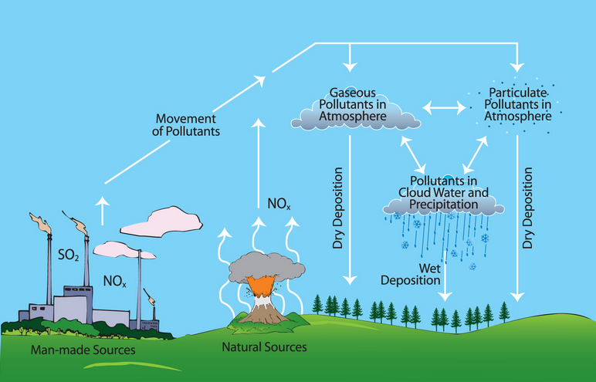
Acidification Potential (AP)
Scale of impacts:
Emissions which increase acidity (lower pH) of water and soils
Most common form of deposition is as acid rain
Dry and cloud deposition also occur
Ocean acidification from CO₂ not included
Only anthropogenic sources are included, though natural sources exist too (such as volcanoes)
Regional variations can be important
Commonly reported as:
kg SO₂-eq
mol H⁺-eq
Local
Regional
SO₂: sulfur dioxide mol: ~6*10²³ atoms H⁺: hydrogen ion
Image source: blog.epa.gov

Slide 8
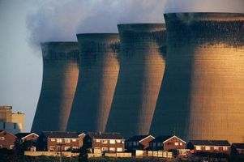
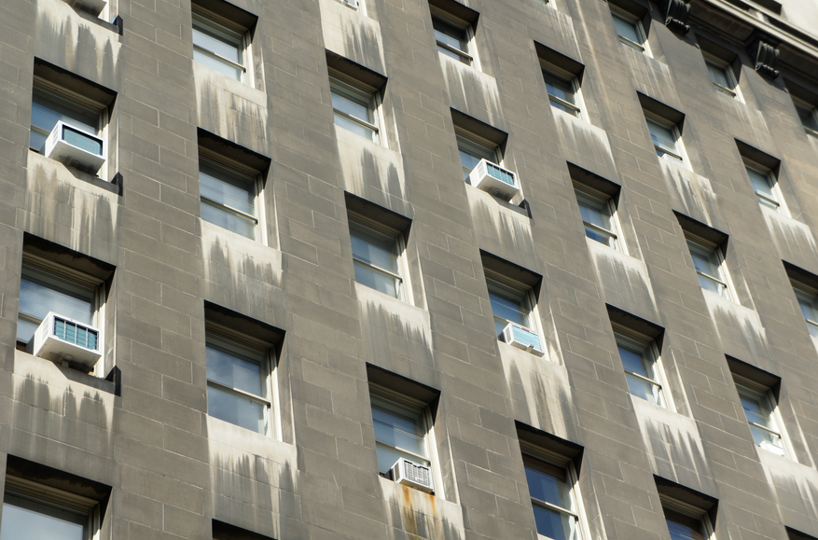
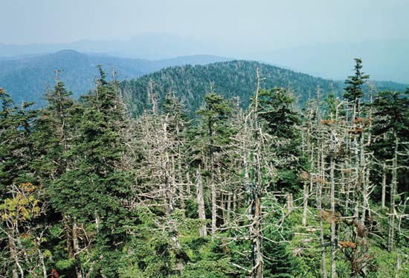
Acidification Potential (AP)
Major sources
Fuel combustion
Electricity
Agriculture
Transportation
Main substances*
Others: 1%
38%
35%
26%
NO_{x}
SO_{x}
NH₃
Midpoint
Increased soil and water acidity
Possible Endpoints
Organisms
Plants (esp. forests)
Buildings
NO_{x}: nitrogen oxides SO_{x}: sulfur oxides NH₃: ammonia
*Ryberg et al. 2014 Building damage: h2owash.biz Forest: Britannica.com Power plant: ehow.com

Slide 9
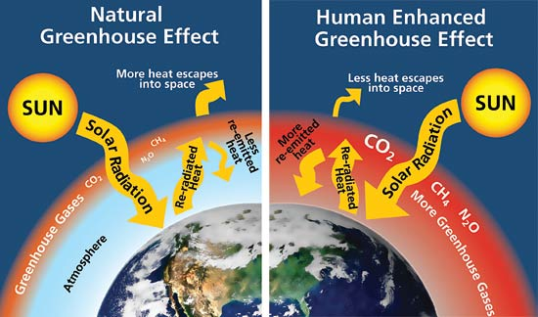
Global Warming Potential (GWP)
Scale of impacts:
Increase in greenhouse gas concentrations, resulting in potential increases in global average surface temperature
Occurs due to the greenhouse effect
Often called climate change to reflect scope of possible effects
CO₂ is biggest anthropogenic source, other sources too
Some greenhouse effect necessary, additional forced by humans is what is counted in LCA
Biogenic CO₂ may or may not be counted
e.g. biofuels
GWP typically reported as 100 year time scale
Almost universally reported as kg CO₂-equivalent
Global
CO₂: carbon dioxide
Source: livescience.com

Slide 10
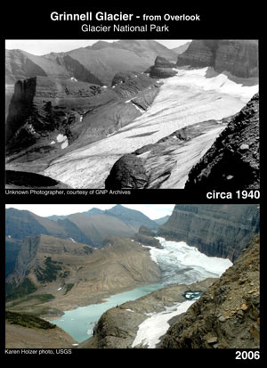
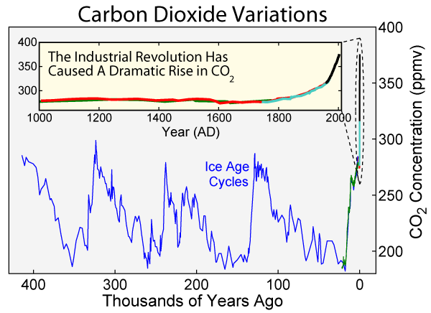
Global Warming Potential (GWP)
Major sources
Fuel combustion
Electricity
Agriculture
Industrial processes
Transportation
Main substances*
80%
9%
11%
CO₂
CH₄
N₂O, O₃, H₂O(g), CFCs, Others
Midpoint
Increased radiative forcing (trapping heat)
Wind and ocean current changes
Soil moisture loss
Possible Endpoints
Sea level increase
Increase in severe weather frequency
Increase in heat-related illnesses
CO₂: carbon dioxide CH₄: methane N₂O: nitrous oxide O₃: ozone H₂O(g): water vapor CFC: chlorofluorocarbons
*Ryberg et al. 2014 CO₂ plot: Wikimedia.org Glacier: nrmsc.usgs.gov

Slide 11
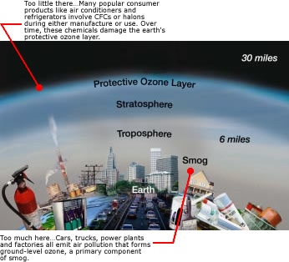
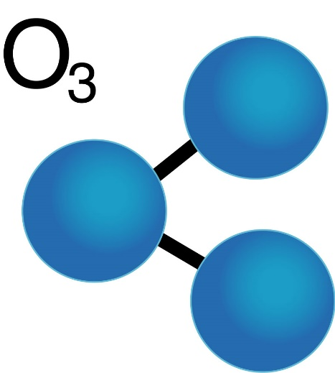
Ozone
Molecule composed of three oxygen atoms
Colorless, odorless gas
The focus of two very different impact categories
Ozone depletion potential – “Good” ozone
Smog creation potential – “Bad” ozone
Ozone molecule: naturallythebest.com Good/bad ozone: epa.gov

Slide 12
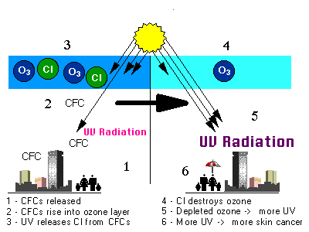
Ozone Depletion Potential (ODP)
Scale of impacts:
Reduction of ozone concentration in the stratosphere
This is “good” ozone which filters out UV-B radiation
Additional UV can cause skin cancer, crop damage, material damage
Primarily caused when CFCs and halons lose chlorine and bromine atoms in reaction with sunlight and catalyzes ozone decomposition reactions
Not a major cause of climate change
Ozone depletion less prevalent since Montreal Protocol (1987)
Required replacement of CFCs with other compounds
Reduction of 98% in ODP emissions since then
Still important to consider, especially for particular sectors
Almost universally reported as kg CFC-11-equivalent
Previously common refrigerant
Global
CFCs: chlorofluorocarbons
Image source: epa.gov

Slide 13
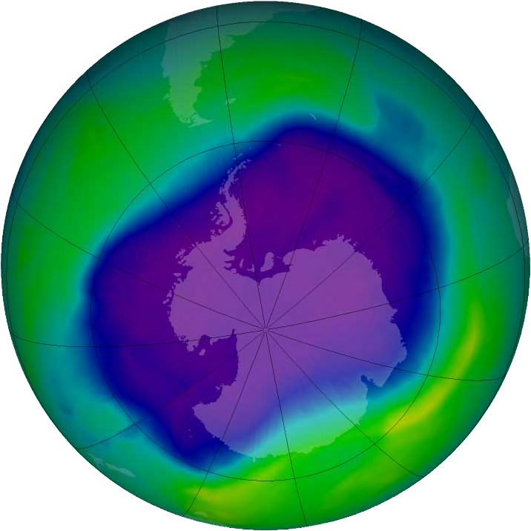
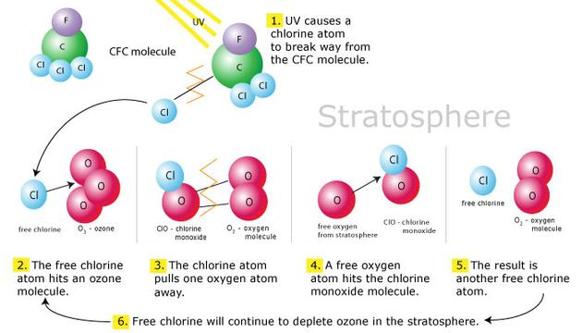
Ozone Depletion Potential (ODP)
Major sources
Manufacturing (polymers, aerosols)
Fire extinguishers
Refrigerant systems
Main substances*
Others: 26%
29%
22%
14%
Halon 1301
CFC-11
CFC-12
9%
HCFC-22
Midpoint
Decrease in stratospheric ozone concentration
Possible Endpoints (Due to increased UV-B radiation)
Skin cancer
Crop damage
Materials damage
Marine life damage
CFC: chlorofluorocarbon HCFC: hydrochlorofluorocarbon
*Ryberg et al. 2014 Ozone hole: Wikipedia.org Ozone chemistry: environmental-chemistry.wikispaces.com

Slide 14
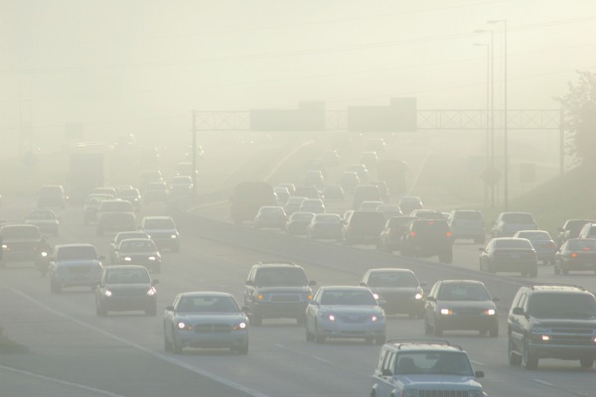
Smog Creation Potential (SCP)
Scale of impacts:
Increased formation of ground level ozone
Also called photoxidant formation, ozone creation, etc.
Formed from reactions of NO_{x}, VOCs, other pollutants, and sunlight
Can have effects on human health and vegetation
Effects vary, but LCA does not usually capture, based on:
Current air composition (i.e. NO_{x} or VOC limited)
Time of day and year (sunlight)
Physical characteristics of area and weather patterns
Exposed populations
Commonly expressed as:
kg O₃-equivalent
kg C₂H₄-equivalent
kg NO_{x}-equivalent
Local
O₃: ozone C₂H₄: ethane NO_{x}: nitrogen oxides VOCs: volatile organic compounds
Image source: edmunds.com

Slide 15
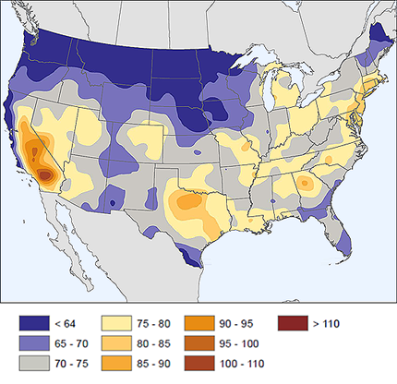
Smog Creation Potential (SCP)
Major sources
Cars and other vehicles
Industrial processes
Energy production
Main substances*
Others: 2%
87%
11%
NO_{x}
VOCs
Midpoint
Increase in ground-level
ozone concentration
2005-2009 4th highest annual value of maximum daily 8-hr. ozone in ppb
Possible Endpoints
Reduced lung function/aggravation
Aggravate Asthma
Vegetation damage
Eye irritation
NO_{x}: nitrogen oxides VOCs: volatile organic compounds
*Ryberg et al. 2014 Image source: science.nature.nps.gov

Slide 16
Common Impact Categories
Acidification Potential (AP)
Global Warming/Climate Change Potential (GWP)
Smog/Ozone/Photochemical Oxidants/Creation Potential (SCP)
Stratospheric Ozone Depletion Potential (ODP)
Human Health Particulates/Criteria Air Potential (HHCAP)
Human Health/Toxicity Cancer/Non-Cancer Potential (HTP)
Ecotoxicity Potential (ETP)
Eutrophication Potential (EP)
Air
Air
Water
Soil

Slide 17
Thank you for completing Module B2!
Group A: ISO Compliant LCA Overview Modules
Group α: ISO Compliant LCA Detailed Modules
Group B: Environmental Impact Categories Overview Modules
Group β: Environmental Impact Categories Detailed Modules
Group G: General LCA Tools Overview Modules
Group γ: General LCA Tools Detailed Modules
Group T: Transportation-Related LCA Overview Modules
Group τ: Transportation-Related LCA Detailed Modules

Slide 18
Self-Assessment Quiz
MODULE B2: Common Air Emission Impact Categories

Slide 19
What is the most common form of deposition for acidification potential?
Acid rain
Ocean acidification from CO₂
Dry deposition

Slide 20
Correct!
Acid rain is the most common way that acidifying substances are deposited in the acidification potential category. Dry deposition happens less often, and ocean acidification by CO₂ is not included in that category.

Slide 21
What time scale is most often used for determining global warming potential in LCA?
1 year
50 year
100 year

Slide 22
Correct!
Global warming potential is usually characterized based on a 100 year time scale, though other time scales like 50 year and 500 year are occasionally used.

Slide 23
Which type of ozone is considered “good”?
Tropospheric
Stratospheric
Both
Neither

Slide 24
Correct!
Ozone in the stratosphere (high up) filters UV-B radiation, while ozone in the troposphere (near ground) can be a health a hazard when breathed in.

Slide 25
What is the main direct result of decreased ozone concentrations in the stratosphere?
More ground-level ozone mixes up into the stratosphere to create an equilibrium reducing smog
Increased greenhouse gas effect contributing to global warming
More UV-B radiation reaches Earth’s surface resulting in impacts such as higher rates of skin cancer, crop damage, and building damage

Slide 26
Correct!
Ozone depletion in the stratosphere allows more UV-B radiation to penetrate the atmosphere. It does not significantly affect global warming or interactions with ground-level ozone.

Slide 27
How is ground level ozone (smog) most commonly formed?
Reactions of NO_{x} and VOCs in the presence of sunlight
Reactions with oxygen catalyzed by chlorine atoms from CFCs and halons
Directly emitted from combustion of fossil fuels

Slide 28
Correct!
Ground level ozone is mostly formed in reaction cycles of NO_{x} and VOCs in the presence of sunlight. Chlorine catalyzed reactions from CFCs and halons are the main contributors of stratospheric ozone depletion, and ozone is rarely emitted directly from any sources.

Slide 29
Sorry that’s Incorrect
Please try again!

