Slide 1

Welcome to the Life Cycle Assessment (LCA) Learning Module Series
Liv Haselbach Sila Temizel Sekeryan
For current modules email lhaselbach@lamar.edu or visit cem.uaf.edu/CESTiCC or https://engineering.lamar.edu/civil/faculty/haselbach/research.html
Acknowledgements:
CESTiCC Washington State and LAmar Universitıes
Natıonal Asphalt pavement assocıatıon (NAPA)

Slide 2
LCA Module Series Groups
Group A: ISO Compliant LCA Overview Modules
Group α: ISO Compliant LCA Detailed Modules
Group B: Environmental Impact Categories Overview Modules
Group β: Environmental Impact Categories Detailed Modules
Group G: General LCA Tools Overview Modules
Group γ: General LCA Tools Detailed Modules
Group T: Transportation-Related LCA Overview Modules
Group τ: Transportation-Related LCA Detailed Modules

Slide 3
Feedstock Energy and Carbon Cycle for Asphalt and Other Materials
Module α7

Slide 4
Feedstock Energy?
Per ISO 14040:2006 feedstock energy is a required component to be considered
in LCA and it defines feedstock energy as (ISO 2006a):
“heat of combustion of a raw material input that is not used as an energy source to a product system, expressed in the terms of higher heating value or lower heating value.
NOTE: Care is necessary to ensure that the energy content of raw materials is not counted twice.”
But where and why should feedstock energy be considered in LCAs?
In the case of asphalt, bitumen is a fossil fuel with energy content that could be directly combusted or upgraded to lighter fuels for combustion (Santero et al. 2010), or remain as a material component.

Slide 5
Feedstock energy or its equivalent tends to be listed in a ‘resource use’ section in environmental reporting, not in an impact assessment section. In many documents, the equivalent of feedstock energy is referred to as “Use of non-renewable primary energy used as raw materials” or “Use of renewable primary energy resources used as raw materials”, depending on the source.
The table below is from BS EN 15804—2012 Sustainability of construction works, Environmental product declarations, Core rules for the product category of construction products, which shows “Parameters Describing Resource Use”. Red rows are examples of feedstock energy equivalent terminology (BS EN 2012).
Parameter | Unit (expressed per FUn or DUn)
Use of renewable primary energy excluding renewable primary energy resources used as raw materials | MJ, net calorific value
Use of renewable primary energy resources used as raw materials | MJ, net calorific value
Total use of renewable primary energy resources (primary energy and primary energy resources used as raw materials) | MJ, net calorific value
Use of non-renewable primary energy excluding non-renewable primary energy resources used as raw materials | MJ, net calorific value
Use of non-renewable primary energy resources used as raw materials | MJ, net calorific value
Total use of non-renewable primary energy resources (primary energy and primary energy resources used as raw materials) | MJ, net calorific value
Use of secondary material | kg
Use of renewable secondary fuels | MJ, net calorific value
Use of non-renewable secondary fuels | MJ, net calorific value
Net use of fresh water | m³
The FUn in Table refers to functional unit, and the DUn refers to declared unit.

Slide 6
How is Feedstock Energy Defined and Found in Different Sources?
Life cycle assessment, life cycle inventory, and other environmental assessments were examined.
Relevant material industries which may include feedstocks with energy content were included such as paving, construction, roofing, wood, flooring, plastics, and agricultural fertilizers.
Reports from scientific and industrial organizations, Environmental Product Declarations (EPDs), Product Category Rules (PCRs) and databases and tools were investigated.
www.jbasphalt.com
www.livemint.com
www.home.bt.com
www.lap-laser.com
www.reminetwork.com

Slide 7
Based on information from the Product Category Rule Guidance Development Initiative, a list of ISO 14025* program operators and other programs for LCA-based environmental claims were examined regarding the selected product groups (PCR Guidance 2015).
Ten program operators, 57 EPDs and 29 PCRs are examined in total. In the following figure, a numerical analysis is presented in terms of industry and existence of feedstock energy or equivalent definition (Refer back to module alpha 6 for more information on EPDs and PCRs.).
Overview of Reviewed
EPDs and PCRs
*ISO 14025:2006 Environmental labels and declarations—Type III environmental declarations —Principles and procedures.
Haselbach, L. and Temizel-Sekeryan, S. (2017) “Critical Review of LCA Treatment of Feedstock Energy” Final report to National Asphalt Pavement Association (NAPA).
Haselbach, L. and Temizel-Sekeryan, S. “Feedstock Energy Reporting Compilation for the Paving and Other Related Industries” (under review).

Slide 8
How Feedstock Energy or Equivalent Nomenclature Application Is Included in Various Resources?
Expression | System Boundaries, Industry and Reference
It is noted that the energy used as feedstock to produce materials should be allocated as material resources (kg), and process energy should be allocated as energy resources (MJ). | Cradle-to-grave PCR for paving industry (EPD® 2013)
Non-renewable energy flows (i.e. feedstock) used to produce materials counted separately and reported as non-renewable fossil energy in MJ (removed from the non-renewable materials section) and it contributes to total primary energy consumption. | Cradle‐to‐building with end-of-life stage EPD for roofing industry (ASTM 2014)
The use of non-renewable primary energy excluding non-renewable primary energy resources used as raw materials and non-renewable primary energy resources used as raw materials are reported separately in MJ. The allocation rules given in the standard BS EN 15804:2012 should be applied while reporting. | Cradle-to-gate with options EPD for wood industry (IBU 2014)
Feedstock is tracked as a material with units of energy (kJ) under abiotic resource depletion of fossil fuels. | Cradle-to-grave PCR for flooring industry (NSF International 2014)
Non-renewable energy sources without energy content (kg) is reported in Use of resources without energy content table and non-renewable resources with energy content (MJ-thermic) is reported in Use of resources with energy content table. | Cradle-to-gate EPD for paving industry (EPD® 2014)
Non-renewable primary energy demand is expressed as MJ and non-renewable material resources are reported as kg. | Cradle-to-gate EPD for paving industry (UL 2016)
Haselbach, L. and Temizel-Sekeryan, S. (2017) “Critical Review of LCA Treatment of Feedstock Energy” Final report to National Asphalt Pavement Association (NAPA).
Haselbach, L. and Temizel-Sekeryan, S. “Feedstock Energy Reporting Compilation for the Paving and Other Related Industries” (under review).

Slide 9
Databases & Tools
In Athena Impact Estimator (Athena Institute 2014), it is reported that “embodied primary energy includes all energy, direct and indirect, used to transform or transport raw materials into products and buildings, including inherent energy contained in raw or feedstock materials that are also used as common energy sources.”
BEES (Building for Environmental and Economic Sustainability) (Lippiatt 2007) tool defines feedstock energy as “the energy content of fuel resources extracted from the earth, while fuel energy is the amount of energy that is released when fuels are burned”.
BIRDS (Building Industry Reporting and Design for Sustainability) (Kneifel 2015) tool defines primary energy consumption as “fossil fuel depletion when fossil fuel resources are consumed at rates faster than nature renews them”. The primary energy consumption is used to calculate the resource depletion (kWh).
GaBi (Ganzheitliche Bilanz) (PE International 2012) uses a set of six indicators for primary energy consumption. (1) primary energy demand from renewable and non-renewable resources (both gross and net calorific value), (2) primary energy from non-renewable resources (both gross and net calorific value), (3) primary energy from renewable resources (both gross and net calorific value).
SimaPro (PRé 2016) uses two different energy expressions: (1) Cumulative Energy Demand (CED), and (2) Cumulative Exergy Demand (CExD). In CExD, 10 different impact categories are presented including “non-renewable primary energy” which may be considered as feedstock energy.

Slide 10
Life Cycle Assessment Case Study Example #1
Butt et al. (2014) focused on the construction, maintenance and disposal of asphalt pavements because of their high environmental impacts in terms of energy use and greenhouse gas emissions (CO₂, N₂O and CH₄) during their lifetime.
Special emphasis was given on the calculation and allocation of the energy used for binder and additives. It was found that the feedstock energy is highly valuable in terms of the cost of the binder. Because the feedstock energy has an alternative value as a fuel, this may affect the cost of the binder.
The article also mentioned that feedstock energy in a life cycle study could be considered as borrowed from the nature. Butt et al. considered feedstock energy for generating energy, and also as stored within the asphalt materials when it is not consumed.

Slide 11
Life Cycle Assessment Case Study Example #2
Ventura and Santero (2012) has an article which tries to clarify the way that feedstock energy is reported in LCAs.
It gives several definitions on primary energy, secondary energy and process energy, and presents a relationship scheme between those energy types.
It defines feedstock energy as “when organics are used as materials, the energy associated with much of this input remains incorporated in the product”.
The article defends that primary energy should not be included in the inventory table, but total primary energy should be calculated because it is considered as a resource depletion indicator.
It implies that feedstock energy which is not combusted is a loss of available resource.
Notes:
These two articles interpret feedstock energy in two very different lights, one positive, the other negative. If therefore appears that until there are more guidance or consensus standards from a life cycle perspective of the fate of the items in a material or product EPD, they may not be consistently used in a fair comparative manner for material selection.

Slide 12
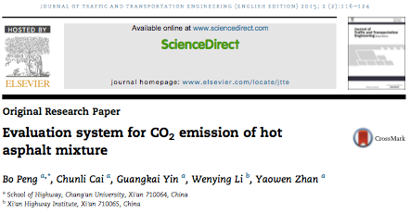
Asphalt Carbon Cycle
A research paper by Peng et al. (2015) focused on calculating carbon emissions stage by stage for both asphalt mixture production and asphalt mixture construction.
Energy saving schemes and environmental and economic advantages were listed.
It was assumed that, carbon emissions were coming from loader (stacking aggregates), heavy oil (aggregate supply), fuel (heating aggregates and asphalt), electric energy (mixing) and diesel (transportation) processes and calculations were made with regard to these sources.
They found that the biggest share comes from heating aggregates with asphalt heating, and mixing process following respectively.
These researchers did not include feedstock energy in their calculations or the carbon stored in feedstock energy in the carbon analyses.
Notes:
For more information on asphalt and its reuse/recycle, you may go to module tau 6 Asphalt Recycling.

Slide 13
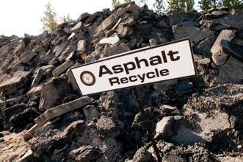
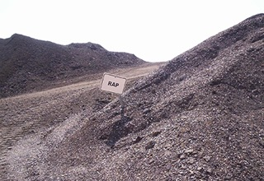
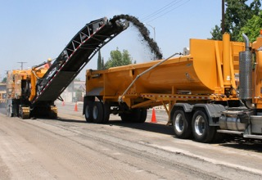
In summary, it was found that typically the carbon in the bitumen was not considered in a carbon cycle in any format from virgin asphalt and through the various recycling methods, when recycled as a material.
However, the energy still contained in the bitumen (feedstock energy) was sometimes added into an energy demand to various life cycle gates, even though not used as energy.
www.taylornw.com
www.morerap.us
www.constructionweekonline.com

Slide 14
Other Industries
www.bbc.com
Concrete
Mohareb and Kennedy (2012) published an article which indicates the methodology and assessment for gross urban carbon sinks classified as direct and embodied sinks.
Direct sinks can be considered as natural processes and they are listed under natural sequestration. Embodied sinks are mainly related to human consumptive behavior resulting in the storage of carbon, for instance landfilling of waste and concrete construction.
The carbonation process of concrete is an example of embodied carbon sink which happens after concrete is poured in the environment.

Slide 15
Other Industries
Wood
An article by Walker et al. (2013) mentioned that forest biomass should be considered in both the short and the long term for its costs and benefit over fossil fuels.
With conventional technologies, burning fossil fuels emits lower carbon emissions compared to burning forest biomass to get an equivalent amount of energy. However, in the long term, the emitted amount of carbon may be re-sequestered by growing forests.
It is indicated that forest biomass combustion can be considered as "carbon neutral" in the long term.
As indicated by Mohareb and Kennedy (2012), during the growth phase of wood products, the carbon emissions are negative over time. Carbon emissions are positive for harvesting, processing and transportation.
www.publicdomainpictures.net

Slide 16
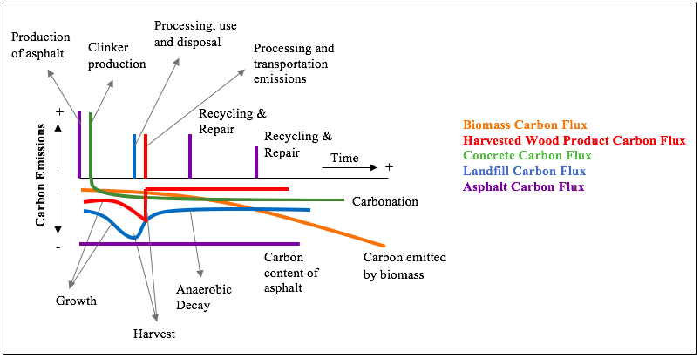
Comparing the Cycles
This figure is a depiction of the compilation of five carbon flux figures. Biomass, harvested wood product, concrete and landfill carbon fluxes were studied by Mohareb and Kennedy (2012) and a flux for asphalt was added (Haselbach and Temizel-Sekeryan). It should be noted that in this figure the line locations and the heights of the indicators are not scaled relative to each other within an industry or between industries.
Haselbach, L. and Temizel-Sekeryan, S. (2017) “Critical Review of LCA Treatment of Feedstock Energy” Final report to National Asphalt Pavement Association (NAPA).
Temizel-Sekeryan, S. and Haselbach, L. “Inclusive Reporting of Feedstock Energy and Stored Carbon: Asphalt Case Study” (in progress).

Slide 17
Conclusions
Carbon and energy accounting are valuable tools to evaluate products in terms of their environmental performances.
Carbon sequestration refers to the carbon stored:
  in biogenic construction products for example biogenic carbon sequestration in wood materials,
  fossil carbon sequestration in asphalt and
  inorganic carbon sequestration in limestone or carbonated concrete.
In many materials, carbon can be stored in a constructed facility such as a building or a roadway during its whole life and released during incineration or degradation (EPD® 2015), or further sequestered when reused, recycled or landfilled.
The feedstock energy, and in many cases the carbon, in a material at this gate may be valuable assets for future use as energy or continued sequestration.
Many EPDs have been formatted and reported in such a manner that does not readily capture these concepts, so that in a full LCA, the feedstock energy and/or carbon reporting can be optimized through to the end-of-life. This may not allow the users of EPDs to be able to fully understand and consider the impacts of feedstock energy, especially when looking at the carbon, recycling and other benefits of the material use of this resource.
Haselbach, L. and Temizel-Sekeryan, S. (2017) “Critical Review of LCA Treatment of Feedstock Energy” Final report to National Asphalt Pavement Association (NAPA).
Temizel-Sekeryan, S. and Haselbach, L. “Inclusive Reporting of Feedstock Energy and Stored Carbon: Asphalt Case Study” (in progress).

Slide 18
Thank you for completing Module α7!
Group A: ISO Compliant LCA Overview Modules
Group α: ISO Compliant LCA Detailed Modules
Group B: Environmental Impact Categories Overview Modules
Group β: Environmental Impact Categories Detailed Modules
Group G: General LCA Tools Overview Modules
Group γ: General LCA Tools Detailed Modules
Group T: Transportation-Related LCA Overview Modules
Group τ: Transportation-Related LCA Detailed Modules

Slide 19
Suggestions for Assignments
Read the following EPDs and analyze how they report feedstock energy and carbon accounting.
  EPD® (2016). EPD for Flexible Bitumen Sheets for Roof Waterproofing, The International EPD® System, Stockholm, Sweden.
  CSA Group (2016). EPD for Cassara Slabs and Boulevard Pavers, Canadian Standards Association, Toronto, ON.
  IBU (2014). EPD for Concrete admixtures – Plasticisers and Superplasticisers, Institut Bauen und Umwelt e.V., Berlin, Germany.
  ASTM (2015). EPD for CMC Concrete Reinforcing Steel, ASTM International, West Conshohocken, PA.
  UL (2013). EPD for North American Oriented Strand Board, UL Environment, Los Angeles, CA
Find out other tools and software whether they focus on feedstock. For example: GREET (Argonne National Laboratory 2016), PaLATE (RMRC-3G 2003), FEC (Georgia Tech 2016) etc. If yes, how do they allocate this in LCAs?

Slide 20
References
Athena Institute (2014) User Manual and Transparency Document Impact Estimator for Buildings v.5. Athena Sustainable Materials Institute, Ontario, Canada
ASTM (2014) EPD for CFFA PVC Roofing Membrane. ASTM International, West Conshohocken, PA
BS EN (2012) Sustainability of construction works. Environmental product declarations. Core rules for the product category of construction products. BS EN 15804:2012. British Standards, London, United Kingdom
Butt AA, Mirzadeh I, Toller S, Birgisson B (2014) Life cycle assessment framework for asphalt pavements: methods to calculate and allocate energy of binder and additives. Int J Pavement Eng 15:290-302
EPD® (2013) PCR for Concrete. The International EPD® System, Stockholm, Sweden
EPD® (2014) EPD for Ready-Mix Concrete. The International EPD® System, Stockholm, Sweden
EPD® (2015). EPD for Folkhem’s concept building, The International EPD® System, Stockholm, Sweden.
Haselbach, L. and Temizel-Sekeryan, S. (2017) “Critical Review of LCA Treatment of Feedstock Energy” Final report to National Asphalt Pavement Association (NAPA).
Haselbach, L. and Temizel-Sekeryan, S. “Feedstock Energy Reporting Compilation for the Paving and Other Related Industries” (under review).
IBU (2014) EPD for Wood Fiberboards. Institut Bauen und Umwelt e.V., Berlin, Germany
ISO (2006a) Environmental management—Life cycle assessment—Principles and framework. ISO 14040:2006. International Organization for Standardization, Geneva, Switzerland
ISO (2006b) Environmental management—Life cycle assessment—Requirements and guidelines. ISO 14044:2006. International Organization for Standardization, Geneva, Switzerland
ISO (2006c) Environmental labels and declarations—Type III environmental declarations —Principles and procedures. ISO 14025:2006. International Organization for Standardization, Geneva, Switzerland
Kneifel J, Lavappa P, Greig A, Suh S (2015) Building Industry Reporting and Design for Sustainability (BIRDS) New Residential Database Technical Manual. National Institute of Standards and Technology (NIST), Gaithersburg, MD
Lippiatt BC (2007) BEES 4.0 Building for Environmental and Economic Sustainability Technical Manual and User Guide. National Institute of Standards and Technology (NIST), Gaithersburg, MD

Slide 21
References continued
Mohareb, E., Kennedy, C. (2012). "Gross Direct and Embodied Carbon Sinks for Urban Inventories." Journal of Industrial Ecology, 16(3), 302-316.
NSF International (2014) PCR for Flooring: Carpet, Resilient, Laminate, Ceramic, Wood. National Sanitation Foundation, Center for Sustainability Standards Ann Arbor, MI
PCR Guidance (2015) PCR Guidance Website. Product Category Rule Guidance Development Initiative. http://www.pcrguidance.org/?page_id=172. Accessed 3 February 2017
PE International (2012) GaBi Manual. PE International Ag., Stuttgart, Germany
Peng, B., Cai, C., Yin, G., Li, W., Zhan, Y. (2015). “Evaluation system for CO₂ emission of hot asphalt mixture.” Journal of Traffic and Transportation Engineering (English Edition), 2(2):116-124.
PRé (2016) SimaPro Database Manual Methods Library 2.9. PRé Sustainability, San Francisco, California
Santero N, Masanet E, Horvath A (2010) Life Cycle Assessment of Pavements: A Critical Review of Existing Literature and Research. Portland Cement Association, Skokie, IL.
Temizel-Sekeryan, S. and Haselbach, L. “Inclusive Reporting of Feedstock Energy and Stored Carbon: Asphalt Case Study” (in progress).
UL (2016) EPD for Concrete Masonry Unit. UL Environment, Los Angeles, CA
Ventura A, Santero N (2012) Organic materials for construction: questionning the concept of feedstock energy. International Symposium on Life Cycle Assessment and Construction. Nantes, France
Walker T., Cardellichio P., Gunn, J.S., Saah D.S., Hagan, J.M. (2013). “Carbon Accounting for Woody Biomass from Massachusetts (USA) Managed Forests: A Framework for Determining the Temporal Impacts of Wood Biomass Energy on Atmospheric Greenhouse Gas Levels”, Journal of Sustainable Forestry, 32:1-2, 130-158.

