Slide 1

Welcome to the Life Cycle Assessment (LCA) Learning Module Series
Liv Haselbach Quinn Langfitt
For current modules email haselbach@wsu.edu or visit cem.uaf.edu/CESTiCC
Acknowledgements:
CESTiCC Washington State University Fulbright

Slide 2
LCA Module Series Groups
Group A: ISO Compliant LCA Overview Modules
Group α: ISO Compliant LCA Detailed Modules
Group B: Environmental Impact Categories Overview Modules
Group β: Environmental Impact Categories Detailed Modules
Group G: General LCA Tools Overview Modules
Group γ: General LCA Tools Detailed Modules
Group T: Transportation-Related LCA Overview Modules
Group τ: Transportation-Related LCA Detailed Modules

Slide 3
Environmental Product Declarations (EPDs)
Module α6

Slide 4
What is an Environmental Product Declaration (EPD)?
“A verified document that reports environmental data of products based on life cycle assessment (LCA) and other relevant information and in accordance with the international standard ISO 14025 (Type III Environmental Declarations).”*
Note that other standards besides ISO 14025 exist for EPDs
*”What is an EPD”, environdec.com/en/What-is-an-EPD/#.VU69tflViko

Slide 5
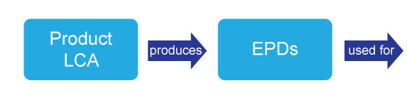
EPD is a Report
Larger LCAs and
Communication
LCA is a METHOD EPD is a REPORT
Simonen, K. and Haselbach, L., Environmental Product Declarations: U.S. Policy and Market Drivers and Implications for the Concrete Industry, Presentation at the NRMCA Sustainability Conference, May 2012 Seattle, WA.

Slide 6



Types of Environmental Information Labeling
ISO Label Types
II
III
I
Example
Overall preferability based on life cycle
Third party claim
Based on ISO 14024
Narrowly focused (single attribute)
Self-declared claim
“Recyclable”
or
“Energy Efficient”
Based on ISO 14021
Based on an ISO 14040 and 14044 (LCA)
Third party verification
Generally called an “EPD” and the focus of this module
Based on ISO 14025
Green Seal: greenseal.org EPD: environdec.com and construction-environment.com

Slide 7
Objectives of EPDs
Overall: Drive the production and use of environmentally sustainable products
Specifically
Provide accurate and verified environmental information that is not misleading
Provide purchasers and users with the ability to make informed product comparisons
Encourage producers to make their products more environmentally friendly
Ease data collection for life cycle environmental assessments of larger systems

Slide 8
Required Content of an EPD
Details of organization making the declaration (company producing the product)
Descriptive information on the product (including model number, if applicable)
Reference to the product category rule (PCR) used to develop the EPD
Information about LCA modelling procedures
  System boundary
  Functional unit
  Allocation, etc.
Data sources used
LCA results in pre-specified impact categories (according to PCR)
LCI results
Rules for developing EPDs made specifically for groups of products

Slide 9


Required Content of an EPD (cont.)
Information on any life cycle stages not included
Date of publication and length of validity
Accuracy limitations
Description, address, and logo of program operator (entity which approves and publishes EPDs and creates PCRs)
Statement that EPDs may not be comparable if based on different PCRs or from different program operators
Reviewer information

Slide 10
Optional Content of an EPD
Optionally, non-LCA results in addition to LCA impact category indicators might be included
  Social impacts
  Persistence in environment (how long it takes to break down)
  Toxicity to humans in the use stage
  Recycled content
  Materials origin
Can give important information that is not well captured by the LCA method
These may be specified in the PCR

Slide 11
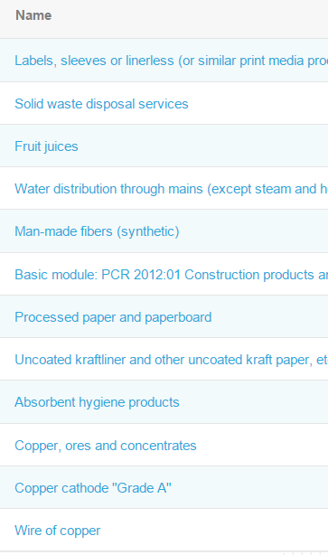
Product Category Rules (EPD Requirements)
PCR Product Category Rule
‘Rules’ on what to include and how to compute inputs and outputs to enable ‘apples-to apples’ comparisons between products and enable the creation of EPDs.
Sample list of PCR Groupings**
*
Developed separately for groups of similar products (ones for which the same functional unit can apply)
Can be cradle-to-gate or cradle-to-grave
Specific set of environmental impact categories
How to model the product system (e.g. functional unit, system boundaries)
Updated on a regular basis
*Simonen, K. and Haselbach, L., EPD: U.S. Policy and Market Drivers and Implications…, NRMCA Sustainability Conference, 2012 Seattle, WA.
**Recently published PCRs at.environdec.com/en/PCR/

Slide 12
Required Content of a PCR
Description of product category (such as bridges and elevated highways)
Common goal of the EPD
Required scope elements
  Functional unit, system boundary, data description, cut-off criteria, data quality
Requirements of inventory analysis
  Data collection methods, calculation procedures, allocation procedures
Requirements of results to report
  Impact categories, additional environmental information
Other
  Format of the declaration, information on other life cycle stages (for PCRs not covering full life cycle), period of validity, region of applicability (e.g. Europe, NA, etc.)
Note
More information in learning modules on:
Scope: A2
Goal: α1
Functional Unit: α1
System boundary: α2
Allocation: α2
Stages: α3
Data: α5
Impact Categories: B1,B2,B3

Slide 13
Comparability of an EPD
Description of product category
Common goal
Scope elements
  Functional unit, system boundary, data description, cut-off criteria, data quality
Inventory analysis
  Data collection methods, calculation procedures, allocation procedures
Results
  Impact categories, additional environmental information
Other
  Format of the declaration, information on other life cycle stages (for PCRs not covering full life cycle), period of validity
Note
EPDs are considered comparable only when the red underlined elements are “identical” and the other blue elements are “equivalent”

Slide 14
What is the point of PCRs?
LCA in general leaves a lot of modelling choices up to analyst (based on goal and scope of individual studies)
  PCRs ensure that most important modelling choices will be consistent among studies
  Allows for relatively fair comparison of products
Some key parameters covered in PCRs which often differ in LCA
Functional unit determination
Recommended data sources
Temporal and geographic boundaries
Allocation rules
Impact assessment methods
Cut-off criteria

Slide 15
Inconsistencies between PCRs
Not one body responsible for creating PCRs
  Many “program operators” have been established to make PCRs
  These include companies, trade associations, public agencies, independent scientific bodies, etc.
Program operators are supposed to “facilitate harmonization when developing PCR[s]”*
  Principle way to do this: adopt PCRs from other program operators that have already been developed
  In practice, there are often reasons to create a new PCR so multiple might exist for one product type
ISO 14025 does allow for developing new PCRs for products that already have a PCR in some cases
  Must be based on content differences (e.g. a different definition of the system boundary)
  Not based on the origin of the PCR (i.e. based on which program operator developed it)
When EPDs are developed with different PCRs they may not be directly comparable
*ISO 14025

Slide 16
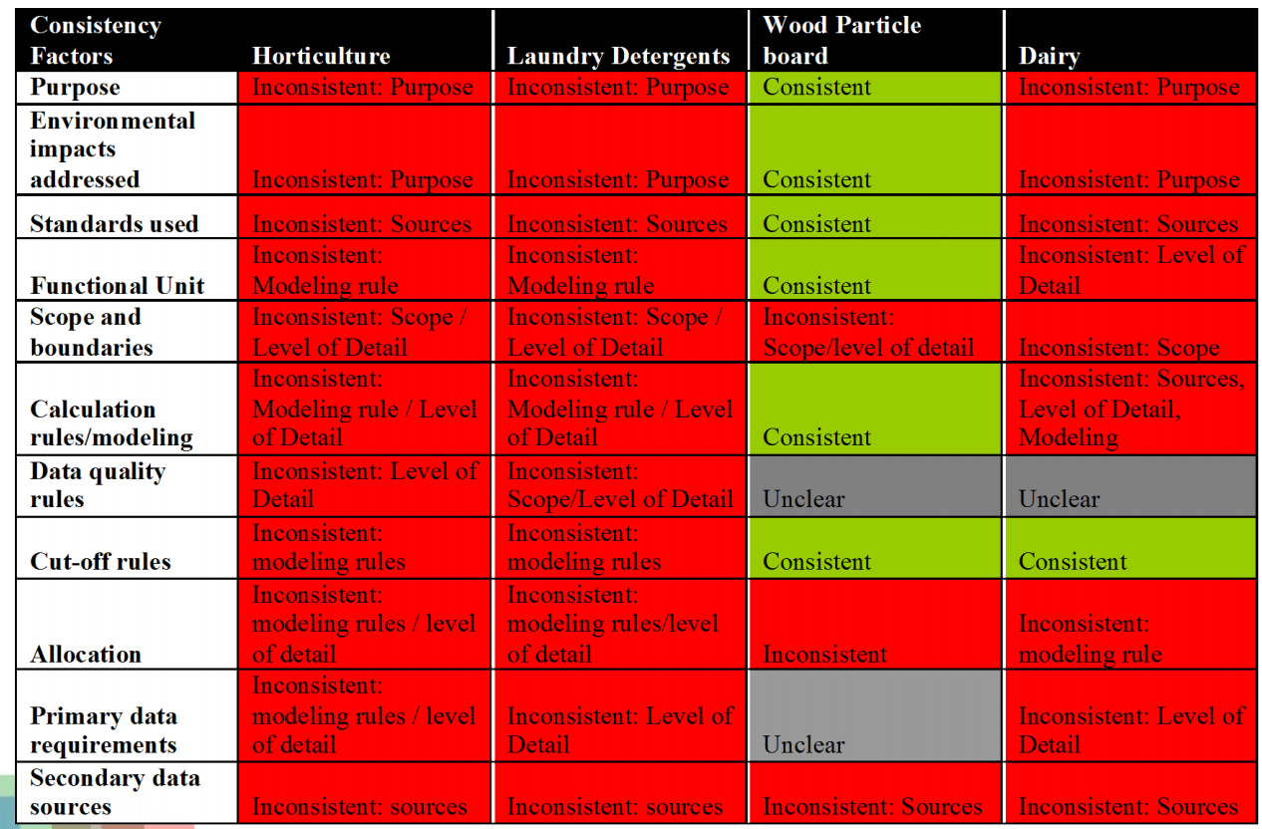
PCRs Compared
(Subramanian et al. 2011)
Subramanian, V., Ingwersen, W., Hensler, C., and Collie, H. (2011). “Comparing PCRs from Different Programs: Learned Outcomes Toward Global Alignment” Presented at LCA XI.

Slide 17
Program Operators (US list)
Program Operator Name | Website
ICC Evaluation Service | http://www.icc-es.org/ep/epd-index.shtml
UL Environment | http://industries.ul.com/environment/certificationvalidation-marks/environmental-product-declarations
The Sustainability Consortium | http://www.sustainabilityconsortium.org/smrs/
National Center for Sustainable Standards | www.nsf.org/services/by-type/standards-publications/ncss
American Society of Testing and Materials (ASTM) | www.astm.org/CERTIFICATION/EpdAndPCRs.html
SCS Global Services | http://www.scsglobalservices.com/environmental-product-declaration
NSF International | http://www.nsf.org/
Earthsure | http://iere.org/index.php/programs/earthsure
Longer list available at: www.pcrguidance.org/?page_id=172

Slide 18
Program Operators (International list)
Program Operator Name | Place | Website
International EPD System | Sweden | www.environdec.com/en/PCR/
Institut Bauen | Germany | bau-umwelt.de/hp6252/…
Japanese Environmental Assoc. for Industry | Japan | http://www.ecoleaf-jemai.jp/eng/
British Standards Institute | United Kingdom | www.bsigroup.com/en/Standards-and-...
Korea Environmental & Technology Institute | South Korea | http://www.edp.or.kr/edp/english/process/process_list.asp
Canadian Standards Association | Canada | http://www.csaregistries.ca/epd/about_epd_pcrs_e.cfm
Longer list available at: www.pcrguidance.org/?page_id=172

Slide 19
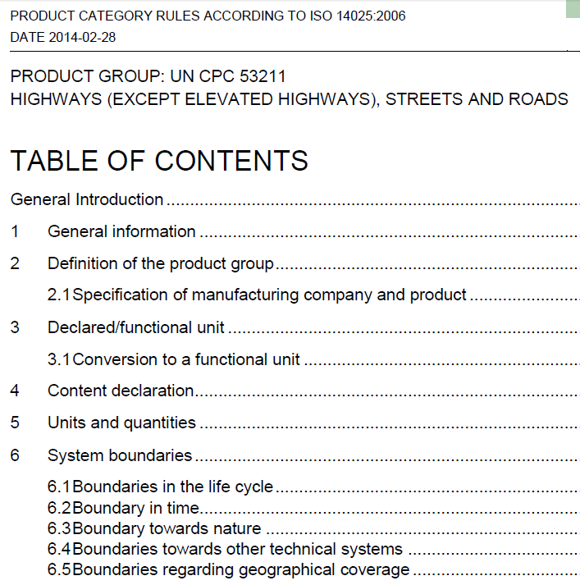
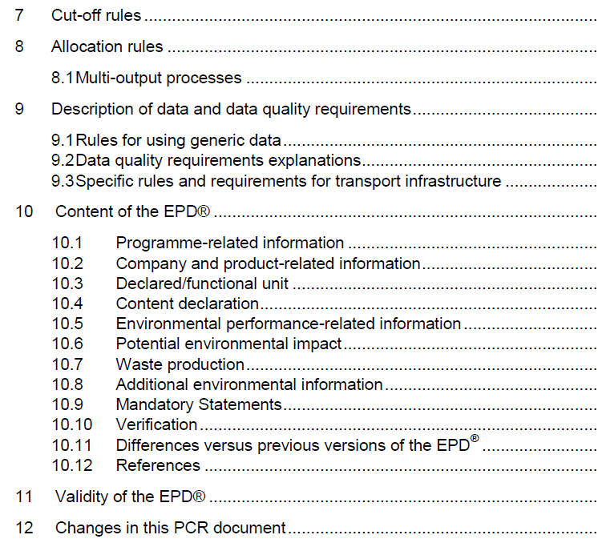
Table of Contents of Example PCR for Highways
http://www.environdec.com/en/PCR/Detail/pcr2013-20#.VVTVvvlViko

Slide 20
Highways PCR Summary
Functional Unit
1 km of road for 1 year
System Boundary in the Life Cycle
Construction, operation, and maintenance, with specific processes in flow diagram
Cut-off Criteria
At least 99% of energy, mass, and overall relevance, determined through expert judgment and sensitivity analysis
Valid for 3 years, then revisit
Impact Categories
Global warming potential
Acidification potential
Ozone creation potential
Eutrophication potential
Material resources (specific ones)
Energy resources
Validity of the EPD
Update if one indicator worsens ≥10%

Slide 21
Development of an EPD
PCR
Read and follow methodology outlined in PCR for product
Data
Primary data collection and processing
Already developed LCAs of product components or LCI databases
Parties
Involve suppliers, manufacturers, associations, users, public agencies, etc.
May be, but not necessarily, open to the public
Review
LCA, LCI, and other data verified by an independent third-party
Overall EPD verified by an independent third-party
Find appropriate PCR or develop one if none exists for the product category

Slide 22
Common Uses and Audience of EPDs
Usually “thought of as communicating to a more ‘sophisticated’ audience of institutional buyers and not the average consumer”*
  EPDs are multipage documents
  Contain detailed environmental information
Therefore, most common use is marketing to businesses or companies
Sometimes the format is simplified and can be targeted directly at average consumers
Can be used as parts of other systems such as LEED v.4
  Leadership in Energy & Environmental Design (LEED) is a green building rating system
Can be used as data sources for larger LCAs which include those products
*Stevenson and Ingwersen. (2012). “Environmental Product Claims and Life Cycle Assessment.” In M.A. Curran (Ed.), Life Cycle Assessment Handbook, 475-490, Wiley/Scrivener, Hoboken, N.J.

Slide 23
Where to Find EPDs
Group | Website | Product types | Number of products*
EPD International | www.environdec.com/en/EPD-Search/ | Various | ~450
ASTM | www.astm.org/CERTIFICATION/filtrexx40.cgi?- | Masonry, flooring, roofing | 8
The EPD Registry | www.theepdregistry.com/search-epds-actual | Construction products | 35
The Aluminum Association | www.aluminum.org/sustainability/environmental- | Aluminum: hot rolled, cold rolled, extruded, ingots | 5
EcoLeaf (Japan Envir. Manag. Assoc. for Industry) | http://www.ecoleaf-jemai.jp/eng/label.html | Printers, fax machines, telephones, etc. | Hundreds
*As of May 2015

Slide 24
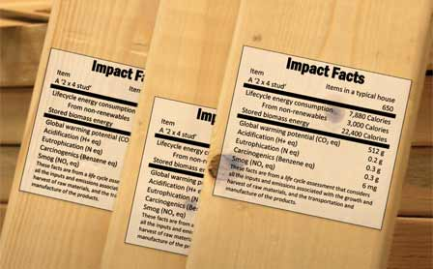
Implementation of EPDs
Thousands in existence on a wide variety of products
Would like transparent and rigorous supply chain specific EPDs
However, implementing standards to enable equitable, practical and meaningful EPDs is challenging
  Such as issues with agreement of PCRs
Concept is simple……..implementation is not.

Slide 25
Thank you for completing Module α6!
Group A: ISO Compliant LCA Overview Modules
Group α: ISO Compliant LCA Detailed Modules
Group B: Environmental Impact Categories Overview Modules
Group β: Environmental Impact Categories Detailed Modules
Group G: General LCA Tools Overview Modules
Group γ: General LCA Tools Detailed Modules
Group T: Transportation-Related LCA Overview Modules
Group τ: Transportation-Related LCA Detailed Modules

Slide 26
Homework
For a product that interests you search for an applicable PCR that could be used to develop an EPD. If one is found, include the reference to it. If not, state that no PCR exists for that product type.
Find an EPD on a product that interests you and provide a one paragraph summary of the report including at least the product, the program operator, the functional unit used, and general information about the results.
Find two EPDs developed from the same PCR. Look back to the slide titled comparability of an EPD and identify which of the needed comparability factors meet the criteria of identical or equivalent.

