Slide 1
Welcome to the Life Cycle Assessment (LCA) Learning Module Series
Liv Haselbach Quinn Langfitt
For current modules email haselbach@wsu.edu or visit cem.uaf.edu/CESTiCC
Acknowledgements:
CESTiCC Washington State University Fulbright

Slide 2
LCA Module Series Groups
Group A: ISO Compliant LCA Overview Modules
Group α: ISO Compliant LCA Detailed Modules
Group B: Environmental Impact Categories Overview Modules
Group β: Environmental Impact Categories Detailed Modules
Group G: General LCA Tools Overview Modules
Group γ: General LCA Tools Detailed Modules
Group T: Transportation-Related LCA Overview Modules
Group τ: Transportation-Related LCA Detailed Modules

Slide 3
Data Types and Sources
Module α5

Slide 4
Data is Very Important in LCA
LCA is built around data
Poor/missing data either
Increases uncertainty and decreases usability of the study
Goes unnoticed and might bias results
Good data more important for processes with higher impacts
No single database that all LCA analysts use
Data must be sourced and/or collected
Can take time and money to collect, especially for complex systems
Sources must be documented and quality should be considered and discussed

Slide 5
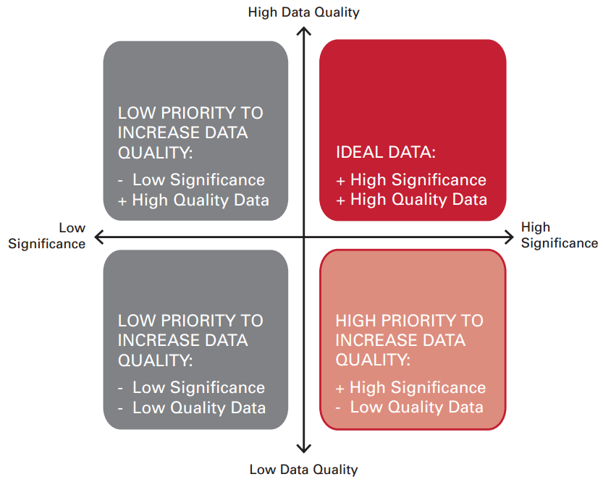
Data Quality (Simonen 2014)
One way to determine significance is sensitivity analysis
Change process data by certain percent and analyze how much that impacts overall results
High impact=high sensitivity
Diagram: Simonen, K. (2014). Life Cycle Assessment. Routledge, New York, NY.

Slide 6
Data Types
Primary Data
Measured or calculated directly from the source
Example: Measure pollutants in an exhaust stream with gas chromatography
Example: Read electricity use from a meter at a manufacturing facility
Secondary Data
Obtained from sources such as databases and literature
Example: Crude oil production from NREL US LCI database
Example: Lubricating oil disposal by re-refining impacts from Geyer et al. 2013
Proxy Data
Data for a product or process that is assumed to be roughly equivalent to the product or process of interest
Example: Emissions from a school bus assumed to be similar to city transit bus when no data for school bus is available

Slide 7
Data Sources
Direct measurement of process data
Communication with companies/agencies that have directly measured process data
Journal articles
Other papers and reports, such as agency reports (DOE, EPA, DOT), private company reports, and theses
LCI databases
Free software sources such as GREET or EIO-LCA
Environmental product declarations (EPDs)
Estimation
Primary data
Secondary data
Estimated data

Slide 8
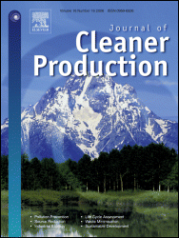
Journals Commonly Including LCA
International Journal of Life Cycle Assessment
Journal of Industrial Ecology
Journal of Cleaner Production
Environmental Science and Technology
Environmental Impact Assessment Review
Management of Environmental Quality

Slide 9
LCI Databases
Often the most feasible way to locate large amounts of high quality data for completing an LCA
LCI databases contain information on inputs and outputs
Usually functions seamlessly with LCA software
Also usually contain extensive documentation describing sources of data, allocation procedures, system boundaries, etc. used to develop that data
Both free and paid versions available with focuses varying by:
Geographic region
Industry

Slide 10
Common LCI Databases (US Focused List)
National Renewable Energy Laboratory (NREL) US LCI
ecoinvent (European focused)
GaBi (professional and extension databases)
Franklin US LCI Library
USDA National Agricultural Library Digital Commons
Athena Institute Database
GREET (Not an LCI database, but a data source often used for LCA)

Slide 11
US LCI
Produced by the National Renewable Energy Laboratory starting in 2001, with support from other stakeholders such as:
Athena Institute
American Plastics Council
Portland cement association
U.S. Car Project (Ford, General Motors, and DaimlerChrysler)
U.S. Department of Energy
U.S. Department of Agriculture
U.S. EPA
U.S. Green Building Council
Many others
Motivation was to provide a free, consistent, US-focused set of data

Slide 12
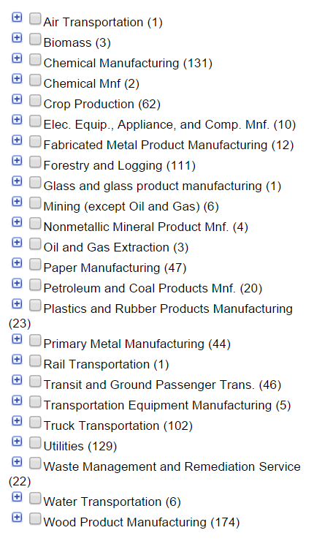
US LCI
Many products and processes from categories on right
Can be merged into most LCA software including SimaPro, GaBi, OpenLCA, and others
Can also be accessed and used directly from the NREL website: http://www.nrel.gov/lci/
Most data includes sources, but not embedded information on modelling procedures
Note that: “Although most of the data in the US LCI database has undergone some sort of review, the database as a whole has not yet undergone a formal validation process.”

Slide 13
ecoinvent
Originally based in Switzerland, and then Europe, Version 3 includes many global market chains
Covers a wide range of sectors with over 11,0000 datasets
ecoinvent is a not-for-profit association founded by ETHZ, EPFL, PSI, Empa and ART
ETHZ (Swiss Federal Institute of Technology in Zurich)
EPFL (Swiss École Polytechnique Fédérale De Lausanne)
PSI (Paul Scherrer Institute in Switzerland)
Empa (research Institute of the ETH Domain)
ART (Agroscope research in Switzerland)
Uses ecoSpold data format for compatibility with many LCA softwares including GaBi, SimpaPro, OpenLCA, and others
This database must be purchased, which can be done at their website

Slide 14
GaBi Databases
Produced by thinkstep (PE International)
Only available with purchase and use of GaBi
Processes and documentation available to explore before purchasing
Also include various normalization and weighting factors
Professional database includes a range of 2500 products and processes built mostly on European/global data
Many focused “extension” databases can be purchased and used alone or along with the Professional database
Full US Database includes about 1000 products and processes
Extension Databases

Slide 15
Franklin US LCI 98 Database
Database available in SimaPro, developed by Pré consultants
All data focused on US
Products from the sectors of fuel production, transportation, and material production
Individual process data not provided
More information:
http://www.pre-sustainability.com/download/manuals/DatabaseManualFranklinUS98.pdf

Slide 16
USDA National Agri. Library Digital Commons
Crop impacts for corn, cotton, oats, peanuts, rice, soybeans, and wheat
Impacts for various agricultural equipment including balers, combines, generators, irrigation, pumps, tractors, and more
Mineral, fertilizer, and pesticide data under development
Most products and processes include detailed documentation
Data available at: https://www.lcacommons.gov/discovery/

Slide 17
Athena Institute Database
Focused on the buildings sector with materials such as steel, wood, wallboard, insulation, shingles, and paint
Only available within Athena’s Impact Estimator, not for standalone use or use with another LCA program
However, some of the data in it is publically available in the form of LCA and LCI reports detailing their studies of products

Slide 18
GREET
Greenhouse gas, Regulated Emissions, and Energy Use in Transportation
Not an LCI database, but instead returns information on some specific emissions to air and energy
Not an ideal data source alone due to the limited information
Can be used as inputs for an LCA or verification of full LCI data from other sources
Available as a spreadsheet tool or graphic program for download from: https://greet.es.anl.gov/

Slide 19
Some Databases for Other Countries
China – Eco-materials Institute & Center for Materials LCA, College of Materials Science and Engineering, Beijing University of Technology. www.cnmlca.com
India – Under development by SimaPro India. http://simaproindia.com/simapro_software.html

Slide 20
Thank you for completing Module α5!
Group A: ISO Compliant LCA Overview Modules
Group α: ISO Compliant LCA Detailed Modules
Group B: Environmental Impact Categories Overview Modules
Group β: Environmental Impact Categories Detailed Modules
Group G: General LCA Tools Overview Modules
Group γ: General LCA Tools Detailed Modules
Group T: Transportation-Related LCA Overview Modules
Group τ: Transportation-Related LCA Detailed Modules

Slide 21
Homework
Think about a research project you are doing or would like to do where LCA could be applied. Give an example of a measurement that could be made as primary data.
For the same project, find a piece of relevant secondary data for one process. This could come from a database or the literature.
Find a journal article which includes either LCI (inventories of emissions and uses) or LCIA (impact category indicator results) data that could be used an in input to a larger system. Cite the source and tell what larger system it could be an input to.
Find one additional database that is not discussed in this presentation and briefly describe what types of products or processes it covers, who produces it, and how to access it.

