Slide 1

Welcome to the Life Cycle Assessment (LCA) Learning Module Series
Liv Haselbach Quinn Langfitt
For current modules email haselbach@wsu.edu or visit cem.uaf.edu/CESTiCC
Acknowledgements:
CESTiCC Washington State University Fulbright

Slide 2
LCA Module Series Groups
Group A: ISO Compliant LCA Overview Modules
Group α: ISO Compliant LCA Detailed Modules
Group B: Environmental Impact Categories Overview Modules
Group β: Environmental Impact Categories Detailed Modules
Group G: General LCA Tools Overview Modules
Group γ: General LCA Tools Detailed Modules
Group T: Transportation-Related LCA Overview Modules
Group τ: Transportation-Related LCA Detailed Modules

Slide 3
LCIA Optional Elements: Grouping, weighting, and normalization
Module α4

Slide 4
Phases of an LCA
LCA
Phases
1. Goal and Scope
3. Life Cycle Impact Assessment (LCIA)
4. Interpretation
2. Life Cycle Inventory (LCI)
Note: For an LCI study LCIA phase is omitted
Image Sources: Target: wikia.nocookie.net Data: dreamstime.com Earth: business2community.com

Slide 5
Optional Elements
Weighting
Converting results with valuation of importance of each impact category
Grouping
Normalization
Optional Elements
Organizing impact categories by themes
Dividing indicator results by a reference value
Additional Data Quality Analysis
May be useful as interpretation aids
Some may be subjective
Inclusion of each element should be consistent with the goal and scope

Slide 6
Grouping
Receptor Type
Priority of Abatement
Sorting impact categories into groups sharing some common theme
Could also include ranking
Human Health
Ecosystems
High Priority
Medium Priority
Resources
Low Priority
Geographic Scale
Impact Medium
Global
Regional
Air
Water
Soil
Local
Resources

Slide 7
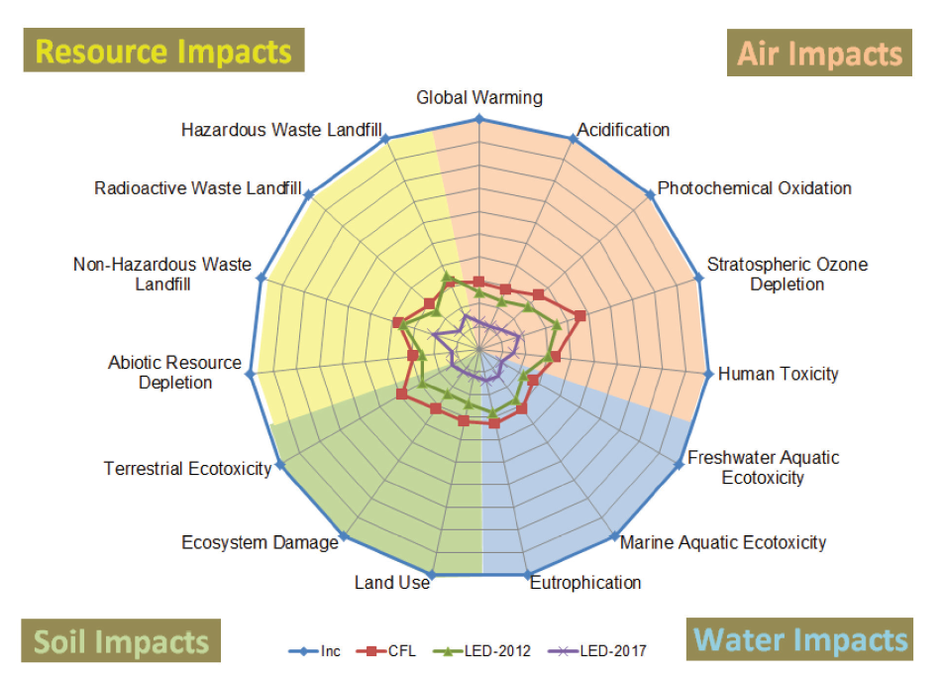
Grouping Example – By Impact Medium
Scholand, M.J., and Dillon, H.E. (2012). “Life-Cycle Assessment of Energy and Environmental Impacts of LED Lighting Products.” Department of Energy.

Slide 8
Grouping Example – By Priority
This was derived from the BEES Stakeholder interpretation ranking – priority is a value choice!
High Priority
Medium Priority
Low Priority
Global Warming
Ecotoxicity
Smog Formation
Fossil Fuel Depletion
Eutrophication
Indoor Air Quality
Human Health Particulates
Land Use
Acidification
Water Use
Human Health
Non-Cancer
Ozone Depletion
Human Health Cancer
Note: Grouping not done by the panel, but by the module developers based on these criteria and BEES weighting: ≥8% weight=high priority, 5-7%=medium priority, 1-4% low priority

Slide 9
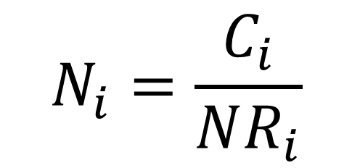
Normalization
General Normalization Equation
Present impacts as a relative magnitude to a reference value
Can aid in interpretation and error checking
Can also have unintended consequences
Internal normalization
Divide by value derived from within the study
Can be division by maximum, sum, one alternative, etc.
External normalization
Divide by external reference
Usually total impacts from a geographical area (state, region, country, continent, world)
Could also be an agency or corporation's total impacts
$$N_{i}=\frac{C_{i}}{NR_{i}}$$
where,
N_{i} = Normalized value of impact in impact category i
C_{i} = Characterized value of impact in impact category i (e.g. x kg CO₂)
NR_{i} = Normalization reference in impact category i (internal or external)

Slide 10





Normalization
Example scenario: Comparing city transit to bus to school bus. Normalized results of one impact category shown below. Same procedure for all other impact categories.
Internal
External
Relative to alternatives in the study
Relative to outside reference
= 0.6 x
x 1.3 =
Per 100 passenger-kilometers
= 0.8 x

Slide 11
Internal vs. External Normalization
 | Internal Normalization | External Normalization
Pros | No need to collect normalization references from other sources | Conveys some information about significance of the contribution to each impact type
 | Simple to compare alternatives | Can act as an error check by revealing unreasonably proportioned impacts
Cons | Loss of information because internal ratio is insensitive to magnitude | May make results appear insignificant
 |  | Normalization reference databases are not available for many reference areas
 | Susceptible to rank reversal problem during subsequent decision-making | Normalization reference databases can suffer from poor data and performance biases
Bottom line: There are pros and cons to each approach. Analysts might consider including both type to get the best of both worlds. Decision makers should be aware of these and request more information if needed.

Slide 12
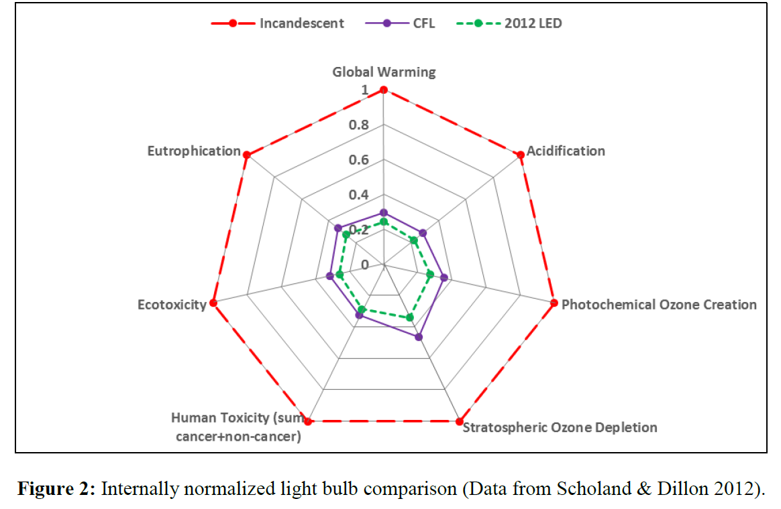
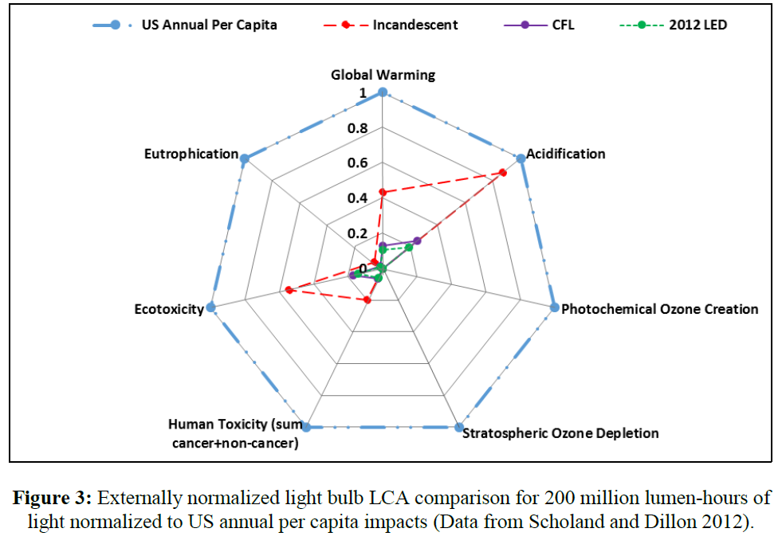
Side-by-Side Comparison
Internally Normalized
Externally Normalized

Slide 13
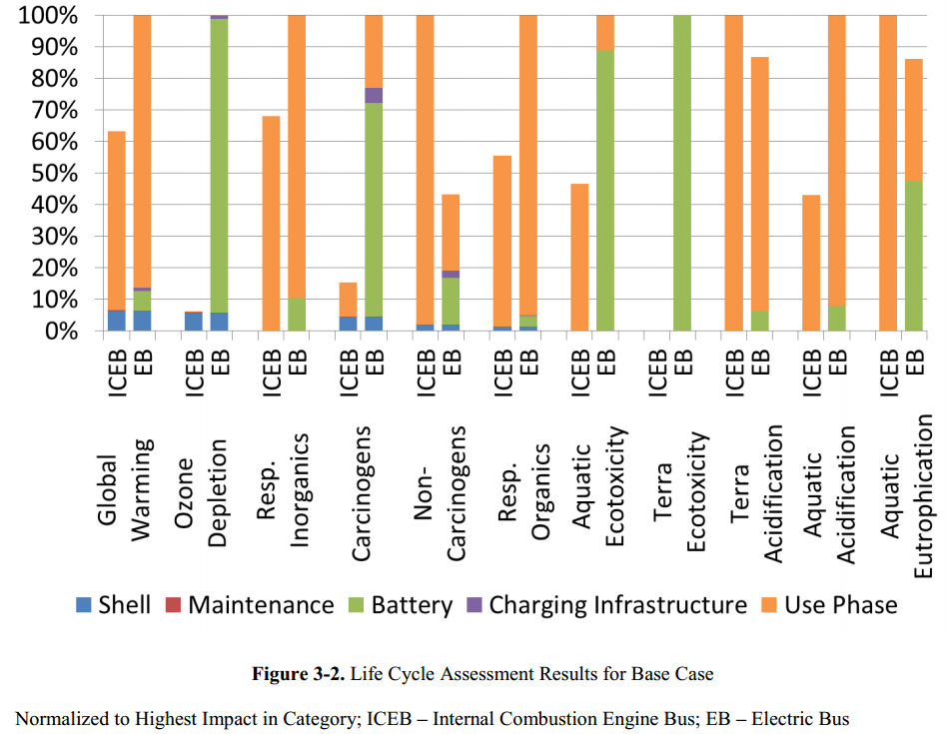
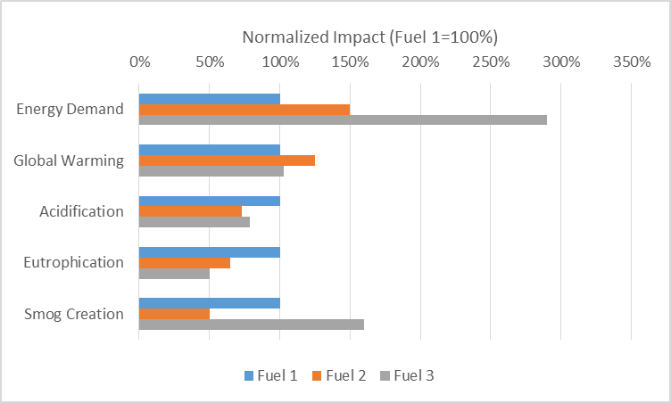
Internal Normalization Examples
Comparison of diesel and electric bus, normalized by maximum
Comparison buses using various fuel types, normalized to Fuel 1
Cooney, G.A. (2005). “Life Cycle Assessment of Diesel and Electric Public Transportation Buses.” Master’s Thesis, University of Pittsburg.
Adapted with masking from: Ally, J., and Pryor, T. (2007). “Life-cycle assessment of diesel, natural gas and hydrogen fuel cell bus transportation systems.” Journal of Power Sources, 170(2), 401–411.

Slide 14
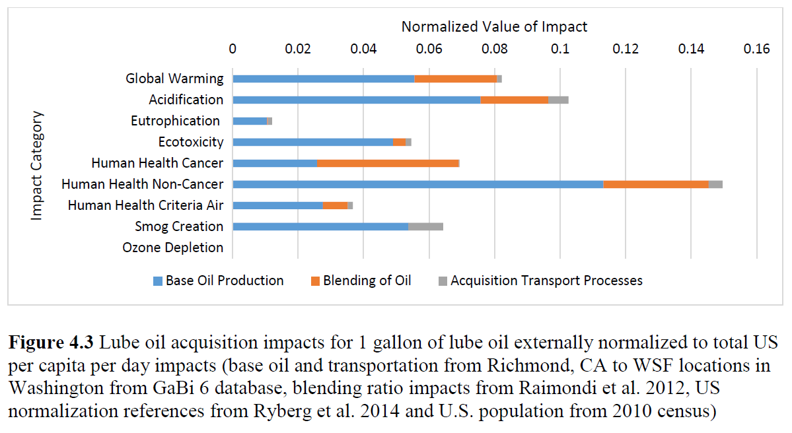
External Normalization Example
Langfitt, Q., and Haselbach, L. (2014). “Assessment Of Lube Oil Management And Self-cleaning Oil Filter Feasibility In WSF Vessels.” Report to PacTrans Region X.

Slide 15
Some US External Normalization Reference Databases
Bare et al. (2006). “Development of the Method and U.S. Normalization Database for Life Cycle Impact Assessment and Sustainability Metrics.” Environ. Sci. Technol., 40(16), 5108-5115.
Lautier et al. (2010). “Development of normalization factors for Canada and the United States and comparison with European factors.” Science of the Total Environment, 409(1), 33-42.
Laurent et al. (2011). “Normalization references for Europe and North America for applications with USEtox characterization factors.” Int. J. Life Cycle Assess, 16(8), 728-738.
Kim et al. (2013). “The Importance of Normalization References in Interpreting Life Cycle Assessment Results.” Journal of Industrial Ecology, 17(3), 385-395
Ryberg et al. (2014). "Updated US and Canadian normalization factors for TRACI 2.1." Clean Technologies and Environmental Policy, 16(2), 329-339.
Jointly used in BEES

Slide 16

Weighting
Human Carcinogens
Converting the impact category results using valuation of how important each impact category is to abate
Usually not specific to project
Some groups have published weighting factors
Usually expressed as percentage of total importance in each impact category
Impact categories typically sum to 100%
Sometimes used to create an overall score (aggregation)
Particularly when used in conjunction with normalized results
Weighting includes (according to US EPA):
“Identifying the underlying values of stakeholders
Determining weights to place on impacts
Applying weights to impact indicators.”
Water Use
Eco-
Toxicity
Ozone
Depletion
*Not actual weighting, fictional representation

Slide 17

Further Weighting Considerations
Weighting adds subjectivity
Little or no scientific basis for determining weights
Usually developed from value-choices
Sensitivity analysis with different sets of weighting factors might be wise
Weighted Results
Only
Comparative
Weighting not allowed in comparative studies
Must also present category indicators or normalized results

Slide 18
Weighting Scheme Development
Panel method
Elicit input from a panel on importance of various impacts
Use structured procedure to determine weights from responses
Can be very subjective and may be made up of experts, stakeholders, or others
Monetary valuation methods
One example: based on how much people would be willing to pay to avoid some amount of each impact
Many more types (some discussed in Ahlroth et al. 2011)
Also subjective since most rely on survey input
Distance-to-target method
Higher weights to categories where current level of impacts are farthest from some target value
Target value usually from regulations or laws, such as from the EPA
Can suffer from politically (rather than scientifically) set regulations and from the assumption that meeting each regulation is equally important as another
Ahlroth et al. (2011) “Weighting and valuation in selected environmental systems analysis tools…” J. of Cleaner Production, 19, 145-156.

Slide 19
Weighting Scheme Examples
Group | BEES Stakeholder Panel¹ | EPA Science Adv. Board¹ | PE Int. N. America² | PE Int. Global²
Global Warming | 29% | 16% | 13% | 13%
Acidification | 3% | 5% | 9% | 9%
Ecotoxicity | 7% | 11% | 10% | 10%
Eutrophication | 6% | 5% | 10% | 10%
Human Health Cancer | 8% | 7% | 11% | 10%
Human Health Non-cancer | 5% | 4% | 11% | 10%
Human Health Criteria Air | 9% | 6% | 10% | 10%
Smog | 4% | 6% | 10% | 9%
Stratospheric Ozone | 2% | 5% | 8% | 9%
Abiotic Resource/Fossil Fuel Depletion | 10% | 5% | 8% | 10%
Water Use | 8% | 3% | N/A | N/A
Land Use | 6% | 16% | N/A | N/A
¹Listed in BEES online tool. ²Listed in GaBi 6 Quantities Folder

Slide 20
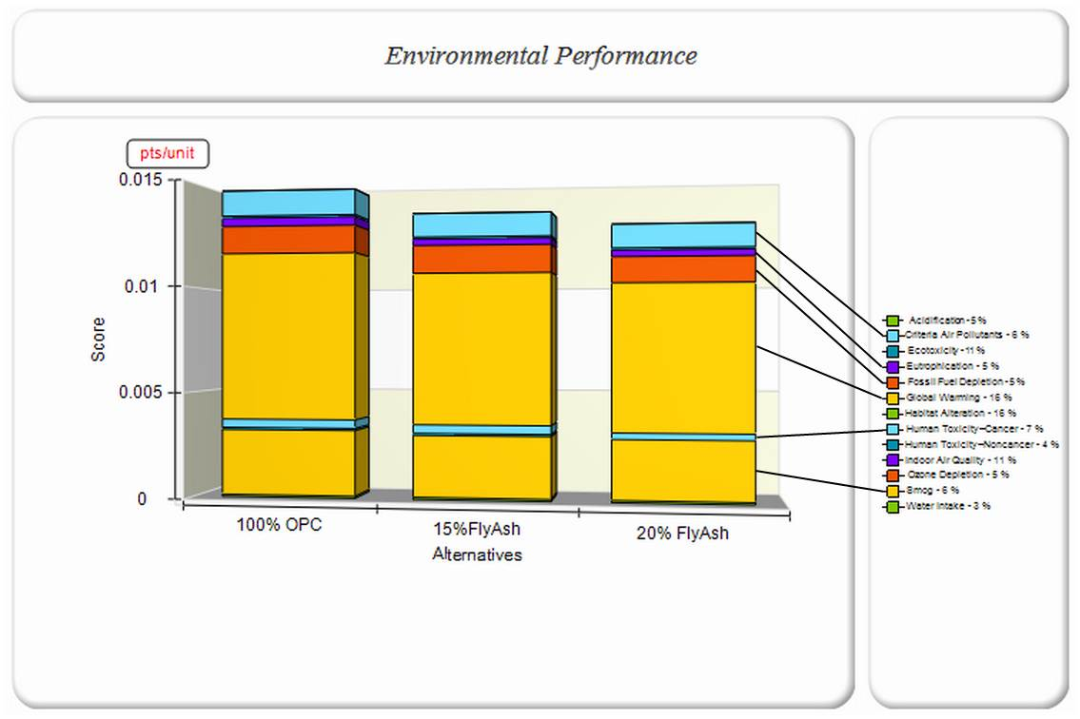
BEES Score Aggregation
Link to BEES Online

Slide 21
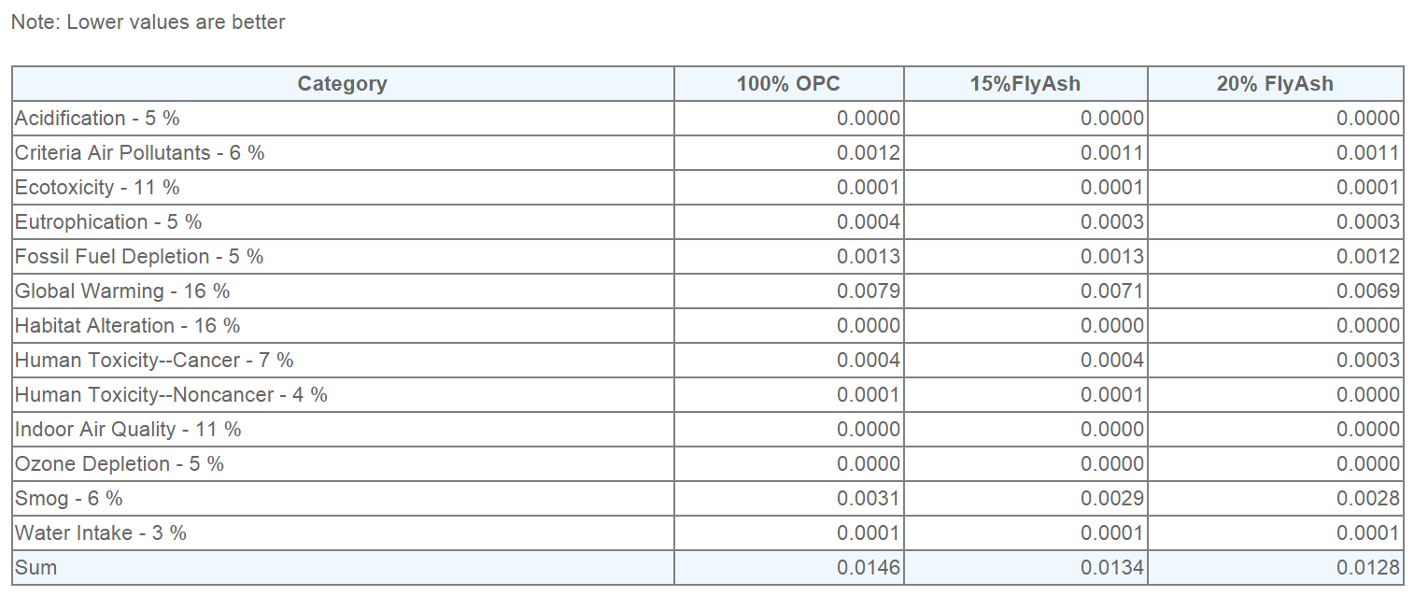
BEES Score Table
Functional Unit = 1 ft³

Slide 22
Thank you for completing Module α4!
Group A: ISO Compliant LCA Overview Modules
Group α: ISO Compliant LCA Detailed Modules
Group B: Environmental Impact Categories Overview Modules
Group β: Environmental Impact Categories Detailed Modules
Group G: General LCA Tools Overview Modules
Group γ: General LCA Tools Detailed Modules
Group T: Transportation-Related LCA Overview Modules
Group τ: Transportation-Related LCA Detailed Modules

Slide 23
Homework
Organize the impact categories shown on Slide 8 into one of the following (your choice):
by geographic scale of impacts,
by receptor type, or
by any other grouping scheme of your choice (except priority or impact medium are not allowed)
Look up the paper by Kim et al. (2013) on external normalization references. Comment on the disparity between the values in the two reference sets in Table 2 and explain why the values for human health and ecotoxicity vary so drastically (explained in Kim et al. 2013).
Find a comparative LCA and normalize the impact category indicators to any one of the external normalization databases. Note which set of references you used.
Internally normalize (by one alternative, maximum, or sum – your choice) the same LCA you externally normalized in Question 3. Compare the graphs and comment on how interpretation might differ if one or the other was presented alone.
Comment on the differences between the various weighting schemes presented in Slide 19 and qualitatively discuss how results might appear differently under the various schemes.

