Slide 1

Welcome to the Life Cycle Assessment (LCA) Learning Module Series
Liv Haselbach Quinn Langfitt
For current modules email haselbach@wsu.edu or visit cem.uaf.edu/CESTiCC
Acknowledgements:
CESTiCC Washington State University Fulbright

Slide 2
LCA Module Series Groups
Group A: ISO Compliant LCA Overview Modules
Group α: ISO Compliant LCA Detailed Modules
Group B: Environmental Impact Categories Overview Modules
Group β: Environmental Impact Categories Detailed Modules
Group G: General LCA Tools Overview Modules
Group γ: General LCA Tools Detailed Modules
Group T: Transportation-Related LCA Overview Modules
Group τ: Transportation-Related LCA Detailed Modules

Slide 3
Life Cycle Stages
Module α3

Slide 4
Phases versus Stages
Phases
Portions of LCA procedure
Stages
Sections of product life cycle
Goal and Scope
Interpretation
Extraction and upstream production
Transport
Manufacture
Inventory Analysis
Transport
Use
Transport
Impact Assessment
Disposal/recycling
Note: This is a general diagram of stages and some products or processes may have more or less stages than those shown here
Figure: ISO 14040:2006

Slide 5
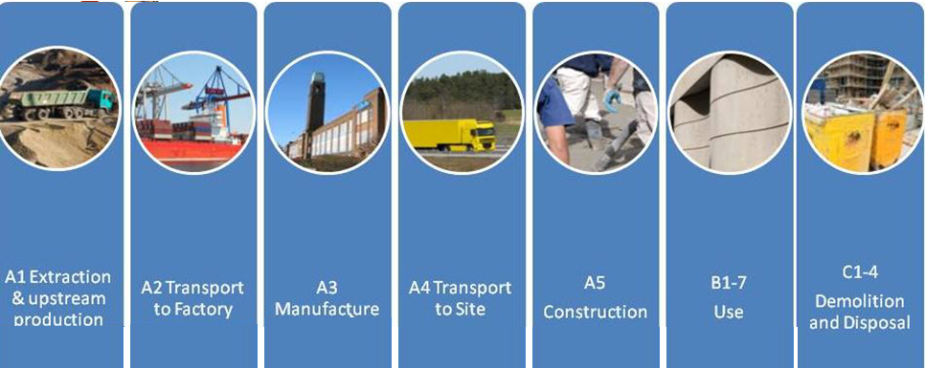
Life Cycle of a Building
Source (bottom cropped): WBCSD Cement Sustainability Initiative, PCR for concrete, UN CPC 375, 2013-02-12

Slide 6
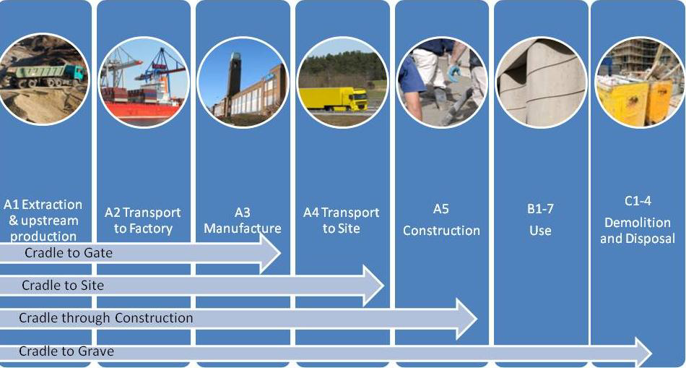
Life Cycle Split by Stages Analyzed
Most common/applicable to wide range of situations
Source: WBCSD Cement Sustainability Initiative, PCR for concrete, UN CPC 375, 2013-02-12

Slide 7
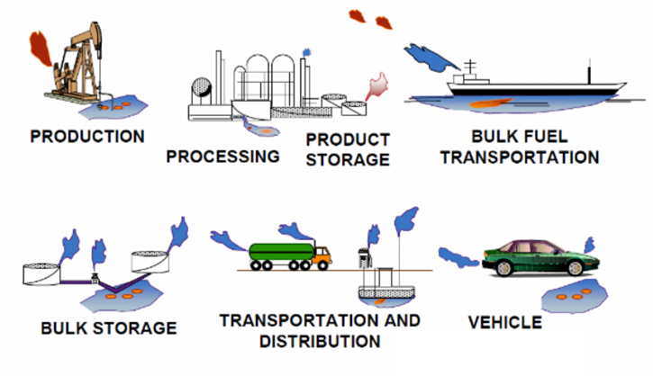
Life Cycle of a Transportation Fuel
Well-to-Wheel
Well-to-Pump
Pump-to-Wheel
Image Source (without dashed boxes): transportblog.co.nz

Slide 8
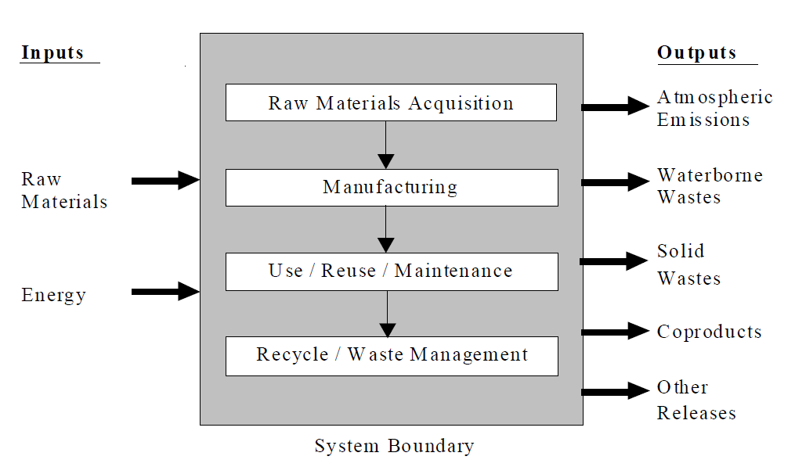
Inputs and Outputs throughout Stages
Source: Environmental Protection Agency. 1993. Life Cycle Assessment: Inventory Guidelines and Principles. EPA/600/R-92/245. Office of Research and Development. Cincinnati, Ohio, USA.

Slide 9
Why Split into Stages?
Organize data collection
Organize presentation
Identify weak environmental links in life cycle
Group unit processes to make it easier to identify which were included
Allow for easier aggregation and disaggregation
For others studying the product with only one or two stages different
For ability to consider cradle-to-gate instead of cradle-to-grave only

Slide 10
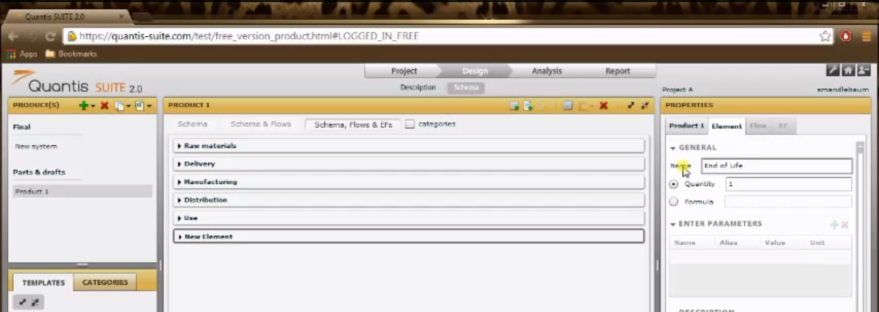
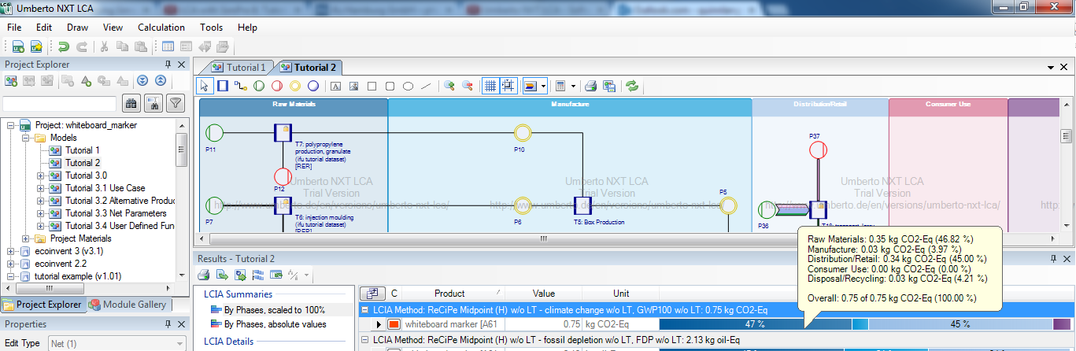
Software Organizing by Life Cycle Stage
Quantis screenshot: Quantis (2013). “QS Product Free 2 project and system setup” YouTube, https://www.youtube.com/watch?v=utUd4hE-ZVw

Slide 11
Common Stages (Covered in this Module)
Raw Materials/Upstream Processing
Transportation
Manufacture
Transportation
Use
Transportation
Disposal/Recycling/Reuse
*Other stages, such as construction (execution), could be included depending on the product/system

Slide 12
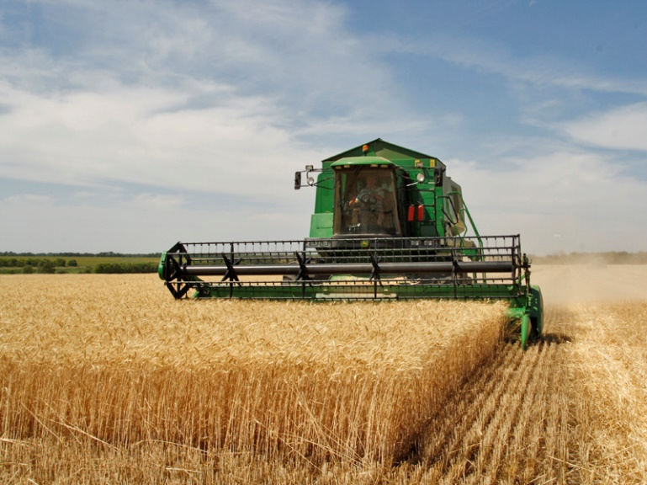
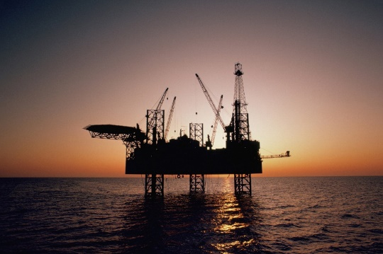
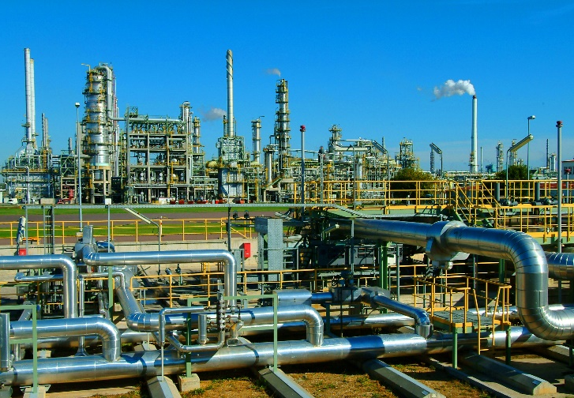
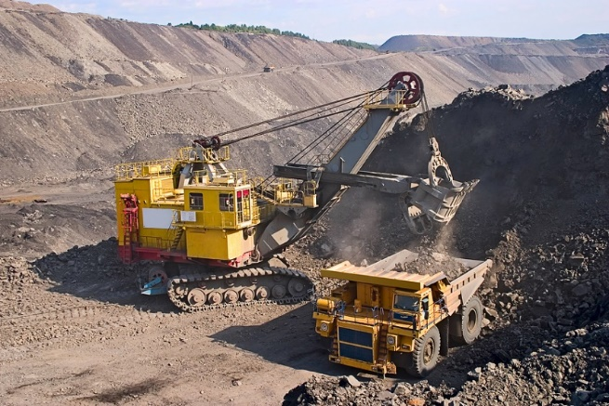
Material Extraction/Upstream Processing
Material Extraction
Exploration for and removal of raw materials from natural systems
Some Considerations
Equipment
Fuel use
Land use
Water use
Waste flows
Upstream processing
Transformation of raw materials into a form useful for manufacturing
Image sources: phoenixparts.com, blog.tradequip.com, columbiatechnologies.com

Slide 13
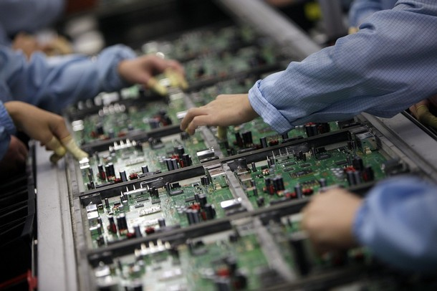
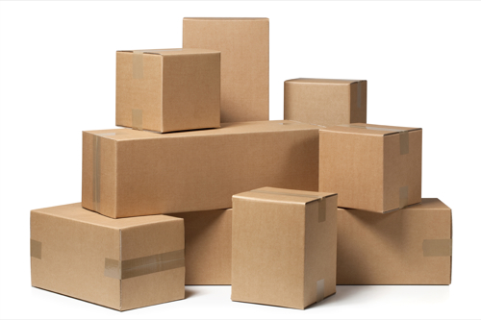
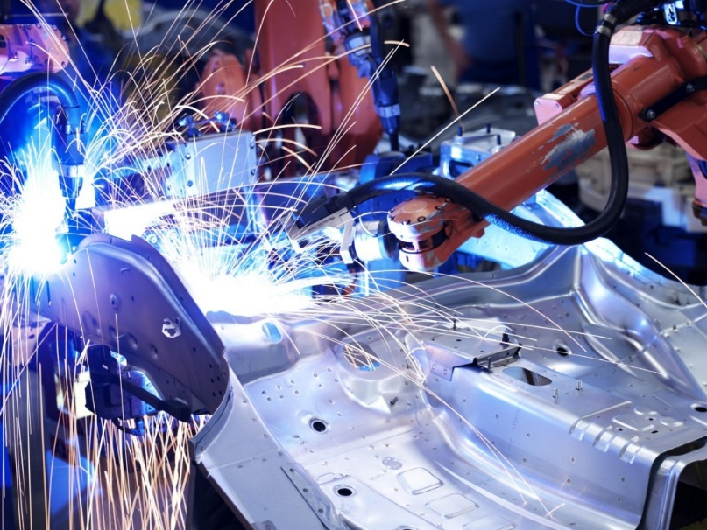
Manufacture
Some Considerations
Transforming energy and raw/pre-processed materials into products, and packaging them for distribution
Energy use (gas, electric, etc.)
Raw material use
Chemical use and wastes
Equipment
Co-products?
May include assembly of parts, transportation between facilities, packaging for distribution, and any uses and emissions from the facility
Image sources: madeintheusa.dreamlandinteractive.com angus-selfstorage.co.uk info.zentech.com

Slide 14

Use
Consumer’s use of the product, including maintenance
Difficult to quantify in some cases since use can vary considerably and be out of the control of the company producing the product
For example, use impacts from a lawn mower depends on
Frequency of mowing
Size of lawn
Mower life span given treatment by user
Quality of lubrication and other parts upkeep
Due to uncertainty, may be wise to examine multiple use cases
How is the product intended to be used?
How much will the product typically be used?
What variations are possible (operating, environmental, etc.)?
How much of the product might be spilled or improperly used?
Some
Considerations
Image source: livestrong.com

Slide 15
Examples of products with varying levels of use impacts
Ruler
Few or no inputs or outputs during use
New strings
Acoustic guitar
Very infrequent, minor inputs/outputs
Old strings
Electricity
Television
Regular energy input
Electricity
Dishwasher
A few frequent inputs/outputs
Soap
Wastewater
Water
Gasoline
Car
Many frequent energy and material inputs/outputs
Tailpipe emissions
Oil/coolant/brake/washer fluids
Oil/coolant leaks
Seals/replacement parts
Tire/brake wear
Brake pads, tires
Used tires

Slide 16
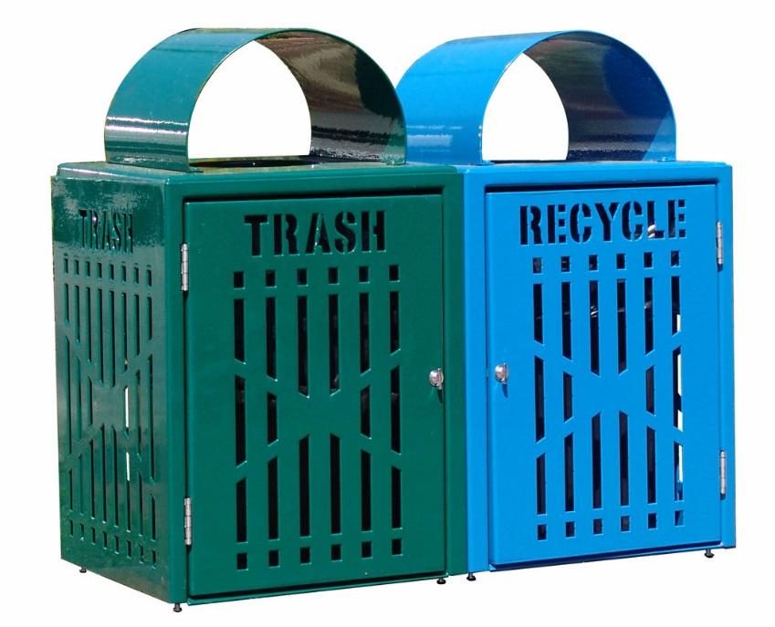
Disposal/Recycling/Reuse
Some Considerations
Getting rid of product at the end of its life
What disposal options possible?
Which most likely?
Is a product offset by disposal?
Is there additional transport involved in this stage?
Similar issues as use for uncertainty
For example, disposal of lubricating oil could be done by
Dumping (illegal)
Incineration
Re-refining
Distillation
Due to uncertainty, may be wise to include multiple use cases in analysis or present sensitivity analyses
If recycling or reusing, some impacts may be offset in this stage
Can sometimes result in net environmental benefits for this stage
Example: -5 kg CO₂-eq for GWP means that it was as if 5 kg of CO₂ were sequestered (does not mean actual physical sequestration occurred)
Image source: theparkcatalog.com

Slide 17
Example of Disposal Routes for a Plastic Water Bottle
Refill with tap water and reuse
Plastic water bottle production from raw materials
Labeling, packaging, distribution
Use
Throw in trash
Disposal
Options
Recycling of plastic and reforming into water bottles
Throw in recycle bin

Slide 18
Transport
Materials and products must be moved at multiple points in the life cycle
After extraction
After processing and/or manufacture
To the customer
To the disposal facility
Impacts from various transport methods are generally well studied
Most databases have these processes
Many studies in the literature
Often only include energy, regulated emissions, and greenhouse gases
Transport processes can be:
Considered to be one stage overall
Considered to be individual stages for each transport process
Included as part of the stage directly before or after
Choose one or the other to avoid double counting
Some Considerations
Modes of transport
Fuel type
Distance
Weight
Shipped with other products?

Slide 19
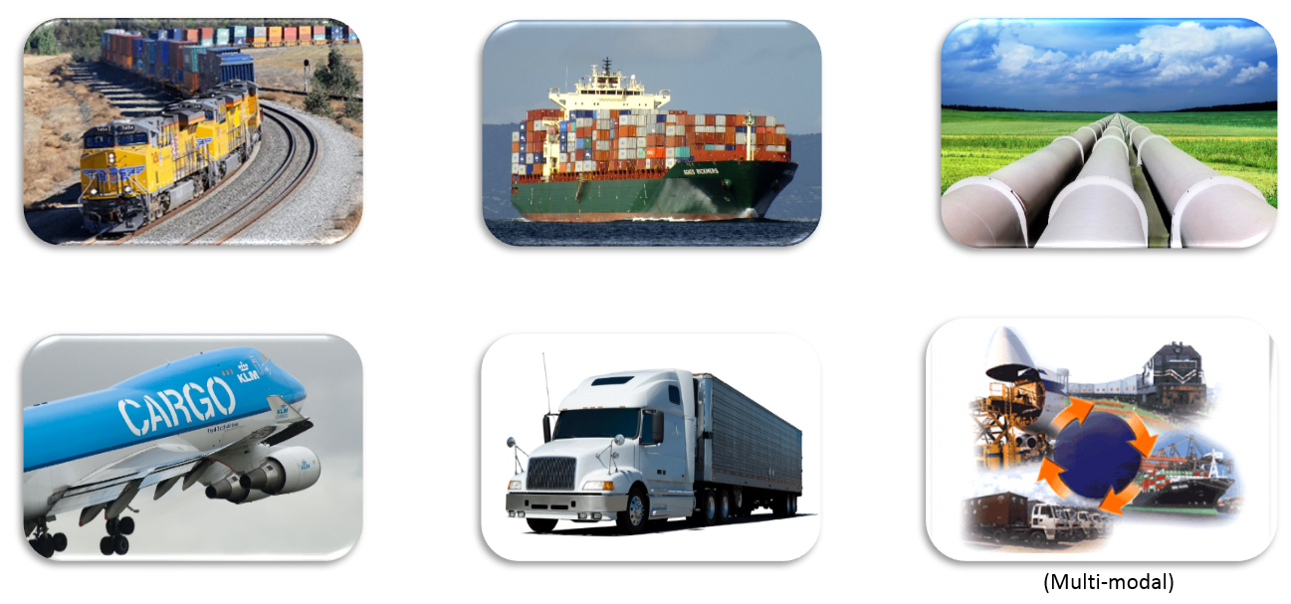
Common Transport Modes
Image sources: popularmechanics.com blog.uship.com truckstars.com maritime-connector.com jsg.utexas.edu boluo-logistics.com

Slide 20
Thank you for completing Module α3!
Group A: ISO Compliant LCA Overview Modules
Group α: ISO Compliant LCA Detailed Modules
Group B: Environmental Impact Categories Overview Modules
Group β: Environmental Impact Categories Detailed Modules
Group G: General LCA Tools Overview Modules
Group γ: General LCA Tools Detailed Modules
Group T: Transportation-Related LCA Overview Modules
Group τ: Transportation-Related LCA Detailed Modules

Slide 21
Homework
For an LCA from the literature, write down which stages were included and whether or not data were presented separately for each stage. Cite the source of the LCA.
Find an example of a cradle-to-gate LCA. Did the authors give a reason for only including these stages, and if so what was it? What other considerations might have been important for comparing the products/processes during the use, disposal, or other stages?
Write an example for each of the levels of use impacts (as shown in slide 15) for components of highway systems or buildings:
Little or no inputs or outputs
Very infrequent/minor inputs and outputs
Regular energy inputs, but little or no other inputs and outputs
A few frequent inputs and outputs
Many frequent inputs and outputs

