Slide 1
Welcome to the Life Cycle Assessment (LCA) Learning Module Series
Liv Haselbach Quinn Langfitt
For current modules email haselbach@wsu.edu or visit cem.uaf.edu/CESTiCC
Acknowledgements:
CESTiCC Washington State University Fulbright

Slide 2
LCA Module Series Groups
Group A: ISO Compliant LCA Overview Modules
Group α: ISO Compliant LCA Detailed Modules
Group B: Environmental Impact Categories Overview Modules
Group β: Environmental Impact Categories Detailed Modules
Group G: General LCA Tools Overview Modules
Group γ: General LCA Tools Detailed Modules
Group T: Transportation-Related LCA Overview Modules
Group τ: Transportation-Related LCA Detailed Modules

Slide 3
System, System Boundary, and Allocation
It is suggested to review Modules A1 and A2 prior to this module
Module α2

Slide 4
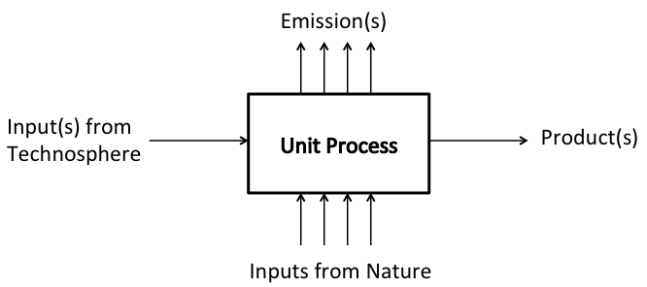
Processes
Unit process
“Smallest element considered in the life cycle inventory analysis for which input and output data are quantified.”*
Process
“Set of interrelated or interacting activities that transforms inputs into outputs.”*
Corn
Seed
Natural gas
Produce Ethanol
Grow Corn
Ethanol
Water
Corn
Electricity
Fertilizer
Stillage
Fertilizer
Runoff
Water
Tilling
Enzymes
Carbon dioxide
Whole corn
Milling
Yeast
Corn flour
Electricity
General Unit Process Diagram: Scott et al. 2013 *ISO 14040

Slide 5
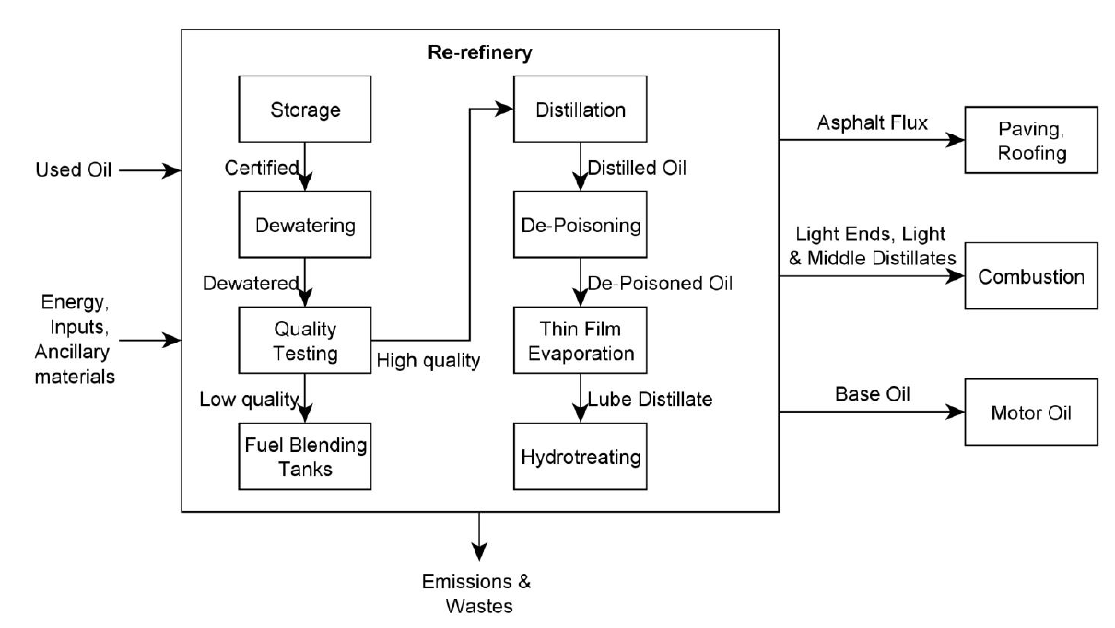
Product System
“Collection of unit processes with elementary and product flows, performing one or more defined functions, and which models the life cycle of a product”*
*ISO 14040 Diagram: Geyer, R., Kuczenski, B., Henderson, A., Zink, T. (2013). “Life Cycle Assessment of Used Oil Management in California.” California Dep. of Resources Recycling and Recovery.

Slide 6
System Boundary
“Set of criteria specifying which unit processes are part of a product system”*
Ideally only materials and energy directly from and to the environment would cross boundary
Practically inputs and outputs from other systems will cross
Choice of system boundary will affect results
Ideal System Boundary
Practical System Boundary
Process A
Raw materials from envr.
Materials to Environment
Raw materials from environment
Materials to Environment
Process A
Process B
Inputs from other systems
Outputs to other systems
Process C
Process B
Energy
Process D
Energy
Energy
Energy
System Boundary
System Boundary
*ISO 14040

Slide 7
System Boundary - Corn Ethanol
Inputs
Sunlight
Water
Farming Processes
Corn Grain
Grain Processing
Inputs to fertilizer, pesticide, seed, ethanol production
Fertilizer Production
Fertilizer
Corn Stover
Ethanol Product.
Processes
Outputs
Emissions to air
Farm Infrastructure Manufacture
Out
Pesticide Production
Pesticides
Inputs
Emissions to water
Infrastr.
Emissions to soil
Seed Production
Seeds
Ethanol Combustion
Inputs
Ethanol
Prod. Equip. Manufacture
Out
Energy
Equip.
Inputs
Diesel
Diesel Production
Out
System Boundary

Slide 8
Cut-off criteria
“Specification of the amount of material or energy flow or the level of environmental significance associated with unit processes or product system to be excluded from a study.”*
Why are they useful?
Reduce omissions of important processes/flows
Reduce data collection waste for inconsequential processes/flows
Can be based on mass, energy, or environmental significance
Best to avoid mass-only cut-off criteria
Can be based on percentage of a process or percentage in overall system
If all flows from a process would fall below cut-off, whole process would be excluded
For example: development of infrastructure and capital goods are generally excluded
Possible effects of cut-off criteria should be assessed and described
*ISO 14040

Slide 9
Allocation
“Partitioning the input or output flows of a process or a product system between the product system under study and one or more other product systems.”*
Main cases:
Co-products
Reuse/recycling
Many choices to deal with partitioning
Best one is to avoid allocation altogether
Must state procedures to use in the scope
Allocation procedures for similar scenarios within study should be consistent
Process
Product A
Product B
*ISO 14040 Image source: tinleypark.org

Slide 10
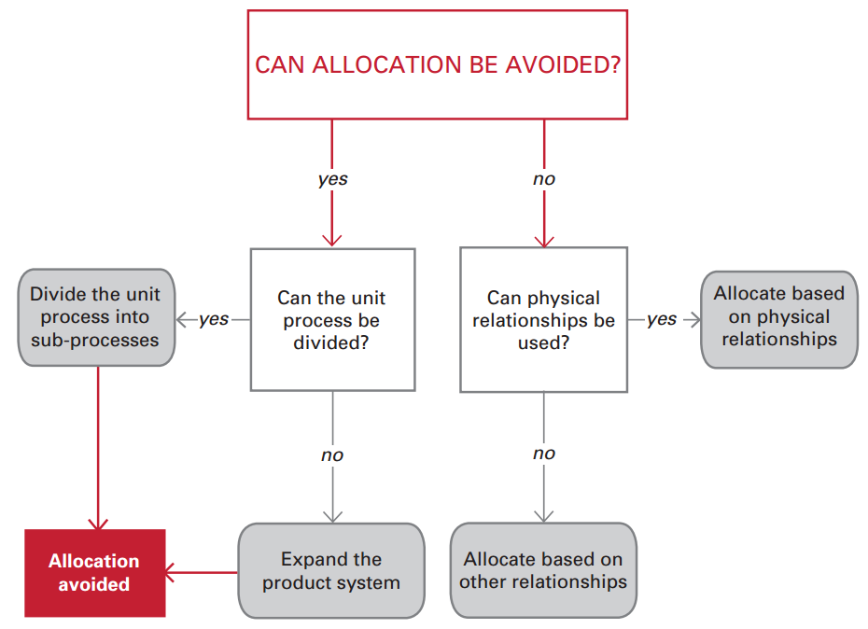
Allocation Decision Tree (Simonen 2014)
Must do sensitivity analysis
Diagram: Simonen, K. (2014). Life Cycle Assessment. Routledge, New York, NY.

Slide 11
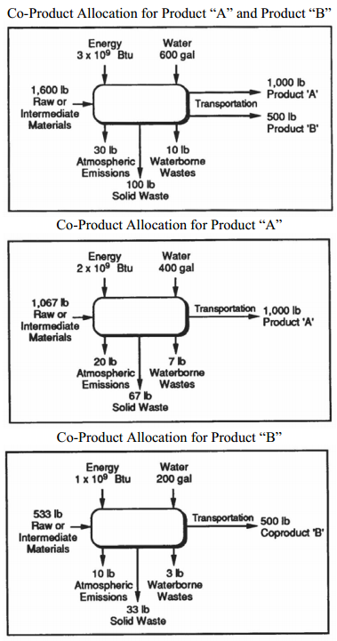
Allocation – Co-products
Co-products: more than one product is produced in a single unit process
How much of the process impacts should be assigned to each product?
Mass, volume, energy are common ways to decide based on physical relationships
No physical relationship between outputs
Economic value is a common choice
Consider if one is waste or if they are truly co-products
Frequently encountered in following industries:
Chemical
Agricultural
Mining
Oil refining
Metallurgy
Figure source: http://www.epa.gov/nrmrl/std/lca/pdfs/chapter3lca101.pdf

Slide 12
System Expansion to Avoid Allocation
Want to compare Products A and C
Emissions/Wastes
Emissions/Wastes
System 1
Emissions/Wastes
System 1
Inputs
Inputs
Inputs
x kg of Product A
+
y kg Product B
Production Processes for A and B
–
Production Processes for B
=
x kg of Product A
Production Processes for A and B
=
By subtraction
Output by system:
x kg Product A
z kg Product C
x kg Product A
x kg Product A
y kg Product B
y kg Product B
y kg Product B
Emissions/Wastes
System 2
Emissions/Wastes
System 2
Emissions/Wastes
Inputs
Inputs
Inputs
By addition
z kg of Product C
+
y kg Product B
Production Processes for C
=
Output by system:
x kg Product A y kg Product B
z kg Product C y kg Product B
z kg of Product C
Production Processes for C
+
Production Processes for B
=
z kg Product C
z kg Product C
y kg Product B
Figures adapted from: Klöpffer, W. and Grahl, B. (2014). Life Cycle Assessment (LCA). Wiley, Weinheim, Germany.

Slide 13
Co-products – Corn Grain and Stover
Inputs
Sunlight
Water
Farming Processes
Corn Grain
Grain Processing
Inputs to fertilizer, pesticide, seed, ethanol production
Fertilizer Production
Fertilizer
Corn Stover
Outputs
Ethanol Product.
Processes
Emissions to air
Farm Infrastructure Manufacture
Out
Pesticide Production
Pesticides
Inputs
Emissions to water
Infrastr.
Emissions to soil
Seed Production
Seeds
Ethanol
Prod. Equip. Manufacture
Out
Ethanol Combustion
Inputs
Energy
Equip.
Inputs
Diesel
Diesel Production
Out
System Boundary

Slide 14
Allocation – Reuse/Recycling
Two things happening
Impacts from recycling/reuse process
Impacts avoided from using recycled material rather primary (similar to subtractive system expansion)
Question: Which product takes on these impacts/avoided impacts?
The one being disposed of?
The one being produced?
Examples:
Aluminum recycling
Lube oil re-refining
Tire burning for energy recovery
Consider if properties of product are different than from production with primary materials

Slide 15
Allocation – Reuse/Recycling
Closed Loop Recycling
Recycle oil into base oil
Crude oil
Produce base oil
Blend additives
Use oil
Lubricating Oil
Recycle into MDO
Open Loop Recycling
Marine Diesel Oil (fuel)
Crude oil
Produce MDO
Use fuel

Slide 16
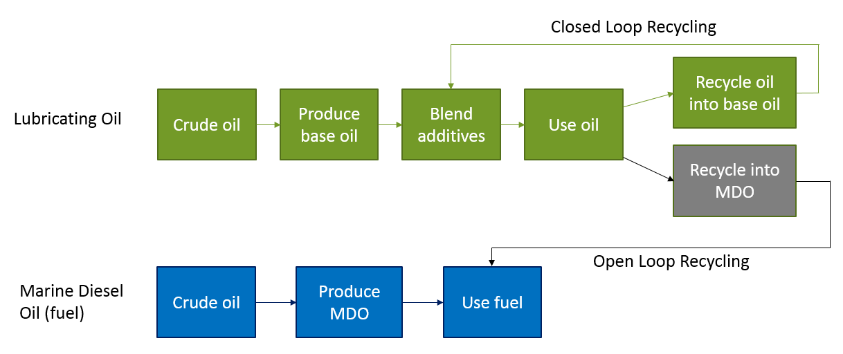
Allocation – Reuse/Recycling
Closed loop – relatively simple
Open loop – more difficult allocation decision
With open loop, less MDO from crude oil needed so can discount impacts, but from where:
End-of-life method: from lube oil life– rewards recyclable products
Recycled content method: from MDO life cycle – reward products made from recycled materials
Equal parts: half to lube oil, half to MDO
Decide that certain recycling processes go with one system and others to the other

Slide 17
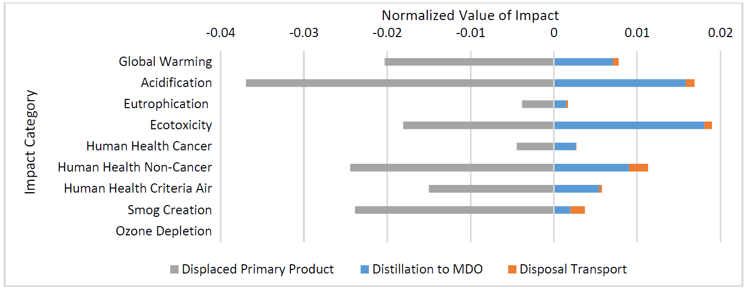
Allocation – Reuse/Recycling – Open Loop
Reward allocated to lubricating oil in this example for lube oil disposal (End-of life method)
Figure source: Langfitt, Q., and Haselbach L. (2014). “Assessment of Lube Oil Management and Self-Cleaning Oil Filer Feasibility in WSF Vessels.” Report for PacTrans.

Slide 18
Thank you for completing Module α2!
Group A: ISO Compliant LCA Overview Modules
Group α: ISO Compliant LCA Detailed Modules
Group B: Environmental Impact Categories Overview Modules
Group β: Environmental Impact Categories Detailed Modules
Group G: General LCA Tools Overview Modules
Group γ: General LCA Tools Detailed Modules
Group T: Transportation-Related LCA Overview Modules
Group τ: Transportation-Related LCA Detailed Modules

Slide 19
Homework
Draw a simple system diagram for generation of electricity in a coal fired power plant. Look up online what some of the major inputs, outputs, and processes are (detailed inputs and outputs are available from the US LCI website if interested). Don’t worry about capturing all of the flows and processes, just draw a simplified diagram with a few majors ones. Be sure to include a system boundary and place a process for use of the electricity outside of this boundary.
Find an LCA study that addresses cutoff criteria and write the authors names, year, and title of the study. What did they use for their criteria?
Describe the two ways in which allocation can be avoided for systems with co-products.
Describe the difference between a closed loop and an open loop recycling process. Give an example of each besides the lubricating oil example given in this module.

