Slide 1
Welcome to the Life Cycle Assessment (LCA) Learning Module Series
Liv Haselbach Quinn Langfitt
For current modules email haselbach@wsu.edu or visit cem.uaf.edu/CESTiCC
Acknowledgements:
CESTiCC Washington State University Fulbright

Slide 2
LCA Module Series Groups
Group A: ISO Compliant LCA Overview Modules
Group α: ISO Compliant LCA Detailed Modules
Group B: Environmental Impact Categories Overview Modules
Group β: Environmental Impact Categories Detailed Modules
Group G: General LCA Tools Overview Modules
Group γ: General LCA Tools Detailed Modules
Group T: Transportation-Related LCA Overview Modules
Group τ: Transportation-Related LCA Detailed Modules

Slide 3
Goal, Function, and Functional Unit
It is suggested to review Modules A1 and A2 prior to this module
Module α1

Slide 4
Goal
Analyst
Commissioner
First component of an LCA following the requirements of ISO 14044
Goal must state:
Intended use
Reasons for study
Audience
Whether comparative and disclosed to public
Helps form the basis for:
Scope definition
Methodologies used
Presentation of results
Not reviewable in the critical review
Goal and Scope
Interpretation
Inventory Analysis
Impact Assessment
Phases figure: ISO 14040

Slide 5
Goal Statement Example
Introduction
The goal was to generate a quantitative environmental profile of the management system for all of the used oil generated in California. The results of the LCA, when combined with a closely integrated economic assessment performed by the economic contractor, will provide sufficiently broad information to be used by CalRecycle to fulfill its duties pursuant to Section 48651.5 (b) (1) (D), namely to provide suggestions to the Legislature regarding possible policy changes to promote increased collection and responsible management of used oil. The intended audience of the study is CalRecycle, all industries involved in and affected by the management of used oil generated in California, and the public at large. The results of this study are intended to be used in comparative assertions intended to be disclosed to the public.
Reason for
carrying out
Intended use
Intended audience
Public, comparative
Statement source: Geyer, R., Kuczenski, B., Henderson, A., Zink, T. (2013). “Life Cycle Assessment of Used Oil Management in California.” California Dep. of Resources Recycling and Recovery.

Slide 6
Goal Statement Guides Analysis
Include definitions for technical terminology?
Public among intended audience
Include multiple scenarios covering different combinations of disposal techniques?
Intended use to provide info to legislature for policy development
Analyze general US impacts for other states to be able to use the data?
Carried out specifically to serve decision making in California
YES!
YES!
NO!

Slide 7
Function
What the product(s) or process(es) is designed to do
Often intuitive
However, function must be stated to make it unambiguous
Important to help define the system and functional unit
Generate Light
Transport People
House Students
Dorm: dci-engineers.com

Slide 8
Functional Unit Definition
Functional Unit
“Quantified performance of a product system for use as a reference unit.”*
*ISO 14044

Slide 9
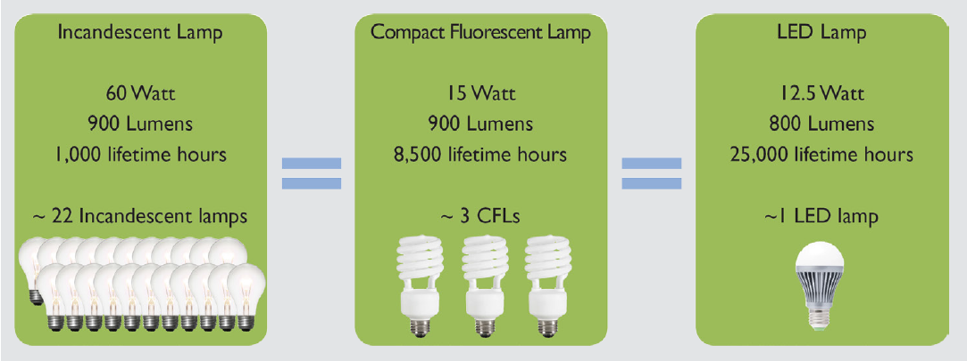
Functional Unit
Functional unit defines what quantity of the product’s function is achieved to cause the environmental impacts identified
Light bulb functional unit might be 1,000,000 lumen-hours of light
Bus functional unit might be 10,000 passenger-kilometer
Dormitory building functional unit might be house 200 students for one year
For 20 Million lumen-hours
Figure credit: U.S. Department of Energy. “Life Cycle Assessment of Energy and Environmental Impacts of LED Lighting Products.”

Slide 10
Functional Unit
Quantity
Duration
Functional Unit
Quality
Some consider correct determination of functional unit the highest priority in LCA*
Must be “clearly defined and measurable”**
Especially important in comparative studies to ensure fair comparison
Value not particularly important
Unit is very important
Best to set functional unit before collecting data (though not required)
Can always change it later
Product life time should be considered later when applying functional unit
*Klopffer, W., and Grahl, B. (2014). “Goal and Scope Definition.” Life Cycle Assessment. **ISO 14044 Components description: Simonen, K. (2014). Life Cycle Assessment. Routledge, New York, NY.

Slide 11
Functional Unit Example Statement
Situation: Comparing an LED, CFL, and incandescent bulb
Example statement: The function of the compared product systems is to provide lighting in residential applications. The functional unit is defined to be twenty million lumen-hours of light, with a wavelength between 450-600 nm, provided. This functional unit was chosen because lumen-hours is a common unit of cumulative illumination measurement, twenty million lumen-hours represents approximately one LED lamp’s illumination over its full life time, and the wavelength range represents visible light appropriate for home illumination.

Slide 12
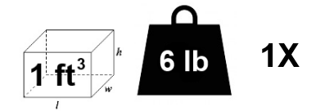
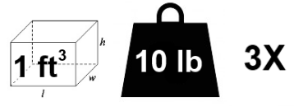
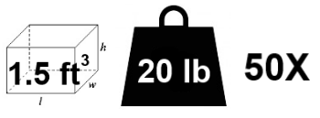
Functional Unit Choice not Trivial
Shopping bag comparing paper, plastic, and cloth
Functional unit could be to carry a certain volume or a certain weight of groceries a certain number of times (i.e. 5 kg of groceries on 10 trips)
Image sources: Plastic: thisoldhouse.com Paper: tumblr.com Cloth: nextshark.com

Slide 13
Relating to the functional unit basis
Functional unit = 50,000 passenger-miles traveled
Collect input/output
data based on how much of the function is accomplished
Express inputs/outputs in terms of one unit of function
Multiply by value of functional unit
Image source: hrc.org

Slide 14
Relating to the functional unit basis
Manufacture
1,000 lb steel per car which lasts for 100,000 miles at average occupancy of 1.5 persons
Use
Gaseous emissions:
20 lb CO₂ per gallon of gas, which powers car for 28 miles w/ 1.5 pass
Brake/tire wear:
0.2 lb PM₁₀ per 60000 miles w/ 1.5 passengers
Disposal
1,000 lb steel to be recycled per car
Collect input/output
data based on how much of the function is accomplished
Express inputs/outputs in terms of one unit of function
Multiply by value of functional unit

Slide 15
Relating to the functional unit basis
Manufacture
$\frac{1000 lb steel}{100,000 mi∗1.5 pass}=0.0067\frac{lb steel}{pass∗mi}$
Use
Gaseous emissions:
$\frac{20 lb CO_{2}}{1 gal gas}∗\frac{1 gal}{28 mi∗1.5 pass}=0.48 \frac{lb CO_{2}}{pass∗mi}$
Brake/tire wear:
$\frac{0.2 lb PM_{10}}{60000 mi∗1.5 pass}=2.2×{10}^{−6} \frac{lb PM_{10}}{pass∗mi}$
Disposal
$\frac{1000 lb steel}{100,000 mi∗1.5 pass}=0.0067\frac{lb steel}{pass∗mi}$
Collect input/output
data based on how much of the function is accomplished
Express inputs/outputs in terms of one unit of function
Multiply by value of functional unit

Slide 16
Relating to the functional unit basis
Manufacture
$0.0067\frac{lb steel}{pass∗mi}∗50,000 p∗m$
$$=$$
$$335 lb steel$$
Use
Gaseous emissions:
$0.48 \frac{lb CO_{2}}{pass∗mi}∗50,000 p∗m$
$$=$$
24,000$lb CO_{2}$
Brake/tire wear:
$2.2×{10}^{−6} \frac{lb PM_{10}}{pass∗mi}∗50,000 p∗m$
=
0.11 lb PM₁₀
Disposal
$0.0067\frac{lb steel}{pass∗mi}∗50,000 p∗m$
$$=$$
$$335 lb steel$$
Collect input/output
data based on how much of the function is accomplished
Express inputs/outputs in terms of one unit of function
Multiply by value of functional unit

Slide 17
Thank you for completing Module α1!
Group A: ISO Compliant LCA Overview Modules
Group α: ISO Compliant LCA Detailed Modules
Group B: Environmental Impact Categories Overview Modules
Group β: Environmental Impact Categories Detailed Modules
Group G: General LCA Tools Overview Modules
Group γ: General LCA Tools Detailed Modules
Group T: Transportation-Related LCA Overview Modules
Group τ: Transportation-Related LCA Detailed Modules

Slide 18
Homework
Write a goal statement for a fictitious LCA of your choosing.
Find an LCA in a journal or online and examine its goal statement. Does it cover all necessary information as outlined in ISO 14044? Summarize the statements on the four points, or if any are not included state that.
Determine what functional unit should be used for an LCA comparing gasoline and ethanol production (hint: think energy). Explain your choice.
Consider the use stage of a life cycle assessment on an incandescent light bulb. Assume that the only flow within the system during that stage is the electricity needed to operate the bulb. The bulb consumes 1 kWh of electricity to produce 16,000 lumen-hours of light. Each kWh of electricity has the following simplified inputs and outputs to and from nature:
Inputs: 0.356 kg coal
Outputs: 1.01 kg CO₂, 1.60×10⁻³ kg NO_{x},1.22×10⁻² kg SO₂, and 9.26×10⁻⁶ kg PM₁₀
Considering the functional unit is 20,000,000 lumen hours, convert the LCI data into the quantities of inputs and outputs based on the functional unit.

