Slide 1

Welcome to the Life Cycle Assessment (LCA) Learning Module Series
Liv Haselbach Quinn Langfitt
For current modules email haselbach@wsu.edu or visit cem.uaf.edu/CESTiCC
Acknowledgements:
CESTiCC Washington State University Fulbright

Slide 2
LCA Module Series Groups
Group A: ISO Compliant LCA Overview Modules
Group α: ISO Compliant LCA Detailed Modules
Group B: Environmental Impact Categories Overview Modules
Group β: Environmental Impact Categories Detailed Modules
Group G: General LCA Tools Overview Modules
Group γ: General LCA Tools Detailed Modules
Group T: Transportation-Related LCA Overview Modules
Group τ: Transportation-Related LCA Detailed Modules

Slide 3
LCA Requirements and Guidelines: ISO 14044
It is suggested to review Module A1 prior to this module
Module A2

Slide 4
Disclaimer on this Module
This module intended only as an overview of ISO 14044 by the International Organization for Standardization. It does not include all of the information in that standard and presentation of the information is subject to our interpretations. Therefore, this module is not meant as a replacement for reading the standard when carrying out an ISO compliant LCA, but simply as an introduction to the general requirements.
The standard can be purchased from a few sources: ISO ANSI Other standard organizations

Slide 5
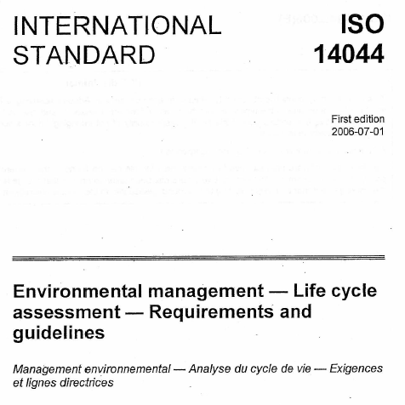
ISO 14044:2006 Background
LCA Requirements and Guidelines
Similar to ISO 14040 in:
  Introduction
  Terminology definitions
  Phases and overview of process
Describes in more detail the required process for completing a life cycle assessment
First and only edition published in 2006
Replaces a host of previous ISO LCA standards

Slide 6
ISO LCA Standards Combination
ISO 14040:2006
Principles and Framework
ISO 14044:2006
Requirements and guidelines
ISO 14040:1997
Principles and framework
ISO 14041:1998
Goal and scope definition and inventory analysis
ISO 14042:2000
Life cycle impact assessment
ISO 14043:2000
Life cycle interpretation

Slide 7
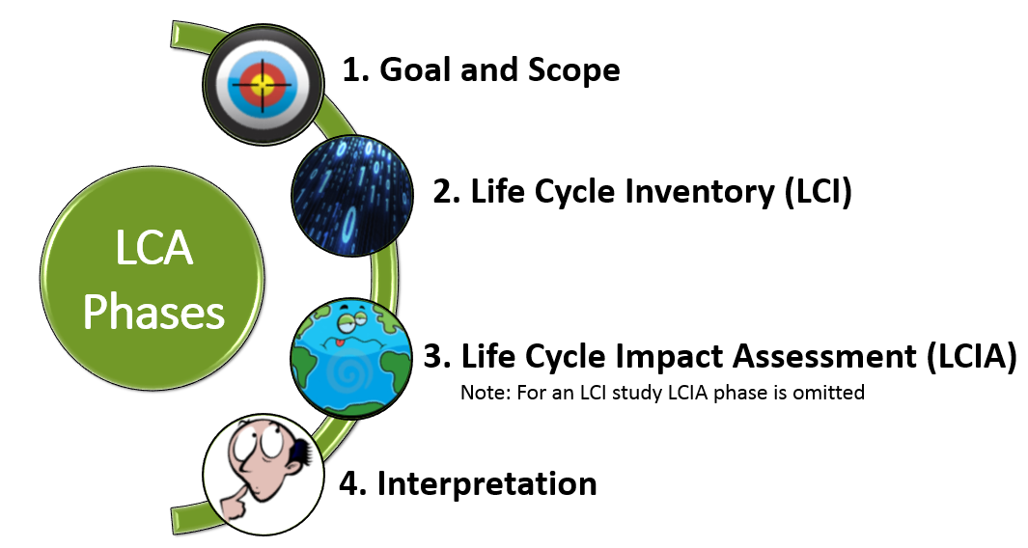
Phases of an LCA
Image Sources: Target: wikia.nocookie.net Data: dreamstime.com Earth: business2community.com

Slide 8

LCA Phases
Goal Statement
Goal statement is the first component of an LCA and guides much of the subsequent analysis
Goal must state:
Intended use
Reasons for study
Audience
Whether comparative and disclosed to public
Goal and Scope
Life Cycle Inventory
Life Cycle Impact Assessment
Interpretation

Slide 9
LCA Phases
Scope Elements
    All developed to be consistent with the stated goal of the LCA
Function and functional unit
  Define the functional characteristics of the product system
  Functional unit for amount of function achieved, useful as a reference measure
System boundary
  Define which processes are included in the study
  Helpful to include a process flow diagram
LCIA methodology
  State which impact categories and category indicators are used
  State which impact characterization methodology is used
Inventory Data
  Obtain either from direct measurement of processes or from secondary sources (or a mix of the two)
  Include inputs and outputs to air, water, and soil
Goal and Scope
Life Cycle Inventory
Life Cycle Impact Assessment
Interpretation

Slide 10
LCA Phases
Scope Elements (cont.)
    All developed to be consistent with the stated goal of the LCA
Data quality
  Address age, geographic coverage, technology coverage,
  precision, completeness, representativeness, consistency, reproducibility, sources, minimum length of time to collect, and uncertainty.
  For missing data a zero value, non-zero value, or a calculated value from similar technology should be used and explained.
Comparisons between systems
  Use the same functional unit, system boundaries, data quality, allocation, and impact assessment procedures (if not possible, identify differences)
  For publicly disclosed studies must include a critical review and the LCIA phase
Critical Review
  State whether or not a critical review will be conducted
  Define how, and by whom, the critical review will be carried out
Goal and Scope
Life Cycle Inventory
Life Cycle Impact Assessment
Interpretation

Slide 11

LCA Phases
Data Collection
Collect for each unit process and reference sources, time taken, quality, etc.
Clearly define each unit process to prevent overlap in data collection
Provide the following details:
  Overall process flow diagrams
  Description of each unit process with inputs and outputs
  Flows and operating conditions of each unit process
  Units used
  Description of data collection techniques
  Instructions to document irregularities and all details
Example data collection sheet provided in the standard
Goal and Scope
Life Cycle Inventory
Life Cycle Impact Assessment
Interpretation

Slide 12
LCA Phases
Data Classifications
Collect data and classify under the following major headings
Energy inputs, raw material inputs, ancillary inputs, and other physical inputs
Releases to air, water, and soil
Goal and Scope
Life Cycle Inventory
Life Cycle Impact Assessment
Interpretation
Products, co-products and waste
Other environmental aspects

Slide 13
LCA Phases
Data Collection Procedure
Consider goal and scope
Prepare for data collection
Collect data
Validate data
Relate data to unit process and allocations (reuse, etc.)
Relate data to functional unit
Aggregate data
Refine system boundary
Revise, repeat as needed
Already done if data from literature
Already done if using database
Goal and Scope
Life Cycle Inventory
Life Cycle Impact Assessment
Interpretation

Slide 14

LCA Phases
Life Cycle Impact Assessment
Data are converted into potential environmental impacts
During LCIA determine if:
  Quality of data sufficient to conduct the LCIA
  System boundaries and cut-offs (magnitude of input or output flow that is small enough to be negligible) appropriate to calculate indicator results
  Other methodological choices, like the choice of functional unit or averaging used, decreased the direct linkage between the data collected and environmental impact results obtained, potentially biasing the results
Goal and Scope
Life Cycle Inventory
Life Cycle Impact Assessment
Interpretation

Slide 15
LCA Phases
Mandatory Elements
Characterization
Classification
Goal and Scope
Life Cycle Inventory
Life Cycle Impact Assessment
Interpretation
Mandatory Elements
Impact category selection (Comprehensive set)
Category indicator selection
Characterization model selection (impact methodology)

Slide 16
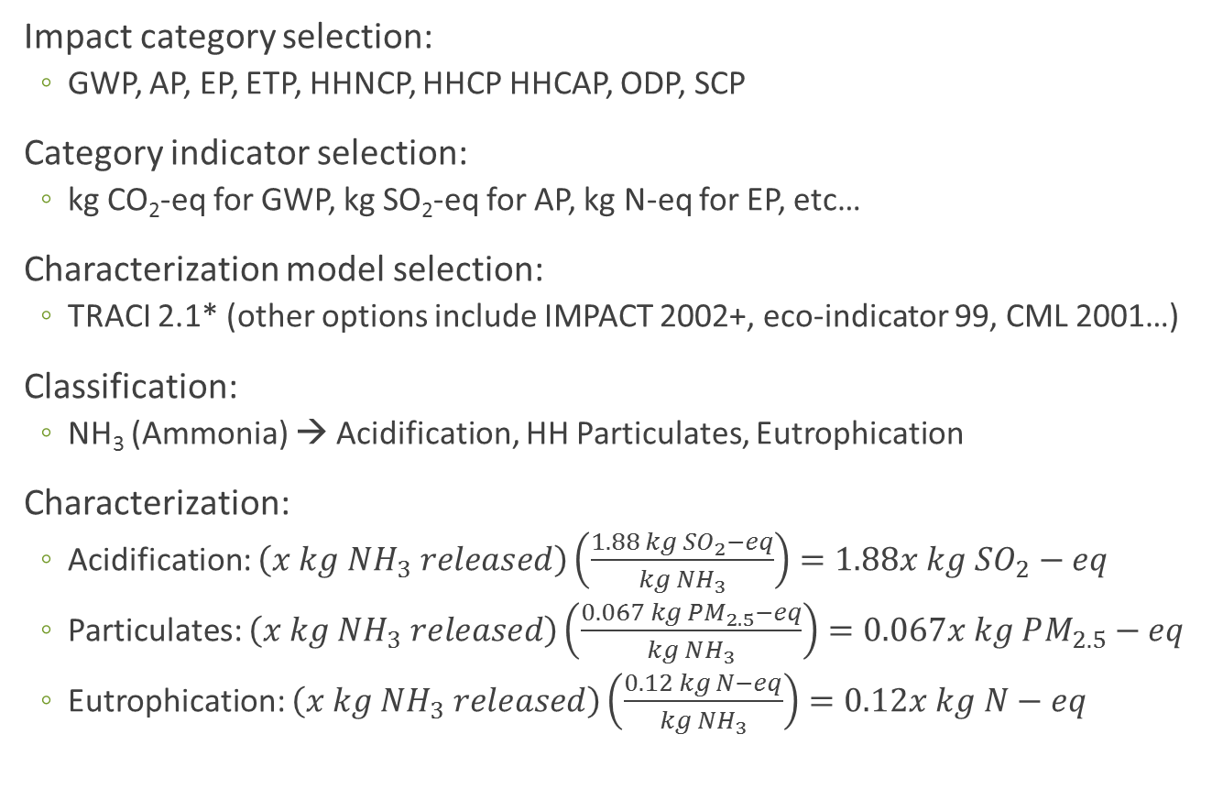
LCA Phases
Mandatory Elements Example
Impact category selection:
  GWP, AP, EP, ETP, HHNCP, HHCP HHCAP, ODP, SCP
Category indicator selection:
  kg CO₂-eq for GWP, kg SO₂-eq for AP, kg N-eq for EP, etc…
Characterization model selection:
  TRACI 2.1* (other options include IMPACT 2002+, eco-indicator 99, CML 2001…)
Classification:
  NH₃ (Ammonia) → Acidification, HH Particulates, Eutrophication
Characterization:
  Acidification: $\left(x kg NH_{3} released\right)\left(\frac{1.88 kg SO_{2}−eq}{kg NH_{3}}\right)=1.88x kg SO_{2}−eq$
  Particulates: $\left(x kg NH_{3} released\right)\left(\frac{0.067 kg PM_{2.5}−eq}{kg NH_{3}}\right)=0.067x kg PM_{2.5}−eq$
  Eutrophication: $\left(x kg NH_{3} released\right)\left(\frac{0.12 kg N−eq}{kg NH_{3}}\right)=0.12x kg N−eq$
Goal and Scope
Life Cycle Inventory
Life Cycle Impact Assessment
Interpretation
Repeat for each flow, sum results in each impact category
Characterization factor
*TRACI is the Tool for the Reduction and Assessment
of Chemical and Other Environmental Impacts

Slide 17
LCA Phases
Optional Elements
Grouping
Optional Elements
Weighting
Normalization
Goal and Scope
Life Cycle Inventory
Life Cycle Impact Assessment
Interpretation
Data Quality Analysis
These elements can be useful to help decision makers interpret results, but also may introduce additional subjectivity. Inclusion of these elements should be consistent with goal and scope.
Notes:
Data Quality Analysis includes
Gravity analysis such as Pareto analysis identifies data with the greatest contribution
Uncertainty analysis
Sensitivity analysis

Slide 18
LCA Phases
Example of terminology for acidification
Impact Category
Acidification potential
LCI result
500 kg SO₂, 100 kg NO_{x} , 10 kg HNO₃ per functional unit
Characterization Model
TRACI 2.1*
Characterization Factor
Category Indicator Result
Category Indicator
Increase in acidity in the environment (moles H⁺)
Potential of each compound to cause acid deposition (such as acid rain) in relation to that of SO₂
Kilograms of SO₂-equivalent
Category Endpoints
Environmental Relevance
Ecosystem effects such as acidic lakes, corrosion to buildings, damage to plants
Increased emissions of species such as nitric oxides and sulfur oxides directly contribute to increases in environmental acidity, depending on transport and chemistry models, such as in the form of acid rain.
Goal and Scope
Life Cycle Inventory
Life Cycle Impact Assessment
Interpretation
*TRACI is the Tool for the Reduction and Assessment of Chemical and Other Environmental Impacts

Slide 19
LCA Phases
Comparative Assessment LCIA
No weighting allowed
Sufficiently comprehensive set of category indicators
Category indicators should be scientifically valid, environmentally relevant, and internationally accepted
Not sole basis for decisions
Must include sensitivity and uncertainty analyses
If grouping used then there are lots of additions (caveats) required as in Section 5.3.2
Goal and Scope
Life Cycle Inventory
Life Cycle Impact Assessment
Interpretation

Slide 20

LCA Phases
Interpretation
Takes the form of conclusions and recommendations
Identify significant issues with:
  Inventory data
  Impact categories
  Significant contributions from life cycle stages
Include information on:
  Assembled findings from LCI and LCIA
  Methodologies used
  Value choices
  Limitations
  Roles of interested parties in compilation and review
Consider the following that may be critically reviewed:
  Completeness check
  Sensitivity check
  Consistency check
Goal and Scope
Life Cycle Inventory
Life Cycle Impact Assessment
Interpretation
Notes:
Completeness check is making sure all relevant data all data needed for a sound interpretation was included
Sensitivity check is examining how much uncertainty might have affected results
Consistency check is making sure that the assumptions, methods, and data were consistent with the stated goal and scope

Slide 21
LCA Phases
Critical Review
Process intended to ensure consistency between a life cycle assessment and the principles and requirements of the lnternational Standards on life cycle assessment*
Done by an independent third party
Defined in the scope
Required if comparative and disclosed to the public
All LCA phases might be critically reviewed, with the exception of the goal
Answers the questions in the following slide
Goal and Scope
Life Cycle Inventory
Life Cycle Impact Assessment
Interpretation
*ISO 14044
Notes:
Completeness check is making sure all relevant data all data needed for a sound interpretation was included
Sensitivity check is examining how much uncertainty might have affected results
Consistency check is making sure that the assumptions, methods, and data were consistent with the stated goal and scope

Slide 22

Responsibilities of Critical Review
Study is transparent and consistent?
Methods scientifically and technically valid?
Methods consistent with ISO 14044?
Interpretations reflect limitations and goal?
Data appropriate and reasonable for scope?

Slide 23
Thank you for completing Module A2!
Group A: ISO Compliant LCA Overview Modules
Group α: ISO Compliant LCA Detailed Modules
Group B: Environmental Impact Categories Overview Modules
Group β: Environmental Impact Categories Detailed Modules
Group G: General LCA Tools Overview Modules
Group γ: General LCA Tools Detailed Modules
Group T: Transportation-Related LCA Overview Modules
Group τ: Transportation-Related LCA Detailed Modules
Please remember that this presentation is not intended as a replacement for reading ISO 14044 when carrying out an LCA.

Slide 24
Self-Assessment Quiz
MODULE A2: ISO 14044

Slide 25
What is the first step of the data collection procedure?
Refine system boundary
Consider the goal and scope
Collect data

Slide 26
Correct!
Since all procedures need to be consistent with the goal and scope, this is generally the first consideration when starting any process in LCA

Slide 27
What is the difference between ISO 14040 and ISO 14044?
ISO 14044 is the updated version of ISO 14040
ISO 14040 describes life cycle assessment procedures, while ISO 14044 is an example of a life cycle assessment.
ISO 14040 is the general introduction to life cycle assessment concepts and procedures, while ISO 14044 includes more details about the procedures.

Slide 28
Correct!
ISO 14044 simply gives more detail-oriented guidance about the specific procedures for completing an LCA

Slide 29
Which of these is an optional element of the LCIA phase?
Grouping
Characterization
Classification
None of the above

Slide 30
Correct!
Grouping, weighting, normalization, and additional quality analysis are all optional steps of the LCIA phase.

Slide 31
Can the Goal and Scope be updated after completing the LCI stage?
No, it must be left as originally written
Yes, but it should be avoided if possible
Yes, this type of iterative process is encouraged and can strengthen results

Slide 32
Correct!
The entire process of life cycle assessment is iterative between each phase to accommodate incorporation of new information at any point.

Slide 33
Sorry that’s Incorrect
Please try again!

