Slide 1

Introduction to Department Continuity Planning
Gary Rash
Director EHS & Risk Management

Slide 2
Objectives
Introduce the Institutional Continuity Framework
Discuss the structure for a Lamar University Departmental Plan Template
Review components of the plan
Determine next steps

Slide 3
Definition of COOP
Continuity Planning is an effort to ensure that the capability exists to continue essential functions across a wide range of potential emergencies.

Slide 4
Emergency Response and Recovery During an Incident

Slide 5
Institutional Continuity Plan
Continuity of Operations Plan
Department A Continuity Plan
Department B Continuity Plan
Overall guidance and purpose (Continuity & Recovery Group)
Alternate work procedures. Roles & Responsibilities
Department C Continuity Plan
Attachments
Worksheets, Contact List, Supporting Documents
Attachments
Attachments

Slide 6
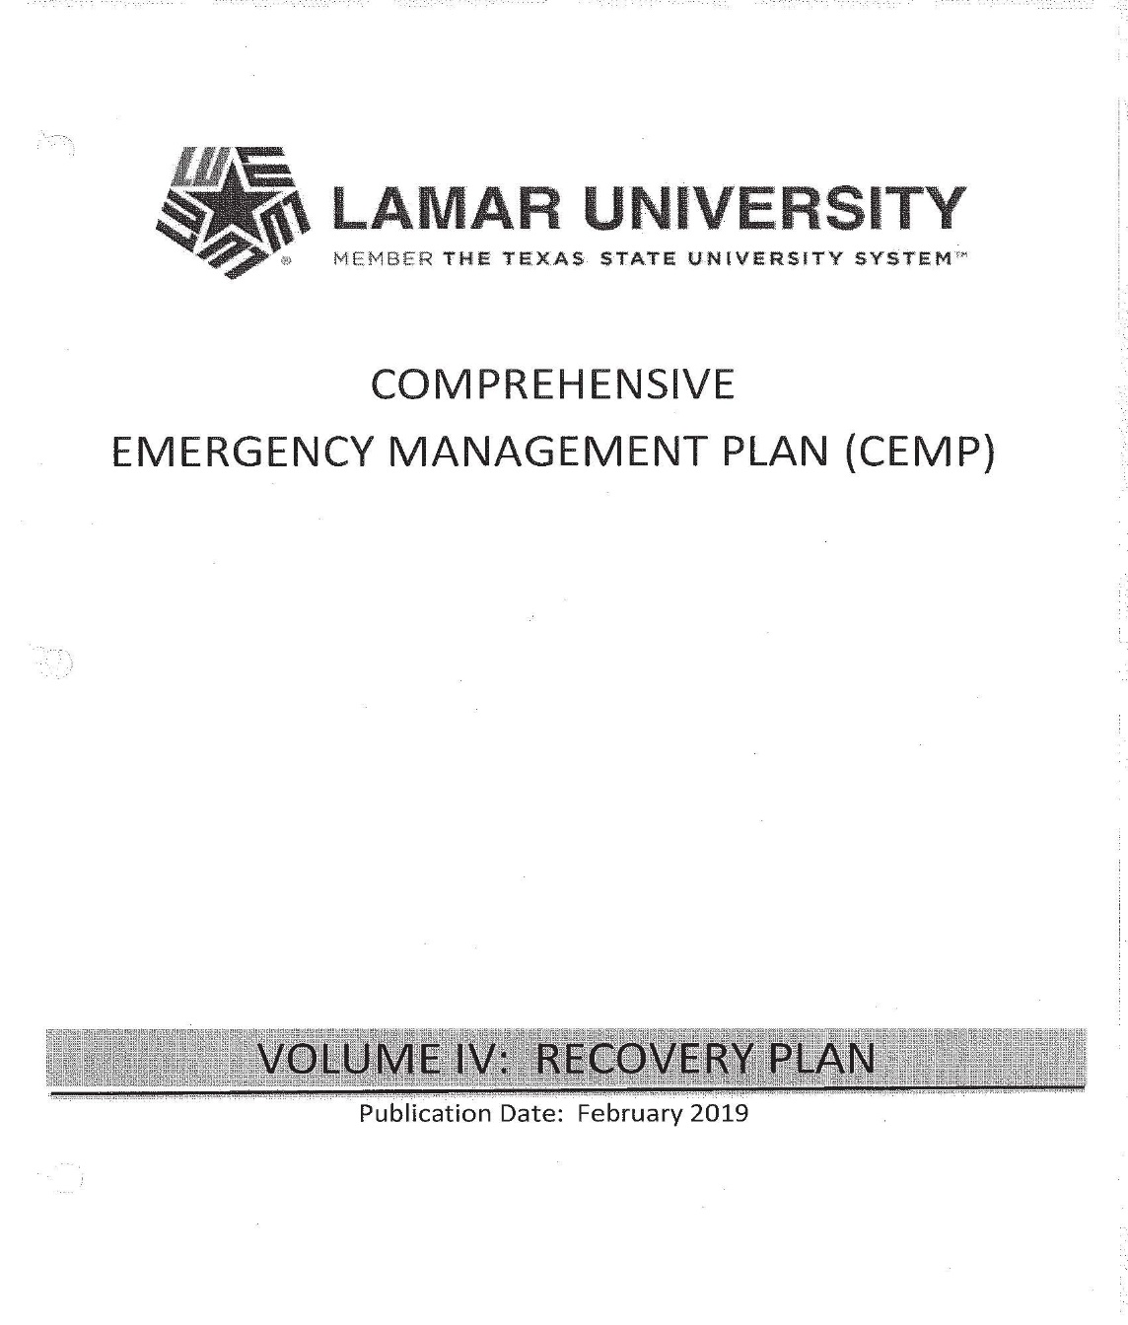
Departmental Template
Augment the Institutional Plan
Formstack
Emergency Contacts and Alternates
Critical/Essential Department Operations (in order of importance)
Planning Readiness Checklist
Essential Resources/Supplies Required for Maintaining Department’s Critical Operations
Department’s External Communication Plan in the Event of an Emergency
Department’s Internal Communication Plan in the Event of an Emergency
Essential Contract Services Required for Maintaining Department’s Critical Operation
Essential Travel Required for Maintaining Department’s Operations
Additional Department Staff Information
Review and Approval

Slide 7
Emergency Contacts and Alternates

Slide 8
Critical/Essential Department Operations (In Order of Importance)

Slide 9
Planning Readiness Checklist

Slide 10
Essential Resources/Supplies Required for Maintaining Department’s Critical Operations

Slide 11
Department’s External Communication Plan in the Event of an Emergency

Slide 12
Department’s Internal Communication Plan in the Event of an Emergency

Slide 13
Essential Contract Services Required for Maintaining Department’s Critical Operations

Slide 14
Essential Travel Required for Maintaining Department’s Operations

Slide 15
Additional Department Staff Information

Slide 16
Section XIII: Testing, Training, & Exercise Example Worksheet

Slide 17
Section XIV: Plan Maintenance
Activity | Tasks | Frequency
Plan update & certification | Review entire plan for accuracy. Incorporate lessons learned and changes in policy and philosophy. Manage distribution. | Annually
Maintains orders of succession and delegations of authority | Identify current incumbents. Update rosters and contact information. | Semi-annually
Monitor and maintain vital records program | Monitor volume of materials. Update and remove files. | Ongoing
Contact information for essential personnel | Confirm and update essential personnel information. | Annually

Slide 18
Questions EHS & Risk Management 409-880-7115 continuityofoperationsplanning@lamar.edu

